Slide 1
Advanced Manufacturing Processes (AMPs) Introduction to AMPs
by
Dr. Sunil Pathak Faculty of Engineering Technology sunilpathak@ump.edu.my

Slide 2
Chapter Description
Aims
To provide and insight on advanced manufacturing processes
To provide details on why we need AMP and its characteristics
Expected Outcomes
Learner will be able to know about AMPs
Learner will be able to identify role of AMPs in todays sceneries
Other related Information
Student must have some basic idea of conventional manufacturing and machining
Student must have some fundamentals on materials
References
Prof N K Jain (IIT Indore, Lecture Notes)
Prof. V K Jain (IIT Kanpur, Lecture Notes)

Slide 3
Materials Used In Engineering Applications
Metal and its Alloys
Plastics and Composites
Ceramics
Engineering Materials Having Much Superior Properties
Getting More Popularity
Definite Advantages Over Others
HOW TO MACHINE THEM
?
Ultra High Strength, Hardness Very High Temperature Resistance
Difficult To Machine By Conventional Machining Methods
SOLUTION
Advanced Manufacturing/Machining Processes

Slide 4
Need of Advanced Manufacturing/Machining Processes
Limitations of conventional machining methods (workpiece hardness, surface roughness, 3-d parts and complex geometries)
Increased Workpiece Hardness
Decreased Economic Cutting Speed
Lower Productivity
Rapid Improvements In The Properties Of Materials (Workpiece Hardness, Strength, Etc.)
Metals & Non – Metals : Stainless Steel , High Strength Temperature Resistant(hsrt) Super Alloys: Stellite, Incoloys Etc.
Tool Material Hardness >> Workpiece Hardness
Requires Much Superior Quality Of Tool Materials

Slide 5
Need Of Advanced Manufacturing/Machining Processes
??
Product Requirements
Complex Shapes
Machining In Inaccessible Areas
Low Tolerances (Say, 10 µm)
High Production Rate While Processing Difficult –To- Machine Materials
Low Cost Of Production Precision And Ultra precision Machining (Nano-meter Machining)
Better Surface Integrity (No Surface Defects,
Etc.)
High Surface Finish (Nano Level Ra Value =>Nm)
Miniaturization Of Products (Examples: Landline Phone & Mobile, Old Computers & Lap Top, Etc.)
High Mrr
Requires Material Removal In The Form Of Atoms And / Or Molecules
ADVANCED MACHINING PROCESSES (Amps)

Slide 6
Behaviour and Manufacturing Properties of
Engineering Materials
Structure of Material
Physical and Chemical Properties
Mechanical Properties
Property Modification
Strength
Ductility
Elasticity
Stiffness
Hardness
Toughness
Fatigue
Creep
Resistance to Wear,
Corrosion, Oxidation
Hot Hardness
and Strength
Heat
Treatment
Annealing
Tempering
Normalizing
Hardening
Alloying
Reinforcement s
Composites
Laminations
Fillers
Surface
Treatment
Atomic Bond: Metallic,
Ionic, Covalent
Crystalline
Amorphous
or Non-Crystalline
Partly Crystalline
Polymer Chains
Melting Point
Density
Specific Heat
Thermal Conductivity
Thermal
Expansion
Electrical Conductivity
Magnetic
Properties
Oxidation
Corrosion

Slide 7
[1] CLASSIFICATION OF VARIOUS MANUFACTURING PROCESSES
 | Basic Nature | Traditional or Conventional Processes |  |  | Advanced or Unconventional Processes
 | Primary Forming Processes [Additive Or Accretion: Create Shape From Molten, Gaseous, or Solid Particles] | Casting and Molding Processes |  |  | Rapid Prototyping Processes [After 1990]
 |  | Single-Use or Expendable Mold Casting |  | Multiple-Use Mold Casting | Liquid Based | Solid Based | Powder Based
 |  | Multiple-use Pattern | Single-use Pattern | Permanent Mold Casting: Slush casting, Corthias Casting Low-pressure Vacuum Casting Die Casting, Squeeze Casting, Centrifugal Casting, Semicentrifugal Casting Centrifuging Casting, Continuous Casting, Electromagnetic Or Levitation Casting | SLA, SLT, SGC, SOUP, SCS, etc. | FDM, LOM, MJM, SAHP, etc. | SLS, BPM, TDP, MJS, DSPC, etc.
 |  | Sand Casting, Plaster Mold Casting, Ceramic Mold Casting, Rubber Mold Casting, Graphite Mold Casting, Shell Molding, | Investment Casting, Full-mold and Lost- Foam Casting |  | For Fabrication of Polymers: Thermoforming, Extrusion, Blow, Compression, Injection, Reaction Injection, Transfer, Cold, Rotational, & Foam Molding, Calendering, Spinning, Dipping, etc. For Fabrication of Ceramics: Blow Molding, Dry Pressing, Isostatic Pressing, Slip Casting, Plastic Forming Techniques For Fabrication of Fiber Reinforced Composites: Pultrusion, Filament Winding, Vacuum-bag and Pressure-bag Molding, Resin-transfer Molding, Spray Molding, Sheet Stamping, Braiding, 3D- Knitting & Weaving,
 |  | Powder Metallurgy Processes [Late Nineteenth Century]

Slide 8
[1] CLASSIFICATION OF VARIOUS MANUFACTURING PROCESSES (Cont…)
Basic Nature | Traditional or Conventional Processes |  | Advanced or Unconventional Processes
Deforming Processes [Formative: Shapes The Material In Solid State Using Property Of Plasticity.] | Metal Forming Processes |  | Advanced Metal Forming Processes
 | Hot- working | Cold-working Processes | High Energy Rate Forming (HERF) Processes: Electromagnetic Forming, Explosive Forming, and Electro-hydraulic Forming. Laser Bending, 3d-laser Forming, Hot Isostatic Pressing (HIP) For Sheet Metal Components: Electroforming, Plasma Spray Forming
 | Rolling, Forging, Extrusion, Hot- drawing, Piercing | Squeezing: Cold Rolling, Cold Forging , Cold Extrusion, Swaging, Sizing, Riveting, Staking, Coining, Peening, Burnishing, Hubbing, and Thread Rolling. Bending: Angle Bending, Roll Bending, Draw and Compression Bending, Roll-forming, Seaming, Flanging, and Straightening. Shearing: Slitting, Blanking, Piercing, Lancing, Perforating, Notching, Nibbling, Shaving, Trimming, Cutoff, and Dinking. Drawing: Spinning, Embossing, Stretch Forming, and Ironing Sheet-metal Forming Operations

Slide 9
[1] CLASSIFICATION OF VARIOUS MANUFACTURING (Continued)
Basic Nature | Traditional or Conventional Processes |  |  | Advanced/Unconventional Processes
Material Removal Processes Subtractive : Shape the Product by Removing the Excess Material] | Conventional Machining Processes [19th Century Onwards] |  |  | AMPs [After 1945]
 | Axi-symmetric Parts | Prismatic Parts | General | Mechanical | Chemical | Electro- chemical | Thermal
 | Turning, Facing, Taper Turning, Threading, Drilling, Boring, Reaming, etc. | Milling, Shaping, Planning, etc. | Sawing, Broaching, Hobbing, Grinding, Honing, Lapping, etc. | USM, AJM, WJM, AWJM, IJM, AFM, MAF, MRF | CHM, PCM, TCM | ECM | EDM EBM LBM IBM PAM

Slide 10
[1] CLASSIFICATION OF VARIOUS MANUFACTURING (Continued)
Joining Or Consolidation Or Fabrication Processes [For assembling the various component s of a product] | Joining Processes |  |  |  |  |  | Advanced Welding Techniques: EBW, LBW, USW Welding of Plastics (only for Thermoplastics) : USW, LBW, Friction/spin Welding Vibration Welding Friction stir welding Hot-plate welding Hot-gas welding Implant welding Infrared welding Micro-wave welding
 | Mechanical Bonding |  | Atomic Bonding
 | Tempor- ary | Permanent or semi- permanent | Solid state welding | Liquid state or Fusion Welding |  | Solid/ Liquid state
 |  |  |  | Electrical | Chemical
 | Thread joints | Rivets, Stitches, Staples, Shrink-fits, | Friction, Forge, Diffusion welding, Cold Welding: Pressure, Explosive, Ultrasonic Welding | Arc welding: Using Consumable Electrode SMAW, GMAW, FCAW, SAW; Those using Non- consumable Electrode: GTAW, PAW, SW. Resistance welding: RSW, RSEW, RPW. Induction welding | Gas welding: OAW, and PGW, Thermit welding | Brazing, Soldering, and Adhesive bonding

Slide 11
[1] CLASSIFICATION OF VARIOUS MANUFACTURING (Continued)
Basic Nature | Traditional or Conventional Processes |  | Advanced or Unconventional Processes
Heat Treatment or Bulk Property Enhancing Processes [To modify the bulk properties.] | HARDENING TECHNIQUES | SURFACE HARDENING (ie Selective Heating) Processes: Flame Hardening, and Induction Hardening | Laser Beam Hardening and Electron Beam Hardening
 |  | CASE HARDENING (ie Surface Chemistry Altering) Processes: Carburizing (pack, gas, and liquid type), Nitriding, Cyaniding or Carbonitriding. | Additional Layer Depositing: Ionitriding, Ion Carburizing, Ion Plating, and Ion Implantation
 |  | CRACK REDUCTION TECHNIQUES: Austempering, Martempering / Marquenching
 | DUCTILITY, TOUGHNESS, and MACHINABILITY changing processes: Annealing (Full and Process type), Normalizing, Tempering, Spheroidizing.
 | STRENGTHENING processes: Solid Solution Strengthening, Grain Size Refinement, Strain Hardening, Precipitation or Age Hardening, Dispersion Hardening, and Phase Transformation Hardening

Slide 12
[1] CLASSIFICATION OF VARIOUS MANUFACTURING (Continued)
Basic Nature | Traditional or Conventional Processes |  | Advanced or Unconventional Processes
Finishing And Surface Treatment Processes [To modify the surface properties.] | BURR REOMVAL: Grinding, Chamfering, Filing, Centrifugal and Spindle Finishing, Thermal-energy Deburring, Power Sanding, Power Brushing, and Mechanical Cleaning Processes as described below. |  | For burr Removal: USM, AJM, WJM, AWJM, AFM, CHM, ECDE
 | MECHANICAL CLEANING and FINISHING: Abrasive Cleaning, Barrel Finishing Or Tumbling, Vibratory Finishing, Belt Sanding, Wire Brushing, Buffing, Electro-polishing.
 | CHEMICAL CLEANING: Vapor Degreasing, Acid Pickling, Alkaline, Solvent, And Ultrasonic Cleaning.
 | COATING TECHNIQUES | COATING (Liquid/Gas Deposition): Painting, Chemical Conversion Coating, Hot Dip Coating, Electro-plating, Anodizing, Electroless or Autocatalytic Plating, Mechanical Plating, Porcelain Enameling.
 |  | CLADDING (Solid deposition)
 | VAPORIZED METAL COATING | Physical Vapor Deposition (PVD): Vacuum Metallizing, Sputtering, Ion Plating
 |  | Chemical Vapor Deposition (CVD)

Slide 13
Types of AMPs
Basic AMPs: 15 (8 Mechanical + 1 Electrochemical + 1 Chemical + 5 Thermal)
Derived AMP: Modification of Basic AMP to Meet Specific Objectives
Electro Stream Drilling (ESD)
Shaped Tube Electro Machining (STEM)
Electrolytic Jet Drilling (EJD)
Derived AMPs from ECM
Derived AMP from CHM Photo Chemical Machining (PCM)
Derived AMP from EDM Wire Electro Discharge Machining (WEDM)
Derived AMP from AFM Centrifugal Force Assisted Abrasive Flow Machining (CFA-AFM)
Derived Version of HMP have also Reported TW-ECSM
Hybrid Machining Processes (HMPs)

Slide 14
Hybrid Machining Processes (HMPs)
[1] Concept of HMP
Combining Either Two or More than Two AMPs
or
AMP + Conventional Machining Process
[2] When to Conceptualize and Develop an HMP ?
To Simultaneously Exploit the Potentials and Capabilities of the Constituent Processes; and / or
To Minimize the Adverse Effects Induced When a
Constituent Process is Used Independently
Generally, Development of an HMP is either Material or Shape
Application Specific

Slide 15
HMPs are Gaining Considerable Attraction
Meet Some of the Ultraprecision Machining Requirements
Meet High Productivity Requirements for the Components
Made of Advanced DTM Materials
Meet the Challenging Stringent Design Requirements
Meet Extreme Surface Quality and Tolerance Requirement
Types of HMPs [Can be Classified Into Two Major Categories (Kozak & Rajurkar, 2001)]
Processes in which Constituent Processes are Directly
Involved in Material Removal;
Processes in which only ONE of the Participating Processes Directly Removes the Material while others Only ASSIST in Removal By Changing the Conditions of Machining in a Positive Manner
Most of the HMPs are in their Inception and Development Phase
Sustained Research is Required to Transform HMPs into a Matured Manufacturing Technology and for Their Successful Commercialization and Industrial Applications

Slide 16
Process | Combining Energy Sources | Mechanism of Material Removal |  | Tool | Transfer Media
Conventional Machining + Electrochemical AMP
ECH | Electrochemical + Mechanical | Electrochemical Dissolution and Abrasion |  | Abrasive Sticks | Electrolyte
ECG | Electrochemical + Mechanical | Electrochemical Dissolution and Abrasion |  | Abrasive Wheel | Electrolyte
ECAG | Electrochemical + Mechanical | Electrochemical Dissolution and Abrasion |  | Metal Bonded Abrasive Wheel | Electrolyte
Conventional Machining + Thermal AMP
AEDM | Mechanical + Thermal | Melting, Evaporation and Abrasion |  | Loose Abrasive Particles | Dielectric
EDAG | Mechanical + Thermal | Melting, Evaporation and Abrasion |  | Metal Bonded Abrasive Wheel | Dielectric
EDDG | Mechanical + Thermal | Melting, Evaporation and Abrasion |  | Diamond wheel | Dielectric
LAT | Mechanical + Thermal | Shearing and Heating |  | Turning Tool | Air
PAT | Mechanical + Thermal | Shearing and Heating |  | Turning Tool | Air
LAE | Chemical + Thermal | Chemical Dissolution and Heating |  | Mask | Etchant
Conventional Machining + Mechanical AMP
RUM | Mechanical + Ultrasonic Vibration | Abrasion | Sonotrode having Diamond Abrasives |  | Coolant
UAT | Mechanical + Ultrasonic Vibration | Shearing | Turning Tool |  | Air
Examples of HMPs [Conventional Machining + AMP]

Slide 17
Process | Combining Energy Sources | Mechanism of Material Removal | Tool | Transfer Media
Electrochemical + Thermal
ECSM or ECAM | Electrochemical + Thermal | Melting and/Or Evaporation | Electrode | Electrolyte
LAECM | Electrochemical + Thermal | Electrochemical Dissolution and Heating | Electrode | Electrolyte
Electrochemical + Mechanical
USECM | Electrochemical + Ultrasonic Vibration | Electrochemical Dissolution | Sonotrode | Electrolyte
ECMAF | Electrochemical + Mechanical | Electrochemical Dissolution + Abrasion | Abrasives | Electrolyte
Mechanical + Thermal
USEDM | Thermal + Ultrasonic Vibration | Melting and Evaporation | Sonotrode | Dielectric
USLBM | Thermal + Ultrasonic Vibration | Melting and Evaporation | Laser Beam | Air
Two Mechanical AMPs
MRAFF | Two Mechanical AMPs | Shearing | Abrasives | MR Fluid
More than Two AMPs
BEDMM | Electrochemical + Mechanical + Thermal | Electrochemical, Melting and Mechanical Rupture | Rotating Metal Brush | Water Glass Solution In Water
Examples of HMPs [Two or More AMPs]

Slide 18
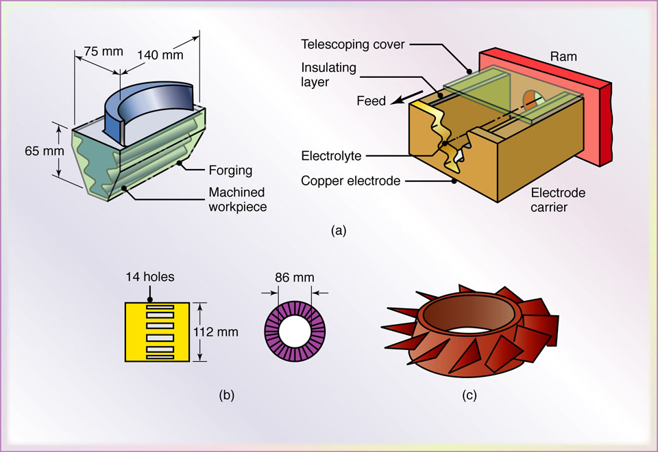
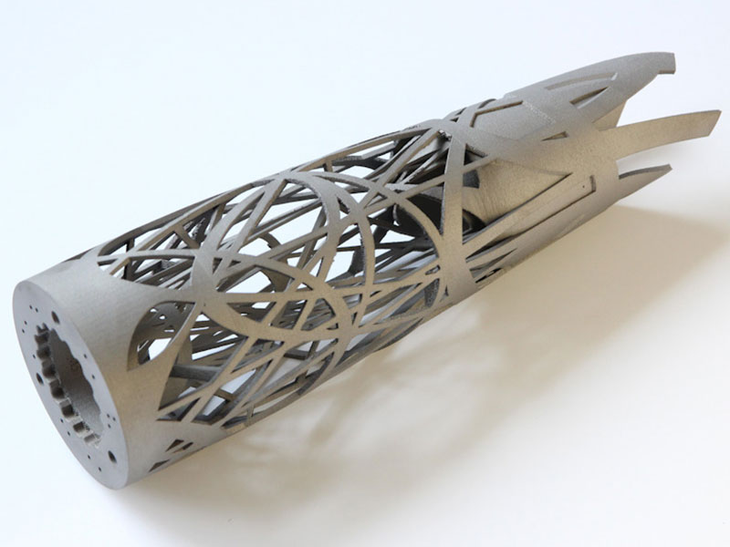
Typical Examples of Parts Developed by AMPs
MALE
FEMALE
PRECISION WIRE EDM
Figure:1 Typical parts made by electrochemical machining. (a) Turbine blade made of nickel alloy of 360 HB. Note the shape of the electrode on the right. (b) Thin slots on a 4340-steel roller-bearing cage. (c) Integral airfoils on a compressor disk.
Design Made using 3D Printing

Slide 19
Important Characteristics of AMPs
Process performance is independent of Workpiece Material properties such as hardness. Toughness, ductility, brittleness etc.
Process Performance highly depends upon the thermal, electrical, magnetic and chemical properties of the workpiece material
Process utilizes different types of source energy i.e. Mechanical, Thermal, Electrical and Chemical in its direct form
Usually AMPs Possesses lower material removal rate as compared to conventional processes but in turns AMPs provide high quality parts
Initial investment cost of setting an AMP is high due to costly machine tools and high operating costs

Slide 20
Dr Sunil Pathak, PhD - IIT Indore (MP) India
Senior Lecturer
Faculty of Engineering Technology
University Malaysia Pahang, Kuantan Malaysia
https://www.researchgate.net/profile/Sunil_Pathak4 https://scholar.google.co.in/citations?user=9i_j3sMAAAAJ&hl=en

