Slide 1
IMAGE PROCESSING
IMAGE RESTORATION
AND NOISE REDUCTION
Editor by
DR. FERDA ERNAWAN
Faculty of Computer Systems & Software Engineering
ferda@ump.edu.my

Slide 2
Today’s Lesson
Filtering in the Frequency Domain
  Image restoration
  Noise models
  Noise reduction Techniques
    Uniform Filtering, Gaussian Filtering, Median Filtering, Inverse Filtering, Weiner Filtering
Learning Outcomes:
  To understand noise reduction techniques in spatial and frequency domain.

Slide 3
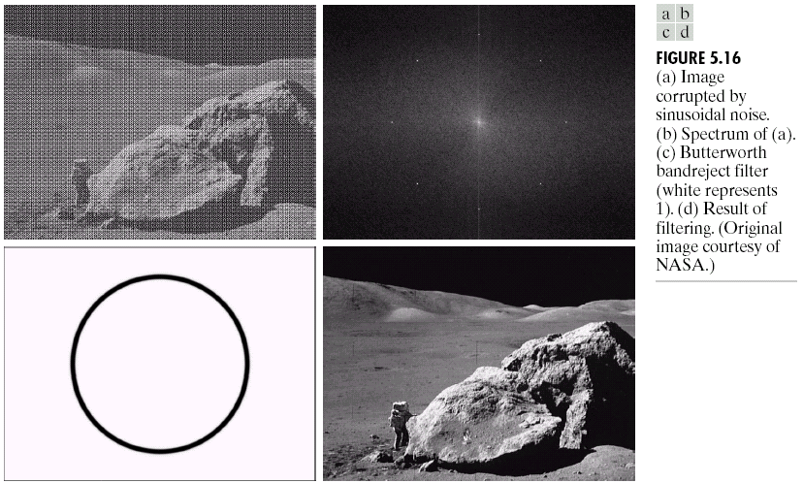
Image Restoration
Image restoration aim to recover the image from degraded measurement (Bahadir K. Gunturk, Xin Li, 2013).
Images taken from Gonzalez and Woods, 2016
Original noisy image
Image restoration
Notes:
The goal of restoration techniques is to reconstruct the acquired signal to recover the original signal.
Image is called degraded when presence of redundant information corrupts the useful information content.
Causes of degradation can be:
Defects of optical lenses
Non-linearity of the electro-optical sensor
Relative motion between object and camera
Wrong focus
Turbulence in atmosphere (remote sensing and astronomy)
Misalignment
Vibration during capture

Slide 4
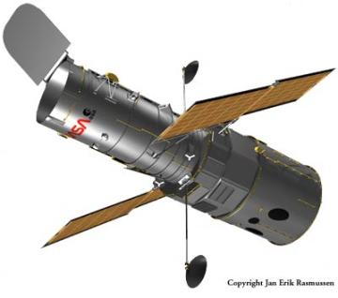
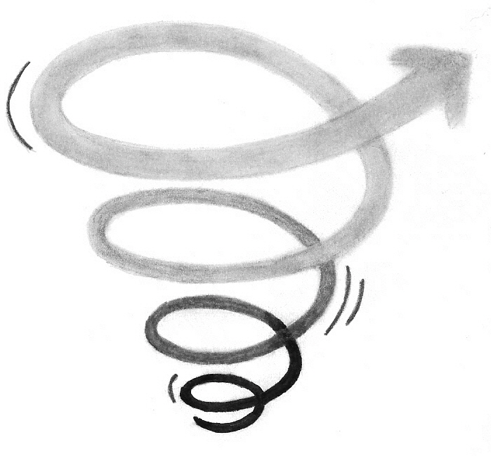
Image Restoration
The degradation may be due to
Atmospheric distortions (Aerosol scattering)
Optical aberrations (Diffraction and out-of-focus)
Sensor blur (results from spatial averaging at photosites)
Motion Blur (Camera shake)
Noise (Shot noise and quantization)

Slide 5
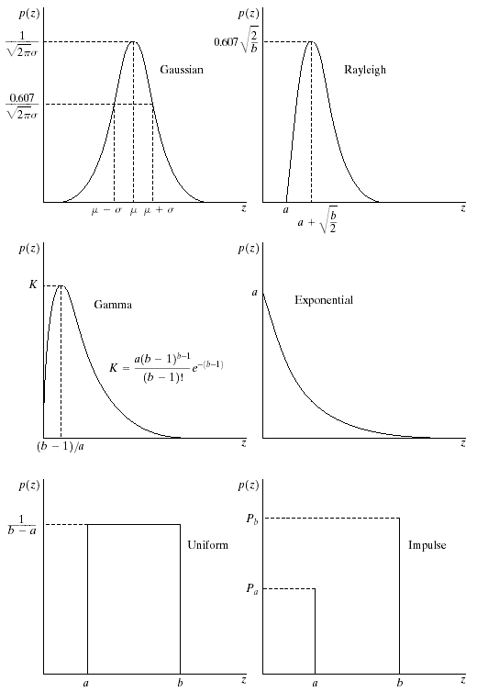
Different types of Noise
Some noise models are graphically depicted as follows:

Slide 6
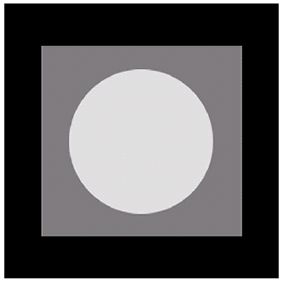
Different types of Noise
Given an image as shown on the right-side, that image is used to demonstrate the noise addition.
The next slide will show the effect of adding noise using different types of noise model.
Image
Images taken from Gonzalez and Woods, 2016
here
Histogram

Slide 7
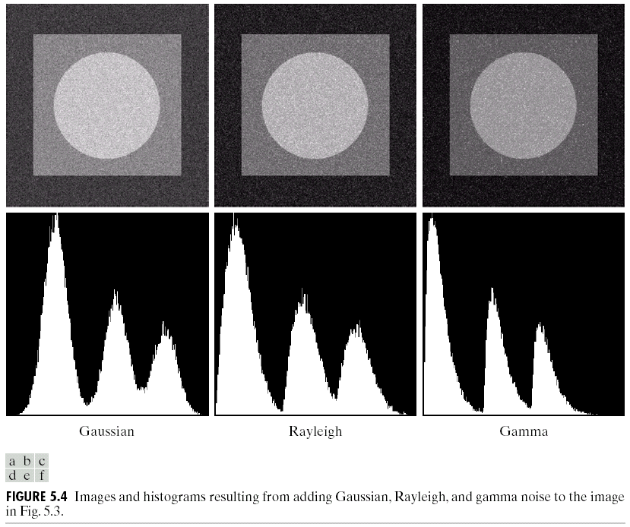
Order Statistics Filters
Different types of Noise
Images taken from Gonzalez and Woods, 2016
Gaussian Noise
Rayleigh Noise
Erlang Noise

Slide 8
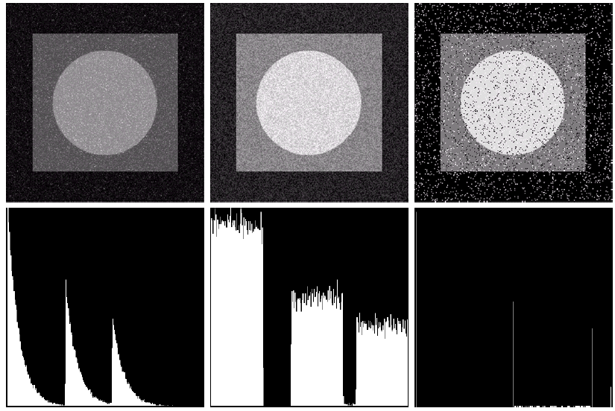
Order Statistics Filters
Different types of Noise
Images taken from Gonzalez and Woods, 2016
Exponential Noise
Uniform Noise
Impulse Noise

Slide 9
Noise Reduction Techniques
Noise reduction can be implemented in spatial and frequency domain.
  A general technique to noise reduction is smoothing and median filter. General techniques to reduce noise are given as follows:
    Uniform Filtering / Averaging Filter
    Median Filtering / Order statistic Filter
    Gaussian Filtering / Band Reject Filter
    Inverse Filtering
    Weiner Filtering

Slide 10


Uniform Filter / Averaging Filter
Spatial filter is suitable to remove impulse noise (pepper and salt noise). The averaging filter of size 3x3 pixels is given by:
Filter mask

Slide 11
Averaging Filter
Geometric Mean
Harmonic Mean
Contraharmonic Mean

Slide 12
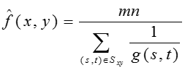
Harmonic Mean
Harmonic mean technique is suitable to reduce salt noise, while it can’t perform well for pepper noise. This technique also can reduce damaged image due to Gaussian noise.

Slide 13
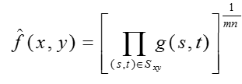
Geometric Mean
The result obtained from geometric mean produces blur image, the detail of image information will lost.

Slide 14
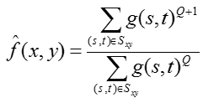
Contraharmonic Mean
Contraharmonic Mean:
Q represents the filter order, if the Q value is negative value, it can reduce salt noise, otherwise if positive value, it means that can reduce pepper noise. This technique can’t eliminate both salt and pepper noise concurrently.

Slide 15
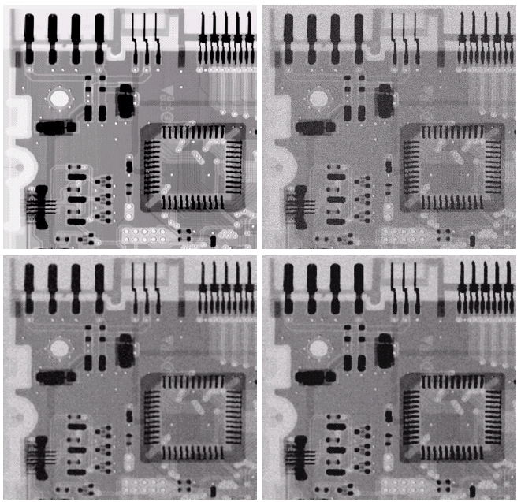
Noise Reduction Examples
Image corrupted by Gaussian noise
Original image
Images taken from Gonzalez and Woods, 2016
3x3 Geometric
Mean Filter (less blurring than AMF, the image is sharper)
3x3 Arithmetic
Mean Filter

Slide 16
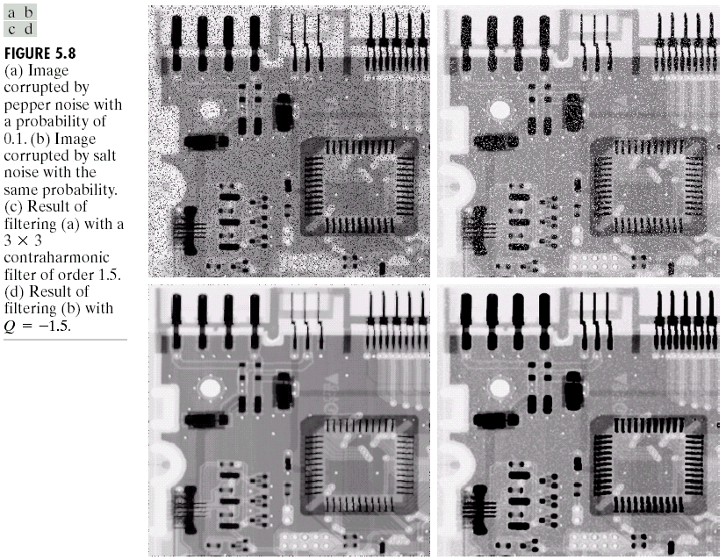
Order Statistics Filters
Noise Reduction Examples (cont…)
An image has degraded by Salt & Pepper with density 0.1
Images taken from Gonzalez and Woods, 2016
Average filtering using 3x3 harmonic filter with Q=1.5

Slide 17
Order Statistics Filters
Noise Reduction Examples (cont…)
An image has degraded by Salt & Pepper with density 0.1
Images taken from Gonzalez and Woods, 2016
Average filtering using 3x3 Contraharmonic Filter with Q=-1.5

Slide 18
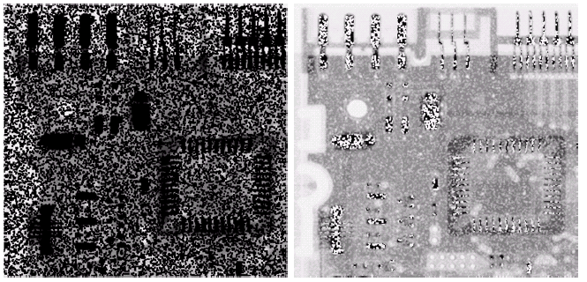
Contraharmonic Filter
Choosing the wrong value for Q when using the contraharmonic filter can have drastic results
Images taken from Gonzalez and Woods, 2016
Pepper noise filtered by a 3x3 CF with Q=-1.5
Salt noise filtered by a 3x3 CF with Q=1.5

Slide 19

Median Filter
Median filter technique is suitable to reduce impulse noise such as Salt & Pepper. Median filter is defined as:
Center value in the original image 3x3 pixels is replaced by the median value. Median filter technique is applied for each non-overlapping block of 3x3 pixels, from top-left corner to top-right corner and from top to bottom.

Slide 20
Order Statistics Filters
Median Filter
Given a grayscale image 3x3 pixels in below.
164 | 156 | 145 | 96 | 168 | 188
146 | 135 | 90 | 185 | 200 | 198
137 | 83 | 189 | 199 | 214 | 199
94 | 191 | 215 | 211 | 201 | 198
179 | 221 | 200 | 218 | 222 | 201
185 | 210 | 221 | 220 | 198 | 214
164 | 156 | 145 | 96 | 168 | 188
146 | 135 | 90 | 185 | 200 | 198
137 | 83 | 191 | 199 | 214 | 199
94 | 189 | 215 | 211 | 201 | 198
179 | 221 | 200 | 218 | 222 | 201
185 | 210 | 221 | 220 | 198 | 214
ascending order : 83, 94, 137, 179, 189, 191, 200, 215, 221

Slide 21
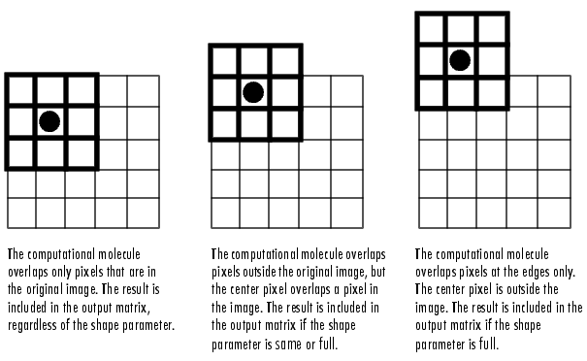
Order Statistics Filters
Median Filter
The computational block overlap only pixels that are in the original image.
The computational block overlap pixels outside the original image, but the center pixel overlaps a pixel in the image.
The computational block overlap pixels at the edges only. The center pixel is outside the image.

Slide 22
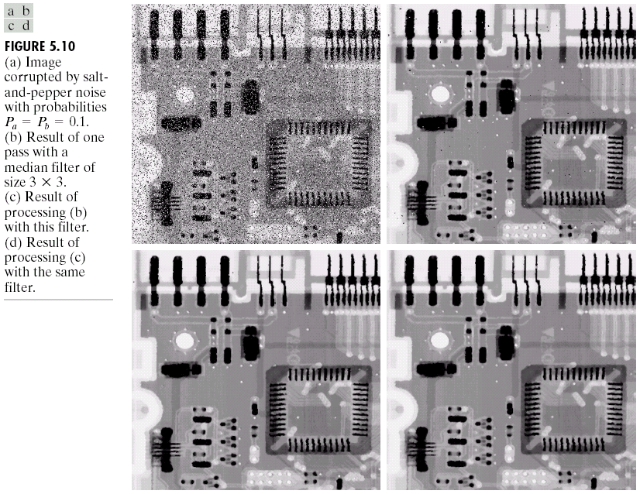
Order Statistics Filters
Noise Reduction Examples
Pepper & Salt with density 0.2
Result of 1 passes from 3x3 Median
Filter
Images taken from Gonzalez and Woods, 2016
Result of 2 passes from 3x3 Median
Filter
Result of 3 passes from 3x3 Median
Filter
Repeated passes remove the noise better but also blur the image

Slide 23
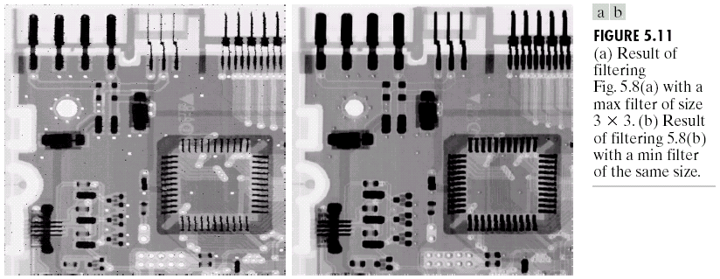
Order Statistics Filters
Noise Reduction Examples
Pepper with density 0.2
Salt with density 0.2
Images taken from Gonzalez and Woods, 2016
Filtered image from 3x3 Min Filter
Filtered image from 3x3 Max Filter

Slide 24
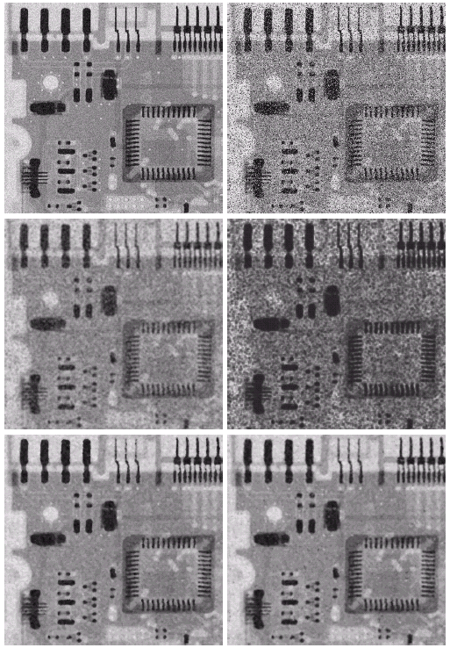
Order Statistics Filters
Noise Reduction Examples
Image further corrupted by Pepper & Salt noise
uniform noise
Filtering by a 5x5 Arithmetic Mean Filter
Filtering by a 5x5 Geometric Mean Filter
Images taken from Gonzalez and Woods, 2016
Filtering by a 5x5 Alpha-Trimmed
Mean Filter (d=5)
Filtering by a 5x5 Median Filter

Slide 25
Adaptive median Filters
adaptive median filters can perform better than media filter on impulse noise such as pepper & salt noise.
The results obtained from adaptive median filter produce slightly smooth image.

Slide 26
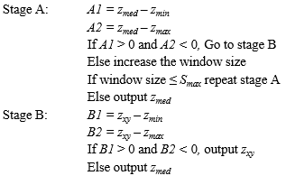
Adaptive Median Filtering

Slide 27
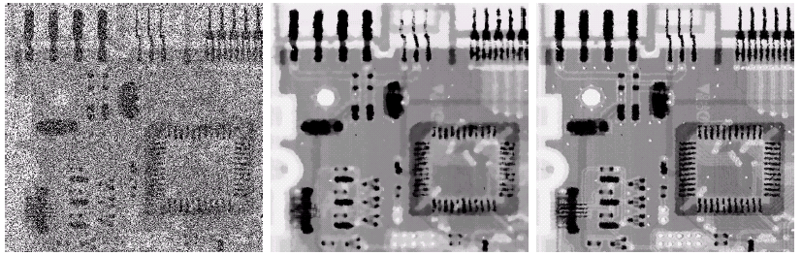
Order Statistics Filters
Adaptive Filtering Example
Image corrupted by pepper & salt noise with probabilities P_{a} = P_{b}=0.25
Filtering result with a 7x7 median filter
adaptive median filtering result with
S_{max} = 7
AMF preserves sharpness and details, e.g. the connector fingers.

Slide 28
References
R.C. Gonzalez and R.E. Woods, 2016. Digital Image Processing, Pearson Education India; Third edition.
A.K. Jain, 2015. Fundamentals of Digital Image Processing, Pearson Education India; First edition.
R.C. Gonzalez, R.E. Woods and S.L. Eddins, 2017. Digital Image Processing Using MATLAB. McGraw Hill Education; 2 edition.
S. Jayaraman, T. Veerakumar, S. Esakkirajan, 2017.Digital Image Processing, McGraw Hill Education; 1 edition.
Bahadir K. Gunturk, Xin Li, 2013. Image Restoration: Fundamentals and Advances, CRC Press, Taylor & Francis.

