Slide 1
Clamp unit
Plastic Injection Technology BMM 4843
Wan Sharuzi Wan Harun
Faculty of Mechanical Engineering Universiti Malaysia Pahang
sharuzi@ump.edu.my
jihad_ku@yahoo.com
019 959 0039
09 424 6339

Slide 2
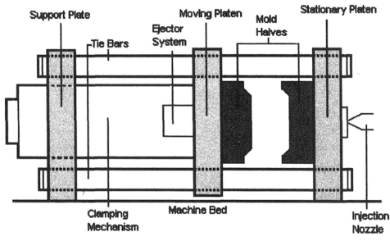
INTRODUCTION
Figure 6.1 Schematic of an IMM clamp unit

Slide 3
The clamp unit performs the following functions;
Holds the mold;
Closes the mold;
Keep the mold closed under pressure during injection;
Opens the mold to allow the parts to be ejected; and
Accommodates the ejector system which ejects the part out of the mold.

Slide 4
The clamp unit is illustrated in Figure 6.1 showing the mold in the open position with the moving platen as far to the left as possible.
The clamping mechanism provides the force to keep the mold closed during the injection and holding-pressure stages of the machine cycle.
Two types of clamping mechanisms;
Hydraulic
Hydro-mechanical

Slide 5
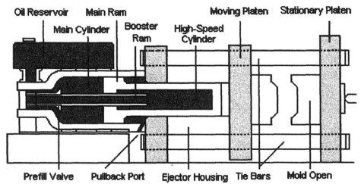
Hydraulic Clamp System
Uses direct acting hydraulic cylinders to achieve the closing and clamping of the mold.
Figure 6.2 IMM hydraulic clamp unit

Slide 6
Figure 6.2 is typical design of this type of system with the mold in the open position.
The hydraulic oil reservoir is mounted in a position (some on top and some below the main cylinder) that allows the oil to flow by gravity or by pumping pressure into the main cylinder.
The high-speed cylinder is smaller in diameter and permits the rapid movement on the moving platen to a point where mold is nearly closed.

Slide 7
During this movement, the prefill valve is open, allowing the oil to flow into the hydraulic main cylinder behind the main ram.
When the mold is nearly closed, the prefill valve closes.
The hydraulic pressure, developed by hydraulic pumps, develops a force on the main ram of about 21 MPa. This force is used to achieve the final clamping of the mold, typically a relatively short stroke.
Depending upon the size of the main ram, the 21 MPa can translate into a clamp tonnage of considerable magnitude.

Slide 8
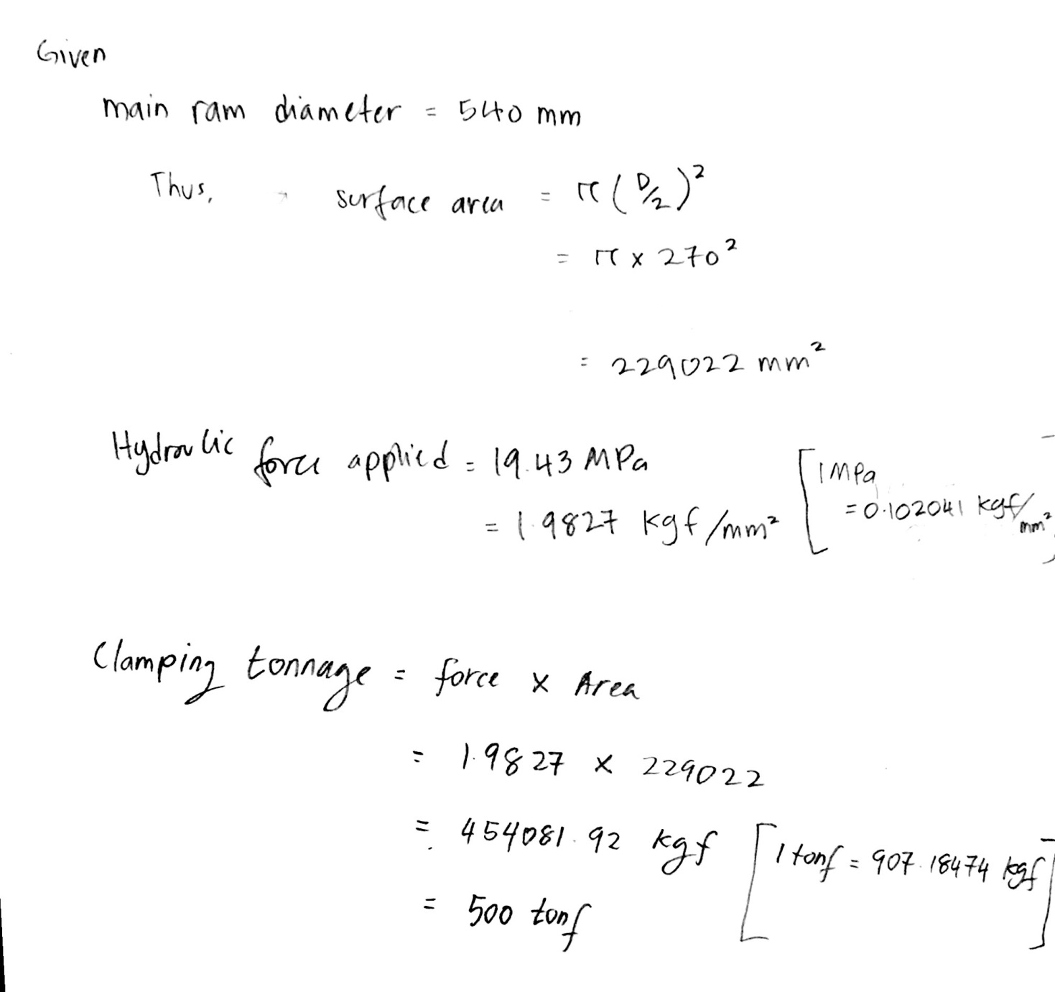
Example Calculation

Slide 9
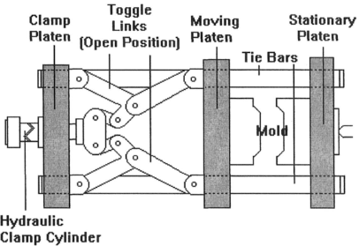
Hydro-Mechanical System
Uses lever arms, toggles or other mechanical devices to multiply the force exerted by the hydraulic system to achieve desired clamping force.
Figure 6.3 IMM toggle clamp unit

Slide 10
Also referred to as a toggle clamp system.
Figure 6.3 illustrates the functioning of a double toggle clamping unit. Its referred as double toggle because of the 2 sets of toggle links bringing force to the moving platen, one set at the top sets and another set at the bottom.
On smaller machines (<50tons), a single toggle clamp unit is often used.
Because the mechanical force enabled by the toggle links, the hydraulic cylinder that provides the force to the toggle links can be much smaller than hydraulic clamp unit.

Slide 11
The mechanical advantage in the toggle system can range from 25:1 to 50:1.
This mechanical advantage reduces the diameter of the hydraulic cylinder required to achieve clamp force.
It also permit the use of lower hydraulic pressures and hydraulic oil requirements.

Slide 12
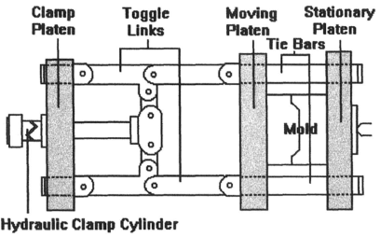
Figure 6.4 Toggle clamp unit in a closed position
The toggle clamp unit in the closed position in shown in Figure 6.4.
IMMs in use today offer clam tonnage from less than 30 tons to 5000 tons.
The force generated by these systems is to clamp and hold the mold closed.

Slide 13
For example, 200 ton machine means that the clamp unit can develop 200tons of force to hold the closed mold during injection and holding stages.
The clamp force is needed to withstand the opposing force of injection pressure as the screw comes forward.
Typical injection pressure is 110 to 152 MPa.
Does this mean that a clamp force of about 150MPa (10 tons/in²) is required to offset the force?
NO!!, greater tonnage capacities would be required to achieve successfully molding.

Slide 14
Clamp Unit Specifications
Mold Height Maximum/Minimum – Defines the max & min total thickness of a mold that can be used in that particular clamp unit.
Maximum daylight – The max amount of space that is available between the movable and stationary platens. Approx. equal to the max mold height plus the clamp stroke.
Clamp Stroke – the distance that the movable platen is able to move (open). This spec., combined with the max. mold height, can serve to limit the height of a product that you can mold.

Slide 15
Clamp Unit Specifications
Platen Size – the horizontal and vertical measurement of the platens can be a determinant in the maximum size of the mold that can be mounted in that particular clamp unit.
Distance Between Tie Bars – most clamp units have 2 upper and 2 lower tie bars. Horizontal measurement is more critical than the vertical because most molds are mounted from the top. This spec., combined with platen size and the max mold height, serves to limit the overall size of mold that can placed in the clamp unit.

Slide 16
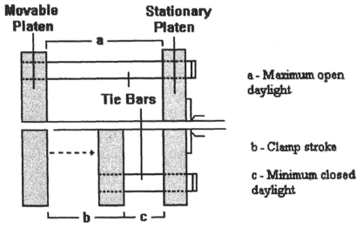
Figure 6.5 Illustration of the stroke of a clamp unit
Some IMM are considered “tie bar-less” machines which facilitate the mounting of and access to the mold.
Most of this machines are small clamp tonnage (<500tons).

Slide 17
Ejector System
The process of ejecting parts out of the mold involves both the clamp unit and the mold itself.
Hydraulic ejection is a standard feature of all machines.
The clamp unit includes the hydraulic mechanism that provides the force to push the part out of the mold.
The mechanism referred to as a knock-out (K.O.) system.
There are standardized hole patterns on both movable and stationary platens

Slide 18
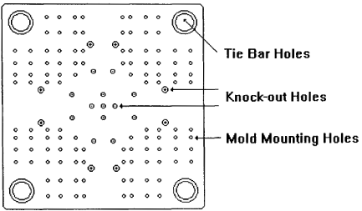
The patterns consists of;
Mounting holes (for mounting the mold on the platen)
Knock-out holes (for ejector system)
The pattern of holes was standardized by the Society of the Plastics Industry (S.P.I)
Figure 6.6 Platen hole patterns for 500 ton IMM

Slide 19
Ejection
Ejector bars (ejector rods) are inserted through the movable platen and threaded into the ejector housing (ejector box) that is mounter on the back side of the movable platen.
The ejector housing is typically a steel plate that rides on guide rods.
The hydraulic cylinder(s) that locates behind the ejector housing actuates the housing to move forward which, in turn, causes the ejector bars to move forward.
The ejector bar enters the back side of the mold and contacts the ejector plate in the mold, causing it to move forward.

Slide 20
The mold ejector plate is in contact with one of several possible devices; ejector pins, a stripper plate, or another ejection mechanism that, when pushed forward, contacts the molded part and ejects it out of the mold.
Springs, mounted between the mold and the ejector plate, return the ejector plate to its normal position.
The important point to understand about the ejector system in the clamp unit is how the hydraulic force causes a forward action against the mold ejector plate.

Slide 21
Figure 6.7 Hydraulic ejector system

Slide 22
Other types of ejection systems are;
A single hydraulic cylinder
A push-pull action with the ejector bars bolted to ejector plate, and
Floating ejection bars.
However, the principles involved in their operation are similar to those illustrated.

Slide 23
Case Study
On many occasions, molders have experienced flash on the parts being produced yet a careful review of the mold and processing parameters fails to disclose a cause.
Finally, a check of the squareness of the platens, one to the other, revealed the source of the problem. In similar instances, the mold halves have been found to not be square, one to the other. Although these maintenance checks seem so fundamental and obvious, such problems do occur.

Slide 24
Case Study
On several occasions during the past few years, we have read of cases where a machine operator has lost fingers and hands as a result of not paying heed to the safety rules involving the clamp unit. In some more violent accidents that have been described in trade journals, men have been crushed to death when the clamp unit accidentally closed on their bodies.
All injection molding machines are equipped with safeties that prevent the accidental closing of the clamp unit.
Discuss your opinion on why accident related to IMM clap unit still occurs regardless all well-quipped machine safeties.

Slide 25
Case Study-answer
Yet there have been and will no doubt be many operators or maintenance men in the future that disable the safeties to theoretically facilitate their work on the clamp unit or the mold while it is in the machine. The results can be fatal!
Do NOT disable machine safeties that affect the operation of the clamp unit. While working around this unit and/or the mold, turn the power off and proceed according to the safety rules that the machine manufacturer supplies.

