Slide 1
Electric and Electronic Technology Chapter 2C – Kirchhoff’s Laws - KVL
by
Akhtar Razali FKM akhtar@ump.edu.my

Slide 2
Chapter Description
Aims
Mesh analysis application around mesh in a circuit
Expected Outcomes
Students able to understand and apply Kirchhoff’s Voltage Law/Mesh analysis
Other related Information
One of mid semester exam is from this topic
No other relevant information be disclosed
References
Rizzoni G., 2004, Principles and Applications of Electrical Engineering, Revised Fourth Edition, Fourth Edition, McGraw Hill
Hambley A.R., 2005, Electrical Engineering Principles and Applications, Third Edition, Pearson Prentice Hall

Slide 3
Contents
Mesh analysis is developed by applying KVL around loops in the circuit
Mesh analysis results in a system of linear equations which must be solved for unknown currents

Slide 4
KVL
The output voltage Vout of this circuit is proportional to the sum of the two input voltages V₁ and V₂
1kΩ
1kΩ
+
+
–
+
–
V₁
V_{out}
1kΩ
V₂
–

Slide 5
Steps of Mesh Analysis
Identify mesh (loops).
2. Assign a current to each mesh.
3. Apply KVL around each loop to get an equation in terms of the loop currents.
4. Solve the resulting system of linear equations for the mesh/loop currents.

Slide 6
1. Identifying the Meshes

Slide 7
Steps of Mesh Analysis
1. Identify mesh (loops).
2. Assign a current to each mesh.
3. Apply KVL around each loop to get an equation in terms of the loop currents.
4. Solve the resulting system of linear equations for the mesh/loop currents.

Slide 8
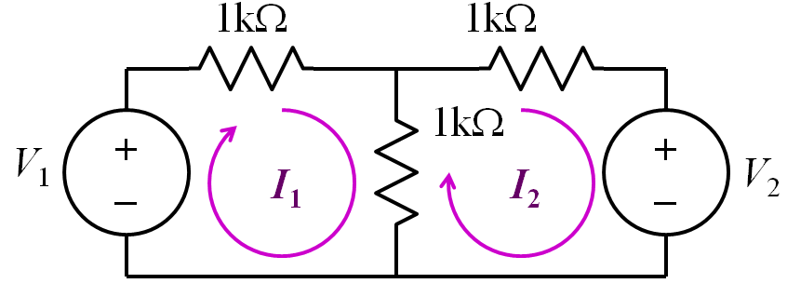
2. Assigning Mesh Currents

Slide 9
Steps of Mesh Analysis
1. Identify mesh (loops).
2. Assign a current to each mesh.
3. Apply KVL around each loop to get an equation in terms of the loop currents.
4. Solve the resulting system of linear equations for the mesh/loop currents.

Slide 10
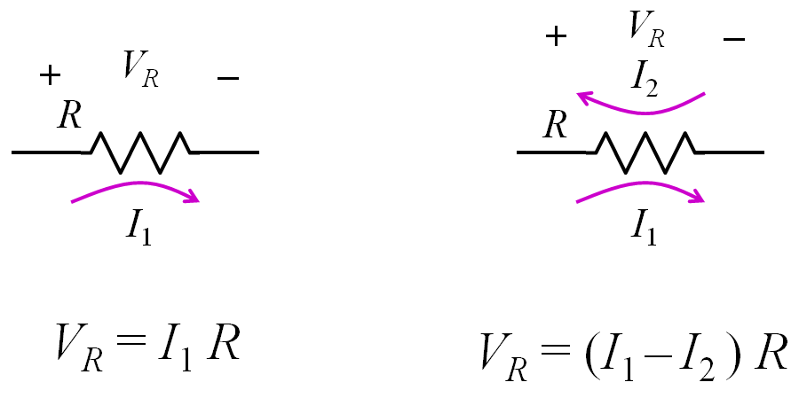
Voltages from Mesh Currents

Slide 11
3. KVL Around Mesh 1
1kΩ
1kΩ
1kΩ
+
–
+
–
V₁
V₂
I₁
I₂
–V₁ + I₁ 1kΩ + (I₁ – I₂) 1kΩ = 0
I₁ 1kΩ + (I₁ – I₂) 1kΩ =V₁

Slide 12
3. KVL Around Mesh 2
1kΩ
1kΩ
1kΩ
+
–
+
–
V₁
V₂
I₁
I₂
(I₂ – I₁) 1kΩ + I₂ 1kΩ + V₂ = 0
(I₂ – I₁) 1kΩ + I₂ 1kΩ = –V₂

Slide 13
Steps of Mesh Analysis
1. Identify mesh (loops).
2. Assign a current to each mesh.
3. Apply KVL around each loop to get an equation in terms of the loop currents.
4. Solve the resulting system of linear equations for the mesh/loop currents.

Slide 14
Matrix Notation
The two equations can be combined into a single matrix/vector equation

Slide 15
4. Solving the Equations
Let: V₁ = 7V and V₂ = 4V
Results:
I₁ = 3.33 mA
I₂ = –0.33 mA
Finally
V_{out} = (I₁ – I₂) 1kΩ = 3.66V

Slide 16
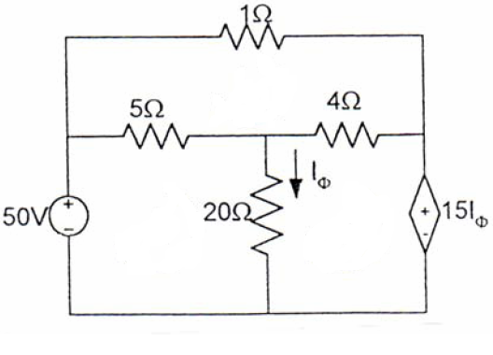
Other Example
Find the power dissipated in 4 Ω resistor.

Slide 17
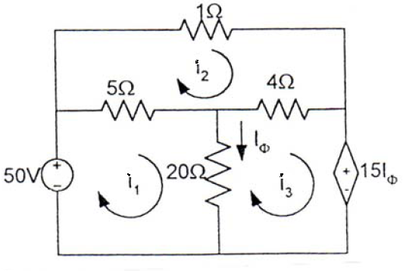
Solution
We apply KVL to the three meshes in turn.
For mesh 1,
…(1)

Slide 18
Solution
For Mesh 2:
…(2)
For Mesh 2:

Slide 19
Solution
…(3)

Slide 20
Conclusion of The Chapter
Conclusion #1
KVL states that the summation of voltage in a mesh is equal to ZERO.
How many elements in a mesh represents how many terms needed to be derived to construct KVL equation.
Conclusion #2
There are 4 steps to do KVL analysis.

Slide 21
Akhtar Razali FKM, UMP.

