Slide 1
BSB3503 - Biomanufacturing CHAPTER 4 GMP – Documentation Part II (Master Formulae & Protocol)
Author: Nurul Azyyati Sabri
Co-Author / Editor: Rama Yusvana Faculty Industrial Sciences & Technology yusvana@ump.edu.my

Slide 2
Learning Outcomes
To explain the importance of SOP, Master Formulae, Protocol and validation
To understand and write SOP

Slide 3
MASTER FORMULAE (MF)
Define as a document that explains the detailed steps included in a facility’s method for producing a batch of product.
The full procedure is detailed in a Master Formula which
details the preparations to be made, the equipment to be used, and the method to be followed
prepared and approved for each batch size of every product manufactured
detail all the manufacturing instructions for that specific batch of product.

Slide 4
The MF explains detailed step-by-step instructions for the production process:
the details include the specific types and amounts of components and raw materials
the details of the processing parameters
indicates what in process quality controls are required
specifications for intermediates
environmental monitoring and control.
The MF is written with blank spaces at each point where data or information is to be recorded to document that the production events occurred as directed.

Slide 5
Term differs.
WHO and Canada use the term “Master Formulae”
USA GMP Regulations the term is “Master Production and Control Record”
in the EU GMP guidelines the term is “Manufacturing Formulae and Processing Instructions”
Australian GMP Guidelines calls it “Master Formulae and Processing Instructions”.
The information to be provided is essentially the same in each of these GMP documents.

Slide 6
The MF can be prepared either
one for each segment of the full production process (e.g. for the production of an intermediate such as a batch of harvest or for the formulation/filling process from final bulk)
single overall document that contains parts which describe the separate batch products that make up the full process from the starting materials to the final vialed product.
Verification signatures or initials of another operator may be required for critical processes and space should be provided accordingly for these steps.
Space for review by a supervisor must be included.
All products, equipment and facility areas listed in the MF should have reference numbers associated with them to permit traceability.

Slide 8
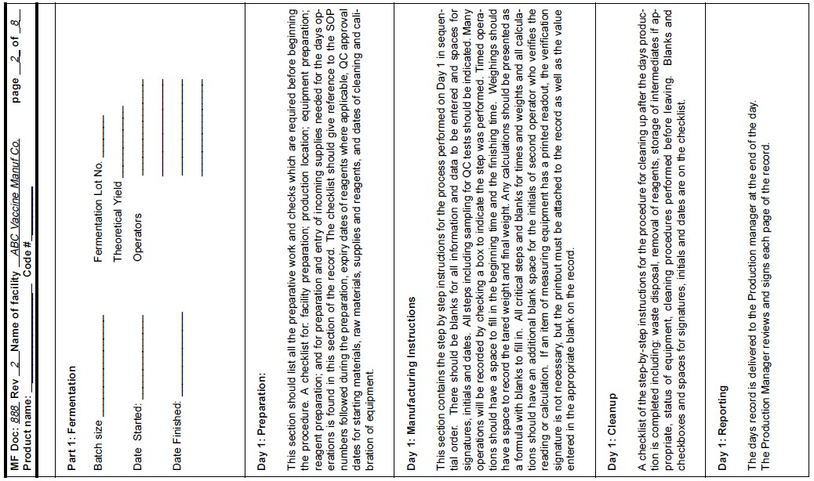

Slide 10
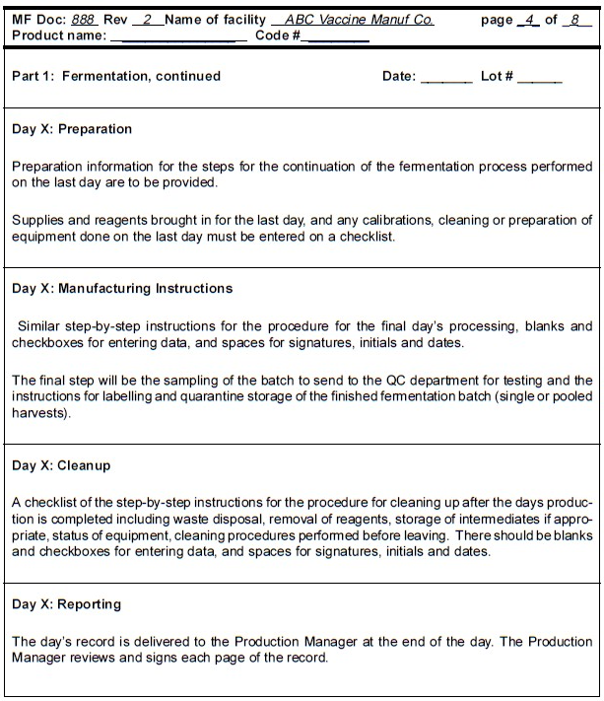

Slide 11
Protocol (Policy / Studies)
A protocol is a written set of instructions broader in scope than a Standard Operating Procedure (SOP).
A protocol describes the details of a comprehensive study to investigate the consistent operation of new system.

Slide 12
Protocol (Policy / Studies)
Protocols include significant background information.
Eg: Validation studies, stability studies, and clinical studies.

Slide 13
Validation / Qualification
Validation is defined as the “documented evidence which provides a high degree of assurance that a planned process will consistently perform according to the intended specified outcomes”.
Performed for
Analytical tests, equipment, facility systems such as air, water, steam
Methods / processes such as the manufacturing processes, cleaning, sterilization, sterile filling, lyophilization, etc.

Slide 14
Validation / Qualification
Validation studies verify the system remains in control.
Revalidation could also be performed.

Slide 15
Master validation plan
The Master Validation Plan is a document pertaining to the whole facility.
The document should provide the format required for
each particular validation document
indicate what information is to be contained within each document.

Slide 16
Qualification/validation study
Explained how to determine which of the qualifications are required.
Designed for defined parameters
Measures specified outcomes.
Any modifications must be controlled.

Slide 17
Qualification/validation study
Include the planning and submission of a proposal for the change with a rationale.
Prepared by the department requesting the change.
Include the effect of the change on the specific system/process under consideration.

Slide 18
The qualification protocols normally divided into three segments:
Installation Qualification (IQ)
Operational Qualification (OQ)
Performance Qualification (PQ)
Depending on the function and operation of some equipment, only IQ/OQ are required.

Slide 19
For equipment correct operation is a sufficient indicator.
Systems which perform critical support processes require installation, operational and performance qualifications.

Slide 20
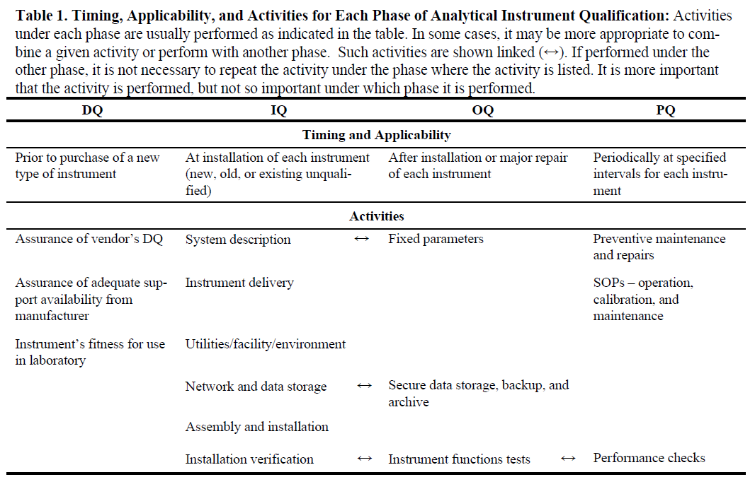

Slide 21
Installation qualification (IQ)
Written for the critical processing equipment.
Prepared for each equipment or system.
Verify that the item matches the purchase specifications.

Slide 22
Operational qualification (OQ)
All the components of a system or of a piece of equipment operate as specified.
Involves testing of all normal operation controls.
The OQ document should provide
a listing of SOPs for operation, maintenance and calibration
information on the training of operators
instructions for any static or dynamic tests.
information on equipment or system calibration.

Slide 23
Performance qualification (PQ)
Performed after both Installation and Operational Qualifications have been completed, reviewed and approved.
Describes the procedure to meet required specifications under routine operation.
Include a description.
Requires validation.

Slide 24
Process / Method Validation
A series of interrelated functions and activities.
Use of validated equipment, under the established procedure usually at least 3 times
Meet all acceptance criteria each time to be considered a validated process.
In many cases, "worst case" conditions are used for the validation to ensure that the process is acceptable in the extreme case.

Slide 25
Examples of processes or method which must be validated in pharmaceutical manufacturing are:
Cleaning
Sanitization
Fumigation
Depyrogenation
Sterilization

