Slide 1
BSB3503 - Biomanufacturing CHAPTER 10 GMP – Laboratory & Production Area
Author: Nurul Azyyati Sabri
Co-Author / Editor: Rama Yusvana Faculty Industrial Sciences & Technology yusvana@ump.edu.my

Slide 2
cGMP for Biotechnology Production Area
Area Design
Room Classification (over view)
Flow (Personnel, Material, Waste, Product)
2

Slide 3
General Points Before Designing the Facility
Consider the production process
Separation for personnel entrance
Separation for entrance of raw materials
HVAC facility
water systems
3

Slide 4
General Points Before Designing the Facility
Waste flow and waste management system
Put main utilities outside the production area (if possible)
The smaller the area, the better for contamination control
Smart piping network (shorter line, valve system)
4

Slide 5
Room Classification in Biopharmaceuticals production area
EU Class | US Class | Activities
A | 100 | Aseptic operation during sterile product or microorganism is exposed to the environment (Laminar Air Flow Class II conditions)
B | 1000 | Aseptic area surrounding class 100 (A). In case of handling pathogenic, Room pressure should be negative.
C | 10, 000 | Fermentation/extraction, non-sterile media preparation, purification steps, storage of sterile materials.
D | 100, 000 | Material wrapping area, Rooms used for sterilization of equipment and materials
unclassified | 100, 000 | Materials Washing room, non-sterile corridor, office, quality assurance laboratory, storage of materials, finished packed product and equipment
5

Slide 6
Personnel Flow
One general entrance
Separate male/female changing room and restroom (Three changing room is usually considered, male,female and visitors)
“Personnel should move between areas of a bioactivity according to detailed revised regulation. Procedure established according to biological regulatory requirements”.
6

Slide 7
Personnel Flow
Secured and limited to authorized personnel only
Change from city garment to production garment, (1st change)
Before entering aseptic room, another change to put sterile gown & sterile boots.
7

Slide 8
Material Flow
Sampled & tested
Approved from QA/QC
Using of dedicated Material Cardboard Lock
“The effectiveness of the sterilization procedure shall be no less than that achieved by an attained temperature of 121.5⁰C maintained for 20 min. by saturated steam.
That is higher than general role of sterile drug products (121.5⁰C for 15 min)”
8

Slide 9
Material Flow
External packaging removed
No Cardboard and wood should enter the production area
The production core should have storage facility for raw materials of different temperatures if required
Sterile materials validated
9

Slide 10
Material Flow (cont.)
Sterilized materials/equipments stored into sterile storage area
The soiled material/equipment removed from the sterile core production area via air lock (Air Lock Out)
10

Slide 11
Material Flow (cont.)
Air lock is used to decontaminate the external surface of mobile vessels.
After use, the mobile vessel should be decontaminated in place (DIP) using steam
Fumigation cycle is applied (using peracetic acid or hydrogen peroxide generator).
11

Slide 12
Media and Buffer Flow
Authorized personnel only
Two-stage media preparation suite: non-sterile media and sterile media preparation area
Specific gowning practices
Validated container system for sterile items
12

Slide 13
Product Flow
Walking Cell Bank (dedicated unit)
UNDIRECTIONAL
Segregation : live organisms v.s. NO live organism
Dedicated storage room and product exit
13

Slide 14
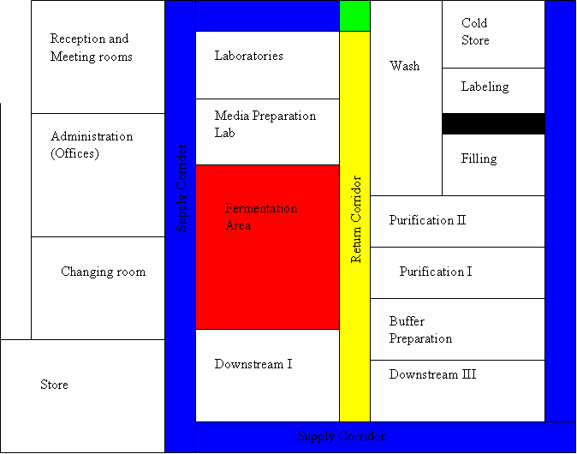
Primary Floor Plan

Slide 15
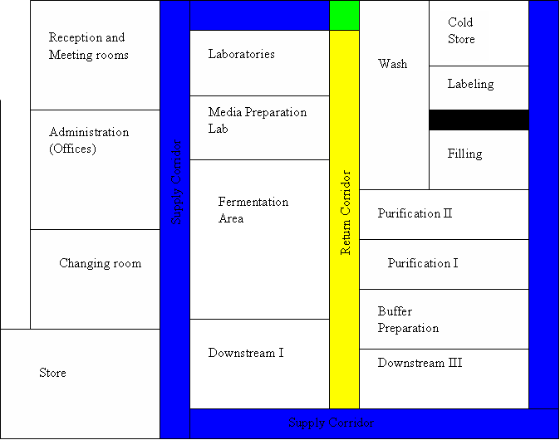
Process Flow

Slide 16
Material Flow

Slide 17
Material Flow

Slide 18
Personnel Flow

Slide 19
Media Preparation
Fermentation Room
Inoculation
Preparation
Personnel flow

Slide 20
Media Preparation
Fermentation Room
Inoculation
Preparation
Personnel flow
Material flow

