Slide 1
GEOTECHNICAL ENGINEERING Site Investigation
For updated version, please click on
http://ocw.ump.edu.my
by
Dr. Amizatulhani Abdullah Faculty of Civil Engineering ad Earth Resources amizatulhani@ump.edu.my

Slide 2
Chapter description
Aims
This chapter provides further discussion and explanation related to site investigation.
Expected Outcomes
Aware the importance to conduct site investigation and the important things related to site investigation phases.
References
Das, B.M., “Principles of Geotechnical Engineering, 5th edition”, Thomson Learning (2002).
Budhu, M., “Soil Mechanics and Foundations, 3rd edition”, John Wiley and Sons (2010).
Raj, P.P., “Soil Mechanics & Foundation Engineering”, Pearson Education (2008).
Wan Zuhari, W. Y, “Engineering geology (A glimpse of engineering geology and rock mechanics)”, UKM (2014).
Site Investigation by Dr. Amizatulhani Abdullah

Slide 3
Content
Introduction of the chapter
Objectives
Desk study
Site reconnaissance (walk over survey)
Detail site exploration (sub surface exploration)
Rock coring
In situ tests
Laboratory tests
Data presentation and report
Conclusion
Site Investigation by Dr. Amizatulhani Abdullah

Slide 4
Introduction of the chapter
This section details some of the more common soil exploration methods used to determine these various soil parameters.
The extent to which a soil exploration program should reach depends on the magnitude of the project.
If the proposed construction program involves only a small expenditure, lack of information about subsoil conditions must be compensated for by using a liberal factor of safety.
Site Investigation by Dr. Amizatulhani Abdullah

Slide 5
The first step in any subsoil exploration should be an investigation of the general geological character of the site.
The more clearly the geology is understood, the more efficiently can the soil exploration be carried out.
The second step is to make exploratory drill holes or test pits that furnish more specific information regarding the general character and thickness of the individual soil strata.
Site Investigation by Dr. Amizatulhani Abdullah

Slide 6
Objectives
Identify and describe pertinent surface conditions.
Determine location and thickness of soil and rock strata (subsurface soil profile).
Determine location of groundwater table.
Recover samples for laboratory testing.
Conduct laboratory and/or field testing.
Identify special problems and concerns.
Site Investigation by Dr. Amizatulhani Abdullah

Slide 7
Desk study
Conduct preliminary study of site.
Compiling of existing information regarding the structure.
Collection of all relevant & existing information/data for subsoil condition;
eg: Development plans, construction plans, site location maps, topographic maps, aerial photograph, geologic maps, soil survey maps, existing soil exploration reports at nearby site.
Site Investigation by Dr. Amizatulhani Abdullah

Slide 8
Site reconnaissance
The process of visually inspect the site & the surrounding area, to verify the info obtain from the desk study, as well to get additional info at site.
Observation of Surface Conditions
Accessibility to the site
Traffic Control
Surface Drainage & erosion
Geologic Features
Vegetation
Soil stability / slopes
Ground water
Site Investigation by Dr. Amizatulhani Abdullah

Slide 9
Detailed site exploration
Indirect methods of subsurface exploration
(Geophysical methods e.g. electrical resistivity method, seismic refraction method and sounding methods).
* Establish the soil
principal strata.
* The results obtained are generally satisfactory.
Semi-direct methods of subsurface exploration
(Wash boring, rotary drilling, auger).
* The depth of certain
layers are ascertained
(depend on the boring
tools used).
* Soil sampling can be
made for a particular
layer.
Direct methods of subsurface exploration
(Test pits, trenches, large diameter boring, shafts, drifts).
* Provide relatively undisturbed samples.
Source : Raj (2008)
Site Investigation by Dr. Amizatulhani Abdullah

Slide 10
Sounding methods
Normally used in preliminary subsurface investigation and also to supplement more elaborate soil investigation.
2 types commonly used are the JKR probe and Mackintosh probe.
A simple and cheap dynamic penetration test used to check the consistency of subsoil.
A light dynamic test where 60⁰ cone is driven directly into the soil by driving a 5kg hammer through a free drop of 280mm.
Max penetrations 12m or 400blow/30cm which ever come first.
Unable to penetration into medium strength & also gravelly soil.
Site Investigation by Dr. Amizatulhani Abdullah

Slide 11
Wash boring
Consists of tripod with driven winch.
A casing of 2-3m long is driven into the ground, soil inside casing is then removed by means of a chopping bit attached to drilling rod.
Water is forced through the drilling rod & goes out at a high velocity through the holes at the bottom of the chopping bit.
The water & the chopped soil particles rise upward in the drill hole and overflow at the top of the casing.
Site Investigation by Dr. Amizatulhani Abdullah

Slide 12
Test pit
The trial/Test pits can give an immediate impression of the sub-soil strata. In general, this method;
Can be carried out manually or by mechanical excavator – depth limited to 5m & sides of cut need to be provided by lateral support.
Provides easy visual examination of soil strata in their natural conditions, disturbed sample can be collected for lab testing & insitu test can also be carried out.
Usually carried out at site where shallow foundation is feasible & design pressure is high.
Is preferable in cohesive soil above water table.
Site Investigation by Dr. Amizatulhani Abdullah

Slide 13
Sampling
After boring process reached desire depth, a soil sampler is advanced by driving it with a drop hammer or by pushing it with a hydraulic piston or jack.
Then, the sampler is brought to the surface.
Some soil is removed from each end of the sampler, wax is applied and the tubes covered by protective caps.
Samples are clearly labeled (project name, date, borehole number, depth, method of sampling etc).
Site Investigation by Dr. Amizatulhani Abdullah

Slide 14
Open-Drive Sampler
Thin-Walled Sampler
SAMPLERS
Piston Sampler
Split-Spoon Sampler
Site Investigation by Dr. Amizatulhani Abdullah

Slide 15
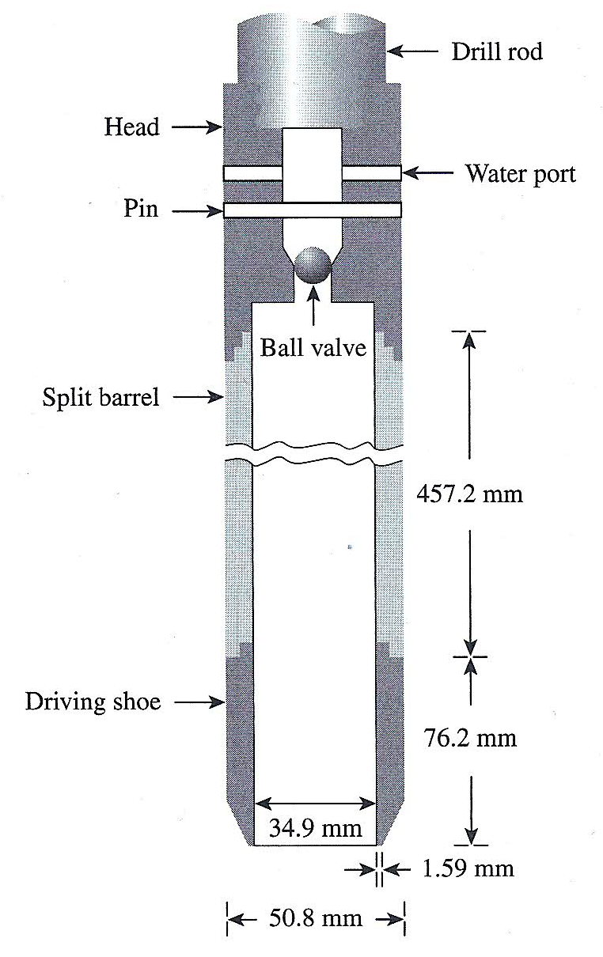
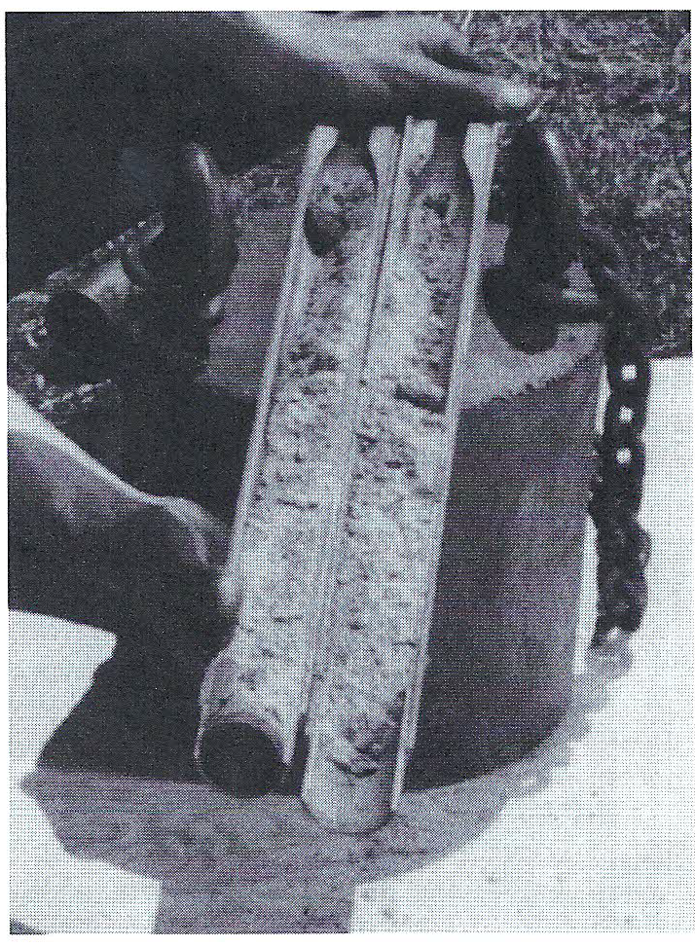
Diagram of standard split spoon sampler (Das, 2010)
Unassembled split spoon sampler (Das, 2010)
Site Investigation by Dr. Amizatulhani Abdullah

Slide 16
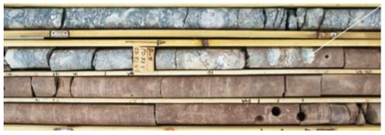
Rock coring
Diamond or tungsten-carbide tooth bit.
Rock Quality Designation (RQD)
Defines the fraction of solid core recovered greater than 4 inches in length.
Calculated as the ratio of the sum of length of core fragments greater than 4 inches to the total drilled footage per run, expressed as a percentage.
Source : Wan Zuhairi, W. Y (2014)
Site Investigation by Dr. Amizatulhani Abdullah

Slide 17
RQD | Rock Quality Classification
< 25% | Very poor
25 - 49% | Poor
50 - 74% | Fair
75 - 89% | Good
90 - 100% | Excellent
Site Investigation by Dr. Amizatulhani Abdullah

Slide 18
In-situ tests
Standard Penetration test – SPT
Cone Penetration Test – CPT
Vane Shear Test
Groundwater Observations
Mackintosh Probe Test
Site Investigation by Dr. Amizatulhani Abdullah

Slide 19
Standard penetration test (SPT)
65 kg Hammer.
(76 cm) free fall.
Drive sampler over 150 mm.
Record no. of blows per each 75 mm penetration.
SPT N value = summed the last four successive of 75 mm increment.
If the resistance is very high, the 2nd stage is discontinued at 50 blows even if the total penetration is less than 450 mm.
Site Investigation by Dr. Amizatulhani Abdullah

Slide 20
SPT result
CLAYEY SOIL
GRANULAR SOIL
Behavior | ‘N’ SPT Value
Very Soft | <2
Soft | 2-4
Firm | 4-8
Stiff | 8-15
Very stiff | >15
Behavior | SPT Value
Very Loose | <4
Loose | 4-10
Quite Dense | 10-30
Dense | 30-50
Very Dense | >50
Site Investigation by Dr. Amizatulhani Abdullah

Slide 21
Cone penetration test (CPT)
Originally Developed in Netherlands 1930s.
Further developments in 1950s.
Also known as “Dutch Cone”
ASTM D3441
Types of CPT devices
mechanical cone
electric cone
piezocone
Site Investigation by Dr. Amizatulhani Abdullah

Slide 22
Vane shear test
Originally developed by Swedish Engineer, John Olsson in 1920s.
Now Standardized as ASTM D2573.
Specially suited for soft, sensitive clays.
Quick test, used to determine undrained shear strength.
Site Investigation by Dr. Amizatulhani Abdullah

Slide 23
TEST PROCEDURE
This test is used to determine shear strength of cohesive soils.
Normally done in-situ on a soft clayey soil (cohesive soil).
The vane is pushed into the soil.
Torque,T is applied at the top of the torque rod to rotate the vane at a uniform speed.
A cylinder of soil (height h & diameter d) will resist the torque until the soil fails.
where β = coefficient of shear strength mobilization at the end of soil cylinder.
= 1/2 @ 2/3 @ 3/5
Site Investigation by Dr. Amizatulhani Abdullah

Slide 24
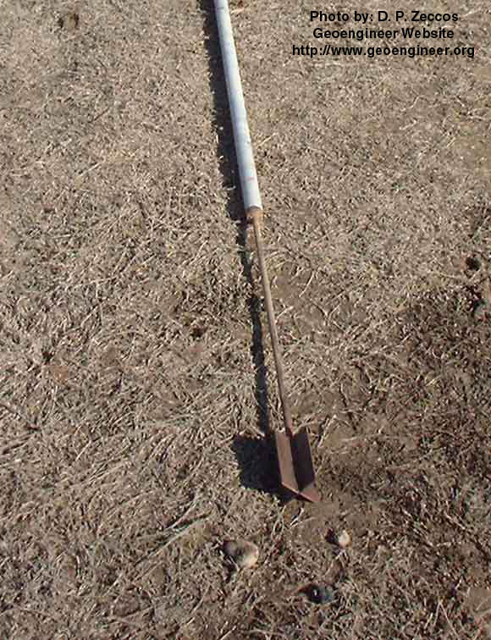
Procedures:
Drill test hole
Insert vane
Rotate head
Measure torque
Relate resistance to soil shear strength
Site Investigation by Dr. Amizatulhani Abdullah
Notes:
http://www.geotechdata.info/geotest/vane-shear-test.html
https://youtu.be/5AXm6NdoXfw

Slide 25
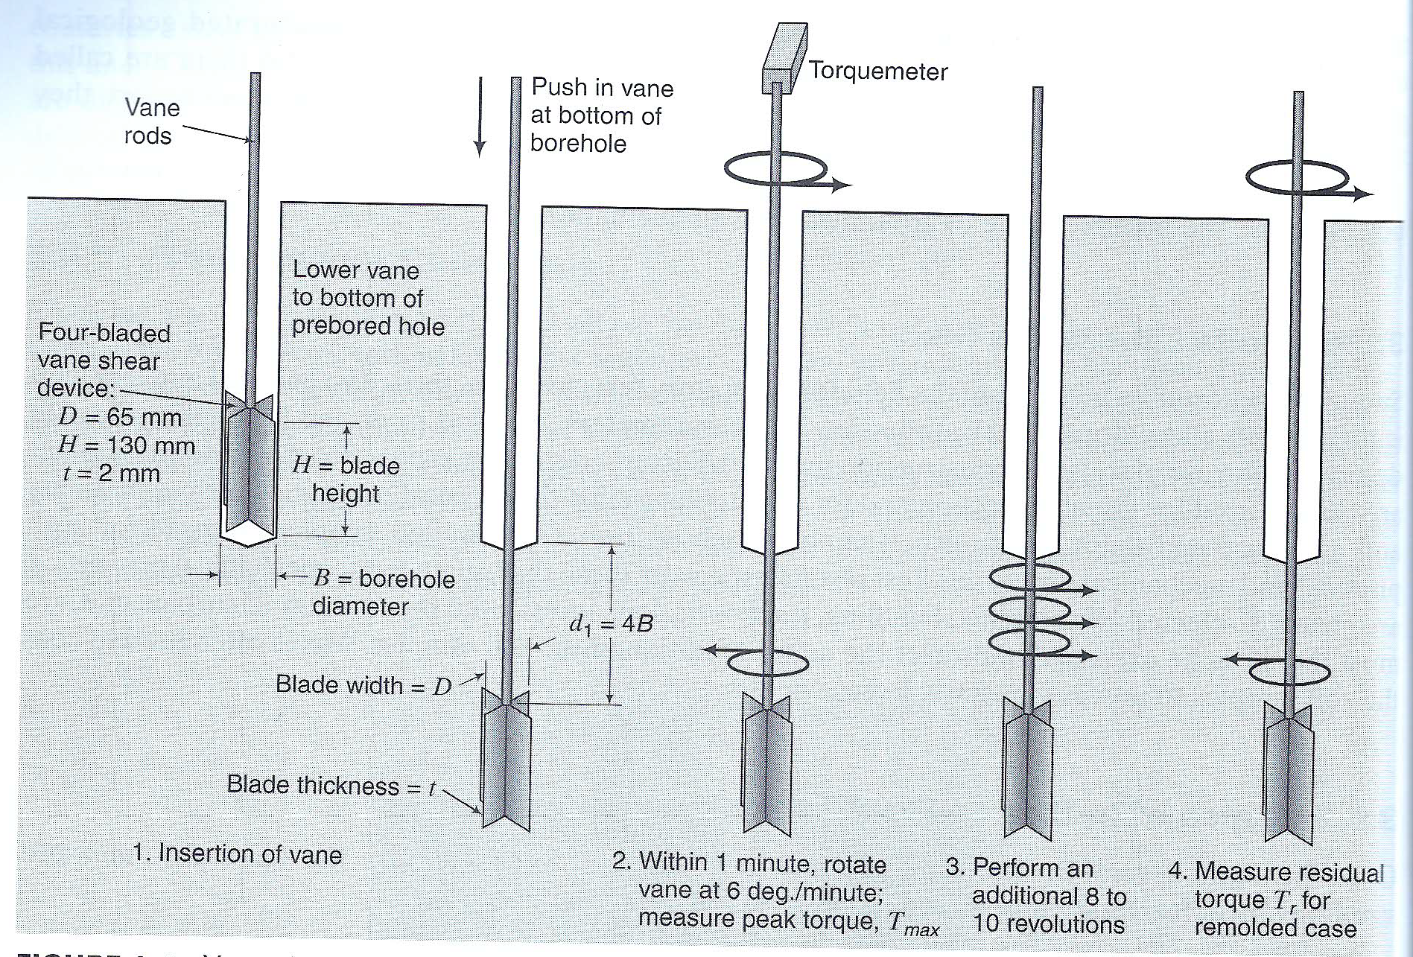
Vane shear tester (Budhu, 2010)
Site Investigation by Dr. Amizatulhani Abdullah

Slide 26
Groundwater observations
GW condition is an important factor to observe for design and construction e.g. deep excavation, deep foundation, slope stability analysis & etc:
Groundwater level must be determined during site investigation works.
Measure at time of drilling and later (24 hrs, 1 week, etc.).
Can be accomplished by make observations in borehole & existing.
Or, install a piezometer.
Monitor Wells & Sampling.
Permeability Tests.
Site Investigation by Dr. Amizatulhani Abdullah

Slide 27
Site Investigation by Dr. Amizatulhani Abdullah

Slide 28
Laboratory tests
COMMON LAB TESTS
Moisture content
Unit weight
Sieve analysis
Atterberg limits
Compaction
Permeability
Hydraulic conductivity
Consolidation
Direct shear
Triaxial shear
Unconfined compression
Site Investigation by Dr. Amizatulhani Abdullah

Slide 29
Data presentation and report
The interpretation and analysis were done based on the method used for analysis.
Bore log information (drilling & sampling depths & methods, field test data, drilling notes, soil appearance, stratification and etc.)
Content of report (introduction, site description, site geology, soil conditions, discussion, appendices and etc.)
Site Investigation by Dr. Amizatulhani Abdullah

Slide 30
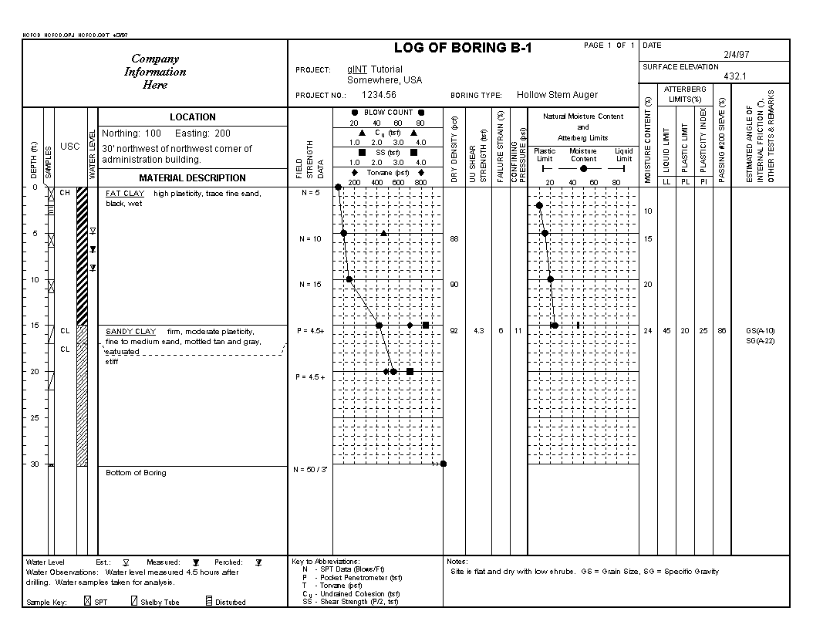
FAKULTI KEJURUTERAAN AWAM & SUMBER ALAM , UNIVERSITI MALAYSIA PAHANG
Site Investigation by Dr. Amizatulhani Abdullah

Slide 31
Content of SI report
Introduction – brief summary of proposed works, investigation conducted, site location, timescale of the work, key personnel.
Site Description – Topography, main surface features, detail access, site history, site maps, pre-existing works / underground openings.
Site Geology – Overall geology, specific area geology, main soil & rock formation/structures.
Soil Conditions – detailed account of the conditions encountered (in relation to the proposed works), description of all strata, results of laboratory and in situ tests, detail of groundwater conditions.
Discussion – Comments on validity and reliability of the information presented, further work (if required). Definition of appropriate design parameters and methods of both design and construction (interpretative report)
Appendices – borehole logs, laboratory test results, in situ tests, geophysical survey records, references, literature extracts
Site Investigation by Dr. Amizatulhani Abdullah

Slide 32
Conclusion
Conclusion #1
Site investigation is crucial to be conducted prior to any construction. It gives a rough idea on what the engineers are dealing with. Proper countermeasures to problems can be drawn if the problems are able to be detected earlier.
Conclusion #2
A good site investigation plan and execution is able to balance the total cost of a project.
Conclusion #3
Site investigation phases are consists of desk study, walk over survey, sub surface exploration, in situ and laboratory testing as well as report prepartion.
Site Investigation by Dr. Amizatulhani Abdullah

Slide 33
Author Information Dr. Amizatulhani Abdullah Dr. Mohd Yuhyi Mohd Tadza Dr. Youventharan Duraisamy Dr. Muzamir Hasan Ir. Azhani Zukri

