Slide 1
Digital Electronics Logic Gates and Boolean Algebra Part 2
by
Norazian Subari
Fakulti Kejuruteraan Elektrik & Elektronik aziansubari@ump.edu.my

Slide 2
Chapter Description
Expected Outcomes
At the end of this topic, students should be able to:
Apply DeMorgan’s theorems to simplify logic expressions.
Use NAND or NOR gates to perform OR, AND and NOT operations.
Utilize alternate logic symbols in addition to the standard symbols.
Understand the basic concepts of IC Logic.

Slide 3
Topics
DeMorgan’s theorems
Universality of NAND gate, NOR gates
Alternative logic-gate representations
Basic Characteristics of IC Logic.

Slide 4
DeMorgan’s Theorem
Useful in simplifying expressions that included inversions
The purpose is to reduce the number of gates required in a logic circuit

Slide 5
DeMorgan’s First Theorem
The complement of a product of variables is equal to the sum of the complements of the variables
or
The complement of two or more ANDed variables is equivalent to the OR of the complements of the individual variables
XY = X + Y

Slide 6
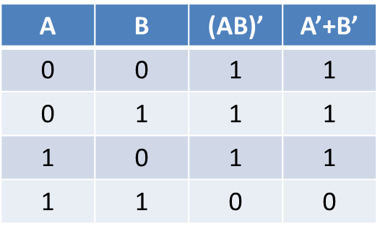
DeMorgan’s First Theorem

Slide 7
DeMorgan’s Second Theorem
The complement of a sum of variables is equal to the product of the complements of the variables
or
The complement of two or more Ored variables is equivalent to the AND of the complements of the individual variables
X + Y = XY

Slide 8
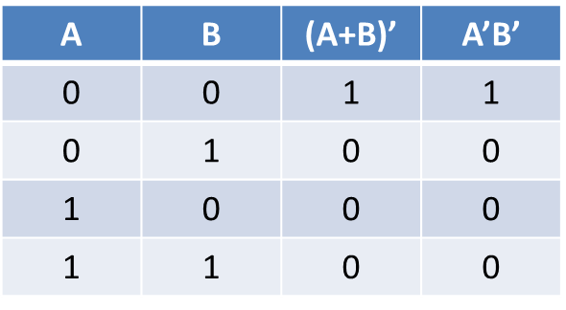
DeMorgan’s Second Theorem

Slide 9
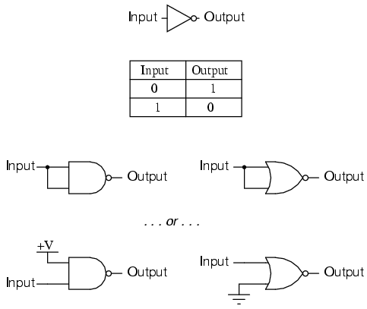
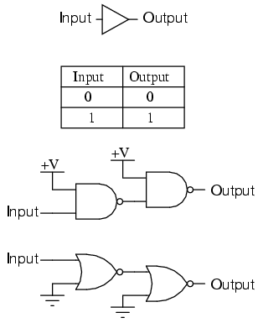
Universality of NAND and NOR gates
NAND and NOR gates can be used to perform each of Boolean operation OR, AND, NOT

Slide 10
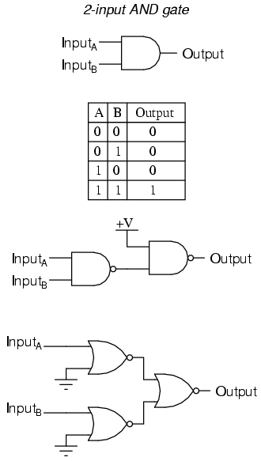
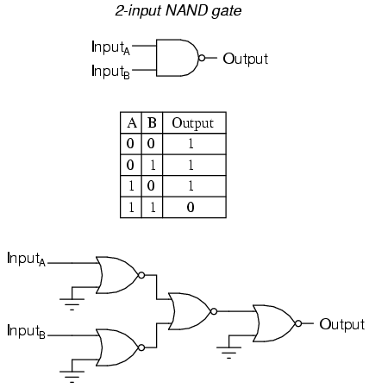

Slide 11
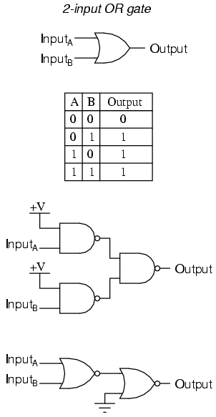
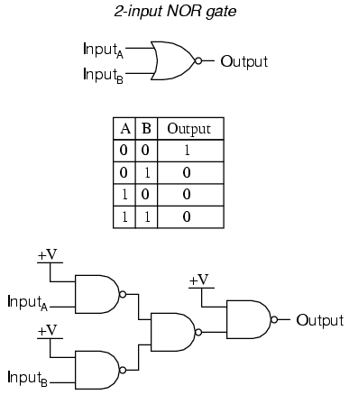

Slide 12
ALTERNATE LOGIC GATE REPRESENTATIONS

Slide 13
Logic symbol Interpretation

Slide 14
Basic Concept Logic
Fan in, fan out
Delay
Skew
Noise margin
Rising, falling time

Slide 15
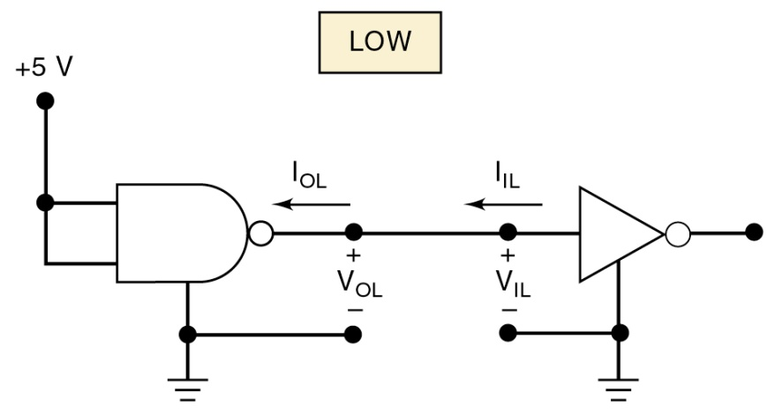
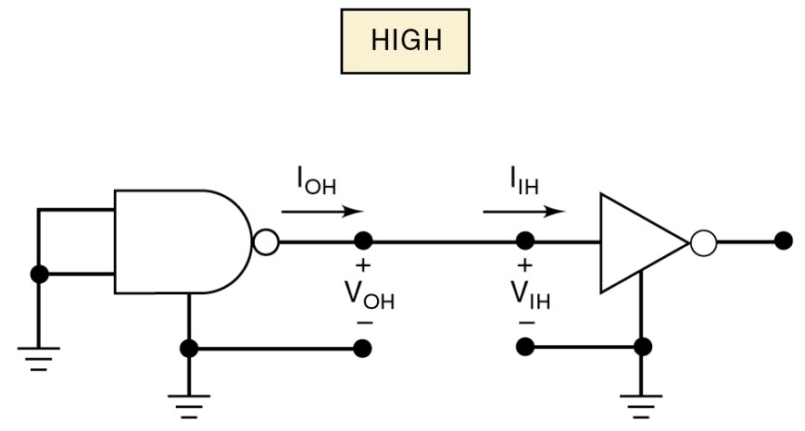
Digital IC Terminology

Slide 16
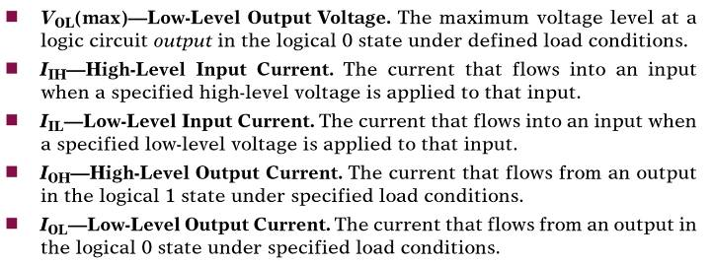
Digital IC Terminology

Slide 17
Fan-Out
A logic-circuit output is generally required to drive several logic inputs.
Sometimes all ICs are from the same logic family.
But many systems have a mix of various logic families.
The fan-out—loading factor—is the maximum number of logic inputs an output can drive reliably.

Slide 18
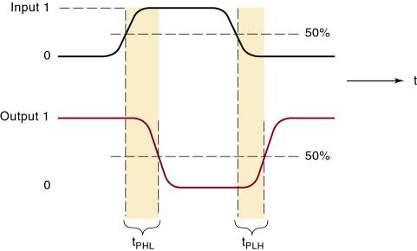
Delay
A logic signal always experiences a delay going through a circuit.
The two propagation delay times are defined as:
Propagation
delays.

Slide 19
Clock Skew
Timing problem in sequential circuit
When a clock signal, because of propagation delays, arrives at the CLK inputs of different FFs at different times.
In many situations, the skew can cause a FF to go to wrong state.

Slide 21
Noise Margin
Stray electric/magnetic fields can induce voltages on the connecting wires between logic circuits
Called noise, these unwanted, spurious signals can sometimes cause unpredictable operation.

Slide 22
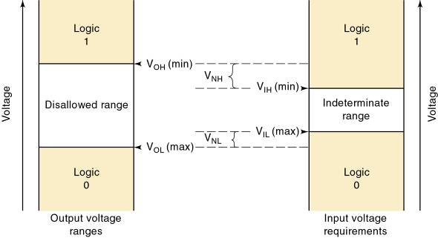
Noise Margin (cont.)
Noise immunity refers to the circuit’s ability to tolerate noise without changes in output voltage.
A quantitative measure is called noise margin.
High-state noise margin:
Low-state noise margin:

Slide 23
Noise Margin - Invalid Voltage
For proper operation, logic circuit input voltage levels must be kept out of the indeterminate range.
Lower than V_{IL}(max) or higher than V_{IH} (min).
Invalid voltage will produce unpredictable output.
It is important to know valid voltage ranges for the logic family being used so invalid conditions can be recognized when testing or troubleshooting.
Logic families can be described by how current flows between the output of one logic circuit and the input of another.

Slide 24
Raising, Falling Time
 | 74 | 74S | 74LS | 74AS | 74ALS | 74F
Performance rating
Propagation delay (ns) | 9 | 3 | 9.5 | 1.7 | 4 | 3
Power dissipation (mW) | 10 | 20 | 2 | 8 | 1.2 | 6
Max. clock rate (MHz) | 35 | 125 | 45 | 200 | 70 | 100
Fan-out (same series) | 10 | 20 | 20 | 40 | 20 | 33
Voltage parameters
V_{OH}(min) (V) | 2.4 | 2.7 | 2.7 | 2.5 | 2.5 | 2.5
V_{OL}(max) (V) | 0.4 | 0.5 | 0.5 | 0.5 | 0.5 | 0.5
V_{IH}(min) (V) | 2.0 | 2.0 | 2.0 | 2.0 | 2.0 | 2.0
V_{IL}(max) (V) | 0.8 | 0.8 | 0.8 | 0.8 | 0.8 | 0.8

Slide 25
References
T. Floyd, “Digital Fundamental”, 10th Ed., USA : Prentice-Hall, 2008.
R.J. Tocci, “Digital Systems: Principles and Applications”, 10th Ed., USA : Prentice-Hall, 2006.

Slide 26
Norazian Subari Fakulti Kejuruteraan Elektrik & Elektronik Universiti Malaysia Pahang 26600 Pekan, Pahang, Malaysia http://fkee.ump.edu.my/index.php/en/staff-menu/articles-staff/1622-norazian-subari-main-profile

