Slide 1
BSK1133 PHYSICAL CHEMISTRY CHAPTER 4 REACTION MECHANISM (PART A)
For updated version, please click on
http://ocw.ump.edu.my
PREPARED BY:
DR. YUEN MEI LIAN AND DR. SITI NOOR HIDAYAH MUSTAPHA Faculty of Industrial Sciences & Technology yuenm@ump.edu.my and snhidayah@ump.edu.my

Slide 2
Description
Aims
To understand the mechanism of a chemical reaction.

Slide 3
Description
Expected Outcomes
Able to understand the mechanism of a chemical reaction.
References
Atkins, P & Julio, D. P. (2006).Physical Chemistry (8th ed.). New York: Oxford.
Chang, R. (2005).Chemistry (8th ed.). New York: McGraw Hill.
Atkins, P & Julio, D. P. (2012). Elements of Physical Chemistry
(sixth ed.). Freeman, Oxford.
Silbey, R. J., Alberty, A. A., & Bawendi, M. G. (2005). Physical Chemistry. New York: John Wiley & Sons.
Mortimer R. G. (2008) Physical Chemistry, Third Edition , Elsevier Academic press, USA.

Slide 4
Contents
4.1 Theory of Chemical Kinetic
4.2 Reaction Rate
4.3 Rate Law and Reaction Order
4.4 Integrated Rate Law
4.5 Half-life
Conclusion

Slide 5
4.1 Theory of Chemical Kinetic

Slide 6
Chemical Kinetics
Chemical kinetics is concern about the speeds or rates of a chemical reactions to be occurred .
Theories of Chemical Kinetics:
1. Collision Theory
2. Transition State Theory

Slide 7
4.1.1 Collision Theory
Collision frequency is the rate of reaction of a chemical process is directly proportional to the number of molecular collisions per unit time.
When the reacting molecules colliding with one another, only a fraction of the collisions will lead to chemical reaction.
There are two types of collision:
1) Effective collision (reaction occur)
2) Ineffective collision (no reaction will occur)

Slide 8
Effective Collision:
The molecular collision can be effective when:
The reactant molecules have sufficient energy (moving energetically).
Activation Energy (E_{a})- lowest energy that the molecules must bring to their collisions for a chemical reaction to occur.
2. The collision between molecules are oriented correctly
(to allow collision)
Proper Orientation of Molecules

Slide 9
4.1.2 Transition State Theory
Transition state theory explaining the temporary state that species occur after a reaction of substance and before forming a product.
It called an activated complex.

Slide 10
Activated Complex
Activated complex is a transition state that appears between the reactants and the products.
At this transition state, breaking of chemical bonds of the reactant is in the progress before forming the product.
At this transition state, the molecule species are very unstable and have high potential energy.

Slide 11
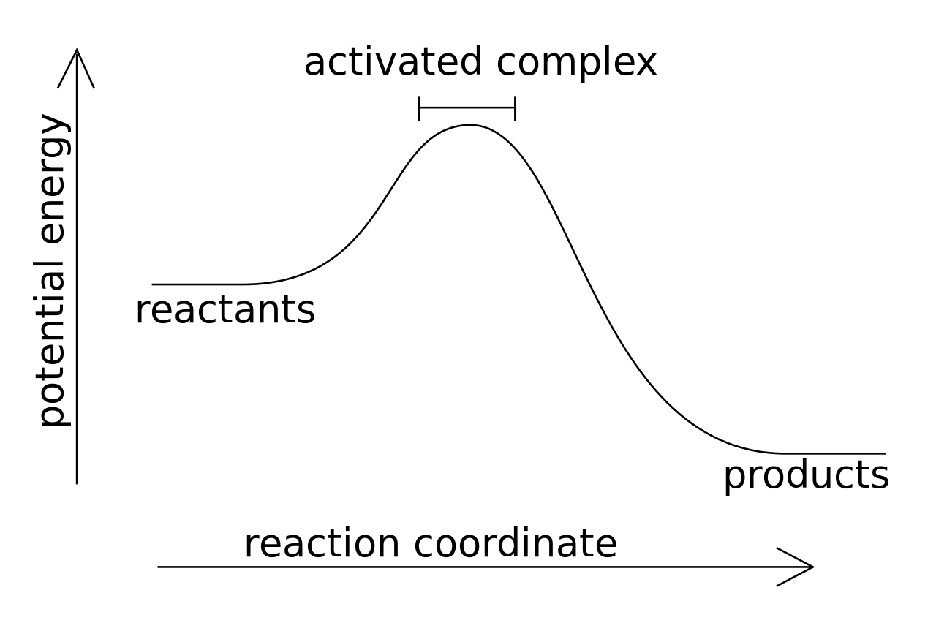
Reaction Rates
Source: Wikipedia

Slide 12
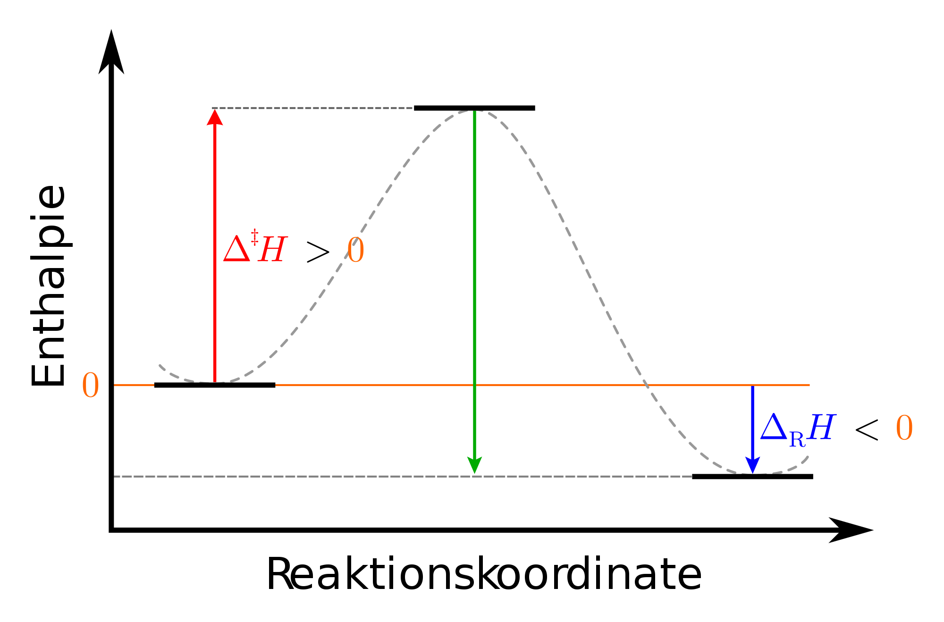
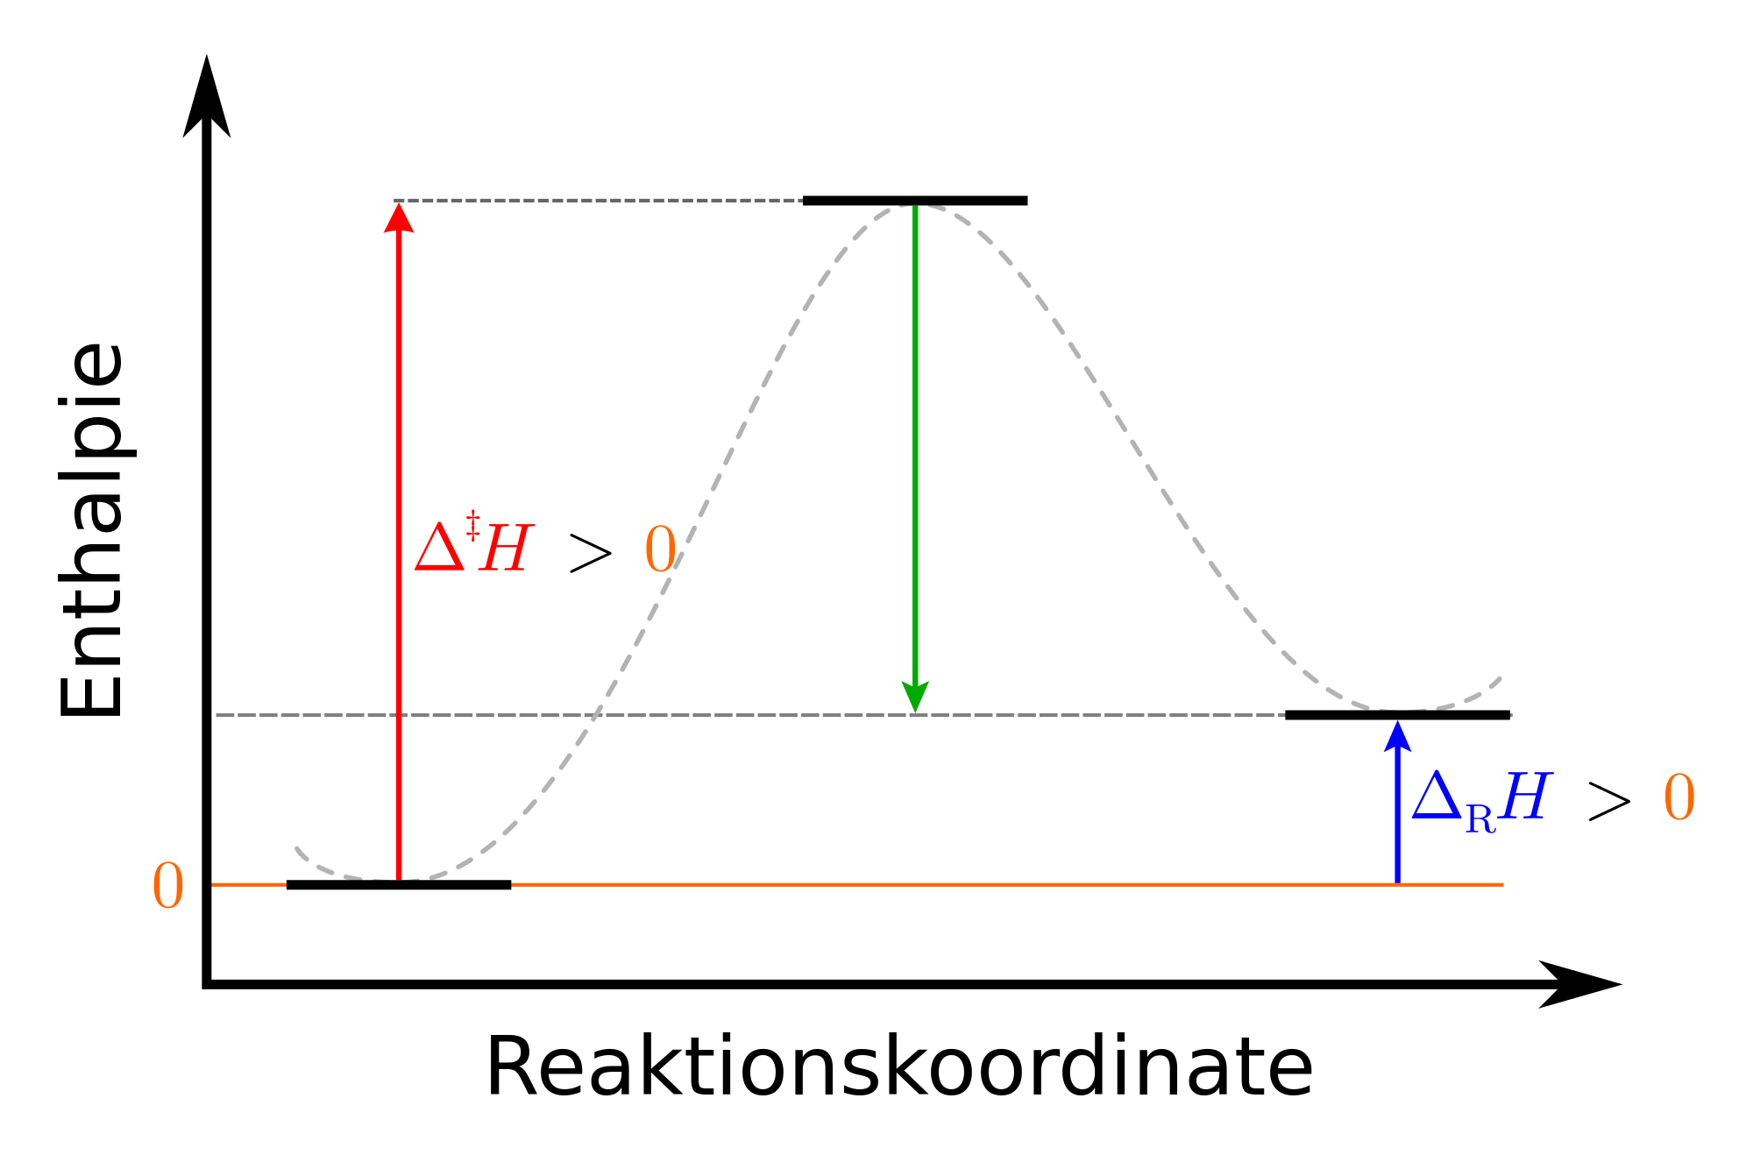
Reaction Rates
Exothermic Reaction
Endothermic Reaction
Source: Wikimedia commons

Slide 13
4.2 Reaction Rate

Slide 14
Reaction rate is the speed of the reaction process.
it can be indicates through the decreasing in the reactant concentration or the increasing in the product formation with time
Reaction rate is concentration change divided by time change
Reaction rate =
Changes!
Final minus initial
Δ[X] = [X]_{final} – [X]_{initial}
Δt = t_{final} – t_{initial}
Concentration normally in molality (mol⋅L⁻¹)
This means that reaction rate has units mol⋅L⁻¹⋅s⁻¹

Slide 15
The reaction rate can be indicate by:
increase in the concentration of a product over time, or
decrease in the concentration of a reactant over time.
A + B → C + D
Reaction rate is always a positive value

Slide 16
Reaction Rates
In general for
aA + bB → cC + dD

Slide 17
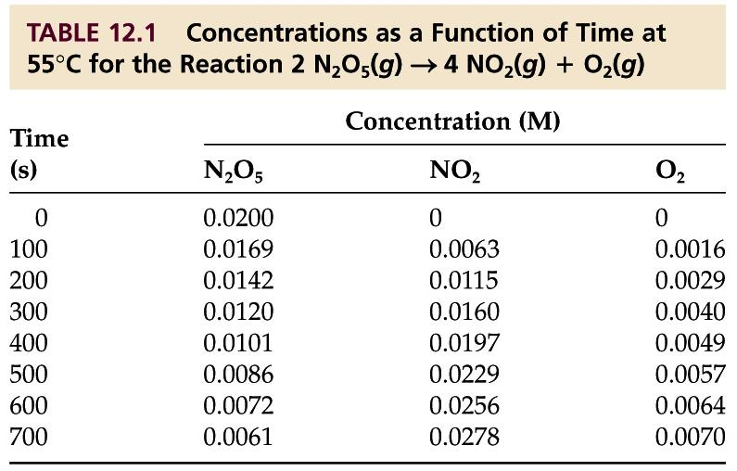
2 N₂O₅ (g) → 4 NO₂ (g) + O₂ (g)

Slide 18
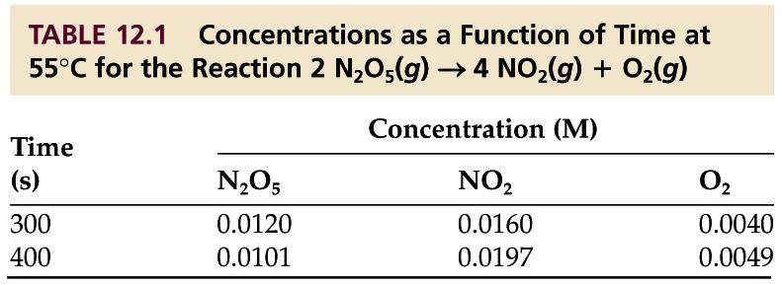
2 N₂O₅ (g) → 4 NO₂ (g) + O₂ (g)
Between 300 and 400 seconds:
Be Careful!
Rate of decomposition of N₂O₅ =
- Δ[N₂O₅] / Δt =
- (0.0101 mol⋅L⁻¹ – 0.0120 mol⋅L⁻¹) / (400 s – 300 s)
= 1.9 x 10⁻⁵ mol⋅(L·s)⁻¹

Slide 19
2 N₂O₅ (g) → 4 NO₂ (g) + O₂ (g)
Between 300 and 400 seconds:
Be Careful!
Rate of formation of NO₂ =
+ Δ[NO₂] / Δt =
+ (0.0197 mol⋅L⁻¹ – 0.0160 mol⋅L⁻¹) / (400 s – 300 s)
= 3.7 x 10⁻⁵ mol⋅(L·s)⁻¹

Slide 20
2 N₂O₅ (g) → 4 NO₂ (g) + O₂ (g)
Between 300 and 400 seconds:
Be Careful!
Rate of formation of O₂ =
+ Δ[O₂] / Δt =
+ (0.0049 mol⋅L⁻¹ – 0.0040 mol⋅L⁻¹) / (400 s – 300 s)
= 9 x 10⁻⁶ mol⋅(L·s)⁻¹

Slide 21
2 N₂O₅ (g) → 4 NO₂ (g) + O₂ (g)
The three values for rate that we calculated are not the same!
Why?
We have different molar amounts.
But the relative rates ARE THE SAME!

Slide 22
2 N₂O₅ (g) → 4 NO₂ (g) + O₂ (g)
The relative rate of formation of O₂ is
(1/1) 9 x 10⁻⁶ mol⋅(L·s)⁻¹ = 9 x 10⁻⁶ mol⋅(L·s)⁻¹
The relative rate of formation of NO₂ is
(1/4) 3.7 x 10⁻⁵ mol⋅(L·s)⁻¹ = 9.25 x 10⁻⁶ mol⋅(L·s)⁻¹
The relative rate of decomposition of N₂O₅ is
(1/2) 1.9 x 10⁻⁵ mol⋅(L·s)⁻¹ = 9.5 x 10⁻⁶ mol⋅(L·s)⁻¹

Slide 23
4.3 Rate Law and Reaction Order

Slide 24
Rate Laws:
Rate law is the equation that showing the relationship of reaction rate and concentrations of the reactants.

Slide 25
aA + bB → products
Rate = k [A]^{m}[B]^{n}
k is the rate constant
m and n is the reaction order
# remember, it is not stoichiometry coefficient.
The overall reaction order is m + n

Slide 26
Reaction order example
rate = k [C]²[D]
The reaction order with respect to C is 2
or the reaction is second order in C
The reaction order with respect to D is 1
or the reaction is first order in D
The overall reaction order is 3 (2 + 1 = 3)
or the reaction is third order overall

Slide 27
4.3.1 Experimental Determination of a Rate Law
Reaction rate laws can only be determined experimentally!
In defining the rate law, a series of experiments need to carried out by:
Measuring the initial rate of the reaction as function of different initial concentrations of the reactants

Slide 28
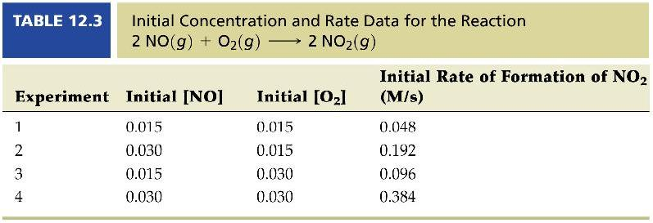
Method of initial rates
If you see a table like this with chemical concentrations or pressures and rate data, chances are good the question is a method of initial rates problem.

Slide 29
2 NO (g) + O₂ (g) → 2NO₂ (g)
General rate law:
rate = k [NO]^{m}[O₂]^{n}

Slide 30
Method of initial rates
Method to calculate the order of reaction:
Choose a pair of reactions where only one reactant concentration changes.
In this case, experiments 1 and 2 is being selected.

Slide 31
rate = k [NO]^{m}[O₂]^{n}
k is the rate constant. Thus, the value is constant through out the reaction
(k for experiment 1 = k for experiment 2)
k = rate / [NO]^{m}[O₂]^{n}

Slide 32
Reaction order w.r.t. NO

Slide 33
Reaction order w.r.t. O₂

Slide 34
Our rate law
rate = k [NO]²[O₂]¹

Slide 35
Using data from experiment 1, the rate constant calculated as follows:
k = rate / [NO]²[O₂]¹

Slide 36
Using data from experiment 2, the rate constant calculated as follows:
k = rate / [NO]²[O₂]¹
The rate constant is the same, as it should be!

Slide 37
Check using extra experiment
rate = (1.42 x 10⁴ M⁻²⋅s⁻¹) [NO]²[O₂]¹
The rate value of the rate of reaction using rate law equation should same (within rounding errors) for each experimental concentration data.

Slide 38
Units of rate constants
Be Careful!
Unit for rate constant k, is depends on its overall reaction order as follows

Slide 39
4.4 Integrated Rate Law

Slide 40
Integrating the rate law of first order given as:
[A]_{t}
[A]₀
ln
= −kt
where
[A]₀ is the initial concentration of A.
[A]_{t} is the concentration of A at time, t.
t is the time of reaction process

Slide 41
Integrated Rate Laws
From the integrated rate law (1st order) equation:
[A]_{t}
[A]₀
ln
= −kt
ln [A]_{t} − ln [A]₀ = − kt
ln [A]_{t} = − kt + ln [A]₀
Could be graphically identify the important parameters
y = mx + b

Slide 42
First-Order Processes
Concentration can be also being indicated by using pressure according to the theory of properties relationship.
When a graph of ln P vs time is plotted, a straight line results with negative slope.

Slide 43
Second-Order Processes
From the integrated rate law (2st order) equation:
1
[A]_{t}
1
[A]₀
= kt +
y = mx + b
Could be graphically identify the important parameters

Slide 44
Second-Order Processes
1
[A]_{t}
1
[A]₀
= kt +
When a graph of 1/[A] vs time is plotted, a straight line results with positive slope.

Slide 45
4.5 Half-life

Slide 46
Half-life is calculated based on the time.
Half-life is the time that the concentration of reactant is reduced to half of its initial concentration.
[A]_{t} = 0.5 [A]₀.
Source: Wikimedia Commons

Slide 47
The half life calculations for 1st order reaction as follows:
0.5 [A]₀
[A]₀
ln
= −kt_{1/2}
ln 0.5 = −kt_{1/2}
−0.693 = −kt_{1/2}
0.693
k
= t_{1/2}
NOTE: For a first-order process, the half-life does not depend on initial concentration, [A]₀.

Slide 48
For a 2nd order process:
1
0.5 [A]₀
1
[A]₀
= kt_{1/2} +
2
[A]₀
1
[A]₀
= kt_{1/2} +
2 − 1
[A]₀
1
[A]₀
=
= kt_{1/2}
NOTE: For a 2nd order is depending on initial concentration, [A]₀.
1
k[A]₀
= t_{1/2}

Slide 49
Conclusion
A chemical reaction goes through its mechanism
which depends on its order of reaction.
The value of certain parameters such as half life, reaction constant could be calculated using equation or graphic

Slide 50
AUTHOR INFORMATION
DR. YUEN MEI LIAN (SENIOR LECTURER)
INDUSTRIAL CHEMISTRY PROGRAMME FACULTY OF INDUSTRIAL SCIENCES & TECHNOLOGY UNIVERSITI MALAYSIA PAHANG yuenm@ump.edu.my
Tel. No. (Office): +609 549 2764
DR. SITI NOOR HIDAYAH MUSTAPHA (SENIOR LECTURER)
INDUSTRIAL CHEMISTRY PROGRAMME FACULTY OF INDUSTRIAL SCIENCES & TECHNOLOGY UNIVERSITI MALAYSIA PAHANG snhidayah@ump.edu.my
Tel. No. (Office): +609 549 2094

