Slide 1
Electric and Electronic Technology Chapter 4A – Magnetic Field and Transformer
by
Akhtar Razali FKM akhtar@ump.edu.my

Slide 2
Chapter Description
Aims
To understand the principle of magnetic field
To understand the principle element and working principle of a transformer
Expected Outcomes
Students able to understand how magnetic field works, its application and other related analysis
Students able to understand how transformer works, its application
Other related Information
One question for final exam is from this topic
No other relevant information be disclosed
References
Rizzoni G., 2004, Principles and Applications of Electrical Engineering, Revised Fourth Edition, Fourth Edition, McGraw Hill
Hambley A.R., 2005, Electrical Engineering Principles and Applications, Third Edition, Pearson Prentice Hall

Slide 3
Contents
Working principle of generator and motor.
Principle element of a generator/motor, working principle and its application.

Slide 4
Faraday Effect
Faraday Effect
Basic Concepts
Voltage – V – Potential to Move Charge (volts)
Current – I – Charge Movement (amperes or amps)
Resistance – R – V = IxR (R in =ohms)
Power – P = IxV = I²xR (watts)

Slide 5
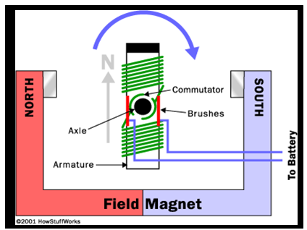
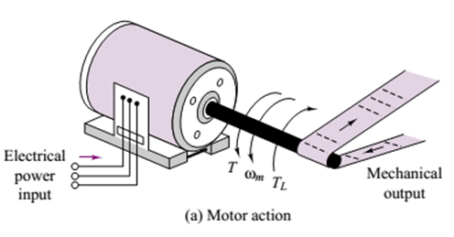
Electric Motor
Image source: howstuffworks.com and Rizzoni

Slide 6
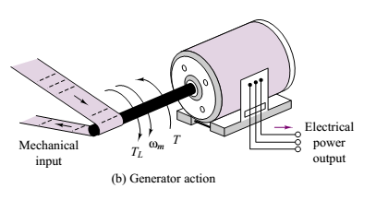
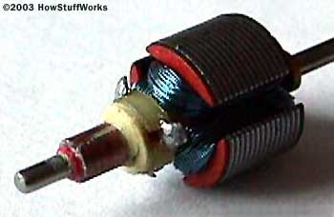
Electric Generator
Image source: howstuffworks.com and Rizzoni

Slide 7
Magnetic Force On A Current – Carrying Conductor
The magnetic force (F) the conductor experiences is equal to the product of its length (L) within the field, the current I in the conductor, the external magnetic field B and the sine of the angle between the conductor and the magnetic field. In short
F= BIL (sinθ)

Slide 8
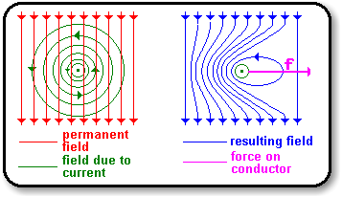
The force on a current-carrying conductor in a magnetic field
When a current-carrying conductor is placed in a magnetic field, there is an interaction between the magnetic field produced by the current and the permanent field, which leads to a force being experienced by the conductor:

Slide 10
Conclusion of The Chapter
Conclusion #1
Capacitor is used in many application that deal with steady current and voltage constant.
Conclusion #2
Series equivalent capacitance is identical to the way we calculate resistor on series.

Slide 11
Akhtar Razali FKM, UMP.

