Slide 1
GEOTECHNICAL ENGINEERING Slope Stability
For updated version, please click on
http://ocw.ump.edu.my
by
Dr. Amizatulhani Abdullah Faculty of Civil Engineering ad Earth Resources amizatulhani@ump.edu.my

Slide 2
Chapter description
Aims
This chapter provides further discussion and explanation related to stability of slope.
Expected Outcomes
Check and analyze the stability of slopes using various method of analysis and propose the best solution to the problem given.
References
Das, B.M., “Principles of Geotechnical Engineering, 5th edition”, Thomson Learning (2002).
Budhu, M., “Soil Mechanics and Foundations, 3rd edition”, John Wiley & Sons (2011).
Liu, C. & Evett, J.B., “Soils and Foundations, 7th edition”, Prentice Hall (2008).
Whitlow, R., “Basic Soil Mechanics”, Prentice Hall (2004).
Slope Stability by Dr. Amizatulhani Abdullah

Slide 3
Content
Introduction of the chapter
Mode of slope failure
Factors in considering method of slope stability analysis
Factor of safety
Infinite slope vs finite slope
Stability of infinite slopes
Conclusion
Slope Stability by Dr. Amizatulhani Abdullah

Slide 4
Introduction of the chapter
an exposed ground surface that stands at an angle with the horizontal surface.
whenever a mass of soil has an inclined surface, the potential for part of the soil mass to slide from a higher location to a lower one always exists.
Slope Stability by Dr. Amizatulhani Abdullah

Slide 5
Mode of slope failure
Fall.
Topple.
Slides : Rotational slides, Compound slides, Translational slides (planar).
Spread.
Flows .
Slope Stability by Dr. Amizatulhani Abdullah

Slide 6
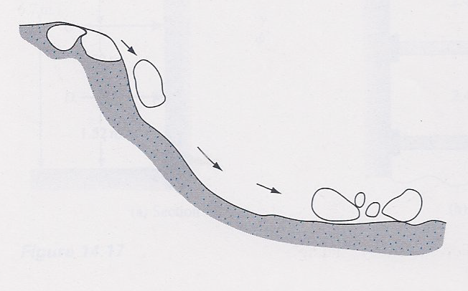
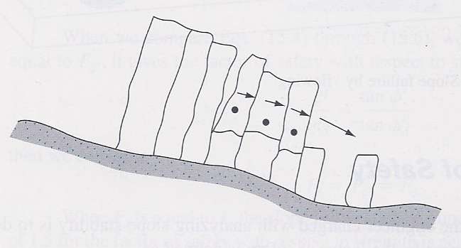
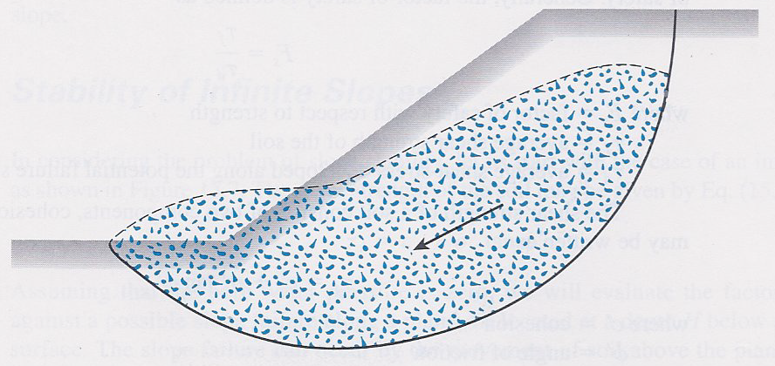
Fall
Toppling
Sliding
Slope failure (Das, 2010)
Slope Stability by Dr. Amizatulhani Abdullah

Slide 7
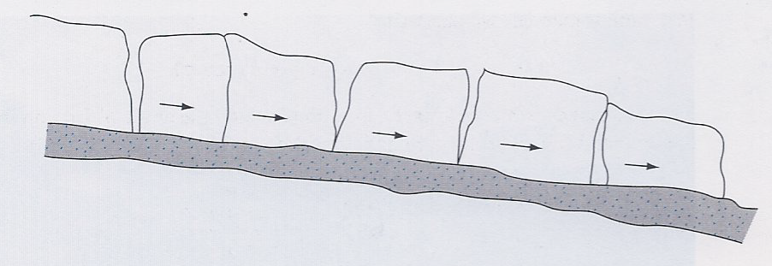
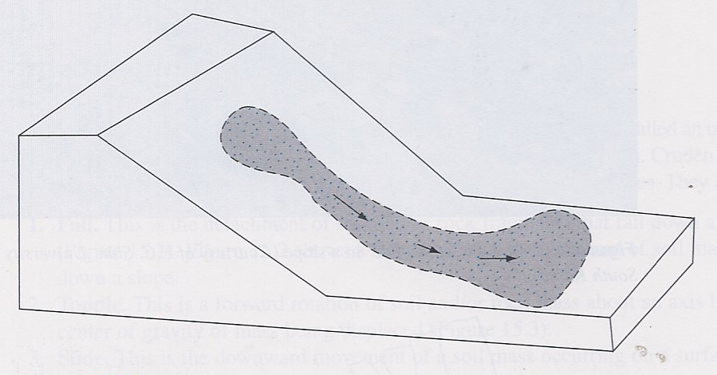
Spreading
Flowing
Slope failure (Das, 2010)
Slope Stability by Dr. Amizatulhani Abdullah

Slide 8
Factors in considering method of slope stability analysis
Types of soil.
Dimension and geometry of the slope (height and gradient).
Gravitational factor.
Pore water pressure.
Tension crack.
Types of analysis.
Vibration or earthquakes.
Slope Stability by Dr. Amizatulhani Abdullah

Slide 9
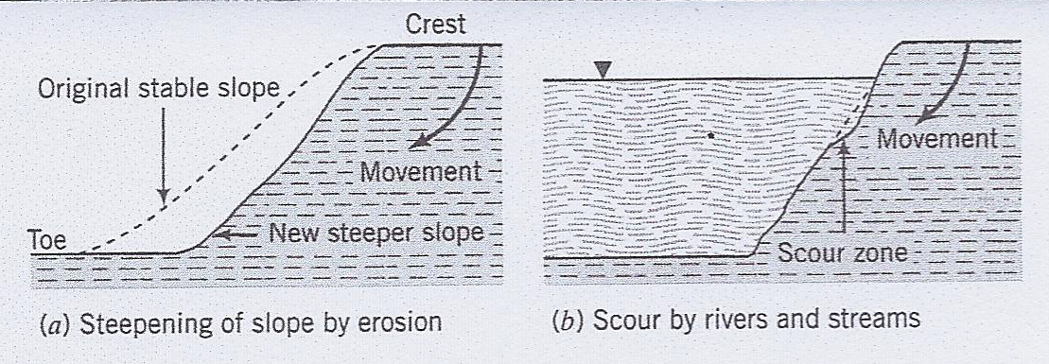
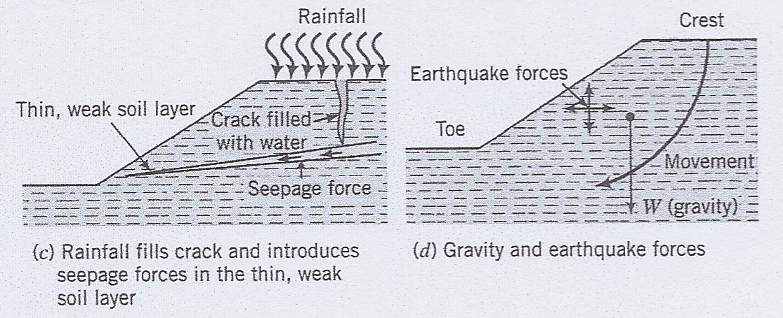
Causes of slope failure (Budhu, 2011)
Slope Stability by Dr. Amizatulhani Abdullah

Slide 10
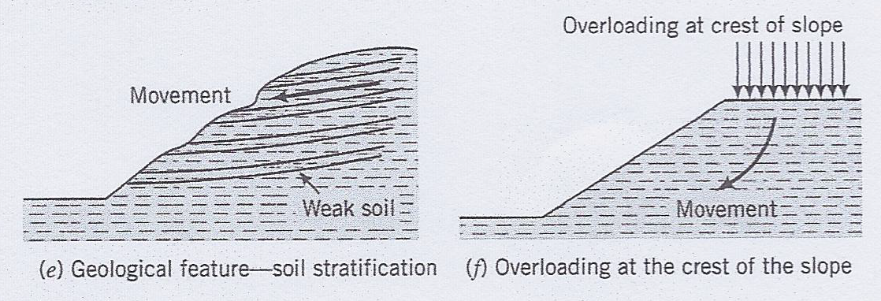
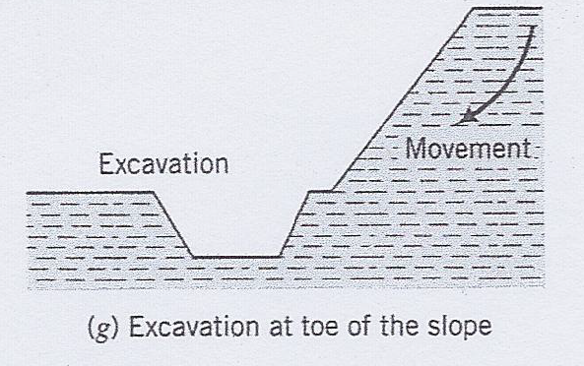
Causes of slope failure (Budhu, 2011)
Slope Stability by Dr. Amizatulhani Abdullah

Slide 11
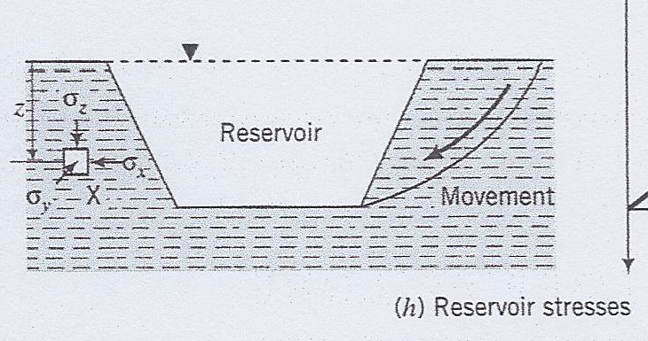
Causes of slope failure (Budhu, 2011)
Slope Stability by Dr. Amizatulhani Abdullah

Slide 12
Factor of safety
FOS = Available Shear Strength
Mobilizied Shear Strength
FOS can be expressed in several ways :
General.
With respect to cohesion.
With respect to friction.
Slope Stability by Dr. Amizatulhani Abdullah

Slide 13
General factor of safety
where :
F_{s} = factor of safety with respect to strength
τ_{f} = average shear strength of the soil
τ_{d} = average shear stress developed along the potential failure surface
Slope Stability by Dr. Amizatulhani Abdullah

Slide 14
Factor of safety with respect to cohesion
Factor of safety with respect to friction
Slope Stability by Dr. Amizatulhani Abdullah

Slide 15
Infinite slope vs finite slope
Infinite slope
Finite slope
Slope which have great extent with uniform soil conditions at any given depth below the surface.
The soil stratum is not necessary homogenous with depth but the strata of different soils are parallel to the slope surface.
Any slope with limited height.
Eg: slope of embankments, cuts etc.
Slope Stability by Dr. Amizatulhani Abdullah

Slide 16
Stability of infinite slopes
Stability without seepage
Slope Stability by Dr. Amizatulhani Abdullah

Slide 17
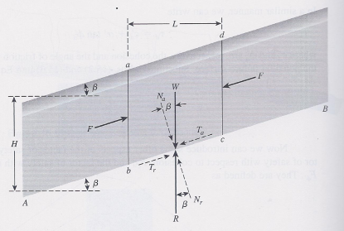
Stability with seepage
Infinite slope with steady state seepage (Das, 2002)
Slope Stability by Dr. Amizatulhani Abdullah

Slide 18
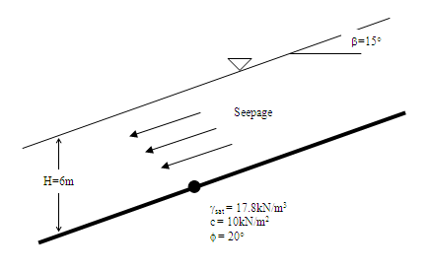
Work example 1
An infinite slope is shown below. There is ground water seepage and the ground water table coincides with the ground surface. Determine the factor of safety, F_{s}.
Slope Stability by Dr. Amizatulhani Abdullah

Slide 19
Conclusion
Conclusion #1
There are several types of slope failure mode (fall, topple, sliding, spread, flows).
Conclusion #2
Factor of safety can be calculated either in general condition, with respect to cohesion and with respect to friction.
Conclusion #3
In general, slope can be divided into two categories which are infinite slope and finite slope.
Conclusion #4
The factor of safety of infinite slope is depend on the seepage condition.
Slope Stability by Dr. Amizatulhani Abdullah

Slide 20
Author Information Dr. Amizatulhani Abdullah Dr. Mohd Yuhyi Mohd Tadza Dr. Youventharan Duraisamy Dr. Muzamir Hasan Ir. Azhani Zukri

