Slide 1
GEOTECHNICAL ENGINEERING Lateral Earth Pressure of Soil
For updated version, please click on
http://ocw.ump.edu.my
by
Dr. Amizatulhani Abdullah Faculty of Civil Engineering ad Earth Resources amizatulhani@ump.edu.my

Slide 2
Chapter description
Aims
This chapter provides further discussion and explanation related to lateral earth pressure in soil.
Expected Outcomes
Understand the concept of lateral pressure.
References
Das, B.M., “Principles of Geotechnical Engineering, 5th edition”, Thomson Learning (2002).
Raj, P.P., “Soil Mechanics & Foundation Engineering”, Prentice Hall (2008).
Liu, C. & Evett, J.B., “Soils and Foundations, 7th edition”, Prentice Hall (2008).
Whitlow, R., “Basic Soil Mechanics”, Prentice Hall (2004).
Lateral Earth Pressure of Soil by Dr. Amizatulhani Abdullah

Slide 3
Content
Introduction of the chapter
At rest lateral earth pressure
Active lateral earth pressure
Passive lateral earth pressure
Conclusion
Lateral Earth Pressure of Soil by Dr. Amizatulhani Abdullah

Slide 4
Introduction of the chapter
Lateral earth pressure estimation are crucial to structures such as retaining walls, sheet piles walls, buried pipes, basement walls, braced excavation, cofferdams and others.
There are 3 conditions of earth pressure that need to be consider ;
At rest pressure
Active pressure
Passive pressure
Lateral Earth Pressure of Soil by Dr. Amizatulhani Abdullah

Slide 5
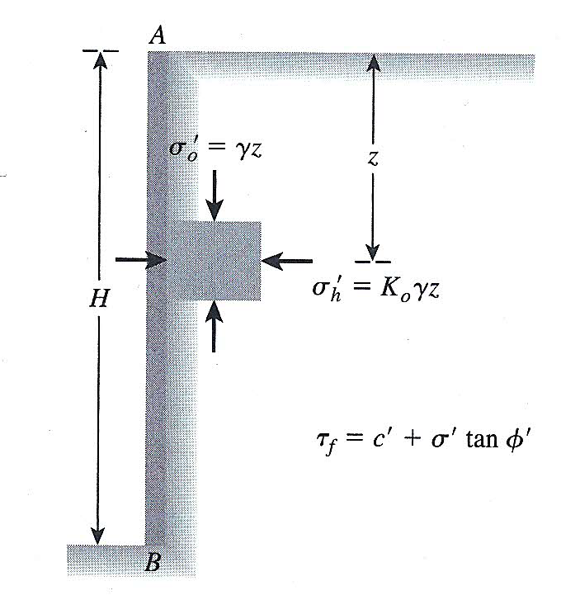
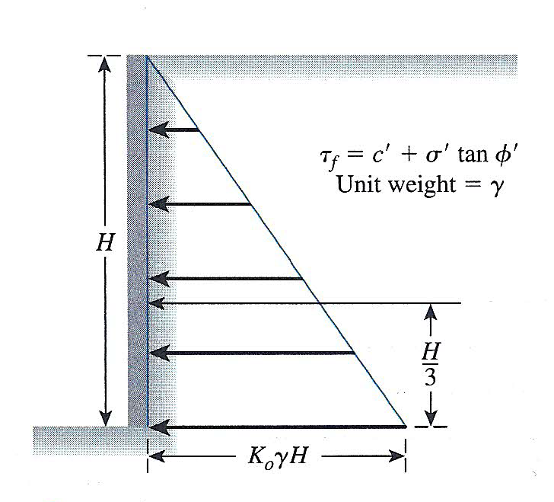
At-rest pressure
Earth pressure at rest (Das, 2002)
Distribution of lateral earth pressure at rest on a wall (Das, 2002)
At rest pressure happens if the wall is not moving either to left or to the right (static).
The soil mass in a state of static equilibrium.
Lateral Earth Pressure of Soil by Dr. Amizatulhani Abdullah

Slide 6
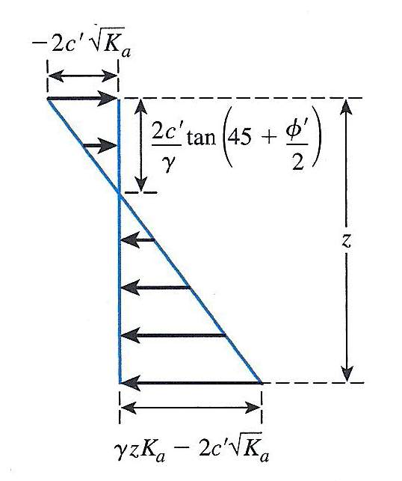
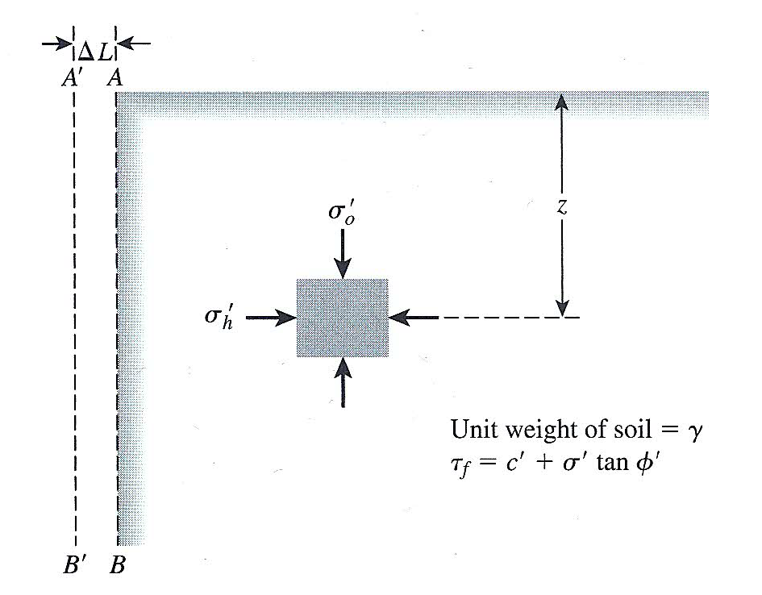
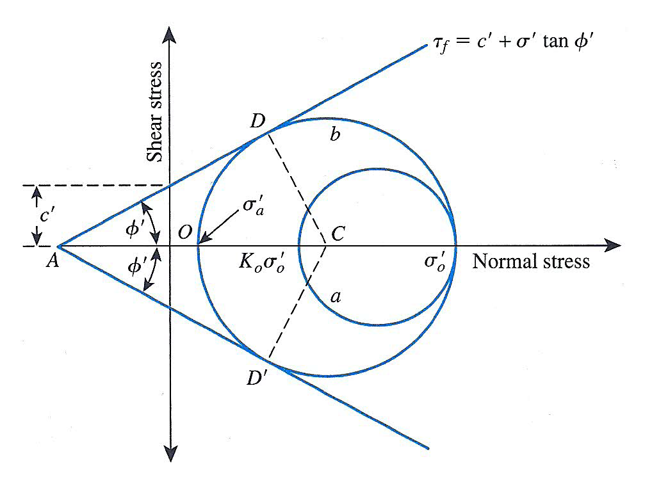
Active pressure
Active pressure (Das, 2002)
When the soil pushes on the structure and resulted to the movement of the wall (away from the soil), it is called as an ‘active earth pressure’ condition.
Lateral Earth Pressure of Soil by Dr. Amizatulhani Abdullah

Slide 7
As the structure moves away, it decreases the confining stress σ₃ = σ_{H} = p_{a}
The soil tend to experienced shear failure which resulted a sliding soil wedge that move forward and downward.
The earth pressure exerted on the wall and the failure at this state is known as active earth pressure, Pa.
Lateral Earth Pressure of Soil by Dr. Amizatulhani Abdullah

Slide 8
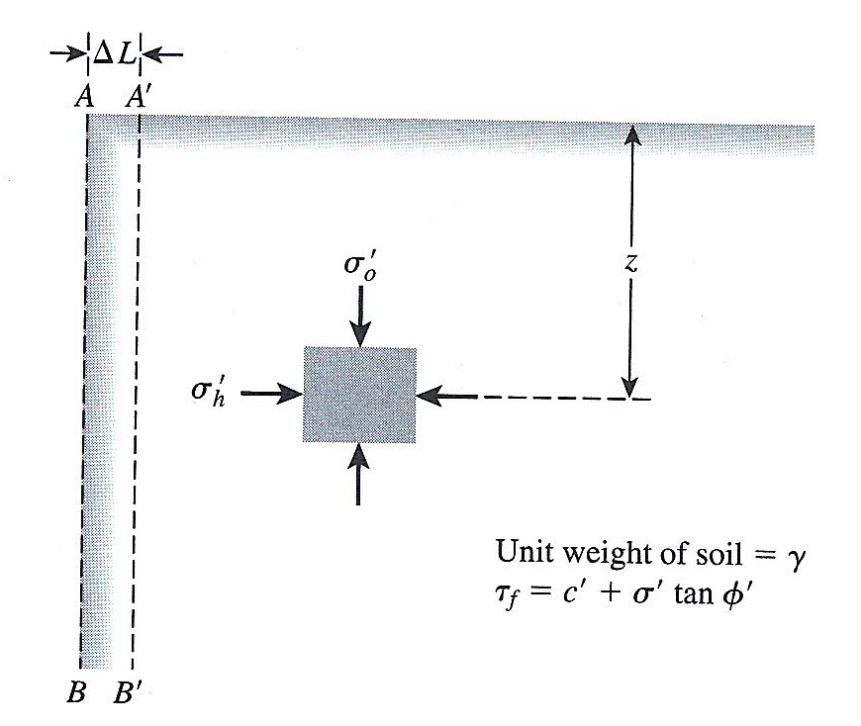
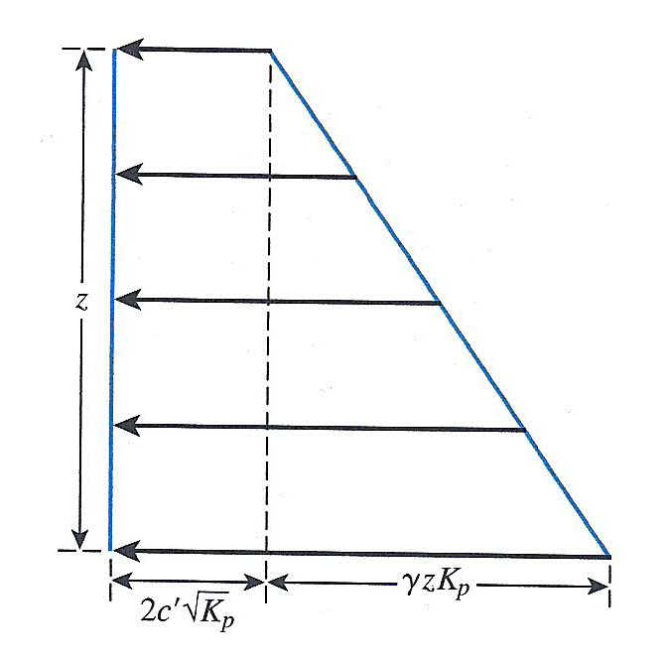
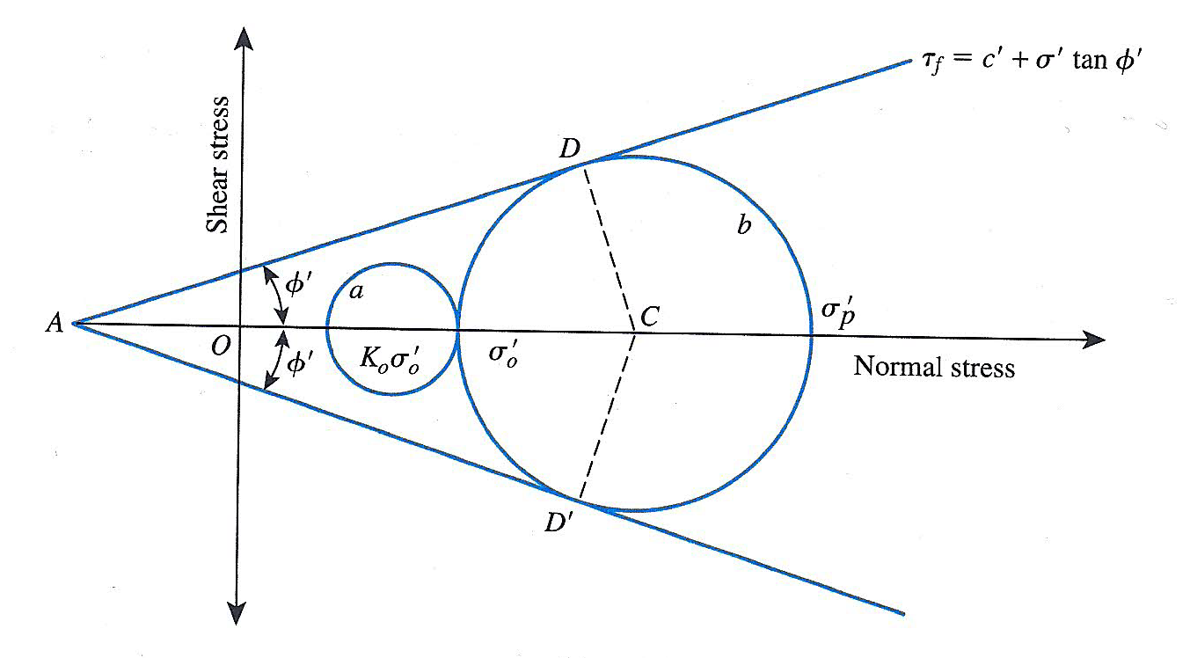
Passive pressure
Passive pressure (Das, 2002)
When the soil pushes on the structure and resulted to the movement of the wall (towards the soil), it is called as an ‘passive earth pressure’ condition.
Lateral Earth Pressure of Soil by Dr. Amizatulhani Abdullah

Slide 9
The soil tend to experienced shear failure which resulted a sliding soil wedge that move forward and upward.
The earth pressure exerted on the wall and the failure at this state is known as passive earth pressure, Pp.
Lateral Earth Pressure of Soil by Dr. Amizatulhani Abdullah

Slide 10
Conclusion
Conclusion #1
Lateral earth pressure can be classified into three conditions (at rest, active and passive).
Conclusion #2
Due to at rest lateral pressure, the retaining wall is in static condition (no movement of wall).
Conclusion #3
Due to active lateral pressure, the retaining wall moves away from soil.
Conclusion #4
Due to passive lateral pressure, the retaining wall moves towards soil.
Lateral Earth Pressure of Soil by Dr. Amizatulhani Abdullah

Slide 11
Author Information Dr. Amizatulhani Abdullah Dr. Mohd Yuhyi Mohd Tadza Dr. Youventharan Duraisamy Dr. Muzamir Hasan Ir. Azhani Zukri

