Slide 1
CHAPTER 1
INTRODUCTION
Synopsys
This chapter is intended to provide the know-how about injection molding related issues to student, with an improved understanding of the basics of injection molding. Although injection molding has been used since the 1930's, the operating personnel have generally learned the process from their supervisors, who either learned from their predecessors or gained the knowledge by "trial and error." The chapter will explore the elements of the molding process at the most basic level in the hope that it will contribute to the productivity and job satisfaction of those injection molding machine personnel. The residual benefit to the managers and owners of molding operations....improved profitability.

Slide 2
Welcome to Plastic Injection Technology course
Code : BMM 4843
Assessment Method;
Quiz / Assignment : 15 %
Test 1 : 25 %
Project (Group) : 20 %
Final Examination : 40 %

Slide 3
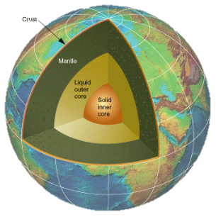
The Course Main Sections
Section 1 (3-4 weeks)
Injection Molding and Plastic
Section 2 (2-3 weeks)
Injection Molding and Metal
Section 3 (7 weeks)
Software and Mold Fabrication and Processes

Slide 4
INTRODUCTION
The injection molding machine itself consists of the clamp unit, the injection unit, the control unit and a hopper.
As we will learn later, the hopper can be modified to include a loader, dryer and in some cases, an additive feeder.
Hopper
Clamp Unit
Injection Unit
Figure1.1
Schematic of an injection molding machine
Control Unit

Slide 5
The diagram shows the clamp unit closed without a mold.
The injection unit heats, melts, pumps and injects the plastic into the mold when the mold is "closed.“
The control unit monitors and, controls the functioning of the injection unit and the clamp unit.
The mold is mounted within the clamp unit and this unit opens the mold to allow plastic parts to be ejected and holds the mold closed when melted plastic is being injected.
The mold consists of two halves, the core half (or male part shape) and the cavity half (or female part shape).
The core is made to be a little smaller than the cavity into which it fits, the area between the core and the cavity represents the part.
This area is filled with melted plastic, then cooled and ejected from the mold to become the plastic part, as illustrated in Figure 1.2.

Slide 6
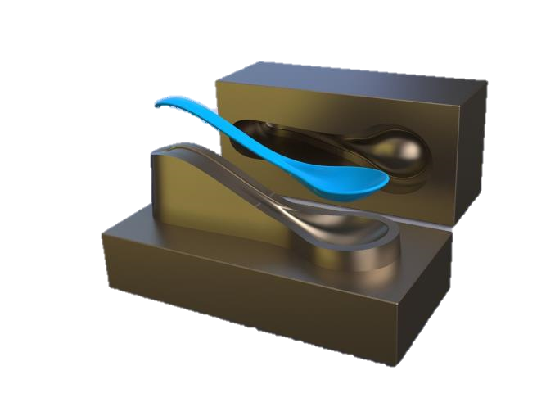
Cavity Half
Part
Core Half
Figure 1.2 Illustrative drawing of an injection mold

Slide 7
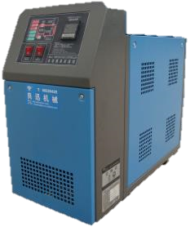
In order to solidify the plastic part in the mold so that it can be removed (ejected), it is usually necessary to cool the mold.
The cooling is accomplished by circulating cool water through cooling channels that are machined into the mold itself.
The water is cooled by a chiller, which can either be a free standing unit nearby the machine or by a part of a temperature controller (TC) system.
TC may take the form of chillers, or in other cases, heating units (for thermosets), heat exchangers, and various types of water and oil temperature controlling devices.
Figure 1.3 Example of mold temperature controller

Slide 8
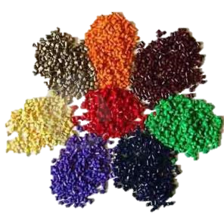
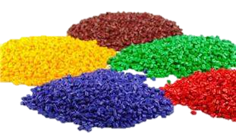
The molder's raw material, plastic, is usually purchased in pellet form. Each pellet is about the size of a small kitchen match head or 3mm in diameter.
Plastic is typically purchased from the manufacturer or a distributor and is delivered in 25kg bags, in drums (about or 100kg), or about 450kg big boxes.
Many types of plastic are available to use in the production of plastic products. Each type offers different mechanical properties in the molded form.
Figure 1.4 Various plastic raw materials

Slide 9
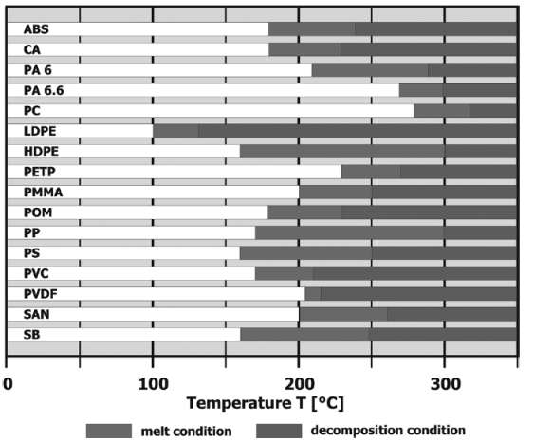
All plastics do not melt in the same way nor at the same temperature, thus further complicating the molding process.
Figure 1.5 Melt-temperature ranges and decomposition in the molten state of some
thermoplastic resins.

Slide 10
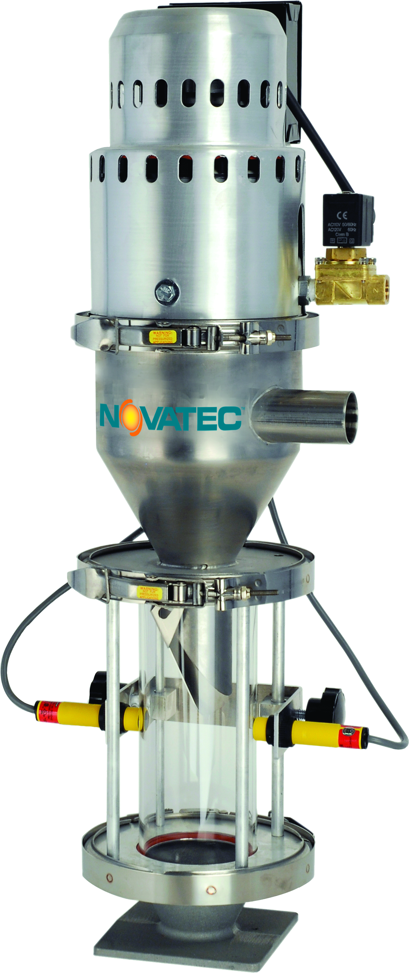
Moving the plastic from its storage to the machine is the function of the loader.
A loader may be as simple as a vacuum powered unit with hoses that pull pellets from a storage box and deposit them in the hopper.
This unit is called a hopper loader and sits beside the machine with hoses that can access storage box that are nearby.
Figure 1.6 Vacuum loader.

Slide 11
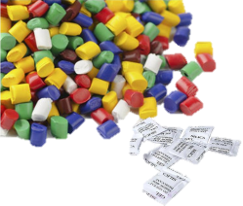
Unfortunately, most plastics are hygroscopic (meaning the plastics are able to absorb and retain moisture).
If the moisture is not removed to a certain level, the plastic parts produced will contain cosmetic or structural defects and the injection unit components may suffer corrosive wear.
As a result, many plastics are processed through a dryer.
There are several types of dryers available today, but all involve the circulation of either hot air or dehumidified hot air through the pellets before they are allowed to enter the injection unit.
Some dryers are quite small and fit on top of the machine as a part of the hopper assembly and others are large enough to dry the plastic that might feed several machines.

Slide 12
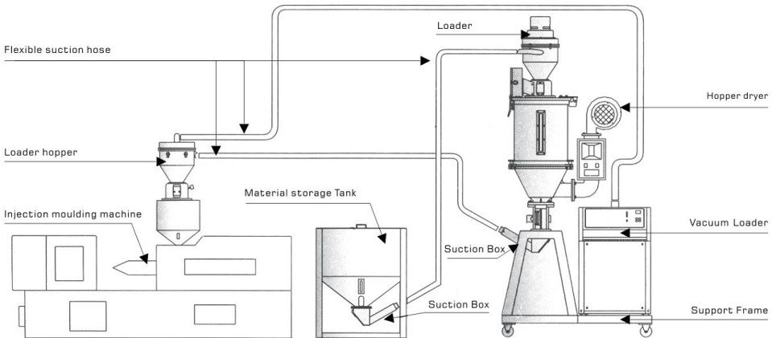
Figure 1.7 Hopper dryer.

Slide 13
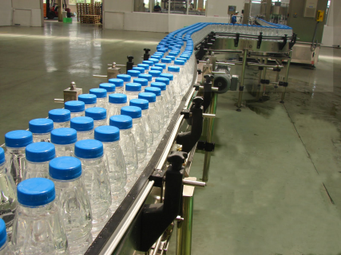
After the plastic parts are ejected from the mold, they may be dropped onto a conveyor (or removed by robot) for further transporting to an inspection or packaging area.
Conveyors come in all sizes and shapes and help automate the parts movement throughout the plant.
In addition to conveying parts, they may also convey runner systems and parts that have defects to a grinder.
Figure 1.8 Conveyor for the large cap PET bottles.

Slide 14
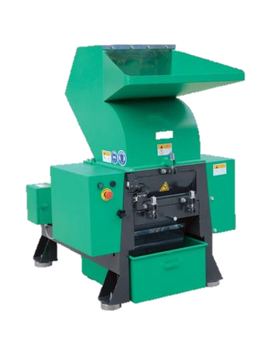
The grinder is used to grind up the runners and defective parts into a form (typically flake-like pieces slightly larger in size than pellets) that can be mixed with new pellets in quantities up to 50% (or more) for remelting again into plastic parts.
The ground-up material is referred to as regrind.
Figure 1.9 Plastic Shredder Grinder and Crusher Machine for Waste Plastic Materials

Slide 15
IM Elements Summary
Element | Function
Plastic | Raw material used to mold parts
Loader | Transports plastic from storage to machine hopper
Dryer | Removes moisture from plastic before entering the injection unit
Additives | Colorants, lubricants or other ingredients added to the plastic pellets
Additive Feeder | Adds specified quantity of additive (colorant or other additive) to the plastic being fed to injection unit
Injection Unit | Part of the IM that heats, melts, and injects the plastic into the mold
Clamp Unit | Part of the IMM that contains the mold and holds it closed during injection and open it when the parts are ejected.
Control Unit | Part of the IMM that controls all elements of the molding process.

Slide 16
IM Elements Summary
Element | Function
Mold | A combination of rectangular tool steel plates that form and support the cavities and cores and allow the injection of melted plastic into the cavities
Chiller | A type of refrigeration unit that cools the water that circulates through the mold to speed the solidification of the plastic part
Conveyor | Transports finished plastic parts to areas for other operations or packaging and conveys the runners to a point where they may enter a grinder for recycling
Grinder | Grinds runners and defective parts into a regrind that may be added to virgin material and recycled
Robots | Used to pick parts out of the mold or perform other automated movement functions

