Slide 1
Electric and Electronic Technology Chapter 4A – Magnetic Field and Transformer
by
Akhtar Razali FKM akhtar@ump.edu.my

Slide 2
Chapter Description
Aims
To understand the principle of magnetic field
To understand the principle element and working principle of a transformer
Expected Outcomes
Students able to understand how magnetic field works, its application and other related analysis
Students able to understand how transformer works, its application
Other related Information
One question for final exam is from this topic
No other relevant information be disclosed
References
Rizzoni G., 2004, Principles and Applications of Electrical Engineering, Revised Fourth Edition, Fourth Edition, McGraw Hill
Hambley A.R., 2005, Electrical Engineering Principles and Applications, Third Edition, Pearson Prentice Hall

Slide 3
Contents
Working principle of magnetic field.
Principle element of a transformer, working principle and its application.

Slide 4
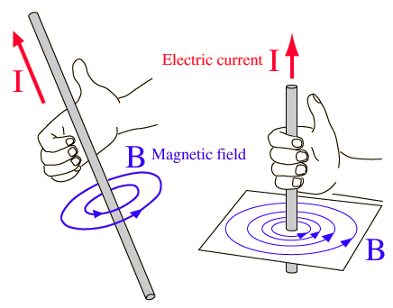
Direction of the Field of a Long Straight Wire
A current-carrying wire produces a magnetic field
Right Hand Rule
Grasp the wire in your right hand
Point your thumb in the direction of the current
Your fingers will curl in the direction of the field
The magnitude of the field at a distance r from a wire carrying a current of I is:
µ_{o} = 4 π x 10⁻⁷ T.m / A
µ_{o} is called the permeability of free space
Image source: https://commons.wikimedia.org/wiki/File:V-1_right_hand_thumb_rule.gif

Slide 5
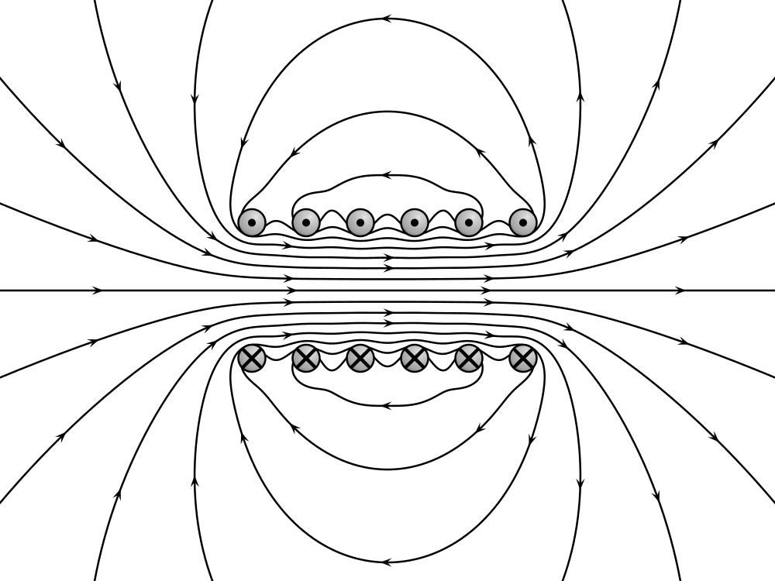
Electromagnet concept
An electromagnet consists of an iron core placed inside a wire coil. The magnetic field strength of a wire coil carrying an electric current increases in direct proportion to the number of turns of the coil
Image source: https://commons.wikimedia.org/wiki/File:VFPt_cylindrical_coil_real.svg

Slide 6
Transformer
An A.C. device used to change high voltage low current A.C. into low voltage high current A.C. and vice-versa without changing the frequency
In brief,
1. Transfers electric power from one circuit to another
2. It does so without a change of frequency
3. It accomplishes this by electromagnetic induction
4. Where the two electric circuits are in mutual inductive influence of each other.

Slide 7
TRANSFORMER USES
Impedance matching
Electrical Isolation
AC power transmission
STEP-UP Transformer
STEP-DOWN Transformer

Slide 8
INDUCTION THEORY
Transformers behaviour is based on Faraday’s Law of Induction
Where:-
ε – EMF (V)
N – No of turns of wire
ΦB – Magnetic flux (Wb)

Slide 9
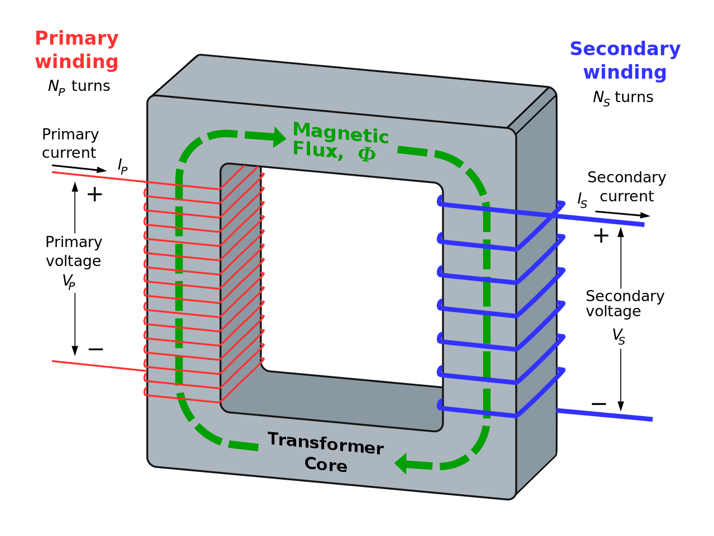
INDUCTION THEORY
Image source: https://en.wikipedia.org/wiki/Transformer

Slide 10
Working Principle of a Transformer
1. When current in the primary coil changes being alternating in nature, a changing magnetic field is produced
2. This changing magnetic field gets associated with the secondary through the soft iron core
3. Hence magnetic flux linked with the secondary coil changes.
4. Which induces e.m.f. in the secondary.

Slide 11
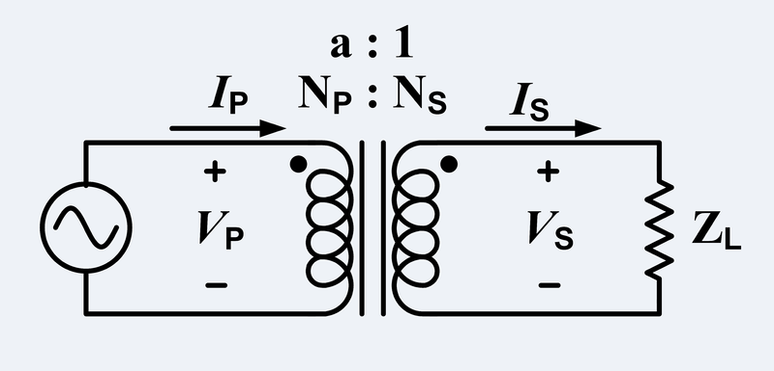
TRANSFORMER MODELS
Image source: https://en.wikipedia.org/wiki/File:Ideal_Transformar.png
N_{p} = No of windings on the primary N_{s} = No of windings on the secondary
i_{p} = Current into the primary i_{s} = Current out from the secondary
V_{p} = Voltage across the primary V_{s} = Voltage across the secondary

Slide 12
Primary and Secondary Relationship
Turns ratio (a) is defined as the ratio of the number of turns in the secondary winding (N_{sec}) to the number of turns in the primary winding (N_{pri}).
VP = NP = iS = a
VS NS iP
Note; a < 1 = Step up transformer
a > 1 = Step down transformer
Voltage and current angles are NOT affected hence,
θP = θS = θ

Slide 13
Losses in a Transformer
Transformers have losses and these losses must come into consideration.
Copper losses (I^2 R)
Leakage Flux losses
Core losses
Eddy currents
Hysteresis losses

Slide 14
REAL TRANSFORMER LOSSES
Copper losses (I^2 R)
Leakage Flux losses
Core losses
Eddy currents
Hysteresis losses

Slide 15
EFFICIENCY
Efficiency (η) is the ratio of the power out to the power in of a transformer.
η in an Ideal transformer, no power losses
PIN = VP IP cos θP
POUT = VS IS cos θS
PIN = POUT = VP IP cos θP = VS IS cos θS
ηIdeal = 100%

Slide 16
Voltage Regulation
Voltage regulation (VR) is the ability of a system to provide near constant voltage over a wide range of load conditions. Also it compares the VO at no load to VO at full load.
An Ideal transformer has a voltage regulation,
VR = 0%
Reference : http://en.wikipedia.org/wiki/Voltage_regulation

Slide 17
Conclusion of The Chapter
Conclusion #1
The strength of magnetic field is proportional to the increasing number of conductor used in a system.
Conclusion #2
Transformer is one of many application of magnetism.

Slide 18
Akhtar Razali FKM, UMP.

