Slide 1
Electric and Electronic Technology Chapter 3A – Capacitance
by
Akhtar Razali FKM akhtar@ump.edu.my

Slide 2
Chapter Description
Aims
Determine current, voltage, power and energy for capacitor.
Expected Outcomes
Students able to understand how capacitance works, its application and related analysis
Other related Information
One question for final exam is from this topic
No other relevant information be disclosed
References
Rizzoni G., 2004, Principles and Applications of Electrical Engineering, Revised Fourth Edition, Fourth Edition, McGraw Hill
Hambley A.R., 2005, Electrical Engineering Principles and Applications, Third Edition, Pearson Prentice Hall

Slide 3
Contents
Determine the current, voltage, power and energy for a capacitance or inductance.
Determine the equivalent capacitance and inductance from combination of series and parallel of capacitance and inductance.

Slide 4
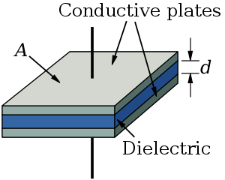
Capacitance
A capacitor is basically a device which stores an electric charge. Physically, it consists of two metal plates separated by insulating material or dielectric
Image source: https://commons.wikimedia.org/wiki/File:Parallel_plate_capacitor.svg

Slide 5
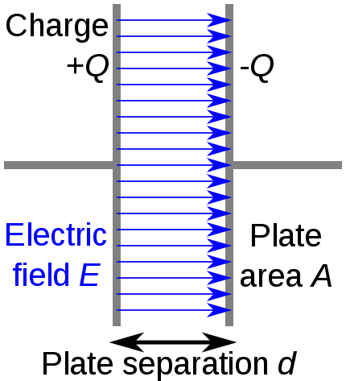
Capacitance
Application of a DC voltage across the capacitor produces deficiency of electrons on the positive plate and excess of electrons on the negative plate
Image source: https://commons.wikimedia.org/wiki/File:Capacitor_schematic.svg

Slide 6
Capacitance
In an ideal capacitor, the stored charge q is proportional to the voltage between the plates:
q = C.v
the constant proportionality is the capacitance C, which has units of farads (F).
Farads are equivalent to coulomb/volt

Slide 7
Current and Voltage for a capacitance
Current at capacitor is the time rate of flow of charge
i = dq/dt
= d (Cv)/dt
= C . dv/dt

Slide 8
If the current (i) flowing through a capacitance C, we can calculate voltage (v) at the capacitor.
Image source: Rizzoni

Slide 9
Example 1 - Capacitance
Suppose voltage v(t) in below figure is applied to a 1uF capacitance. Plot the stored charge and current passing through the capacitance vs. time

Slide 10
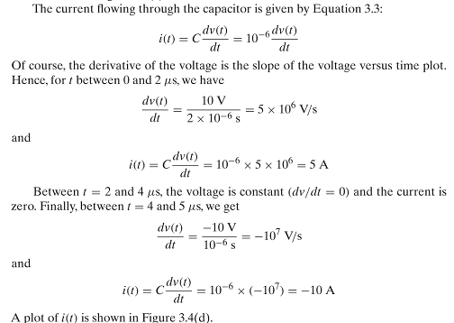
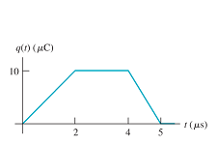
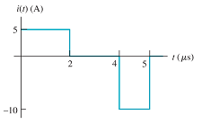
Example 1- capacitance
Source: Rizzoni

Slide 11
Example 2

Slide 12
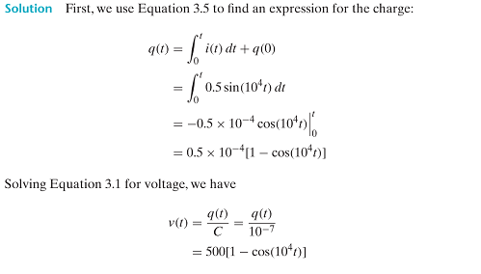
Example 2

Slide 13
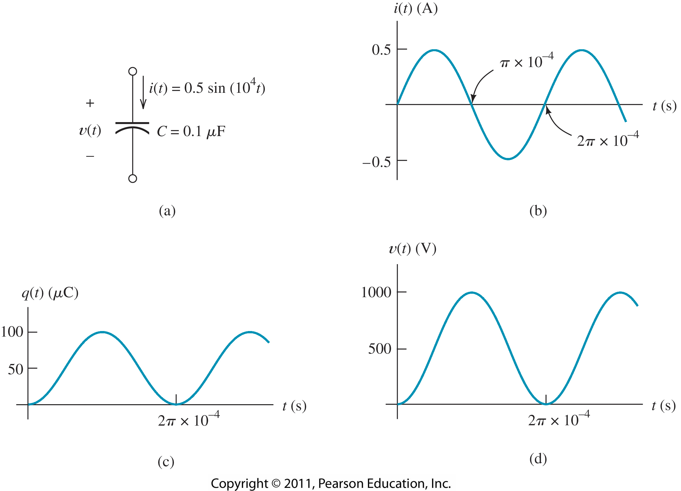
Example 2

Slide 14
Power and energy for capacitance
The power delivered to a circuit element is the product of the current and the voltage.
P = V . I = V. (C . dv/dt)
If we integrate the power delivered from t0 to t, we find energy delivered.
Source: Rizzoni

Slide 15
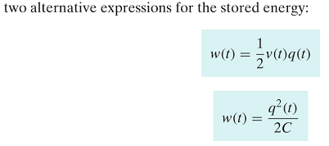
Energy
Source: Rizzoni

Slide 16
Example 2
Suppose the voltage form in the plot is applied to a 10uF capacitor. Find the current , energy and stored charge plots
Source: Rizzoni

Slide 17
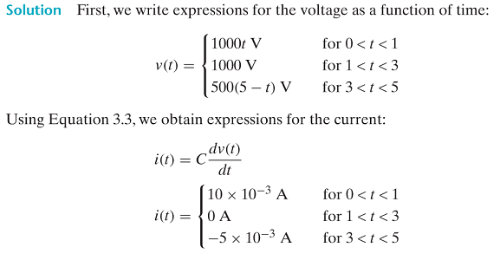
Example 2
Source: Rizzoni

Slide 18
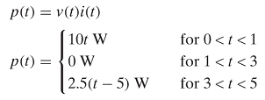
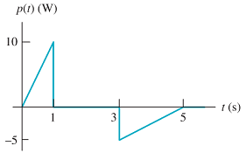
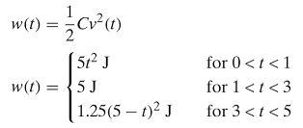
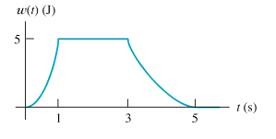
Example 2
Source: Rizzoni

Slide 19
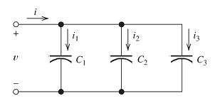
Example 2
Capacitance in parallel connection is expressed by:
Ceq = C1 +C2 +C3
Apply KCL at the top node, then:
Source: Rizzoni

Slide 20
Capacitance in parallel connection
Source: Rizzoni

Slide 21
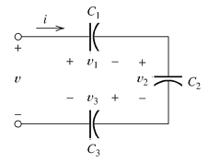
Capacitance in Series Connection
Source: Rizzoni

Slide 22
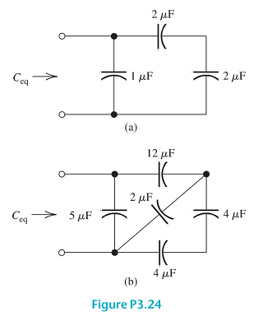
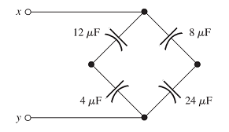
Exercise 1
Find equivalent capacitance in below circuit.
Source: Rizzoni

Slide 23
Conclusion of The Chapter
Conclusion #1
Capacitor is used in many application that deal with steady current and voltage constant.
Conclusion #2
Series equivalent capacitance is identical to the way we calculate resistor on series.

Slide 24
Akhtar Razali FKM, UMP.

