Slide 1
BSB3503 - Biomanufacturing CHAPTER 5 Upstream Processes
Author: Nurul Azyyati Sabri
Co-Author / Editor: Rama Yusvana Faculty Industrial Sciences & Technology yusvana@ump.edu.my

Slide 2
Learning Outcomes
Describe the importance of upstreaming (UPS) and downstreaming (DSP) process
Explain the basic steps in upstreaming (UPS) and downstreaming (DSP) process

Slide 3
What is a bioprocess?
• “Application of natural or genetically manipulated (recombinant) whole cells/ tissues/ organs, or parts thereof, for the production of industrially or medically important products”
• Examples
– DNA for gene therapy and transient infection
– Antibiotics
– Proteins (mAbs, Interleukins, Interferons,enzymes etc)
– Hormones (insulin etc)

Slide 4
Aims of bioprocesses
• “Manipulation of cells and their environment to produce the desired product with the required quality”.
• Molecular biology (genetic engineering) is a tool to achieve this
• Systems used include:
– Viruses
– Procaryotes (bacteria, blue- green algae, cyanobateria)
– Eucaryotes (“yeasts, molds, animal cells, plant cells, whole plants, whole animals, transgenics”)

Slide 5
Importance of process development
- Contribute in solving
- environmental,
- pharmceutical,
- industrial and
- agricultural problems.
- Involves a “careful understanding of the conditions and the duplication of these conditions during scaled- up production”.

Slide 6
Design criteria
BASIC
PHARMACEUTICAL PRODUCT
BULK PRODUCT
• Concentration
• Productivity (volumetric, specific)
• Yield/ conversion
• Quality
– Purity
– Sequence
- Glycosylation
- Activity (in vitro, in vivo)
• Quality
• Concentration
• Productivity
• Yield/ Conversion
High added value products
• Concentration
• Productivity
8
• Yield/ Conversion
• Quality
Low added value products

Slide 7
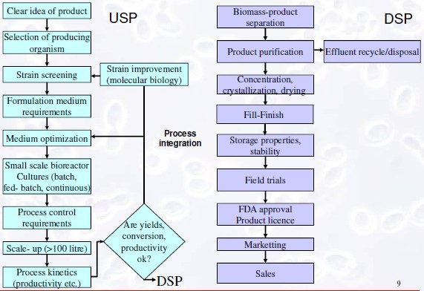

Slide 8
Choice of production cell line
• Bacterial cells
Advantages:
– genetic ease
– high productivity, high μ
– Resistance to shear
Disadvantages: poor secretors, little glycosylation/ Posttranslational modifications
• Yeast
– “High μ, high cell concentrations, high productivity, good secretors, post-translational modifications, glyco-engineered strains available”
– “Non-mammalian glycosylation, post-translational modifications, complexity of genetic manipulation”

Slide 9
Choice of production cell line
• Chinese hamster ovary (CHO)/ Baby hamster kidney (BHK)/ Human embryonic kidney (HEK) cells
– Advantages
• Produce ‘human-like’ proteins
• Capability to Secrete
• Able to Correctly construct
biologically active
– Disadvantages
• Slow growth rate (μ)
• Low cell densities
• Low productivity
• Shear sensitive,
Choice of cell line profoundly affects selection of bioreactor, DSP, feeding regime, scale of production

Slide 10
Type of bioreactor
Depends on:
• Anchorage dependence or suspension adapted
• Mixing
• Mass transfer particularly (OTR = kLa (C*-CL)
(oxygen transfer / mass transfer coefficient, volumetric transfer coefficient)
• Cell density
• Shear resistance
• Validation issues

Slide 11
Type of substrate feeding
• Depends on anchorage dependence or suspension adapted
• OTR (poor oxygen solubility; 5-7 mg/L 25 C)
• Cell density
• Shear resistance
• Stability of product
• Productivity
• Product concentration
• Formation of toxic products
• Osmotic stress
• Substrate inhibition/ catabolite repression/ diauxic growth
• Availability/ Need of PAT (Process Analytical Technology, quality by design, consistency)

Slide 12
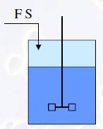
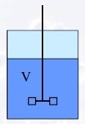
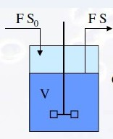
Feeding regimes
Fed Batch
Batch
Continuous

Slide 13
Study Case
For antibody manufacturing process development, the challenges include
maintaining desired quality attributes
Reducing time to market
Cost effectiveness,
Manufacturing flexibility
Drug substance must be produced in large quantities with cost and time efficiency to meet clinical requirements.
Large scale manufacturing plants containing multiple 10,000 L or larger cell culture bioreactors.

Slide 14
Study Case
Mammalian cells have historically been considered difficult to work with due to factors:
low yield
medium complexity
serum requirement
shear sensitivity
Cell specific productivity of over 20 pg/cell/day can be routinely achieved for production cell lines;¹ high titers up to ∼10 g/L and cell densities of over 20 million cells/mL in fed-batch processes

Slide 15
Study Case
The enhancement of specific productivity per cell is achieved by
selection of highly productive clones
optimization of medium composition and bioreactor operation conditions.
Controlling product quality and process consistency at all development stages and production scales.

Slide 16
Cell culture processes for monoclonal antibody production
Cell line development
Cell line engineering
Process development
Bioreactor optimization and scale up
Medium and feeding strategy development
Clone selection
Process characterization and validation
Technology transfer and cGMP

Slide 17
Monoclonal Ab Production
Cell culture process development.
Pilot scale to test scalability and produce material for preclinical toxicology studies,
Larger scale manufacturing for production.
Commercialization process.

Slide 18
Major contaminant issues in biologics production
Impurities can be classified as:
1. Contaminants originating form the host and the media:
Host cell proteins
Media additives
Defined proteins e.g. (mAbs) used in processing
Endotoxin from bacteria
DNA
Infectious agents
2. Product variants
Deamidation products
Oxidation products
Amino acid substitutions
Aggregates
Proteolytic products

Slide 19
Three Phase Purification Strategy
Capture phase: isolate, concentrate and stabilise the target product.
Intermediate purification phase: Remove mostof the bulk impurities.
Polishing phase: Achieve high purity by removing any remaining trace impurities

