Slide 1
IMAGE PROCESSING IMAGE COMPRESSION
By
DR. FERDA ERNAWAN
Faculty of Computer Systems & Software Engineering ferda@ump.edu.my

Slide 2
Today’s Lesson
Introduction to Image Compression
General JPEG Image Compression
Lossless & Lossy compression
Data Redundancies
Lossless Compression Methods
Huffman Coding, Lossless Predictive Coding
Lossy Compression Methods
Block Transform Coding
Learning Outcomes:
To understand image compression processing and the basic operation

Slide 3
Introduction
Image compression is a method to reduce the redundancies in image representation in order to decrease data storage requirements (Gonzalez and Woods, 2013).
It is a technique used to compress an image without visually reducing the quality of the image itself.
Data vs. Information.
The goal of these processes is to represent an image with the same quality level, but in a more solid form.

Slide 4
Why the image must be compressed?
The large storage requirement of multimedia data.
The video or image files consume large amount of data and it always required very high bandwidth networks in transmission as well as communication costs.

Slide 5
Aims of Image Compression
Reduce the data storage and maintain the visual image quality (Gonzalez, Woods and Eddins, 2017).
Increase the speed of transmission by using the repetition property of data.
The goal of these processes is to represent an image with the same quality level, but in a more solid form.

Slide 6
General JPEG Compression

Slide 7
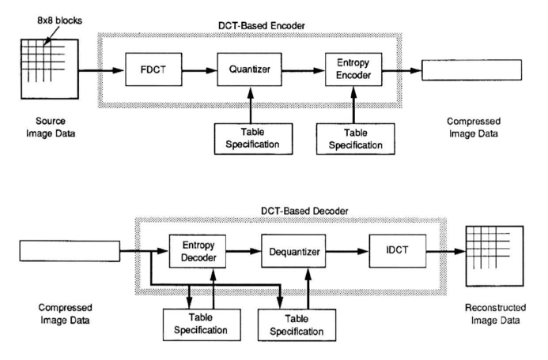
General Image Compression Model
Images taken from Gonzalez & Woods, Digital Image Processing
Encoder
Decoder

Slide 8
Image Compression (Encoder)
Image Transformation
Image Quantization
Entropy Coding
AC Huffman Table
Zig-zag Reordering
Huffman Coding
Color components (Y, C_{b}, C_{r})
Scalar Uniform Quantization
AC
8x8 DCT Transform
Bit-stream
Difference Encoding
Huffman Coding
DC
Quantization Table
DC Huffman Table

Slide 9
Block Transform Coding System
An image is divided into 8x8 pixels of non-overlapping blocks.
Each block is transformed by the transform function (e.g. DCT)
Compression is achieved during the quantization of the transformed coefficients.

Slide 10
DCT Transformation
DCT of an input image A is defined as follows
where
The inverse of DCT is given as follows:

Slide 11
Quantization Process
The JPEG quantization are given as follows:
Where is the frequency image signals at coordinates (i,j) in the k block.

Slide 12
Differential Pulse Code Modulation (DPCM) for DC Coefficients
The DC coefficients of each block are encoded with a DPCM instead of block-based prediction. The DC coefficients are coded by DPCM as follows:
Where is the current block and represents the previous block of DC coefficient.

Slide 13
Differential Pulse Code Modulation of DC Coefficients
Then the difference is encoded using Huffman coding together with the encoding of AC coefficients.

Slide 14
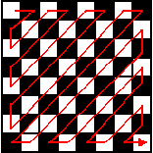
Zigzag Pattern for AC coefficients
The zigzag pattern is an important part of encoding process which gives effect to the statistic of symbols used in entropy coding.
Zigzag order under regular of 8×8 discrete transform

Slide 15
DCT as choice of Transform
Original Image
Compressed Image
JPEG image compression produces visible artifact image, less computational complexity and it has a good energy compactness properties.

Slide 16
Other Compression Method
Symbol-based Coding – JBIG2 format compression for binary images.
LZW (Lempel-Ziv-Welch) Coding – integrated into GIF, TIFF, PDF.
Arithmetic Coding.
Golomb Coding.
Lossy Predictive Coding – DPCM (Differential pulse code modulation).
Wavelet Coding – Haar, Daubechies wavelets.
JPEG-2000

Slide 17
Compression Ratio (CR)
Compression is measured in compression ratio denoted by:
Example:
The original image is 256×256 pixels, 8-bits per pixel grayscale.
The file is 65536 bytes (64 kb) in size.
After compression the image file is 6554 bytes.
The compression ratio is

Slide 18
Relative Data Redundancy ()
The relative data redundancy, R can be determined as:
This indicates that 90% of its data is redundant. The higher the RD value, the more data is redundant and will be compressed. If RD=0, (no redundant data)

Slide 19
Redundancy

Slide 20
Type of Redundancy
There are three types of redundancy:
Coding redundancy
Interpixel redundancy
Psychovisual redundancy

Slide 21
Coding Redundancy
A code is a symbol (letters, numbers, bits) used to represent a body of information (Gonzalez and Woods, 2016). Each information is assigned a sequence of code symbols, called a code word. The number of symbols in each code word is its length.
Symbols with higher appearing probabilities are assigned with codes of less amount of data.
Symbol: codes that human represent information
E.g., Chinese characters, English letters, …
Coding: transform symbols into more efficient codes
E.g., A: 00, B: 01, C: 10, …

Slide 22
Coding Redundancy: Example
Average bit length (Lavg1)=3 bits, Average bit length (Lavg2)=2.7 bits, Compression ratio= 3/2.7=1.11, Relative Redundancy=0.099

Slide 23
Inter-pixel Redundancy
Also called spatial redundancy, geometric redundancy, inter-frame redundancy.
Results from structural or geometric relationships between objects and the image.
Adjacent pixels are usually highly correlated (pixel similar or very close to neighboring pixels), thus information is unnecessarily replicated in the representations.
Neighboring pixels in a natural image are highly correlated. In natural images, local area usually contains pixels of same or similar gray level.

Slide 24
Inter-pixel Redundancy: Example
Pixels of line 128 of Tiffany:
Pixels of line 128 of wheel:

Slide 25
Inter-pixel Redundancy: Example
Pixels of line 128 of wheel:
n1 represent data information and n2 is amounts of data to represent the same information.
Similar segments (graylevel, number): (77, 1), (206, 30), (121, 88), (77,18), (121, 88), (206, 30), (77, 1)
Coding each segment with 16 bits: CR=(256x8) / (7x16)=18.3
RD=1-1/18.3=0.95

Slide 26
Psychovisual Redundancy
For human visual perception, certain information has less relative importance. E.g,: appropriate quantization of gray levels does not impact its visual quality, e.g.,: Tiffany
Can be eliminated without significant quality loss.
Use Lossy compression or Irreversible compression.
“Quantization”.

Slide 27
Information Theory

Slide 28
Basic Information Theory
Measuring amount of information: I(p) = log 1/p = – log p
Average amount of information: entropy.
Theoretically, the lowest average number of bits required to represent one symbol.

Slide 29
Example:
Symbol | Probability
A | 1/4
B | 1/4
C | 1/4
D | 1/4
In average, minimum 2 bits required.
Symbol | Probability
A | ½
B | 1/8
C | 1/8
D | 1/4
In average, minimum 1.75 bits required.

Slide 30
Compression Method
There are two types of compression methods:
Lossy image compression
Lossless image compression

Slide 31
Lossy Compression Methods
Lossy image compression methods are required to achieve high compression ratios for complex images.
An image reconstructed Lossy compression can be performed in both spatial or transform domains.
The process of quantization-dequantization introduces loss in the reconstructed image and is inherently responsible for the “lossy” nature of the compression scheme.
The quantized transform coefficient is computed by
Where is the frequency image signals at coordinates (i,j) in the k block.

Slide 32
Lossy Compression Methods
During dequantization, approximate DCT coefficients are obtained by multiplying the corresponding quantization threshold with the quantized coefficient as follows:

Slide 33
Lossless Compression Methods
Lossless compression methods are needed in some digital imaging applications, such as: medical images, x-ray images, etc.
Lossless compression techniques: run-length coding, Huffman coding, lossless predictive coding etc.

Slide 34
Run-Length Encoding of AC Coefficients
The frequency image signals after quantization process consist of many zeros. Then, a special condition as known end-of-block (EOB) is applied to get an efficient in the entropy code.
A symbol of EOB indicates that the rest of the coefficients in the block are zero. Next, run-length encoding exploits the repeating frequency image signals as the symbols in the sequence a set of the AC coefficients.
The output of run-length encoding represents a sequence value with the consecutive repetition as symbols and the length of occurrence of the symbols

Slide 35
Huffman Coding
Huffman coding is a famous method that uses variable-length codes (VLC) tables for compressing data (Jayaraman, Veerakumar, and Esakkirajan, 2017).
Given a set of data symbols and their probabilities, the method creates a set of variable-length codeword with the shortest average length and assigns them to the symbols.

Slide 36
Huffman Coding (cont..)

Slide 37
Example I

Slide 38
Example I- Cont..

Slide 39
Example I- Cont..

Slide 40
Example II

Slide 41
Example II

Slide 42
Example II- Cont..
Binary coderwork tree representation

Slide 43
Example II- Cont..
Note: Log2 x = Log10 . Log2 (10) = 3.3219 Log10 x
Notes:
Note:
Log2 x = Log10 X Log2 (10)
= 3.3219 Log10 x

Slide 44
Summary of Huffman Code
Achieve minimal redundancy subject to the constraint that the source symbols be coded one at a time.
Sorting symbols in descending probabilities is the key in the step of source reduction.
The codeword assignment is not unique. Exchange the labeling of “0” and “1” at any node of binary codeword tree would produce another solution that equally works well.
Only works for a source with finite number of symbols (otherwise, it does not know where to start).

Slide 45
References
R.C. Gonzalez and R.E. Woods, 2016. Digital Image Processing, Pearson Education India; Third edition.
A.K. Jain, 2015. Fundamentals of Digital Image Processing, Pearson Education India; First edition.
R.C. Gonzalez, R.E. Woods and S.L. Eddins, 2017. Digital Image Processing Using MATLAB. McGraw Hill Education; 2 edition.
S. Jayaraman, T. Veerakumar, S. Esakkirajan, 2017.Digital Image Processing, McGraw Hill Education; 1 edition.

