Slide 1
BSB3503 - Biomanufacturing CHAPTER 7 Good Manufacturing Practices (Facilities)
Author: Nurul Azyyati Sabri
Co-Author / Editor: Rama Yusvana Faculty Industrial Sciences & Technology yusvana@ump.edu.my

Slide 2
Learning Outcomes
Understand GMP concept, the principles as well as the practice.
Understand the importance of GMP

Slide 3
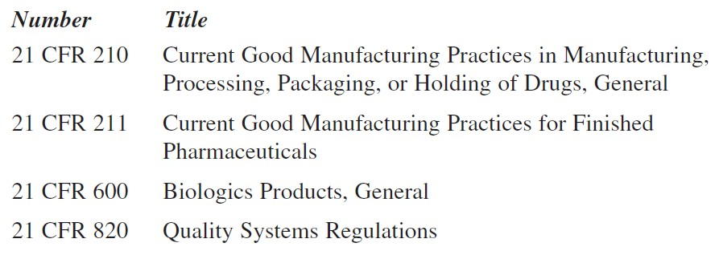
The FDA issues “Code of Federal Register (CFR) 21.” Regulations that include facility and equipment requirements

Slide 4
Paragraph 42 of CFR 211 describes the Design and Construction of features:
§ 211.42 Design and construction features.
(a) “Any building or buildings used in the manufacture, processing, packing, or holding of a drug product shall be of suitable size, construction, and location to facilitate cleaning, maintenance, and proper operations”.

Slide 5
(b) “Any such building shall have adequate space for the orderly placement of equipment and materials to prevent mixups between different components of drug product, containers, closures (lids), labeling, in-process materials, or drug products, and to prevent contamination”.
“The flow of components, drug product containers, closures, labeling, in-process materials, and drug products through the building or buildings shall be designed to prevent contamination”.

Slide 6
(c) “Operations shall be performed within specifically defined areas of adequate size. There shall be separate or defined areas for the firm’s operations to prevent contamination or mixups”. This includes areas for:
Receipt, identification, storage, and withholding
Folding rejected components
Storage of released components

Slide 7
(c) “Operations shall be performed within specifically defined areas of adequate size. There shall be separate or defined areas for the firm’s operations to prevent contamination or mixups”. This includes area for:
Storage of in-process materials;
Manufacturing operations;
Packaging operations;
Quarantine
Storage
Control and laboratory operations;
Aseptic processing

Slide 8
Examples of Aseptic processing facilities or systems:
(i) “Floors, walls, and ceilings of smooth, hard surfaces that are easily cleanable”;
(ii) “Temperature and humidity controls”;
(iii) “An air supply filtered through high-efficiency particulate air filters”

Slide 9
Examples of Aseptic processing facilities or systems:
(iv) “A system for monitoring environmental conditions”;
(v) “A system for cleaning and disinfecting the room and equipment to produce aseptic conditions”
(vi) “A system for maintaining any equipment used to control the aseptic conditions”.

Slide 10
(d) “Operations relating to the manufacture, processing, and packing of penicillin shall be performed in facilities separate from those used for other drug products for human use”.
Paragraph 44 of CFR 211 addresses lighting issues and states:
§ 211.44 Lighting: “Adequate lighting shall be provided in all areas”

Slide 11
Paragraph 46 of CFR 211 addresses ventilation systems and states:
§ 211.46 “Ventilation, air filtration, air heating and cooling”.
(a) “Adequate ventilation shall be provided”.
(b) “Equipment for adequate control over air pressure, microorganisms, dust, humidity, and temperature shall be provided when appropriate for the manufacture, processing, packing, or holding of a drug product”.

Slide 12
§ 211.46 Ventilation, air filtration, air heating and cooling.
(c) “Air filtration systems, including prefilters and particulate matter air filters, shall be used when appropriate on air supplies to production areas. If air is recirculated to production areas, measures shall be taken to control recirculation of dust from production”.
“In areas where air contamination occurs during production, there shall be adequate exhaust systems or other systems adequate to control contaminants”.

Slide 13
§ 211.46 “Ventilation, air filtration, air heating and cooling”.
(d) “Air-handling systems for the manufacture, processing, and packing of penicillin shall be completely separate from those for other drug products for human use”.

Slide 14
The regulations dealing with equipment requirements are written in a similar fashion. For example:
§ 211.63 “Equipment design, size, and location”.
“Equipment used in the manufacture, processing, packing, or holding of a drug product shall be of appropriate design, adequate size, and suitably located to facilitate operations for its intended use and for its cleaning and maintenance”.

Slide 15
§ 211.65 “Equipment construction”.
(a) “Equipment shall be constructed so that surfaces that contact components, inprocess materials, or drug products shall not be reactive, additive, or absorptive so as to alter the safety, identity, strength, quality, or purity of the drug product beyond the official or other established requirements”.

Slide 16
§ 211.65 Equipment construction.
(b) “Any substances required for equipment operation, such as lubricants or coolants, shall NOT come into contact with components, containers, closures, in-process materials, or drug products so as to alter the safety, identity, strength, quality, or purity of the drug product beyond the official or other established requirements”.

Slide 17
European Union GMPs
In EU the governments have issued nine volumes constituting “The Rules Governing Medicinal Products in the European Union”. Of particular interest is Volume 4—”Good Manufacturing Practices, Medicinal Products for Human and Veterinary Use”.
Contain general section followed by annexes.
Describing requirements for facilities and equipment.

Slide 18
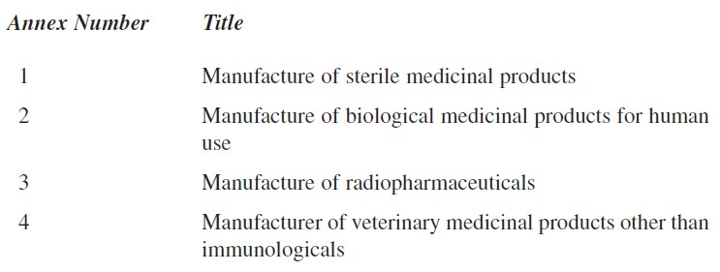
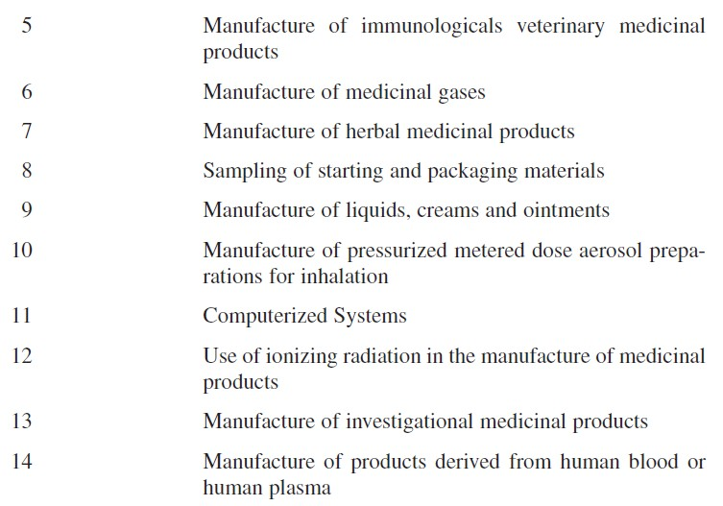
14 annexes included in the regulations covering various dosage forms as follows:

Slide 19
The plant designer is required to perform a thorough review.
Contained detailed requirements than the FDA’s regulations.
Do include much of the same information with the FDA

Slide 20
These annexes are not in conflict with the FDA.
There are additional requirements in the EU regulations.

Slide 21
Validation
An important regulatory issue.
The FDA requires that all processes producing drug substances be validated.
Includes facility systems that support production as well.
The entire documentation and testing effort is generally known as validation.

Slide 22
For example:
an aseptic processing operation requires a “clean” room.
HVAC system must be validated.
All critical utility systems need to be tested to ensure proper operation.

Slide 23
For example:
The nature of the testing depends on the system.
Certain systems are “validated” and others are “qualified”.

Slide 24
APPROACH TO GMP DESIGN - General
During the development, the manufacturing process and facility requirements are defined.
Developed through discussions with QA/QC, engineering, and the validation groups.

Slide 25
Items addressed during this phase are:
Establishing goals and objectives
Preparing user Requirements Specifications (URS), process, and operational flow diagrams
Developing system design criteria
Developing the facility conceptual design

Slide 26
Goals and Objectives
Goals and objectives of the manufacturing unit depend upon the following:
1) Corporate philosophies
2) Operating philosophies
3) Regulatory requirements

Slide 27
User Requirements Specifications, Process Flow, and Operational Flow Diagrams
User Requirements Specifications (URS).
A constructive technique.

Slide 28
User Requirements Specifications, Process Flow, and Operational Flow Diagrams
PFDs depict each unit operational step of the manufacturing process.
In analyzing the overall production scheme, the operation can be broken down into its basic elements.

Slide 29
System Design Criteria
Must be established for each production and support system.
Establishing design criteria.
An analysis of the manufacturing process.

Slide 30
Facility Conceptual Design
Need to be explored and decisions made as to which are to be used.
Developed during the creation of the PFD.

Slide 31
Facility Conceptual Design
Derived when the quantity of the utility is known.
The facility layout is then developed.

Slide 32
Criteria of the facility design must provide:
1. A logical process flow
2. Isolation of critical processes
3. Infected / non-infected separation
4. Clean / dirty separation

Slide 33
Aseptic and Biotech Facilities Issues
Process flow
Inoculum Development
Fermentation Process
Downstream Processing
Product or Packaging

