Slide 1
Chapter 10 Biopharmaceutics Considerations In Drug Product Design
by
Dr. Arshad Ali Khan Faculty of Engineering Technology arshad@ump.edu.my

Slide 2
Introduction
The active drug should be adequately delivered at proper rate to the targeted receptor site in order to achieve the desired therapeutic effect.
The drug must traverse the required biological membrane barriers, escape widespread distribution to unwanted areas, endure metabolic attack, and cause an alteration of cellular function.
Finished dosage form should show the highest bioavailability with minor or no adverse effects.

Slide 3
Biopharmaceutics CONSIDERATIONs in drug product design
Pharmacodynamics consideration
Therapeutic objective
Toxic effects
Adverse effect
Drug considerations
Particle size
pKa & pH profile
Polymorphism
Hygroscopicity
Partition coefficient
Excipient interaction
pH stability profile
Solubility

Slide 4
Drug product considerations
Pharmacokinetics of drug
Bioavailability consideration
Route of administration
Desired dose of drug
Dosing frequency
Patient considerations
Acceptability & Compliance of drug product
Cost
Manufacturing considerations
Cost
Availability of raw materials
Stability
QC

Slide 5
PHARMACODYNAMIC CONSIDERATIONS
Evaluation of the drug effect in the body and its mechanism of action
Therapeutic considerations include desired pharmacodynamics and pharmacologic properties of the drug, including the desired therapeutic response and the type and frequency of adverse reactions to the drug.
Therapeutic objective influences the design of the drug product, route of drug administration, dose, dosage regimen, and manufacturing process.
Eg:
An oral drug used in the treatment of an acute condition is generally formulated in order to achieve rapid release of the drug and to show rapid onset of action. If more rapid drug absorption is desired, then an injectable drug formulation might be formulated.

Slide 6
E.g.
In the case of nitroglycerin, which is highly metabolized if swallowed, a sublingual tablet formulation allows for rapid absorption of the drug from the buccal area of the mouth for the treatment of angina pectoris.
In order to reduce unwanted systemic side effects, locally drugs such as inhaled drugs have been developed.
Advantage
Possible to deliver the drug directly into the lungs,
Reducing the amount needed to reach a therapeutic effect at the locality of action
Reducing systemic adverse effects resulting in an improved risk of unwanted secondary effects.

Slide 7
Certain diseases such as hypertension, chronic pain, etc are preferably treated by a sustained- or extended-release dosage form.
The extended-release dosage form releases the drug slowly, thereby controlling the rate of drug absorption and allowing for more constant plasma drug concentrations.
The main advantage of extended release dosage form is that it releases the drug in a controlled fashion which eventually controls the rate of drug absorption and thus exhibits very uniform plasma drug concentration.
However, in some situations, both immediate- and extended-release dosage form are required where both rapid onset of action followed with a sustained release of the drug could achieve.
E.g. zolpidem tartrate extended-release tablets (Ambien ® CR tablets).

Slide 8
Drug consideration
Table 1: Physicochemical properties of drug that considered in drug product design

Slide 9
Drug consideration
pKa & pH profile
EXCIPIENT INTERACTIONS
Should be pharmacodynamically inert
However, it may change the suitability of drug substance and BA of drug from the dosage form
Affect the dissolution kinetics of the drug, either by altering the medium in which the drug is dissolving or by reacting with the drug itself
Chemical instability / chemical interactions with certain excipients will also affect the type of drug product and its method of fabrication.
High Absorption
Weak Acid pKa > 8
Weak Base pKa < 5
Low Absorption
Strong Base pKa > 11
Strong Acid pKa < 2.5

Slide 10
Drug consideration
POLYMORPHISM
Polymorph - lower aqueous solubility than the amorphous forms, cause product - incompletely absorbed.
Amorphous drug (non-crystalline form) - dissolves more rapidly/highest apparent solubility or dissolution rate - high free energy compared to the crystalline
Amorphous solid dispersion (ASD) - technologies for improving BA of poorly water soluble compounds.
Change in crystal form - cause problems in manufacturing the product.
E.g. change in the crystal structure of the drug - cause cracking in a tablet, problem in tablet compression
The order for dissolution of different solid dosage forms drugs;
Amorphous > Meta-stable > stable

Slide 11
Drug consideration
SOLUBILITY-PH PROFILE
Gives rough estimation of the completeness of dissolution for a dose of a drug in stomach /small intestine
Basic drug is more soluble in an acidic medium, forming a soluble salt.
Acid drug is more soluble in the intestine, forming a soluble salt at the more alkaline pH.
Acidic and alkaline pH influence the rate of decomposition of most drugs.
Solubility may be improved with the addition of an acidic or basic excipient.
STABILITY-PH PROFILE
Many drugs are stable between pH 4 and 8
Some drug - has pH-dependent stability profile
e.g. In acidic medium, erythromycin decomposition occurs rapidly, whereas in neutral/alkaline, the drug is relatively stable.

Slide 12
Drug consideration
PARTICLE SIZE
Reduction in the particle size results in a number of advantages:
enhance the surface area effectively.
Increase in the total surface area of the particles
Once the surface area of the particle enhances, it increases the penetration of water into the particles and eventually increases drug dissolution rate.
Smaller particle size -- greater surface area -- higher dissolution rate – better absorption

Slide 13
Pharmacokinetics of drug
Table 2: Pharmacokinetics of drug and its factors which considered in drug product design
Process | Definition | Factors
Absorption | Transfer drug from its site of administration to the bloodstream. The rate and extent of absorption mainly depends on administration route, the formulation of the drug and chemical entity of the drug. | Patient-specific factors Contact time with epithelial lining of the GI tract
Distribution | The absorbed drug get dispersed or distributed into the systemic circulation throughout the body. However, this is a reversible process which depicted that some drug entity binds to the receptors, while others get released from the receptor and taken up back again by the blood stream. | Affinity of drugs Body composition; cardiac decompensation Age Volume of distribution- to determine appropriate dose of drug
Metabolism | The distributed drug are then undergo few biochemical changes before excretion. This changes takes place in the liver or other tissues to allow excretion. | Group population; generic Age Drug interactions Diet
Excretion | Complete removal of drug from the body is a very crucial part which generally occur through the kidneys. The main and important passage of drug removal is through urination. | Condition of liver and kidney functions Drug interactions; multiple drugs competition for metabolic process reduces drug removal

Slide 14
Drug products consideration
Bioavailability consideration
Rate: The amount or rate of drug absorption from the given dosage form.
Duration: how long does the drug present into the blood stream
Due to poor bioavailability of some drugs, alternative route of drug administration or higher dose may be needed.
Desired dose of drug
Optimal dosage that gives desired effect with minimum side effects
The potency of the drug, determines the plasma concentration of the drug required for the desired therapeutic effect
The desired final drug size manufactured is determined by main two factors: the dose of the drug and the excipients.

Slide 15
Drug products consideration
Dosing frequency
Empirical approach - involves certain quantity of drug and therapeutic response
Kinetic approach - therapeutic & toxic effects on drug related to amount of drug in body / plasma concentration of drug at the receptor site
Drug clearance and drug concentration of plasma.
Pharmacokinetic evaluation - determine the levels of drug attained from multiple dosing estimation
If the drug has a short half-life which means high clearance from the body, then the duration of action of the drug will become shorter and hence the frequency of drug administration must be increased.
Factors
Inherent activity-toxicity
Pharmacokinetic of drug
Clinical factors: patient s’ condition and management of therapy
Tolerance-dependence
Pharmacogenetics-idiosyncrasy
Drug interactions

Slide 16
Drug products consideration
Route of administration
Bioavailability of drug: Route of drug administration greatly effect the bioavailability of the drug which eventually can affects the duration of the pharmacologic effect
Design: the design of a drug must taken into careful consideration to achieve intended pharmacologic effect
Types: Systemic or local effects.
Local effects – application of the drug directly on the site of action (e.g. eyes, nose, or skin)
Systemic effects – administration of the drug into the systemic circulation and its subsequent action on the specific desired site (oral, rectal, parenteral, topical (epicutaneous), implant, transdermal patch)
Table 3: Variation in time of onset action is differs from each dosage forms. (Ch. Taraka ramarao et al, 2016)
Dosage forms | Onset actions
I.V injections | Seconds
I.M and S.C injections, Buccal, Aerosols | Minutes
Injections, solutions, suspensions, powders, capsules, granules, tablets, modified release | Minutes-hours
Enteric coated formulations | Several hours
Deopt injections, implants | Days to weeks
Topical preparations | Varies

Slide 17
Patient considerations
Must be acceptable to the patient
Cost of products
Age, urine pH, condition being treated, existence of other disease states, patients’ background
Poor patient compliance may result from poor product attributes, such as
Swallowing difficulty
Unacceptable odour
Bad medicine taste
Dosing frequency /unusual dosage requirements
Side effects /allergic reaction

Slide 18
Manufacturing consideration
Product quality and performance
Quality control important components for drug product manufacturing – dissolution & drug release tests
Stability – long term stability of drug product – critical attribute of overall product quality
Lower cost
Availability of raw materials

Slide 19
Post Approval Changes

Slide 20
POST-APPROVAL CHANGES
Post approval changes means changes required in the drug after it has been approved for marketing by the FDA.
May impact drug product quality
The reasons for changes in a marketed drug product:
- A revised market fore-cast
- Change in an API source or excipients
- Manufacturing process optimization
- to make changes or upgrade in the packaging
- if any change required in the container closure/system
(little impact on oral tablet dosage)
- primary packaging component

Slide 21
Pharmaceutical manufacturer should take precaution in evaluating drug formulation and should pay attention to the following changes of the approved drug product:
Identity of the drug
Strength of the drug should monitor carefully like content uniformity
Quality of the drug like physical, chemical, and biological properties
Drug should be pure and free from any kind of impurities and degrading components potency (biological activity, bioavailability, bioequivalence)
The potency of the drug in terms of its bioavailability and bioequivalence.
Several guidelines has been published by FDA including Changes to an Approved NDA for the pharmaceutical companies.

Slide 22
Following issues has been addressed by the ANDA guidance:
Components and composition of the drug product
Manufacturing site change
Scale-up of drug product
Manufacturing equipment and process
Packaging
Active pharmaceutical ingredient
The levels of change as described by the FDA :
Level 1: Changes that are unlikely to have any detectable impact on the formulation quality and performance.
Level 2: Changes that could have a significant impact on formulation quality and performance
Level 3: Changes that are likely to have a significant impact on formulation quality and performance.

Slide 23
Assessment of the Effects of the Change
Should include a determination that the drug substance intermediates, drug substance, in-process materials, and drug product affected by the change follow to the approved specifications.
The evaluation may include of any changes in the chemical, physical, microbiological, biological, bioavailability, or stability profiles.
Additional assessment - may involve testing of the post-change drug product or the component directly affected by the change.

Slide 24
Examples of additional tests are as follows:
Impurity or degradant profile evaluation
Tests on toxicology
Tablet hardness or friability evaluation
Bioequivalence evaluation
Moisture permeability evaluation (new container closure system)

Slide 25
Equivalence
Purity (potency) and strength of the drug can be affected by the manufacturing changes, thereby to check if the test results are equivalent, the final drug product measured by comparing test results from pre- and post-change materials.
The final drug product after changes should be equivalent to the product used prior to the change.
Equivalence does not always mean identical, however, it does basically means to keep the quality and stability characteristics.

Slide 26
CRITICAL MANUFACTURING VARIABLES
Factors that can affect in vitro dissolution are: formulation products, processing, equipment's, materials and methods for the drug product used.
If there is any relationship between CMV, in vitro dissolution, and in vivo bioavailability, that should be efficiently determined by the manufacturer.
To obtain this relationship, bioavailability of the test products should be compared to the bioavailability of the marketed drug product with slowest and fastest dissolution characteristics.
The establishment of dissolution specifications for the drug product should be made so that the production of the marketed drug product in future do not fall outside the bioequivalence of the marketed drug product.

Slide 27
Adverse effect
A change in process may cause a degradation that need to be quantified carefully.
If any degradation occur during the process, the new degradant should not affect the safety or efficacy of the product and the manufacturer must confirm.
Qualitative or quantitative changes in the formulation may significantly pose an impact on the quality and performance of the formulation.
On the other hand, minor changes will be considered if intended to affect only the colour of a product by the removal or reduction any ingredient, that is unlikely show any harmful affect on the drug safety.

Slide 28
Post approval changes of drug substance
Active pharmaceutical ingredient (API) changes in the manufacturing may likely to change its quality attributes which includes:
Chemical purity: it is dependent on the synthetic pathway and purification process.
Solid-state properties: it includes particle size, polymorphism, and solubility. API bulk density and tablet hardness may get affected by the change in particle size. Whereas, API solubility and stability may affected by different polymorphs.
Residual solvents: dichloromethane may remain in the API after extraction and/or purification.

Slide 29
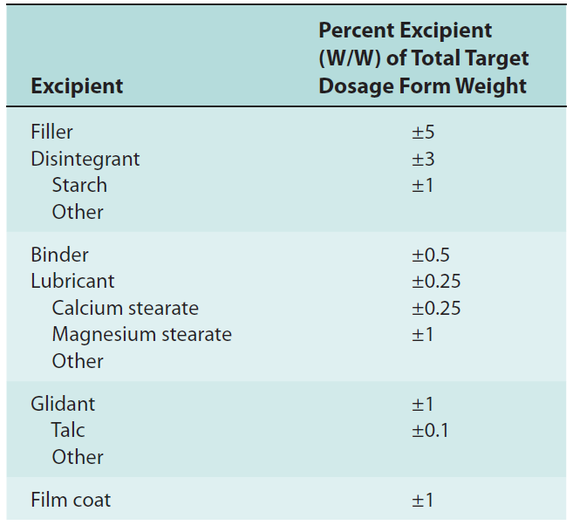
Practical Focus
Quantitative Change in Excipients
For immediate-release drug products, minor changes in some excipients are allowed by FDA
Less than or equal to the following percent ranges stated are considered Level 1 changes.
The total additive effect of all excipient changes should not be more than 5%.
In an immediate-release drug product, even a small change in the excipients amount will affect the bioavailability of a drug.
Changes in Batch Size (Scale-Up/Scale-Down)
According to FDA, if a change in batch size greater than tenfold is considered as a Level 2 change.
All testing of scale-up/scale-down documentation should be notify to the FDA by the manufacturer before marketing the product.
Table 4: Level 1—Allowable Changes in Excipients
These percentages are based on the assumption that the drug substance in the product is formulated to 100% of label/potency.

Slide 30
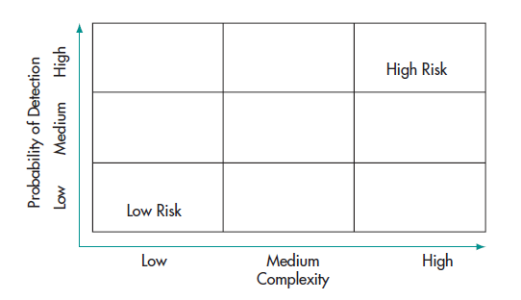
Product Quality Problems
Manufacturing of all approved drug products must be done according to current Good Manufacturing Practices (GMP).
Complexity of synthesis and manufacturing generally increases if the quality of drug substances and drug products are of high quality risk.
Examples of drug products with high quality risk:
High quality risk of biotechnology-derived drugs is more compared to chemically synthesized small molecules,
Extended-release and delayed-release drug products possess greater quality risk than an immediate-release drug product.
Therefore, to maintain the quality of the final product, GMP and critical manufacturing control operations play an important role.
Figure 1: General principles to define low-risk drugs.

Slide 31
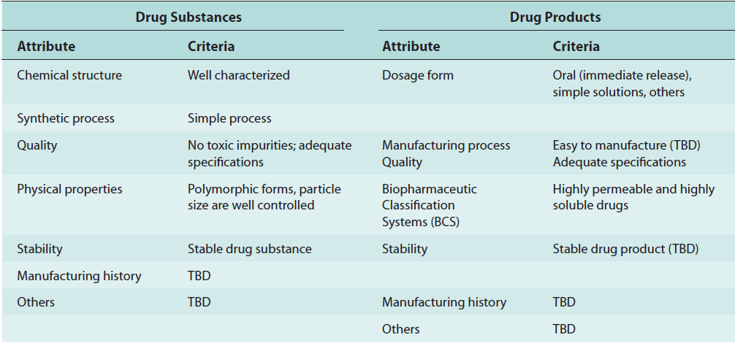
A set of quality attributes and acceptance criteria have been established by FDA and industry for certain less manufacturing risk approved drug substances and products which are given below in the table.
Table 5: Quality Attributes and acceptance criteria for Certain Approved Drug Substances and Products

Slide 32
References
Shargel, l., et al. (2005). applied biopharmaceutics & pharmacokinetics. new york :, appleton & lange reviews/mcgraw-hill, medical pub. division.
(n.d.) applied biopharmaceutics & pharmacokinetics, chapter 14. biopharmaceutic considerations in drug product design, mcgraw-hills, retrieved from http://202.74.245.22:8080/xmlui/bitstream/handle/123456789/338/chapter%2014.%20biopharmaceutic%20considerations%20in%20drug%20%20product%20design?sequence=15
Deliang Zhou and Yihong Qiu (2010), understanding drug properties in formulation and process design of solid oral products retrieved from http://www.ivtnetwork.com/sites/default/files/Understanding%20Drug%20Properties.pdf
Ch. Taraka Ramarao, P. Vineeth, P. Bhanuchandar, M. Madhuri, P. Jayaram,m. Padma Jyothi, T. Bharat Kumar, S. Yugandhar (2016) "Drug Delivery Systems and Biopharmaceutical Consideration of Drug Products Designs: A Review." European Journal Of Pharmaceutical And Medical Research, 2016: 146-154

Slide 33
Thank you

