Slide 1
Computer Programming Chapter 3: Variables and math.h
by
Mohd Jamil Mohamed Mokhtarudin Faculty of Mechanical Engineering mohdjamil@ump.edu.my

Slide 2
Chapter Description
Aims
To construct C programs involving variables, constant macros and math.h library
To construct C program to solve simple engineering problem
Expected Outcomes
Gain understanding of math.h library and arithmetic operations in C program

Slide 3
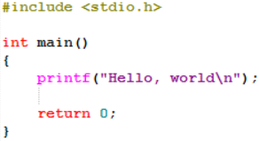
Still remember?
Still remember??
Header – library containing functions

Slide 4
math.h
To allow using various mathematical functions
Function | Description
sqrt | Computes square root of a number
pow | Computes the power of a number
cos | Computes cosine
sin | Computes sine
tan | Computes tangent
Some of the functions in math.h. There are many more!

Slide 5
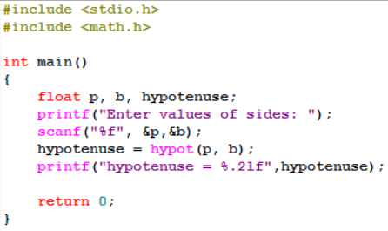
Example 1: Calculating Pythagoras Theorem
Enter values of sides: 5
12
hypotenuse = 13.00
Note: hypotenuse = $\sqrt{5^{2}+{12}^{2}}$
You don’t need to write the formula here; it’s all in the math.h

Slide 6
Variables
Variables (eg: int a,b;) are actually refer to some location in memory
This location holds the value (i.e. values of a and b).
To allow variables to work, you need to declare the variables.

Slide 7
Declaring variables
type name = value;
Examples:
int a = 100;
float b = 0.123456789;
char letter = ‘A’;

Slide 8
Variable Types
Variable type | Description | Format
int | Integer | %d
float | Single-precision floating point (7 decimal places) | %f
char | Character (single letter) | %c
double | Double-precision floating point (15 decimal places) | %f

Slide 9
Constant macros
In C, the #define directive allows the use of constant macros within the code.
Define constant macros before int main()
Do not put ; at the end of the line

Slide 10
Example 2
Note:
String “Jessica” must be in “”.
No ; at the end.
Macros must be defined before int main()

Slide 11
Conclusion of The Chapter
Now you can use macros to define a variable that can be used anywhere in the code (eg: definition of $π=3.142$) to solve math problem.

