Slide 1
Injection unit
Plastic Injection Technology BMM 4843
Wan Sharuzi Wan Harun
Faculty of Mechanical Engineering Universiti Malaysia Pahang
sharuzi@ump.edu.my
jihad_ku@yahoo.com
019 959 0039
09 424 6339

Slide 2
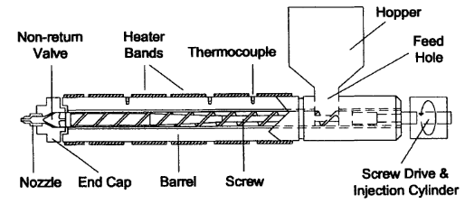
INTRODUCTION
The injection unit of an injection molding machine (IMM) consists of the elements shown in the schematic drawing below:
Figure 5.1 Elements of an injection unit of an IMM

Slide 3
The injection unit is perhaps the most important part of the IMM because if it fails in its: functions, the molding of quality plastic parts will not occur.
The injection unit receives plastic pellets, conveys, heats and melts them and then injects the melt through the nozzle into the mold
The hopper holds the plastic pellets which are gravity-fed through the feed hole in the barrel.
The screw has helical (spiral) flights which, when the screw is rotated, cause the plastic pellets to move forward in the barrel.

Slide 4
The barrel, which houses the screw, has heater bands surrounding it which heat the barrel and the plastic inside based on temp controls which take readings from the thermocouples positioned in the barrel wall.
The screw also provides some heat to melt the plastic pellets by squeezing and shearing the pellets against the screw flights and the barrel wall as the pellets move forward.
The screw drive is typically a hydraulic motor drive, although electric drive units are becoming quite common. It’s a function of converting hydraulic (or electric) power to mechanical power to turn the screw.

Slide 5
As the screw turns, the plastic moves forward and becomes a melt which ultimately reaches the end of the barrel.
The melt then proceeds through the non-return valve and the end cap.
As a result, the pressure of the melted plastic builds up in front of the screw and forces the screw backward. Because of the back and forward motion, some refer to the screw as the “reciprocating screw”.
IMM can set to allow the screw to move backward only a specified distance. The distance is referred to as stroke and is measured in mm/in.

Slide 6
When the specified distance is achieved, the screw drive stops the screw from rotating and the injection cylinder causes the screw to move forward like a ram.
The non-return valve closes to prevent any movement of the melt back into the screw.
With the pressurizing of the hydraulic injection cylinder, the screw moves forward, causing the injection of the plastic forward through the nozzle into the mold.
Shot is the term applied to the amount of the melted plastic that is injected into the mold. The shot size is the quantity of melt injected into the mold, measured in grams/ounces.

Slide 7
The screw hydraulic system holds the screw in its forward position to permit the packing of the melt into the mold cavities.
After a specified time interval, the screw drive again begins to rotate and the entire process is repeated.
This process, beginning with the screw in the forward position, then reciprocating backward, pausing for opening of the mold and ejection, and moving forward to inject the molten plastic of the next shot, is referred to as a cycle. A time required to complete one cycle is called cycle time.

Slide 8
The screw drive performs some additional functions.
The screw drive can exert a forward pressure (or resistance to its backward movement) while the screw is rotating, causing a greater mixing and shearing motion inside the barrel.
Its called back pressure.
Frequently use to help melt the plastic and to increase the mixing action of the screw.
Some back pressure is good; a lot of back pressure can be bad.

Slide 9
The barrel
Is the cylindrical housing in which the screw rotates. Its consists of a shell or backing which is the thick outer wall to provide strength.
The shell may be lined with a variety of different materials to provide wear resistance.
The back end of the barrel fits into the casting of the IMM.
All IMM barrels have a feed hole that is located near the back end of the barrel.
The feed hole is located directly under the hopper and is the opening through which the unmelted plastic pellets are gravity-fed into the feed channels of the screw.
Although most barrel shells are made from an alloy steel in the 4000 series AISI designation, there are several alternative linings available which resist wear.
Nitrided barrels, cast bimetallic barrels, tool steel-lined barrels.

Slide 10
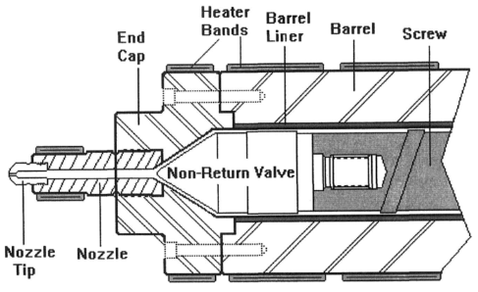
End Cap and Nozzle
Figure 5.2 Nozzle, valve and barrel assembly

Slide 11
Figure 5.2 shows the nozzle end of the injection unit, including the barrel, screw, heater bands, end cap, and nozzle.
The non-return valve is also shown.
The end cap is manufactured from very strong steel to be able to withstand the injection pressures of the molten plastic as it leaves the barrel and goes through the nozzle and into the mold.
The pressure exerted during injection, ranging from a normal level of 113 to 155 MPa (N/mm²)

Slide 12
The nozzle is a “tube which provides a mechanical and thermal connection from the hot barrel to the much colder mold with a minimum pressure and thermal loss”.
The end of the nozzle typically has a radius of either 0.5 or 0.75 inch.
The rounded end of the nozzle fits into a part of injection mold referred to as a sprue bushing.
The fit between the nozzle tip and the sprue bushing is important to be correct.
The incorrect fit could allow the nozzle to back away during high injection pressure results plastic to leak.

Slide 13
Figure 5.3 Illustration of the fit of a nozzle tip to the sprue bushing.

Slide 14
The nozzle usually has a thermocouple and a small heater band to control the temp. of the plastic at the nozzle.
The nozzle tip is used to enable the matching of the orifice in the nozzle to the opening in the mold sprue bushing. Rather than maintaining an inventory of a large number of nozzles, a stock of nozzle tips can accomplish the same objective.
Three common types of nozzles;
Open channel (fig. 5.3) [Majority]
Nozzle with a valve that closes the nozzle (after injection pressure diminishes) using spring. [A few]
Shut-off nozzle which the valve closing is accomplished by pneumatic or hydraulic pressure. Its can prevents drool. [Many]

Slide 15
Heater Bands
Electrical heater bands are used for heating the barrel and the nozzle.
The common type of heater bands
Mica-insulated (up to 371^{O}C).
Ceramic-insulated (up to 820^{O}C).
Mineral-insulated (up to 820^{O}C).
The heat supplied by heater bands should ideally supply 50% of the total heat needed to melt the plastic. The remaining 50% is supplied by the shear heat generated by the screw.

Slide 16
Beside the barrel heater bands, the nozzle requires a heater band to help maintain the proper temp of the melted plastic until it injected into the mold.
Tube and cartridge heaters (in addition to band heaters) are also used to maintain proper nozzle temp.
The nozzle heater is controlled independently of the barrel heater bands.

Slide 17
Non-Return Valve
Simply stated, the non-return valve is placed at the end of an injection screw so that melted plastic will not flow backward into the screw channels during injection.
When the screw comes forward during injection, the valve closes.
When the screw rotates backward, the valve opens to allow melted plastic to flow through the valve into the area in front of the screw.
The most common type is referred to as a ring valve.

Slide 18
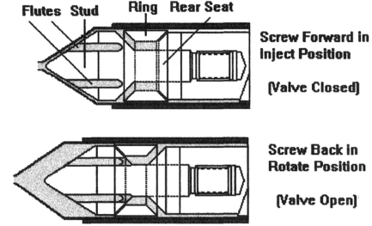
Figure 5.4 Three piece ring type of non-return valve
The non-return valve illustrated above is a three piece ring valve.

Slide 19
Screw
The screw is housed inside the barrel and consist of a shank and a flighted length.
The shank is designed to fit into the quill of the screw drive allowing the screw drive to turn the screw during rotation and cause the screw to go forward during injection.
The flighted length approx. 80% of the overall length of the screw. This portion of the screw which receives the plastic pellets from the hopper through the feed hole. The flighted length also conveys and melts the plastic as the screw rotates backward.

Slide 20
Figure 5.5 Elements of an injection molding machine screw
Refer to figure 5.1, the screw in its most forward position, the pocket sits directly under the feed hole.
Plastic pellets are gravity fed into feed channel of the screw fro the hopper and, as the screw rotates, the pellets are conveyed forward toward the meter section.

Slide 21
The flight depth (channel depth) in the feed section is deeper than in the meter section.
When the pellets are conveyed forward through the transition section (compression section), they begin to be compressed.
The root diameter for feed and meter section are constant.
The compression of the pellets causes heat to build in plastic as a result of the shearing of pellets against the flights, the inside lining of the barrel, and against other pellets.
The shear heat, combined with the conductive heat from the heater bands cause pellets to change from a solid to a melt.

Slide 22
The melted plastic goes through the valve ( which is open) and builds up pressure in front of the valve. This pressure causes the screw to move backward.
As 50% of the heat energy comes from the screw shear and another 50% from the conductive heat, the screw is a vital factor in the proper melting of the plastic.

Slide 23
Length-to-Diameter Ratio
L/D Ratio = Flighted Length/Outside Diameter.
Most screws for IMM have a 20:1 L/D ratio.
Screw Profile
The screw profile is the length, in diameters, of each of the three sections of the screw. A 10-5-5 profile indicates a flighted surface with 10 dia. Length in the feed section, 5 dia. in the transition section, and 5 dia. in meter section.
Feed section
Transition/compression section
Meter section

Slide 24
Compression Ratio
$Compression Ratio =Feed Channel Depth÷Meter Channel Depth$
Typically range from 1.5 : 1 to 4.5 : 1.
Thermoplastic; 2.5 : 1 to 3.0 : 1
Thermoset; 1.0 : 1, means that the material is conveyed and not compressed and sheared.

Slide 25
Injection Pressure
Injection pressure is exerted on the screw by the hydraulic or electric system to push the screw forward.
The pressure forces the melted plastic in front of the screw through nozzle and in the mold.
Upon the melted plastic comes into contact with the cooler mold surfaces, it begins to cool and solidify.
Thus, injection must be completed rapidly and with sufficient pressure so that the mold cavities are filled while the melt will still flow.

Slide 26
The injection pressure must overcome the resistance of the following;
The viscosity of the material
The elements of the mold
The runner system
In many machines, the rule of thumb of 10 to 1 is applicable so that a hydraulic pressure of 13.8 MPa results in 138 MPa of injection pressure.
Low viscosity materials injected into a mold with thick walled section may require 48 to 70 MPa injection pressure (lower).

Slide 27
High viscosity materials being injected into thin walled sections of the mold with small gates might require more injection pressure as high as 345 Mpa.

