Slide 1
Electric and Electronic Technology Chapter 2 – Kirchhoff’s Laws
by
Akhtar Razali FKM akhtar@ump.edu.my

Slide 2
QUIZ 2a – KIRCHHOFF’s Current law
This quiz contributes 4% of the total marks.

Slide 3
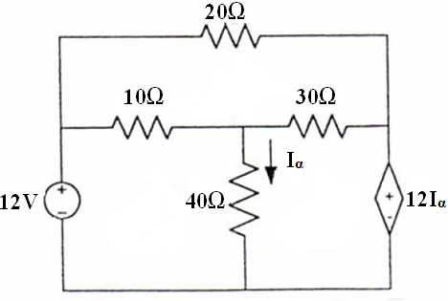
QUIZ 2A – Kirchhoff’s Current Law
QUESTION 1:
Find currents for each mesh. You may use the back page to answer (10 Marks)

Slide 4
Akhtar Razali FKM, UMP.

