Slide 1
Electric and Electronic Technology Chapter 3B – Inductance
by
Akhtar Razali FKM akhtar@ump.edu.my

Slide 2
Chapter Description
Aims
Determine current, voltage, power and energy for inductor.
Expected Outcomes
Students able to understand how inductance works, its application and related analysis
Other related Information
One question for final exam is from this topic
No other relevant information be disclosed
References
Rizzoni G., 2004, Principles and Applications of Electrical Engineering, Revised Fourth Edition, Fourth Edition, McGraw Hill
Hambley A.R., 2005, Electrical Engineering Principles and Applications, Third Edition, Pearson Prentice Hall

Slide 3
Contents
Determine the current, voltage, power and energy for a inductance.
Determine the equivalent inductance from combination of series and parallel of capacitance and inductance.

Slide 4
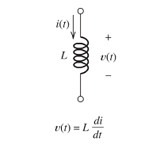
Inductor
Current flowing through the coil creates a magnetic field or flux.
For the ideal inductor, the voltage is proportional to the time rate of change of the current
Image source: Rizzoni

Slide 5
Inductor - Energy
Image source: Rizzoni

Slide 6
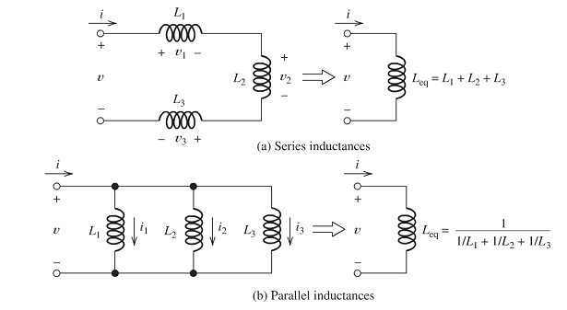
Inductor in Series and Parallel

Slide 7
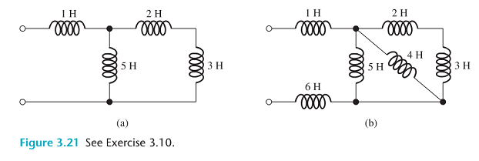
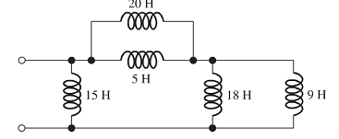
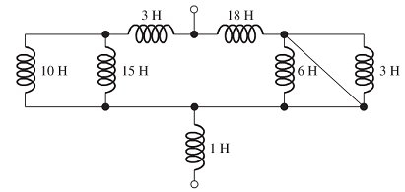
Exercise

Slide 8
Conclusion of The Chapter
Conclusion #1
Inductance is used in many application that deal with steady current and voltage constant.
Conclusion #2
Series equivalent Inductance is identical to the way we calculate resistor on series.

Slide 9
Akhtar Razali FKM, UMP.

