Slide 1
Computer Programming Chapter 4: if-else statement
by
Mohd Jamil Mohamed Mokhtarudin Faculty of Mechanical Engineering mohdjamil@ump.edu.my

Slide 2
Chapter Description
Aims
To construct C programming involving if/if-else and nested if-else
Expected Outcomes
Know to construct conditional statement using C programming

Slide 3
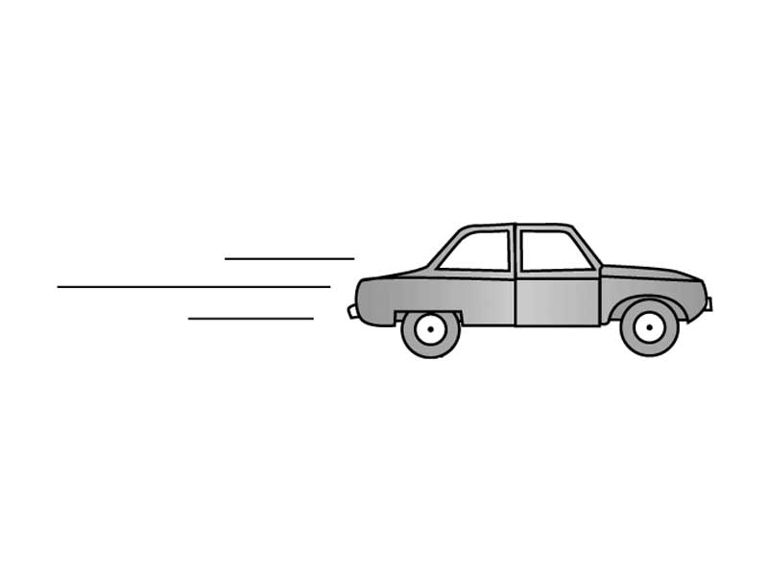
Conditional statement
Still remember??
If drive too fast, car crash happened
If drive too slow, the time taken to arrive is longer

Slide 4
if statement
Exercise: try other variable age to see different results.

Slide 5
if-else statement

Slide 6
Logical Operators in C
Operator | Description | Example | Example (age = 45)
&& | AND operator. | (age>30&&age<40) | False
|| | OR operator. | (age<30||age>40) | True
! | NOT operator. | !(age<30) | True

Slide 7
if-else if statement

Slide 8
if-else if statement

Slide 9
Nested if statement
It’s an if statement within an if (hence, the name).

Slide 10
Example nested if

Slide 11
Conclusion of The Chapter
Now you have the basic knowledge of using conditional statement in C program.

