Slide 1
Engineering Surveying Linear Survey
By
Mohd Arif Sulaiman
Faculty of Civil Engineering & Earth Resources
mdarif@ump.edu
Introduction To Survey Engineering, by Mohd Arif

Slide 2
Chapter Description
Principle of linear surveying
Linear measuring technique
Procedure in linear surveying

Slide 3
Method used for measuring distance
Pacing
Odometers
Tachymetry
Taping or Chaining
EDM
GPS

Slide 4
Principle linear survey
The linear survey is carried out by measuring only the length
No angle measurement are made at all
In order to make a scale drawing of the side, using linear technique, it is necessary to master,
The geometry principle of making a survey
The technique of measuring length
The method of carrying out the survey and recording the measurement
The method of plotting these measurements to scale

Slide 5
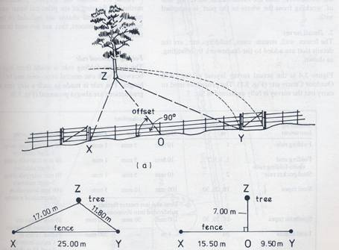
If the distance between two of the points is measured the points are fixed.
The problem, then, is to fix the third point in relation to the two known points.
The third point could be fix using two method, trilateration and offsets.
When the principle is applied to figure, the lengths XY, YZ and XZ are all measured, using tape. Length XY is then drawn to scale on paper, point Z is fixed to XY, using a pair of compasses and drawing arcs XZ and YZ to intersect in the point Z.

Slide 6
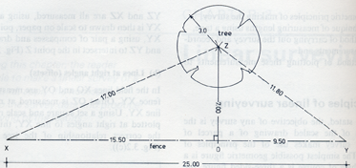
In the field lines XO and OY are measured along the fence XY.
Offset OZ is measured at right angles to line XY.
Using a set square and scale rule, point Z is plotted at right angles to line XY, thus establishing the correct relationship of tree to the fence.

Slide 7
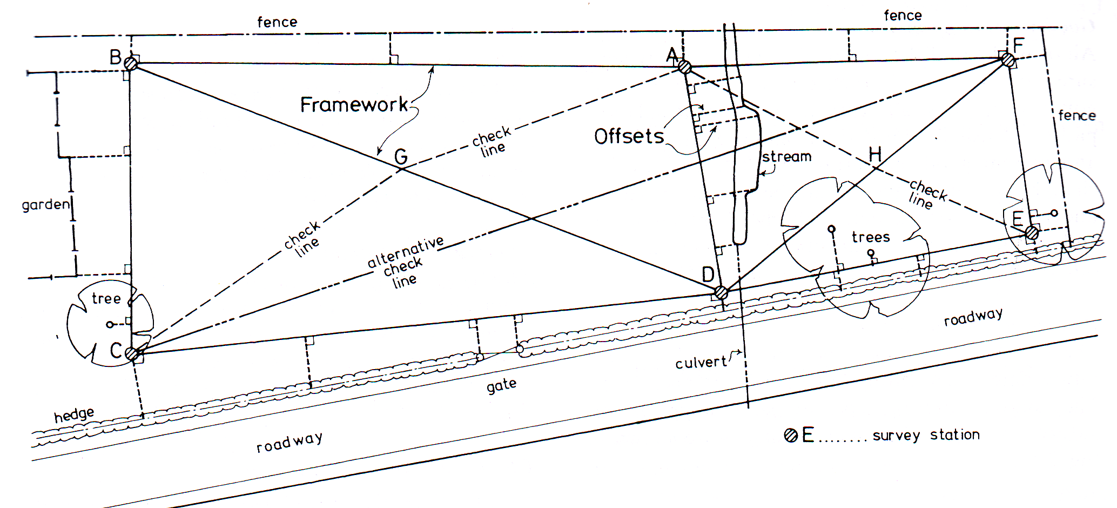
Main Station
Tie line or Subsidiary Line
Tie Station or Subsidiary Station
Check Line
Base Line
Main Survey Line
Offset
Chainage

Slide 8
The principles of trilateration and offsetting are applied to all linear surveys, which are carried out in two parts:
Framework survey (Control Survey)
A framework is established over the whole site to form a geometrical figure, which can be readily plotted.
Detail survey (Preliminary Survey)
The fences, wall, stream, trees, buildings, etc., are the details that are added to the framework by offsetting.
The detail survey is then added to the framework; thus the fundamental surveying rule of ‘working from the whole to the part’ is complied with.

Slide 9
Linear measuring technique
Equipment
Tapes
Ranging Road
Marking Arrow
Writing Pad

Slide 10
Types of taping
Over level ground
Over sloping ground

Slide 11
Measuring horizontal distance
Figure shows a short survey line AB marked on the ground by two pegs. The distance AB is shorter than one length of tape. The measurement of the line AB is obtained by unreeling the tape and straightening it along the line between the pegs.
The zero point of the tape (usually the end of the handle) is held against station A by rear tape person (called the follower).
The forward end of the tape is read against station B by the forward tape person (called the leader) after it has been carefully tightened.

Slide 12
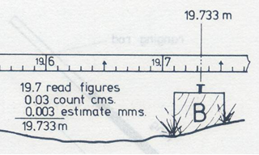

Slide 13
On surveys most of the lines will be considerably longer than one tape length and operational technique is required.
Two ancillary pieces of equipment are necessary, namely ranging rods and marking arrows.
Two surveyors are required to measure a long line. The leader’s job is to pull the tape in the required direction and mark each tape length.

Slide 15
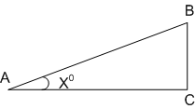
Inclined measurement / Sloping ground
Indirect method
When any measured distance is to be shown on a plan, the horizontal distance is required and any inclined distance must be converted to its horizontal equivalent before plotting.
Figure shows a survey line measured between two stations A and B. The line is not horizontal. Trigonometrically, the inclined distance is the hypotenuse of a right-angled triangle ABC.
In ΔABC
AC/AB = cos x
Therefore AC = AB x cos x
i.e. plan length = slope length x cos inclination

Slide 16
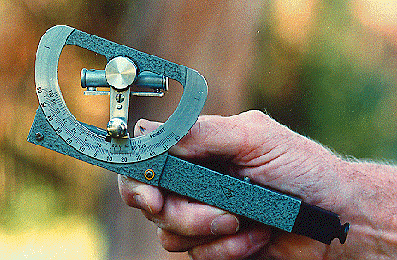
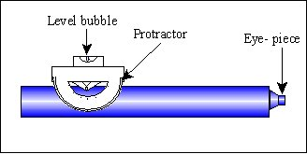
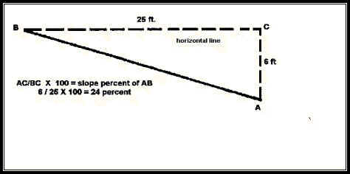
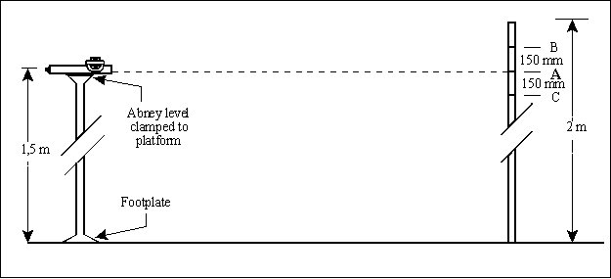
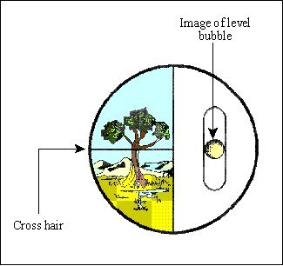
The angle of inclination is measured in the field using some form of clinometer, the most common instrument being the Abney level.

Slide 17
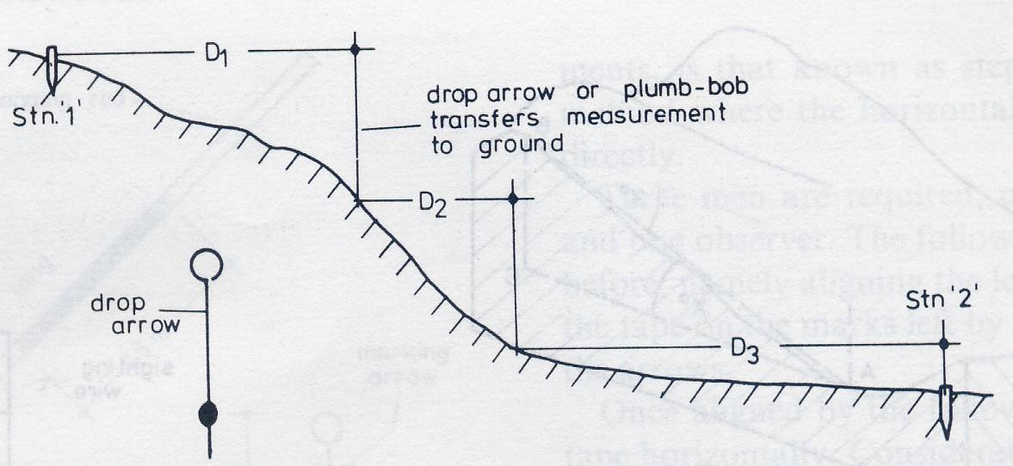
Direct method
This process of measuring with sections of the tape is referred as breaking tape
The plum bob is used
Requires skill and experience

Slide 18
Procedure in linear survey
Reconnaissance survey
Conducting a survey
Recording the survey

Slide 19
Reconnaissance survey
Check measurements or tie lines
Intervisibility of stations
Obstructions to measuring
Referencing the station
Permanency of the stations
Good measuring conditions
Formation of well-conditioned triangles
Working from the whole to the part

Slide 20
Conducting survey
Once the trilateration stations have been selected, the various lines are measured, using the methods previously described.
The three sides and check line of each triangle should be measured before another triangle is attempted.
The survey lines are as close as possible to the details that have to be surveyed. These details include the hedges, trees, fences, building and stream.
2. Offsetting
Offsets are short lengths measured to all points of detail from points along the main framework lines. These latter points are called chainages.
Thus any point of detail must have at least two measurement to fix its position, namely a chainage and an offset.
1. Framework

Slide 21
Recording the survey
Referencing the survey
The first task in booking is to make a reference sketch of the survey as a whole.

Slide 22
Accuracy
All measurement should be accurate, depending upon the precision desired
Legibility
Always keep in mind that notes may be utilized someone else who has never visited the site of survey
Integrity
The notes should be complete in all respects before leaving the site of survey. Even a single omitted measurement may pose a serious problem while plotting
Arrangement
It should be made clear as to how the work began and ended
Clarity
Sketches and tabulation of field data should be clear and readable. Ambiguous notes lead to mistake in drafting and computation

Slide 23
Author Information Dr Idris bin Ali
Dr Cheng Hock Tian

