Slide 1
GEOTECHNICAL ENGINEERING Soil Compression, Consolidation and Settlement
For updated version, please click on
http://ocw.ump.edu.my
by
Dr. Amizatulhani Abdullah Faculty of Civil Engineering ad Earth Resources amizatulhani@ump.edu.my

Slide 2
Chapter description
Aims
This chapter provides further discussion and explanation related to soil consolidation and settlement.
Expected Outcomes
Apply the fundamental of consolidation to solve problems.
Analyze case given and generate effective solution.
References
Das, B.M., “Principles of Geotechnical Engineering, 5th edition”, Thomson Learning (2002).
Raj, P.P., “Soil Mechanics & Foundation Engineering”, Prentice Hall (2008).
Liu, C. & Evett, J.B., “Soils and Foundations, 7th edition”, Prentice Hall (2008).
Whitlow, R., “Basic Soil Mechanics”, Prentice Hall (2004).
Soil Compression, Consolidation and Settlement by Dr. Amizatulhani Abdullah

Slide 3
Content
Compression index and swell index
Time rate of consolidation
Coefficient of consolidation
Normally consolidated and over consolidated clay
Primary consolidation settlement
Secondary consolidation settlement
Conclusion
Soil Compression, Consolidation and Settlement by Dr. Amizatulhani Abdullah

Slide 4
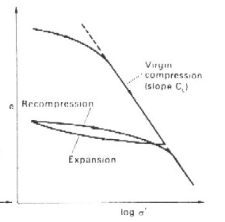
Compression index and swell index
Compression index,
1
e₁
2
e₂
σ₁
σ₂
Soil Compression, Consolidation and Settlement by Dr. Amizatulhani Abdullah

Slide 5
Recompression index / swell index, C_{s} =
e₂
2
e₁
1
σ₂
σ₁
Soil Compression, Consolidation and Settlement by Dr. Amizatulhani Abdullah

Slide 6
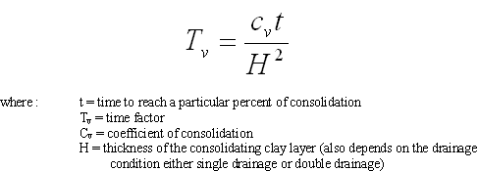
Time rate of consolidation
The rate at which the consolidation occurs depends mainly on the permeability of the soil and the length of drainage path.
Time rate of consolidation can be calculated using the following equation:
Soil Compression, Consolidation and Settlement by Dr. Amizatulhani Abdullah

Slide 7
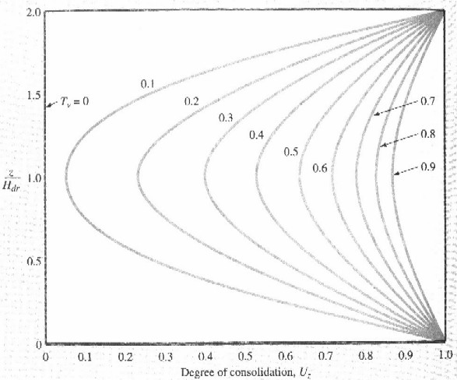
Variation of U_{z} with T_{v} and z/H_{dr} (Das, 2002)
Soil Compression, Consolidation and Settlement by Dr. Amizatulhani Abdullah

Slide 8
Coefficient of consolidation
The coefficient of consolidation, c_{v} can be calculated using the following equation :
the coefficient of volume compressibility, m_{v} can be calculated using the following equation :
Slope of the e/σ’ curve
Soil Compression, Consolidation and Settlement by Dr. Amizatulhani Abdullah

Slide 9
Coefficient of consolidation can also be determine from oedometer test.
A) Casagrande method (logarithmic time method)
B) Taylor method (square root time method)
Please make sure that you know how to obtain t₅₀ and t₉₀ values.
Soil Compression, Consolidation and Settlement by Dr. Amizatulhani Abdullah

Slide 10
Normally & over consolidated clay
NORMALLY CONSOLIDATED
CLAY
OVER CONSOLIDATED
CLAY
If the present effective overburden pressure in the deposit is the maximum pressure to which the deposit has ever been consolidated at any time in the past.
A deposit that has been fully consolidated under a certain pressure in the past, larger than the present overburden pressure. The maximum effective past pressure is called the pre-consolidation pressure, σ_{c}.
Soil Compression, Consolidation and Settlement by Dr. Amizatulhani Abdullah

Slide 11
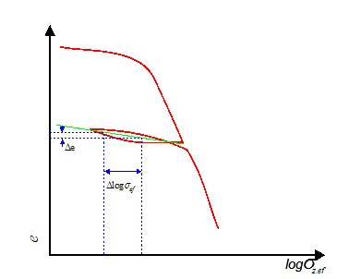
How to determine whether the clay is normally consolidated or not?
(1) Determine the present effective overburden pressure, p.
P, kN/m²
Soil Compression, Consolidation and Settlement by Dr. Amizatulhani Abdullah

Slide 12
a
e
P, kN/m²
(2) By using the void ratio vs log pressure plot, locate the point designated by a pressure of p and void ratio of e.
Soil Compression, Consolidation and Settlement by Dr. Amizatulhani Abdullah

Slide 13
a
e
P, kN/m²
(3) Project the lower right straight line portion of e-log p curve (straight line upward and to the left).
Soil Compression, Consolidation and Settlement by Dr. Amizatulhani Abdullah

Slide 14
b
a
e
P, kN/m²
(4) The dashed line will intersect a horizontal line drawn at e = e₀.
(5) If point b is located to the left of point a, the soil is normally consolidated clay.
Soil Compression, Consolidation and Settlement by Dr. Amizatulhani Abdullah

Slide 15
How to determine whether the clay is over consolidated or not?
Follow step 1 to step 4 (for normal consolidated clay).
If point b is located to the right of point a, the soil is over consolidated clay.
Soil Compression, Consolidation and Settlement by Dr. Amizatulhani Abdullah

Slide 16
Primary consolidation settlement
Occurred due to the expulsion/extrusion of the water that occupies the void spaces.
Primary consolidation settlement is a result of a volume change in saturated cohesive soils.
Very slow and continues over a long period of time.
Soil Compression, Consolidation and Settlement by Dr. Amizatulhani Abdullah

Slide 17
How to estimate primary consolidation settlement?
For normally consolidated clay
Soil Compression, Consolidation and Settlement by Dr. Amizatulhani Abdullah

Slide 18
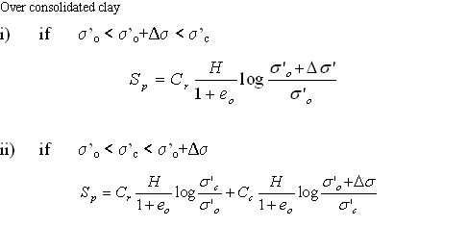
For over consolidated clay
Soil Compression, Consolidation and Settlement by Dr. Amizatulhani Abdullah

Slide 19
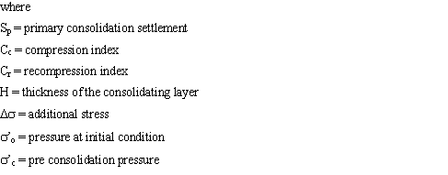
Soil Compression, Consolidation and Settlement by Dr. Amizatulhani Abdullah

Slide 20
Secondary consolidation settlement
Additional form of compression that occurs at constant effective stress at a very slow rate.
Observed in saturated cohesive soils.
Result of the plastic adjustment and rearrangement of soil fabrics.
Occurs after the primary consolidation settlement ended.
Soil Compression, Consolidation and Settlement by Dr. Amizatulhani Abdullah

Slide 21
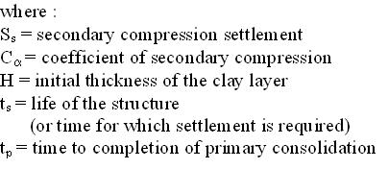
How to estimate secondary compression settlement?
Soil Compression, Consolidation and Settlement by Dr. Amizatulhani Abdullah

Slide 22
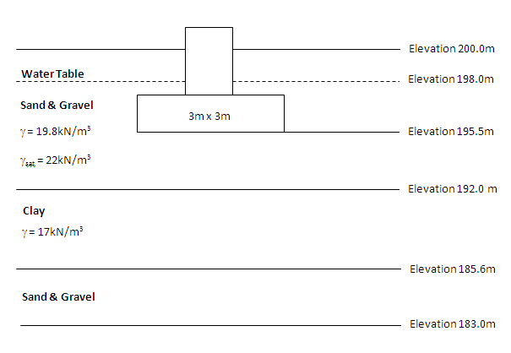
Work example
Soil Compression, Consolidation and Settlement by Dr. Amizatulhani Abdullah

Slide 23
Data :
Total load, Q = 5400kN
Initial void ratio, e_{o} = 1.38
Compression index, C_{c} = 0.68
Influence coefficient, I = 0.08
Calculate the primary consolidation settlement of the soil.
Soil Compression, Consolidation and Settlement by Dr. Amizatulhani Abdullah

Slide 24
Solution for work example
Determine the present effective overburden pressure, σ’_{o}
Determine the stress increment under foundation, Δσ
Substitute all the values into equation, S_{p}
Ans : 0.240m
Soil Compression, Consolidation and Settlement by Dr. Amizatulhani Abdullah

Slide 25
Conclusion
Conclusion #1
There are several important parameters that can be obtained from oedometer result which are compression index, swell index, time rate of consolidation, coefficient of consolidation.
Conclusion #2
By using those related parameters, the settlement of soil can be estimated either in term of primary or secondary settlement.
Soil Compression, Consolidation and Settlement by Dr. Amizatulhani Abdullah

Slide 26
Author Information Dr. Amizatulhani Abdullah Dr. Mohd Yuhyi Mohd Tadza Dr. Youventharan Duraisamy Dr. Muzamir Hasan Ir. Azhani Zukri

