Slide 1
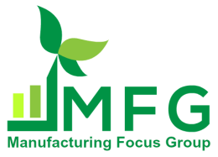
Plastics
Plastic Injection Technology BMM 4843
Wan Sharuzi Wan Harun
Faculty of Mechanical Engineering Universiti Malaysia Pahang
sharuzi@ump.edu.my
jihad_ku@yahoo.com
019 959 0039
09 424 6339

Slide 2
INTRODUCTION
Anyone attempting to learn the basics of IM must first have an understanding of the raw materials used.
There are two types of plastic used in IM. Most IM is performed using thermoplastic material. However, some injection molding uses thermoset material.
There is considerable difference between the two types.

Slide 3
THERMOPLASTICS
The majority of thermoplastics are made from petroleum and have the unique physical property of being able to be melted, solidified, and remelted again without significantly changing the chemistry of the material.
By grinding up the solidified thermoplastic and remelting it, the material can usually be reused, with or without mixing it with new pellet.

Slide 4
Depending upon how many times and under what conditions the thermoplastic material has been melted and solidified (its heat history), some of its properties may be diminished.
As a result, most thermoplastic that is reused (regrind) is mixed with new pellet material where the regrind represents <50% of the resulting mixture.

Slide 5
Thermoplastics typically have long proper names that relate to their basic chemistry type.
All plastics have been given an alphabetic symbol that is a "short name" for each plastic's longer technical name.
Some of the more common plastics and their symbols include the following.

Slide 6
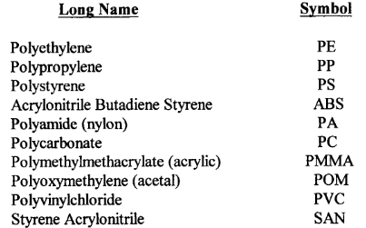

Slide 7
Many of the long names begin with "poly," which simply means many or multiple. The smallest repeating unit in the chemical structure of plastics is called a monomer.
When several monomers are combined or joined, the resulting chemical structure is called a polymer.
So it becomes clear that polyethylene, polypropylene and the others beginning with the letters "poly" are plastics consisting of a combination of monomers.
A list of more common thermoplastics, showing their proper name and symbol is shown in a table on the next page.

Slide 8
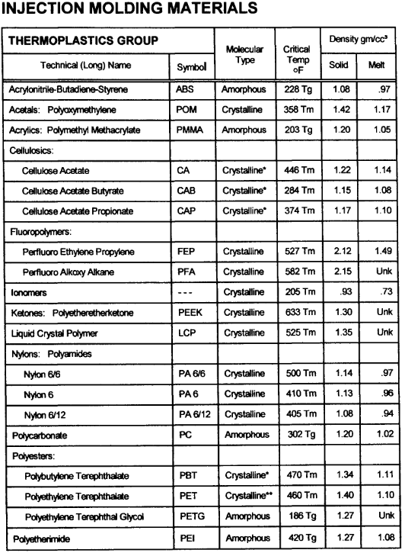
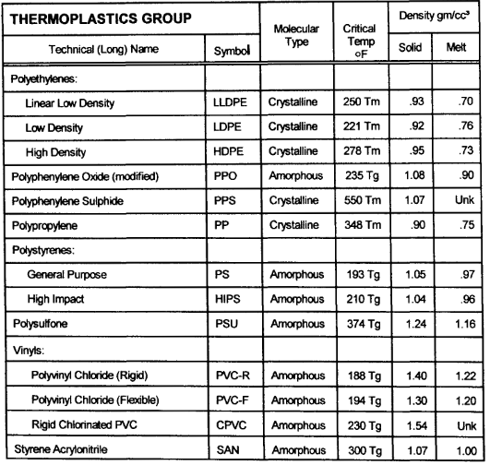
Appendix A

Slide 9
THERMOSETS
Thermosets are plastics that undergo a chemical change when heated to a certain temp.
These materials, once solidified, cannot be remelted or reused. Any attempt to remelt thermosets simply results in burning or decomposition of the material.
Thermosets cannot be reprocessed or welded.
The chemical change that occurs in thermosets is often referred to as curing or cross-linking.

Slide 10
Crystalline vs. Amorphous Materials
We have learned that plastics are composed of small molecules which have been joined together to form long chain molecules that are referred to as polymers.
In the solid state, some of the polymer molecules are arranged in a very orderly, repetitive pattern and are called crystalline.
Others are structured in a very random arrangement without any regularly repeating pattern, and they are called amorphous.

Slide 11
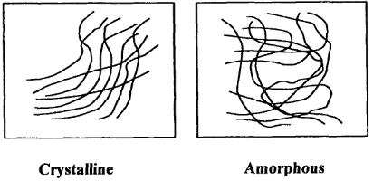
The greater the degree of crystallinity of a polymer, the more orderly its structure becomes.
Figure 2.1 Illustrative drawing of polymer molecules

Slide 12
The important thing to remember is that the physical properties of these two types of plastics are quite different.
This is very important to the part designer who must select the best material for each unique product.

Slide 13
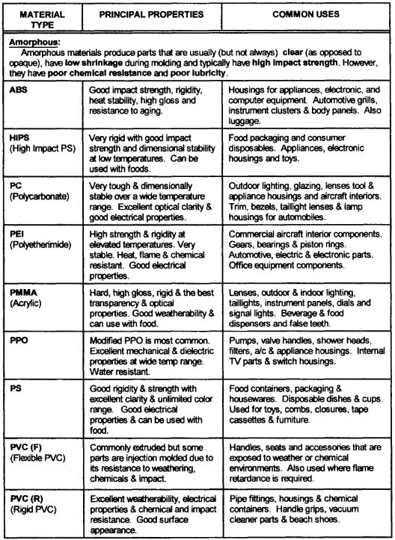
Properties of common plastics.

Slide 14
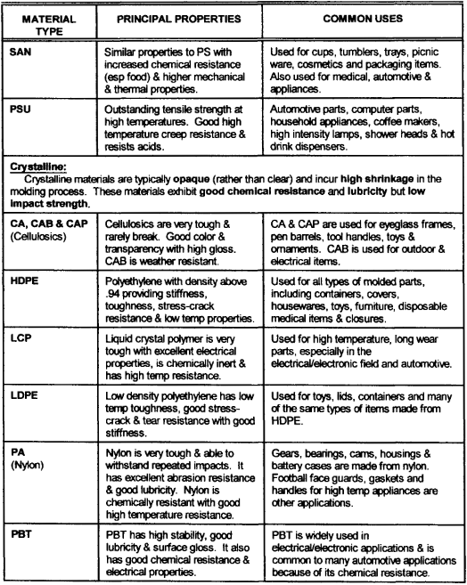
Properties of common plastics.

Slide 15
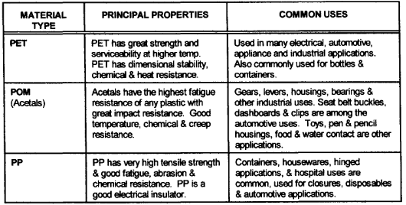
Properties of common plastics.

Slide 16
How plastics affect the molding process?
On top of the two types (crystalline and amorphous) of material respond to the melting and molding process, there are at least three vital differences;

Slide 17
1. Melting Characteristics
The first major processing difference between crystalline and amorphous materials is the way they melt.
As heat is applied, both materials soften at first, but the amorphous material continues to soften gradually until it will flow.
The softening point is referred to as the glass transition temp. (T_{g}).
Amorphous materials have no defined melting point.

Slide 18
In contrast, the more highly crystalline materials remain in a relatively solid state until the temp. reaches their melting point (T_{m}).
This difference in the way the materials melt is an important factor in how the materials are molded.
The listing on the next slide has an added column to indicate whether each material is crystalline (C) or amorphous (A).

Slide 19
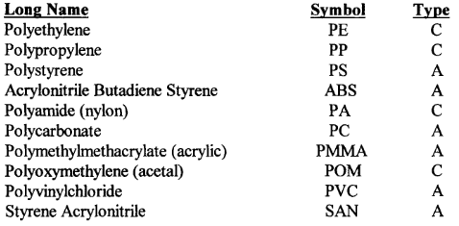

Slide 20
2. Thermal Conductivity
The ability of plastics to absorb heat is quite low, about 3 times lower than metals.
The low rate of heat absorption influences the speed with which plastics can be heated, melted and molded.
Amorphous materials have much less ability to conduct heat than crystalline materials.
In fact, as the crystallinity increases, the ability to conduct heat also increases.

Slide 21
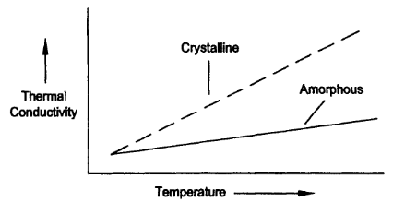
Stated another way, you cannot add more heat to amorphous materials and expect them to melt any faster!
In fact, if too much heat is applied to amorphous materials, they will burn and degrade.
Figure 2.2 Heat absorption characteristics of crystalline vs. amorphous polymers

Slide 22
3. Shear Sensitivity
Amorphous materials are more sensitive to shear.
Shear occurs when plastic pellets are compressed, rubbed together causing friction or are significantly agitated during the molding process.
High shear results in rapidly increasing the temp. of the material while being molded which amorphous polymers do not tolerate well.

Slide 23
It can be concluded that amorphous materials should be gradually heated when changing them from a solid to a melt.
Excessive melt temp. in some materials (amorphous) can cause residual molded-in stresses (upon cooling) that detract from part appearance or reduce the mechanical strength of the parts.
All materials have a max limiting shear rate, beyond which they will degrade.

Slide 24
4. Viscosity (Melt Index)
Another property of both crystalline and amorphous materials that affects the molding process is viscosity.
Viscosity may be defined as the resistance of a fluid to flow.
If the melted plastic is considered viscous, it is thick and will not flow easily.
Viscosity of the melted plastic is measured and given rating known as Melt Index (MI).
A high MI means that the melted plastic is thin and watery (has low viscosity).

Slide 25
The lower the MI, the more thick and viscous the melt is and the less easily it will flow.
The melt index of plastics range from less than one, to more than a hundred.
Most common materials have a MI in the range of 2 to 12. There are various test methods and parameters for measuring MI.
When comparing materials, it is important that the method and parameters are the same.

Slide 26
Today’s Quiz
As known, the quality of the regrind is subjected to its heat history, where some of its properties may be reduced. There are some cases, however, where plastic products are still produced from 100% regrind and sold to the public. Discuss the matter.

Slide 27
Assignment 2
There are various test methods and parameter for measuring Melt Index of polymers. Identify those testing methods. Among those method, suggest a testing method for MI measurement of crystalline polymer material. The suggestion must support with acceptable justifications.
Materials with a very high MI or very low viscosity are harder to push or inject and, in some cases, harder to mold. Discuss the statement above.

