Slide 1
Chapter 1 Introduction to Biopharmaceutics & Pharmacokinetics
by
Dr. Arshad Ali Khan Faculty of Engineering Technology arshad@ump.edu.my

Slide 2
Biopharmaceutics
“Biopharmaceutics is the study of the factors influencing the bioavailability of a drug in man and animals and the use of this information to optimize pharmacological and therapeutics activity of drug products” (American Pharmaceutical Association, 1972).

Slide 3
Bioavailability
Amount of a chemical substance becomes available to the systemic circulation or target organs after the administration to living organisms via any route of administration such as oral, parenteral and topical route etc.

Slide 4
Factors influencing the bioavailability of drugs
Diluent
binding agents
disintegrating agents
coloring agents etc.
Chemical nature of drugs
Inert excipients used for development of the dosage form
Method of manufacturing
Physiochemical properties of drugs
Weak acid or weak base
Weak acid or weak base
Pka
particle size
Size distribution
Partition coefficient
Polymorphism etc.

Slide 5
Relationship between the administered dose and amount of drug in the body
Only the bioavailable drug will produce the therapeutic activity
(AUC)₀ - area under curve of plasma drug concentration versus time (AUC) from time zero to time infinity
K – First order elimination rate constant
V (or V_{d}) – drug’s volume of distribution
F – Bioavailable fraction
Intravenous solution
Extravascular route

Slide 6
Plasma concentration versus time plot – extravascular route

Slide 7
ONSET OF ACTION
The time when medicinal agent reaches the therapeutic level and shows the therapeutic action.
TERMINATION OF ACTION
The time when the medicinal agents stop showing the therapeutic action and go down to the minimum effective concentration (MEC) in the systemic circulation.
DURATION OF ACTION
The time duration between the onset of action and termination of action.
THERAPEUTIC RANGE
The range of the drug concentration in systemic circulation within which medicinal agent shows the therapeutic effect.

Slide 8
Plasma concentration versus time plot – Intravenous route

Slide 9
Comparisons between Intravascular and Extravascular routes
INTRAVASCULAR ROUTE
EXTRAVASCULAR ROUTE
no absorption phase
immediate onset of action
100 % dose available to show the therapeutic action
Adverse reactions are difficult to reverse
absorption phase is exist
Therapeutic action is regulated by factors such as formulations, dosage form, etc
entire administered dose may not reach target site ( poor absorption)

Slide 10
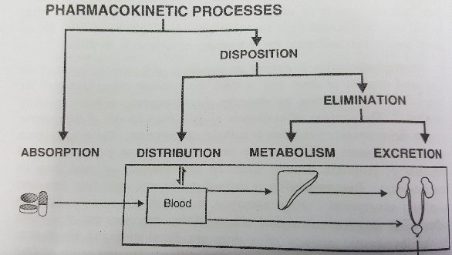
PHARMACOKINETICS
“Pharmacokinetics is the study of kinetics of absorption, distribution, metabolism and excretion (ADME) of drug and their corresponding pharmacologic, therapeutic, or toxic response in man and animals” (American Pharmaceutical Association, 1972).
Is a study of what the body does to the drug.

Slide 11
Absorption
It is process of drug transportation from site of administration to the measurement site such as blood and plasma etc.

Slide 12
Distribution
Distribution is the process of reversible transfer of drug to and form the site of measurement (usually blood or plasma)
The rate and extent of this process is evaluated by
Blood circulation in tissue and organs
Drug binding to tissues and plasma proteins
Drug permeability to the tissue membrane

Slide 13
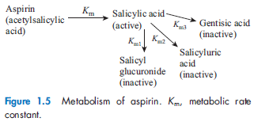
Metabolism
Metabolism is the process of a conversion of one chemicals species to another chemical species
Normally, the metabolites contain less or none of the therapeutic activity of main drug.
Some exception, drug with therapeutic active metabolites:

Slide 14
Elimination
It is a process of irreversible depletion of drug from the site of action.
It can occurs by:
metabolism
excretion

Slide 15
Excretion
kidney
liver
lungs
Major site of excretion of drug in a chemically unchanged or unaltered form
primary organ where drug metabolism occur
important route of elimination for substances of high vapor pressure

Slide 16
Exercise
Group discussion
Extract information's related to biopharmaceutics & pharmacokinetics from the given articles

Slide 17
Rate Processes
After a drug is administered, it is subjected to a number of processes (ADME) whose rates control the concentration of drug in the elusive region known as “site of action”.
These processes affects:
Onset of action,
Duration of pharmacological response
Intensity of pharmacological response.

Slide 18
Rate Processes
Suppose symbol Y a some function that changes with time (t)
Y = dependent variables
t = independent variables
Y – can be either
Drug mass in the body (X)
Drug mass in the urine (X_{u})
concentration of drug concentration in biological fluid such as plasma or serum (C_{p} or C_{s})

Slide 19
Zero-order process
The following is derivation of the equation for zero-order elimination process:
Since Y⁰ = 1
The integration of Eq 1.2 yield the following:
Y = Y₀ – K₀t
K₀ is zero order rate constant, the minus sign indicate negative change over time.
Equation 1.1
Equation 1.2
Y changes at a constant rate.
Equation 1.3
Where Y is the amount present at time t and Y₀ at time zero.

Slide 20
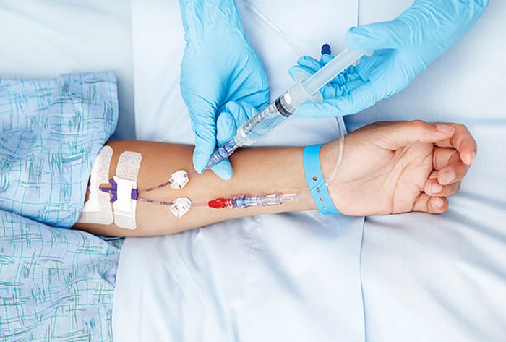
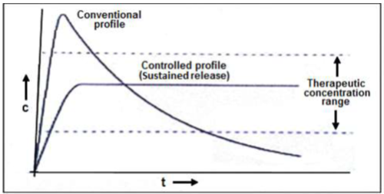
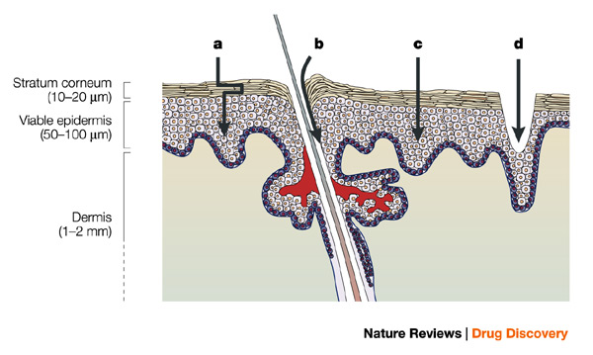
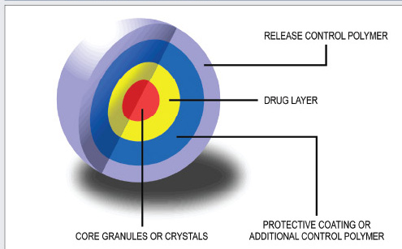
Application of zero-order processes
Intravenous infusion
Controlled-release dosage forms
Transdermal drug delivery

Slide 21
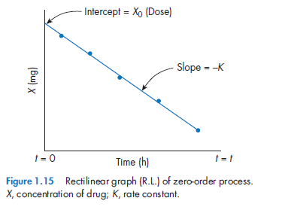
Example for zero-order process
lets substitute the general variable Y with X ( mass of drug in the body at time t) in equation 1.2
Integrated equation is
X = X₀ – K₀t
Where X_{t=0} is the amount of drug in the body at time zero. (for intravenous injection, this equals the administered dose, X₀)
Equation 1.4
Equation 1.5
Unit for rate constant K₀ is mass/time (e.g: mg h⁻¹)

Slide 22
Example for zero-order process
lets substitute the general variable Y with X ( mass of drug in the body at time t) in equation 1.2
Integrated equation is
X = X₀ – K₀t
Where X_{t=0} is the amount of drug in the body at time zero. (for intravenous injection, this equals the administered dose, X₀)
Equation 1.4
Equation 1.5
Unit for rate constant K₀ is mass/time (e.g: mg h⁻¹)

Slide 23
First-order process
The following is derivation of the equation for first-order elimination process:
Since Y¹ = Y
The integration of Eq 1.7 yield the following:
Y = Y₀e^{-kt}
ln Y=lnY₀ – Kt
Log Y = log Y₀ –Kt/2.303
K is first-order elimination rate constant, the minus sign indicate that the amount Y is decreasing over time.
Equation 1.6
Y changes depends on the product of the rate constant (K) and the mass of the substance undergoing change.
Equation 1.7
Equation 1.8
Equation 1.9
Equation 1.10

Slide 24
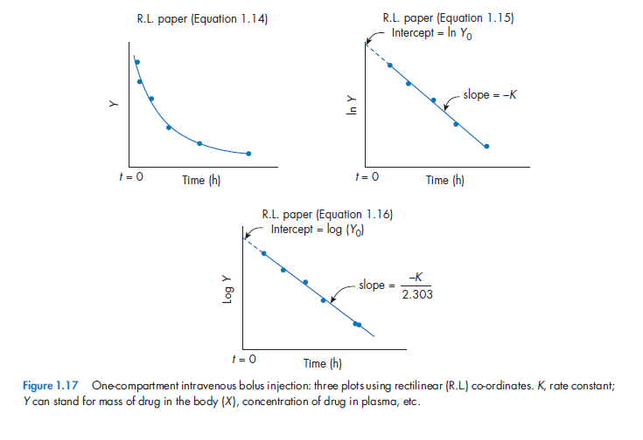
First-order process
Equation 1.8
Equation 1.9
Equation 1.10

Slide 25
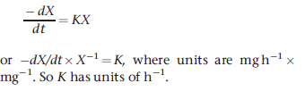
Example for first-order process
lets substitute the general variable Y with X ( mass of drug in the body at time t) in equation 1.6
Integrated equation is
X = X₀ – K₀t
Equation 1.11
Unit for rate constant K is h⁻¹
Equation 1.12
X = X₀e^{-kt}
ln X=lnX₀ – Kt
Log X = log X₀ –Kt/2.303
Equation 1.13
Equation 1.14
Equation 1.15

Slide 27
Thank you

