Slide 1
BSB3503 - Biomanufacturing CHAPTER 1 Introduction to Biomanufacturing
Author: Nurul Azyyati Sabri
Co-Author / Editor: Rama Yusvana
Faculty Industrial Sciences & Technology yusvana@ump.edu.my

Slide 2
Chapter Description
Aims
Provide overview of biomanufacturing industry
Expected Outcomes
Understand the basic steps in production of biopharmaceuticals
Aware of the regulatory issues involved in production of biopharmaceuticals
References
Helmus, F. P. (2008). Process Plant Design. From management from Inquiry to Acceptance. Wiley-VCH.
Peters, M. S. and Timmerhaus, K. D. (1991). Plant Design and Economics for Chemical Engineers. Mc Graw Hill.

Slide 3
What is biomanufacturing?
“Biomanufacturing is an advanced manufacturing technology that involves the use of chemical, physical, and biological processes performed by living cells for use in other applications”.

Slide 4
Biomanufacturing is also known as bioprocessing. People who work in this field need to know Biology, Engineering, and Manufacturing technology.

Slide 5
Biomanufacturing enables the manufacture of products with unique characteristics
Biomanufacturing encompasses technologies such as:
• Biotechnology
• Bioengineering
• Biodetection
• Biomaterials
• Biocomputation

Slide 6
Biomanufacturing is a complex process involving multiple unit operations many of which are critical to insuring patient safety and product efficacy
Types of products:
Vaccines for humans and animals
Biopharmaceuticals
Amino acids
Industrial enzymes
Custom DNA sequences
Therapeutics isolated from blood

Slide 7
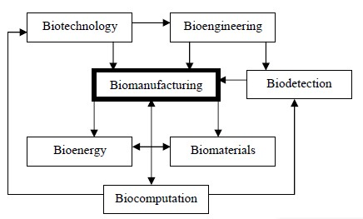

Slide 8
How do the microbes grow?
Microbes are usually incubated under specific conditions in large tanks called fermenters or bioreactors.
Fermentation: A process of growing microorganisms (microbes) to produce various chemical or pharmaceutical compounds.

Slide 9
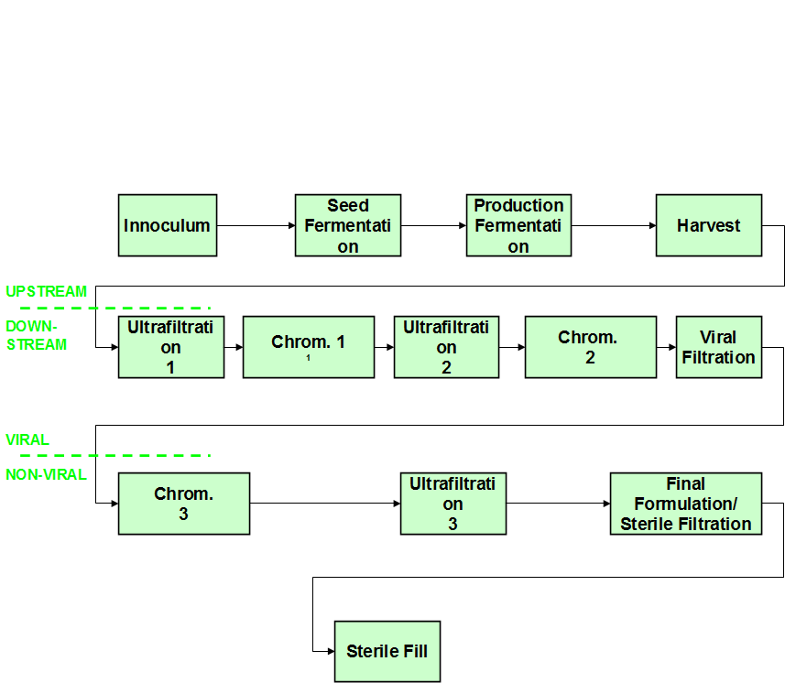
Block Flow Diagram of a typical Production Process

Slide 10
How do biotech companies ensure safe and quality products?
Good Manufacturing Practices (GMP) are regulations established by the U.S. Food and Drug Administration (FDA). GMP regulations describe the methods, equipment, facilities, and controls required for producing pharmaceutical products.

Slide 11
Standard operating procedure (SOP): A document that defines in detail every step of only one particular process so it can be performed exactly the same way every time.
In biomanufacturing, there are SOPs for every single step of the process; for example, the correct way to put on a gown before entering the production area.

Slide 12
WHY ARE GMP AND SOP IMPORTANTS?
Some Biomanufacturing facilities make batches of product worth millions of dollars.
Their employees are responsible for the production of each batch and for helping to ensure its quality by taking samples for testing.
If batches are not made properly, the consequences can be serious and costly:
-Lost profit due to bad/discarded batches
-Loss of customers due to bad product or publicity
-Sick, injured or deceased customers
-Lawsuits
-Company shutdowns and loss of jobs

Slide 13
Industry skill standards are needed to guide educators and trainers in colleges, high schools, companies, private training programs, and other venues to plan training programs, courses, curricula, and other learning experiences to prepare people to meet the real performance needs for an industry’s workforce.
Standards help ensure that what is learned is what industry has said their employees will need for work, thereby creating a secure fit between technical education and employment and career opportunities.

Slide 14
Trend in biotechnology industry
The U.S. biotechnology industry is now well into its third decade.
The industry has enlarged from its early, nearly total emphasis on basic applied research development of products production of consumer-ready products that have been tested and approved by the FDA.
The biomanufacturing component of the biotechnology industry is about to expand significantly, especially in the Northeast as more and more products pass through trials and are approved for consumer use.

Slide 15
Trend in biotechnology industry
Germany's biomanufacturing sector is known worldwide as one of the industry's leaders.
With a fermentation capacity of 675,000 liters, Germany leads Europe and is second only to the US in the production of biopharmaceuticals production of effective ingredients in large fermenters – began in Germany in 1987.
It started with the first commercial manufacture of an active substance for preventing blood clots called alteplase.
This initiated the development of Germany into a locus for medical biotechnology.

Slide 16
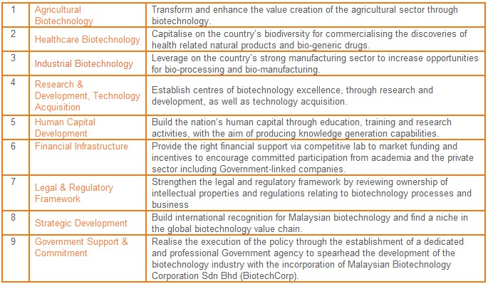
The Nine Thrusts of the National Biotechnology Policy (28 Apr 2005).

Slide 17
Biomanufacturing in malaysia
Biotech Corp
BiotechCorp is an agency under the purview of Ministry of Science, Technology and Innovation and is wholly-owned by the Ministry of Finance Incorporated.
BioNexus-status companies
Eg: Biotropics Malaysia Berhad. Research, development, extraction, production and commercialization of identified biological active compounds from herbs and plants for the formulation of herbal-based health supplement products.

Slide 18
Biomanufacturing in malaysia
Inno bio – Nilai, Negeri Sembilan.
Monoclonal antibodies and therapeutic proteins.
200L and 1,000L production bioreactors, associated inoculums suite and primary recovery equipment for efficient cell removal and concentration.

Slide 19
Biomanufacturing in malaysia
Oct-10 - Biocon to invest RM500 mn in Bio-Xcell in SiLC,
Setting up a bio manufacturing & R&D facility targeted to be operational by Nusajaya by 2014

Slide 20
Technology Park Malaysia
Utilise natural resources.
With the investment of more than RM28m, a biodiversity research and production center was setup on a 500-acres of land in Raub, Pahang.
This research and production center is fully equiped with state-of-the-art laboratory equipments and production facilities to meet the market demand for high quality products with competitive price.

Slide 21
Conclusion
Biomanufacturing is responsible for production of biologics, typically biotech-based
Therapeutics that structurally-mimic biological components found in living organism
Biologics / biopharmaceuticals typically include:
Hormones
Growth factors
Blood proteins
Clotting factors
Enzymes
Antibody
DNA/RNA
Stem cells

