Slide 1
Loaders and Dryers
Plastic Injection Technology BMM 4843
Wan Sharuzi Wan Harun
Faculty of Mechanical Engineering Universiti Malaysia Pahang
sharuzi@ump.edu.my
jihad_ku@yahoo.com
019 959 0039
09 424 6339

Slide 2
INTRODUCTION
The next step in the molding process is to dry the plastic (if required) and move it from its storage location to the IM machine hopper.
This is accomplished by one or more pieces of equipment categorized as dryers and loaders.

Slide 3
Hopper Loaders & Conveying Systems
The equipment may be as simple as a vacuum powered hopper loader with hoses that pull pellets from a storage box or as complex as a pneumatic material handling system.
In recent years, portable self-contained hopper loaders are in greater use. These units have their own blower and motor and are no longer located on top of the IM machine, but rather are cart-mounted configurations located at the floor level.
A central system has a main controller, one large motor/blower, a single stand-alone filter and dust collector and a filterless receiver on each molding machine. Compressed-air blowback filter cleaning and stainless-steel construction are optional features available.

Slide 4
Another option is a portable combination dryer/loader system that allows the drying of the material off-line and is moved into position when the dried material is scheduled to be used.

Slide 5
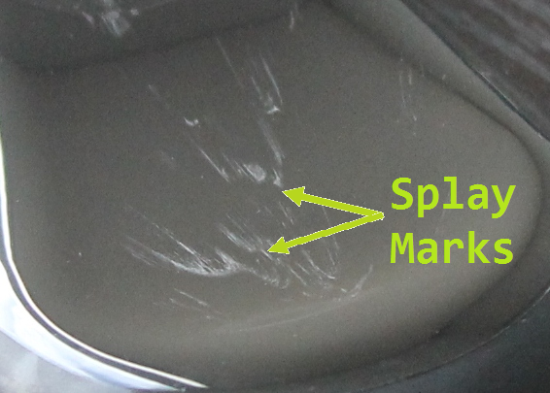
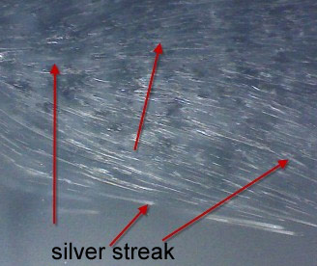
Dryers
All plastics used in the molding process, including regrind, are affected by moisture to some degree.
If the moisture is not removed from the plastic, it can cause defects in the molded product, such as splay marks (streaks) and brittleness.

Slide 6
Plastic materials are considered to be either hygroscopic or non-hygroscopic.
Those considered to be hygroscopic absorbs the moisture within the pellet (or flake) and cause a molecular bond with the material.
ABS, PMMA, FEP, PA, PBT, PC, PET, PPO, PVC, SAN, PSU and PEI. These are the hygroscopic materials.
Beside to causing part defects, moisture that is allowed to remain in these materials can unite with other elements to produce corrosives at processing temperatures.
The result is a premature corrosive wear on the surfaces of the injection unit components.

Slide 7
Non-hygroscopic plastic materials do not absorb moisture, but the moisture in the air adheres to the surface of the pellets or flakes and can cause some of the same types of processing problems observed with hygroscopic materials.
Non-hygroscopic materials include polyethylenes, polypropylenes and polystyrenes. Often it is advisable to dry these materials as well.

Slide 8
Hot Air Dryers
There are two major types of dryers used in the molding process, hot air dryers and dessicant dryers.
The hot air dryer basically consists of heaters and an air blower and are typically mounted on top of the injection unit as a dryer hopper, replacing the standard hopper.
Ambient air is pulled into the dryer-hopper, heated and then blown up through the plastic pellets in the hopper.
The hot air evaporates the moisture in the plastic and then moves it out of the hopper back into the room air

Slide 9
Dessicant Dryers
The dessicant dryer utilizes small beads that can absorb a lot of moisture without undergoing any significant structural change.
It’s pulling the moist air from the plastic pellets in the drying hopper into the dryer through a filter, then through a layer of the dessicant beads (called the dessicant bed), which absorb the moisture, and finally to a heating unit where the dry air is brought up to a specified temperature.
This dry air is then circulated through the plastic pellets in the drying hopper. The dry air becomes more moist as it leaves the plastic and the closed-loop process is repeated until the proper level of moisture allowed for the plastic is achieved.

Slide 10
When the dessicant bed becomes nearly saturated with moisture, the air flow is diverted to another dessicant bed and the process continues.
The original bed is regenerated (rid of moisture) and is ready for use again.
A table designated as Appendix B describes the drying requirements for some of the more common plastics.

Slide 11
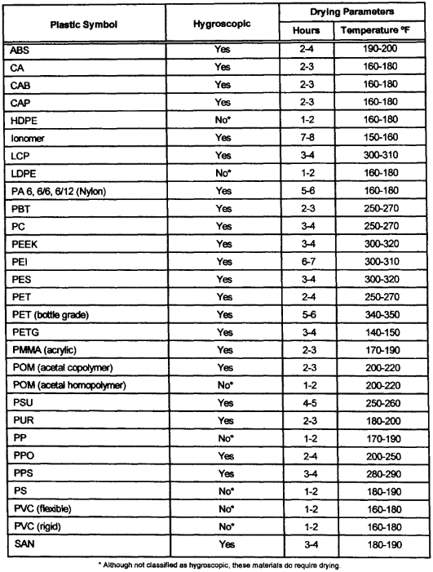
Appendix B; Recommended Plastic Drying Data

Slide 12
The primary consideration in choosing a dryer is throughput or kg per hour. There are basically four options from which to choose a dryer configuration:
1. A totally machine mounted unit;
2. A portable unit;
3. A larger less portable unit that sits near the IM machine; and
4. A central drying system
These units offer various controls, numbers of dessicant beds.

