Slide 1
Electric and Electronic Technology Chapter 5 – Op-Amp and BJT
by
Akhtar Razali FKM akhtar@ump.edu.my

Slide 2
QUIZ 5B – BJT
This quiz contributes 2% of the total marks.

Slide 3
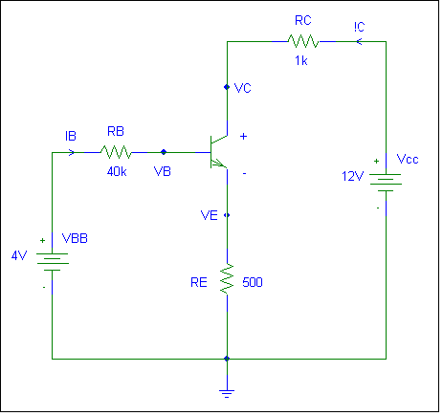
QUIZ 5B – BJT
QUESTION 1:
Calculate the followings:
Given: Gain, β = 100, V_{B} = 8V, V_{E} = 7.5V, Find I_{C}, V_{C} and V_{CE}
(10 Marks)

Slide 4
Akhtar Razali FKM, UMP.

