Slide 1
BSB3503 - Biomanufacturing CHAPTER 13 GMP – Downstream Processes
Author: Nurul Azyyati Sabri
Co-Author / Editor: Rama Yusvana Faculty Industrial Sciences & Technology yusvana@ump.edu.my

Slide 2
Downstream Processing
• Biomolecules (proteins and nucleic acids) are susceptible to aggregation, degradation or inactivation
– By host cell enzymes (proteases, glycosidases, DNAses)
– By heat (proteins may denature/aggregate)
– Changes to pH, ionic strength, solvent strength (proteins may denature/aggregate)
– By oxidation
• Susceptibility is very much on a case-by-case basis

Slide 3
Purification of Biopharmaceuticals
Recombinant therapeutic protein products may be produced in both prokaryotic and eukaryotic systems.
These products and production systems provide different challenges to recovery of the target molecule
Protein Therapeutics
Bacteria
– Product intracellular and may be partly/largely insoluble
– High endotoxin load
Mammalian cells
– Possible low yield (product is dilute)

Slide 4
Downstream processing
Unit operations to recover the target biomolecule from the fermentation process.
Goals are:
– High yield/recovery
– Low or undetectable contaminants
– Limited generation of product variants
– Reproducibility
– Comparability
– GMP-compliance

Slide 5
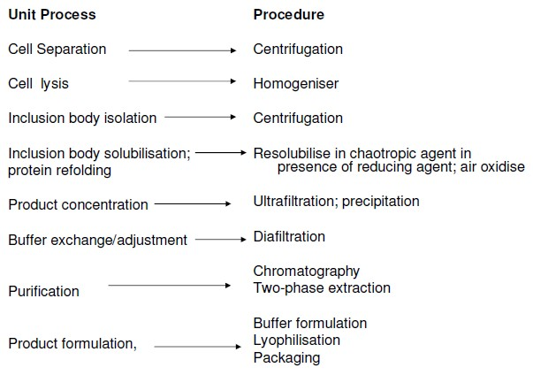
Typical processes and procedures in downstream processing of proteins produced in prokaryotic systems

Slide 6
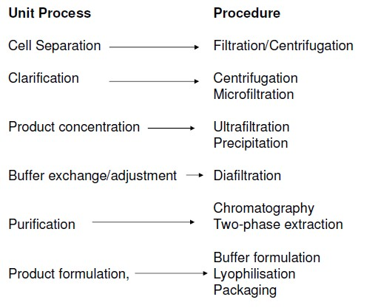
Typical processes and procedures in downstream processing of proteins produced in eukaryotic systems

Slide 7
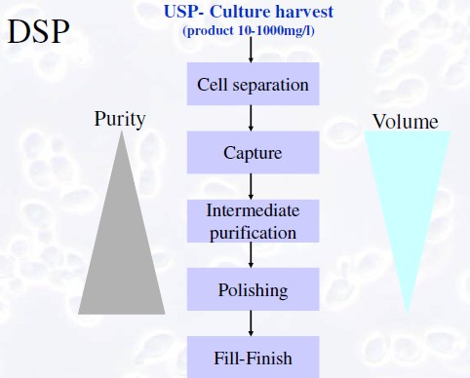

Slide 8
Downstream processing of pharmaceutical products

Slide 9
Purification techniques
• Filtration
• Precipitation
• Liquid-liquid two-phase separation
• Chromatography
– Size exclusion (gel filtration)
– Ion-exchange
– Hydrophobic interaction
– Reverse- Phase
– Hydroxyapatite
– Affinity (protein A,G etc, dyes, metal chelates, lectins etc…)
– Fusion proteins (tagging, Fc, Intein, streptavidin etc…)

Slide 10
Other Technologies for Purification of Pharmaceutical Products
Depth Filtration
Tangential Flow Filtration
Viral Removal

Slide 11
Depth Filtration
3-D filter matrix that serves to remove the bulk of large particulates from the feedstock.
Water and very small (i.e. the product) particles pass through the filter while large debris cannot.
Require high pressure pump

Slide 12
Depth Filtration
Mainly suitable for expression systems in which the molecule of interest is secreted out of the cell into the surrounding solution (mammalian cell culture) and a relatively low density of cell debris is present
This mechanical separation process is referred to as clarification
The advantage of depth filtration is low equipment cost and seamless transfer from bench scale to production scale

Slide 13
Chromatography
Separate a target / product molecule from thousands of others in solution with the liquid “mobile phase” containing the molecule of interest is passed through a solid “stationary phase.”
The stationary phase (resin or media), contains immobilized chemicals (i.e. the “ligands”) that can bind to the product molecule, allowing other unwanted molecules to pass through the column and be discarded.

Slide 14
Chromatography
The captured target molecules can be eluted from the column by changing the microenvironment condition such as pH or ionic concentration that removes or detaches the target molecules from the column

Slide 15
Various types of chromatography
Size exclusion chromatography
Separates molecules according to their size (or more accurately according to their hydrodynamic diameter or hydrodynamic volume)
Also known as gel permeation chromatography (GPC) or gel filtration chromatography

Slide 16
Various types of chromatography
Ion exchange chromatography
Separate analytes based on their respective charges
uses a charged stationary phase to separate charged compounds including anions, cations, amino acids, peptides, and proteins

Slide 17
Various types of chromatography
Affinity chromatography
Based on selective non-covalent interaction between an analyte and specific molecules
Purification of fusion proteins bound to tags.
These fusion proteins are labeled with compounds such as His-tags, biotin or antigens, which bind to the stationary phase specifically

Slide 18
Various types of chromatography
Hydrophobic interaction chromatography
The matrix material is lightly substituted with hydro- phobic groups (methyl, ethyl, propyl, octyl, phenyl)
At high salt concentrations, non-polar sidechains on the surface on proteins "interact" with the hydrophobic groups
Subsequently eluted (harvested/purified) by decreasing salt concentration, use of detergent or change of pH

Slide 19
Tangential Flow Filtration (TFF)
Similar with dialysis principle, is used to remove or change the buffer surrounding the target molecules product with another buffer that is more suitable for the next processing step
The pores in a tangential flow filter are small enough that the drug product does not pass through. However, it moves parallel to the filter surface

Slide 20
Tangential Flow Filtration (TFF)
Impurities, salts, and water pass through the filter and are discarded.
TFF is usually used as a preparative step between chromatography steps or to formulate the product of interest with the optimal salts and excipients

Slide 21
Viral Removal/Reduction Technique
Viral membrane filtration technology with highly specialized filters with precise pore sizes that allow the product molecule to pass through but trap viruses.
The challenge: some viruses, especially parvoviruses, are incredibly small (18–28 nm in diameter) and similar in size to product molecules

Slide 22
Viral Removal/Reduction Technique
Acid treatment is a common tactic for viral reduction in a monoclonal antibody downstream processes, while detergent treatment is sometimes used to reduce viral contamination for enzyme products
Chromatography also contributes to viral clearance. The electrically charged chromatography resins are particularly effective at removing viral contaminants via electrostatic or ionic binding

Slide 23
Filtration
Ultrafiltration Microfiltration
Reverse Osmosis
Nanofiltration
Dead end filtration
Cross-flow filtration
Attention: fouling, membrane polarization, cost, protein aggregation/ precipitation, degradation

Slide 24
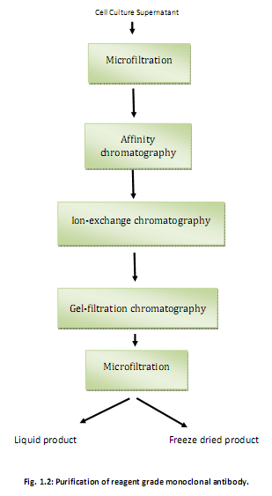

Slide 25
GMP issues in biopharmaceutical downstream units
Cell lines and Media components
– Present a complex matrix of contaminants, many of which may have similar biochemical/biophysical properties to the product
Sterilisation
Validation
– Move to disposables?
• Endotoxin and DNA removal
– Benzonanse for DNA destruction
– Anion exchange chromatography for DNA/Endotoxin removal
• Validated viral inactivation/removal steps required for all mammalian cell processes

