Slide 1
Chapter 6 EXCRETION OF DRUGS
by
Dr. Arshad Ali Khan Faculty of Engineering Technology arshad@ump.edu.my

Slide 2
TOPIC OUTCOMES
Describe the importance of drug excretion through kidney tubules and factors that influences glomerular filtration and tubular excretion
Discuss the effect of ionization, competition and pH/pKa concept in drug reabsorption process
Justify the concept of recycled drug such as enterohepatic recirculation and reabsorption

Slide 3
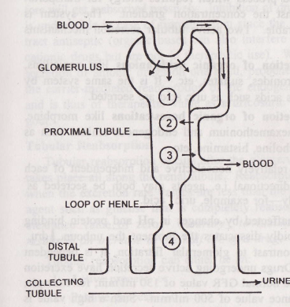
RENAL EXCRETION OF DRUGS
It is an irreversible transportation of drug and their metabolites from body to the outer environment.
1
Glomerular filtration (water, unbound drugs and metabolites)
2
Active tubular secretion (acidic, basic drugs and metabolites)
3
Active reabsorption (acidic, basic endogenous compounds)
4
Urinary excretion drugs and metabolites that are filtered and actively secreted and non reabsorbed
passive reabsorption (lipophilic drugs)
Figure 1 Urinary excretion of drugs
Rate of excretion = rate of filtration + Rate of secretion – Rate of Reabsorption

Slide 4
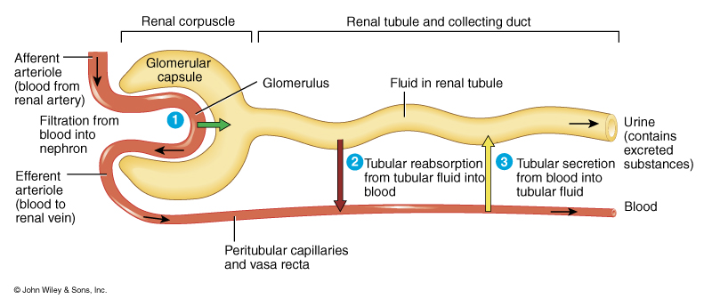
Glomerular Filtration
It is a non selective and unidirectional process where most of the ionized and unionized molecules are filtered
Macromolecules such as plasma protein, drug bound plasma protein and blood cells can not filtered out.
Inhibit anionic compounds filteration

Slide 5
Glomerular Filtration Rate (GFR)
The hydrostatic pressure of the blood flow inside the capillaries provide the driving force for the filtration process in the kidney.
1.2L of blood/min goes to kidney via renal artery,
only 10% or 120 -130 ml/min is filtered
Though 180L of blood protein and blood cells go through glomeruli every day, 1.5L excreted as urine, reminder reabsorbed from the tubules
GFR can be determined by agent that is excreted exclusively by filtration and is neither secreted nor absorbed in the tubules.
The excretion rate for such agent is 120 to 130 ml/min. Example, Creatine, inulin , mannitol and sodium thiosulphate used for the GFR estimation.

Slide 6
Active Tubular Secretion
Carrier-mediated process transport the moiety against the concentration gradient
Limited and saturable
Secretion of organic acids/anions
Penicillins, salicylates etc
Same system by which endogenous acid such as uric acid are secreted
Secretion of organic bases/cations
Morphine, hexamethonium and mecamylamine etc
endogenous amines such as catecholamine, choline, histamine
Both can be bidirectional i.e agents may both be secreted as well as reabsorbed actively

Slide 7
Active Tubular Secretion
Unaffected by pH variation and protein binding
Renal blood flow dependent
Active secretion occurs in the proximal tubule region of the nephron

Slide 8
Tubular Reabsorption
Tubular reabsorption is occurs after the glomerular filtration of drugs
It takes places along the renal tubule
Reabsorption carried out when GFR < 130ml/min
Example:
Glucose has zero clearance because it reabsorbed completely after the filtration

Slide 9
Active tubular reabsorption
Commonly observed with high threshold endogenous substances or nutrient that body need to conserve
Example: electrolytes, glucose, vitamins, amino acids, etc.
Very few drugs undergo reabsorption actively

Slide 10
Passive tubular reabsorption
Common for a large number of exogenous substances including drugs
The concentration gradient is established by the back diffusion or reabsorption of water along with sodium and other inorganic ion.
The primary determinant in the passive reabsorption of drugs is their lipophilicity.
Lipophilic substances extensively reabsorbed while polar molecules are not
Most drugs are weak electrolytes, diffusion through the lipiodol tubular membrane depends on the degree of ionisation

Slide 11
Ionization Factors
3 Factors:
Urine pH
Drug pKa value
Urine flow rate

Slide 12
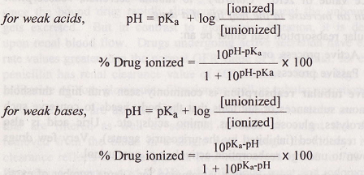
Henderson –Hasselbalch equations

Slide 13
Concentration Ratio of the drug in urine to that in plasma (U:P) can be given by equation derived by Shore et al:

Slide 14
pH dependent excretion depends on pKa and lipid solubility of the compound
A polar and ionized drug will be poorly reabsorbed passively and excreted rapidly
Lipophilic drug which ionized reabsorbed
Unionized but polar excreated

Slide 15
Urine flow rate
The extent of reabsorption influenced by rate of urine flow
The polar drug which is independent of the pH of urine are not reabsorbed and even not affected by urine flow rate
Drugs whose reabsorption is pH-sensitive show dependent on urine flow rate
The drugs with pH sensitive reabsorption also dependent on urine flow rate
Linear relationship between renal clearance and urinary excretion– Drugs reabsorbed to an extent equal to or greater than water
Convex Curvilinear relationship between renal clearance and urinary excretion - Drugs reabsorbed to an extent lower than water

Slide 16
Forced diuresis
The high intake of mannitol induces increased urine flow
This process is popularly used to remove the excessive drugs and reduce the reabsorption time from the body of the intoxicated person.

Slide 17
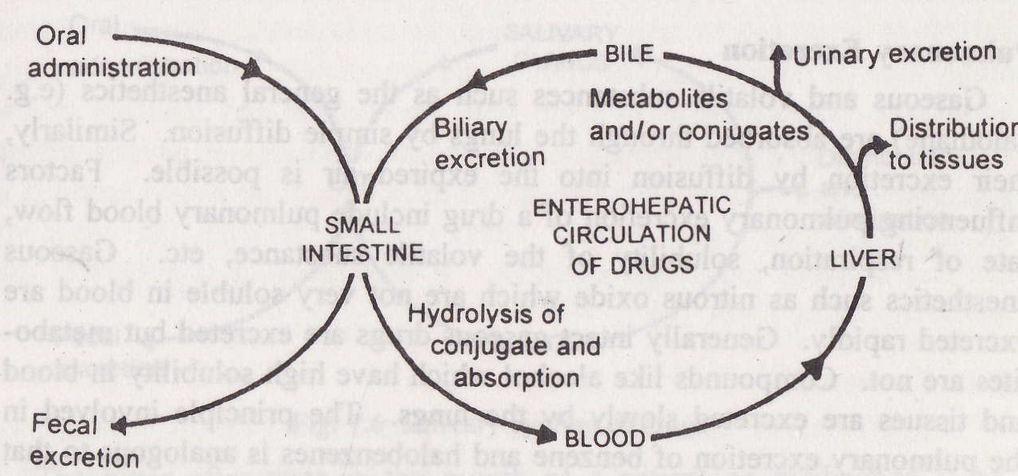
Enterohepatic cycling of drugs
Enterohepatic cycling of the drug is the drug pathway between liver and intestine.
It continued until the whole drug is metabolized or excreted from the body.
The drug which is excreted in the intestine via bile are not reabsorbed and excreted through feces.
Enterohepatic cycling of drugs

Slide 18
Enterohepatic cycling is highly important for the endogenous substances (such as bile salts, Vitamin B12 and folic acid etc) formation.
It prolong the half life of biliary excreted drugs and also prolong the therapeutic effects.

Slide 19
Thank you

