Slide 1
Electric and Electronic Technology Chapter 2D – Kirchhoff’s Laws - KCL
by
Akhtar Razali FKM akhtar@ump.edu.my

Slide 2
Chapter Description
Aims
Nodal analysis application at each non-reference node
Expected Outcomes
Students able to understand and apply Kirchhoff’s Current Law/Nodal analysis
Other related Information
One of mid semester exam is from this topic
No other relevant information be disclosed
References
Rizzoni G., 2004, Principles and Applications of Electrical Engineering, Revised Fourth Edition, Fourth Edition, McGraw Hill
Hambley A.R., 2005, Electrical Engineering Principles and Applications, Third Edition, Pearson Prentice Hall

Slide 3
Contents
KCL or node analysis and loop analysis are both circuit analysis methods which are systematic and apply to most circuits
Analysis of circuits using node analysis or some people call it nodal analysis requires solutions of systems of linear equations
These equations can usually be written by inspection of the circuit

Slide 4
Steps of Nodal Analysis
1. Choose a reference (ground) node.
2. Assign node voltages to the other nodes.
3. Apply KCL to each node other than the reference node; express currents in terms of node voltages.
4. Solve the resulting system of linear equations for the nodal voltages.

Slide 5
Example: A Summing Circuit
The output voltage V of this circuit is proportional to the sum of the two input currents I₁ and I₂
This circuit could be useful in audio applications or in instrumentation
The output of this circuit would probably be connected to an amplifier

Slide 6
1. Reference Node
The reference node is called the ground node where V = 0

Slide 7
Steps of Nodal Analysis
1. Choose a reference (ground) node.
2. Assign node voltages to the other nodes.
3. Apply KCL to each node other than the reference node; express currents in terms of node voltages.
4. Solve the resulting system of linear equations for the nodal voltages.

Slide 8
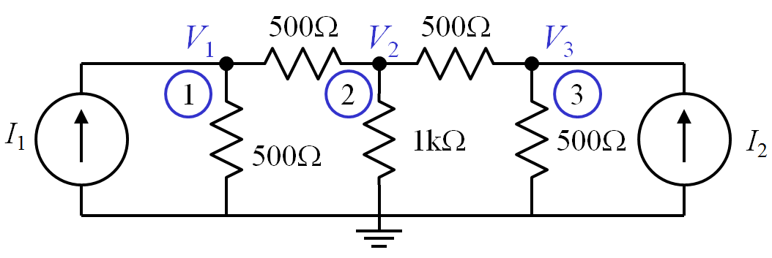
2. Node Voltages
V₁, V₂, and V₃ are unknowns for which we solve using KCL

Slide 9
Steps of Nodal Analysis
1. Choose a reference (ground) node.
2. Assign node voltages to the other nodes.
3. Apply KCL to each node other than the reference node; express currents in terms of node voltages.
4. Solve the resulting system of linear equations for the nodal voltages.

Slide 10
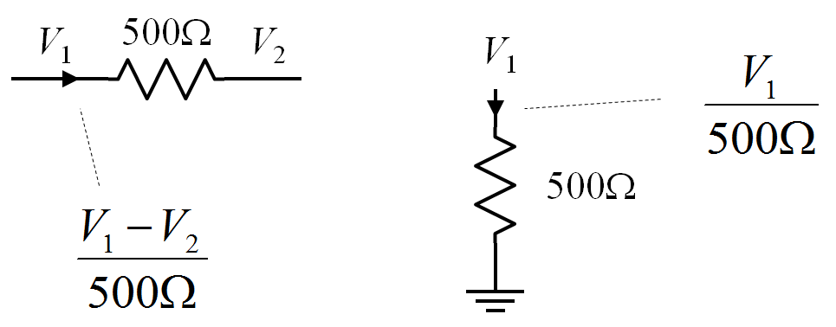
Currents and Node Voltages

Slide 11
3. KCL at Node 1

Slide 12
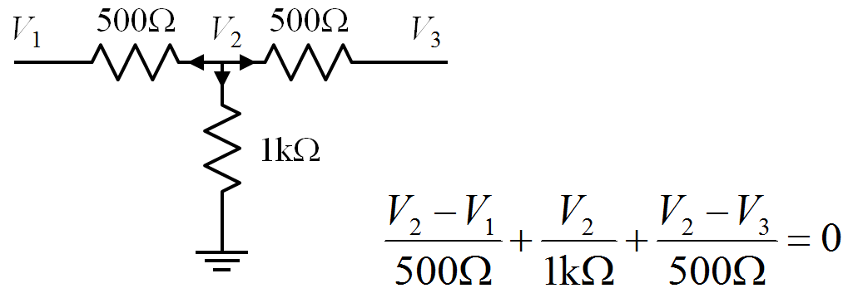
3. KCL at Node 2

Slide 13
3. KCL at Node 3

Slide 14
Steps of Nodal Analysis
1. Choose a reference (ground) node.
2. Assign node voltages to the other nodes.
3. Apply KCL to each node other than the reference node; express currents in terms of node voltages.
4. Solve the resulting system of linear equations for the nodal voltages.

Slide 15
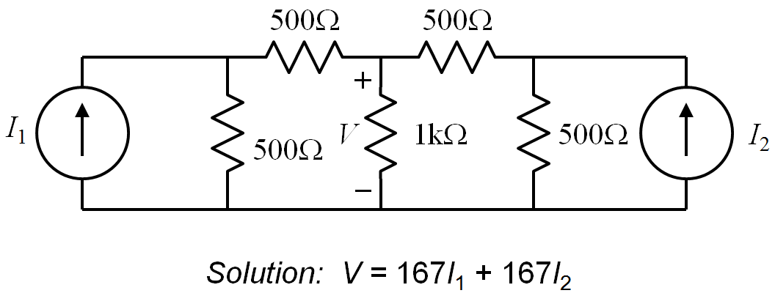
4. Summing Circuit Solution

Slide 16
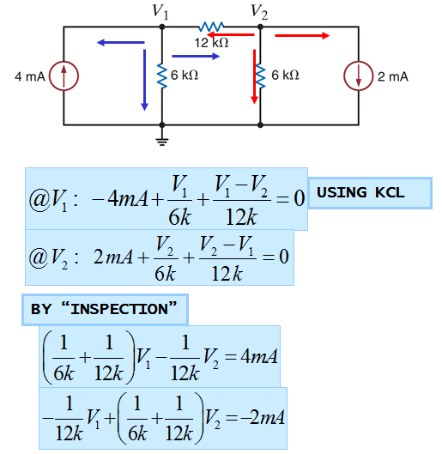
Example

Slide 17
Example

Slide 18
Conclusion of The Chapter
Conclusion #1
KCL states that the summation of current in a node is equal to ZERO.
Numbers of elements connected in a node represents how many terms needed to be derived to construct KCL equation.
Conclusion #2
There are 4 steps to do KCL analysis.

Slide 19
Akhtar Razali FKM, UMP.

