Slide 1
BSK1133 PHYSICAL CHEMISTRY CHAPTER 3 IDEAL AND NON IDEAL SOLUTION (PART B)
For updated version, please click on
http://ocw.ump.edu.my
PREPARED BY:
DR. YUEN MEI LIAN AND DR. SITI NOOR HIDAYAH MUSTAPHA Faculty of Industrial Sciences & Technology yuenm@ump.edu.my and snhidayah@ump.edu.my

Slide 2
Description
Aims
To understand the colligative properties of solution
To understand the colligative properties of electrolyte

Slide 3
Description
Expected Outcomes
Able to understand the colligative properties of solution
Able to understand the colligative properties of electrolyte
References
Atkins, P & Julio, D. P. (2006).Physical Chemistry (8th ed.). New York: Oxford.
Chang, R. (2005).Chemistry (8th ed.). New York: McGraw Hill.
Atkins, P & Julio, D. P. (2012). Elements of Physical Chemistry
(sixth ed.). Freeman, Oxford.
Silbey, R. J., Alberty, A. A., & Bawendi, M. G. (2005). Physical Chemistry. New York: John Wiley & Sons.
Mortimer R. G. (2008) Physical Chemistry, Third Edition , Elsevier Academic press, USA.

Slide 4
Contents
3.6 Colligative Properties of Solution
3.7 Colligative Properties of Electrolyte
3.8 Colloid
Conclusion

Slide 5
3.6 Colligative Properties of Solution

Slide 6
Colligative properties of solution are properties that depend only on the number of solute particles present (concentration) and not on the identity of the solute particles.
Colligative properties include:
Vapor pressure lowering
Boiling point elevation
Melting point depression
Osmotic pressure

Slide 7
Vapor Pressure:
When a solute molecules being added into a solution, the solute-solvent interactions affected to decrease the vapor pressure of the solvent
the solvent become less volatile
Therefore, the vapor pressure of a solution (solute+solvent) is lower than that of the pure solvent (without solute

Slide 8
Roult’s Law
Roult’s law stated that the partial vapor pressure of each component of an ideal mixture of liquids is equivalent to the product of vapor pressure of the pure component and its mole fraction in the mixture
Vapor-Pressure Lowering
Raoult’s law
0
P ₁
= vapor pressure of pure solvent
0
X₁ = mole fraction of the solvent
P₁ = X₁ P ₁
If the solution contains only one solute:
X₁ = 1 – X₂
0
0
P ₁
P ₁
- P₁ = ΔP = X₂
X₂ = mole fraction of the solute

Slide 9
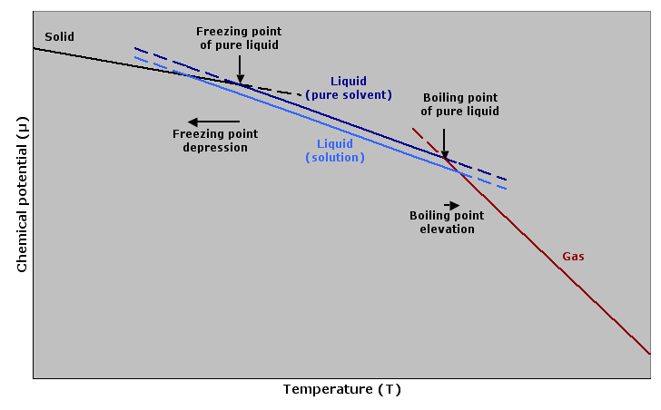
Boiling Point and Freezing Point
The solute-solvent interactions has affected to:
Increase in boiling points
Decrease in freezing points
As compared to the pure solvent.
Source: Wikimedia Commons

Slide 10
Boiling-Point Elevation
0
ΔT_{b} = T_{b} – T _{b}
0
T _{b} is the boiling point of
the pure solvent
T _{b} is the boiling point of
the solution
0
ΔT_{b} > 0
T_{b} > T _{b}
ΔT_{b} = K_{b} m
Source: Wikimedia Commons
K_{b} is the molal boiling-point
elevation constant (⁰C/m)

Slide 11
Freezing-Point Depression
0
ΔT_{f} = T _{f} – T_{f}
0
T _{f} is the freezing point of
the pure solvent
T _{f} is the freezing point of
the solution
0
ΔT_{f} > 0
T _{f} > T_{f}
ΔT_{f} = K_{f} m
Source: Wikimedia Commons
m is the molality of the solution
K_{f} is the molal freezing-point
depression constant (⁰C/m)

Slide 12
Osmosis
Semipermeable membranes allow only some particles to pass through (such as water) and blocking others (solute particles).
In osmosis process, solvent will move from higher solvent concentration (diluted) to lower solvent concentration (concentrated).
The water tries to balance the concentration on both sides and this phenomenon affected to higher pressure.
Source: Wikimedia Commons

Slide 13
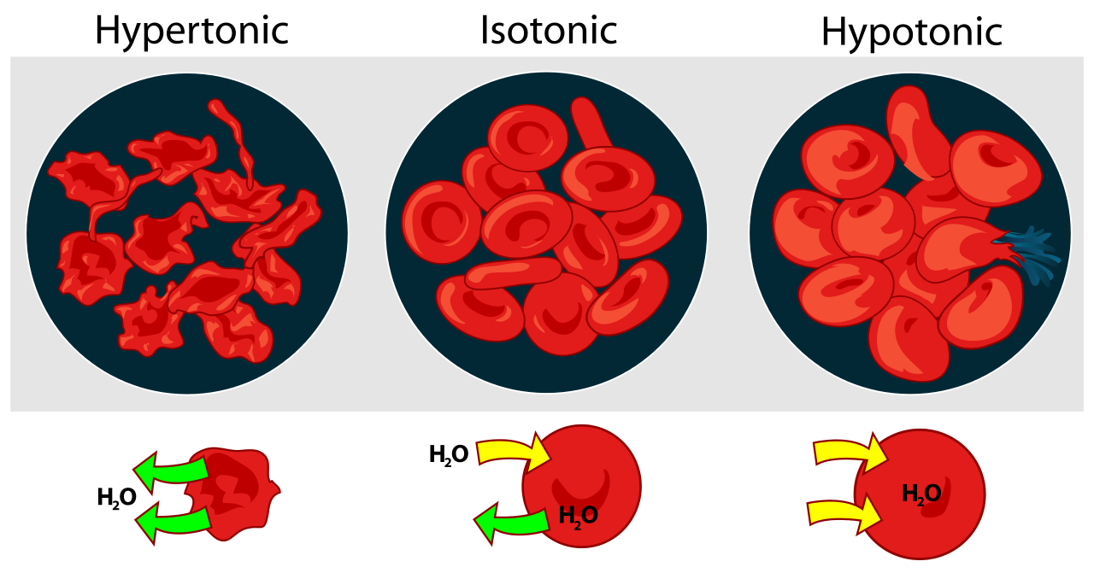
Effect of different type of solution on blood cells (please discuss):
Source: Wikipedia

Slide 14
The pressure required to stop the osmosis process is called osmotic pressure, π :
where M = molarity of the solution
n
V
π = ( )RT = MRT

Slide 15
3.7 Colligative Properties of
Electrolyte

Slide 16
Electrolytes solutions will show greater changes in colligative properties than those of nonelectrolytes solution.
This is due to the dissociation of ion in electrolyte solution which contributed to the increment of solution concentration.

Slide 17
Van’t Hoff Factor
The van 't Hoff factor is:
: $\frac{\text{actual} \text{concentration} \text{of} \text{particles} \text{produced}\text{ (}\text{solution}\text{)}}{\text{concentration} \text{of} \text{a} \text{substance} \text{as} \text{calculated} \text{from} \text{its} \text{mass}\text{.}}$
Example: NaCl in water,
However, 1 M NaCl solution not showing twice the change in freezing point. Because:
NaCl dissociates into ion Na⁺ and Cl⁻
van’t Hoff factor : 2.
Some of Na⁺ and Cl⁻ ion is reassociate as hydrated ion pairs, thus the real concentration of the particles is less than twice of the concentration of NaCl.

Slide 18
Reassociation is more likely happen at higher concentration.
Therefore, the number of particles present is concentration dependent.
 | Concentration
Compound | 0.1 m | 0.01 m | 0.001 m | Limiting Value
Sucrose | 1.00 | 1.00 | 1.00 | 1.00
NaCl | 1.87 | 1.94 | 1.97 | 2.00
K2SO4 | 2.32 | 2.70 | 2.84 | 3.00
MgSO4 | 1.21 | 1.53 | 1.82 | 2.00
For electrolyte solution, the ΔT_{f} equations needs to multiply by the van’t Hoff factor, i
ΔT_{f} = K_{f}  m  i

Slide 19
Degree of dissociation and van’t Hoff factor calculation
Van’t Hoff can be calculated by using:
$$\frac{{∆T}_{f} of the ionic compound}{{∆T}_{f} of the solution}$$

Slide 20
3.8 Colloid

Slide 21
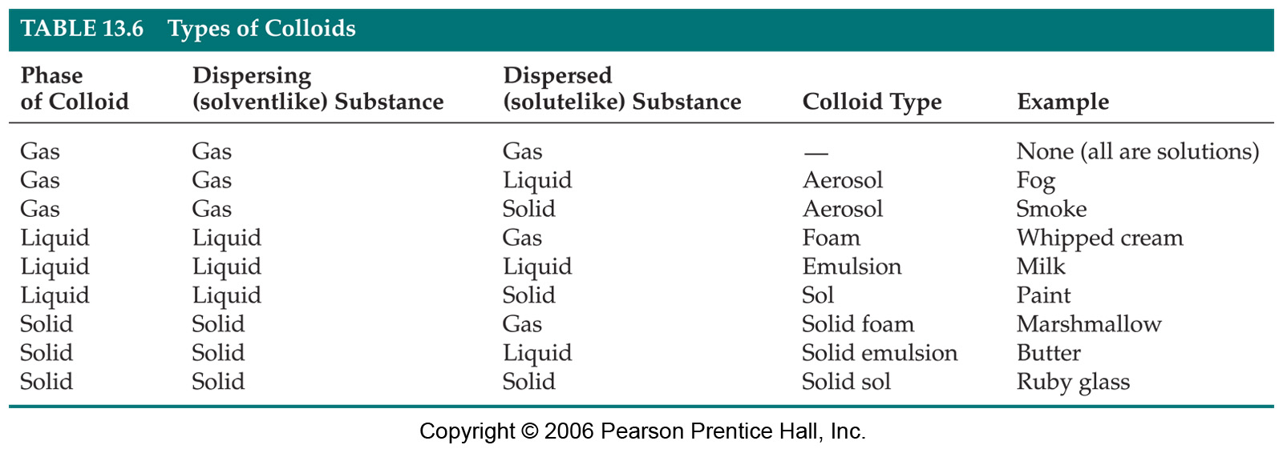
Colloids is happen because suspensions of particles
larger than individual ions or molecules.
Moreover, it is too small to be settled out by gravity.

Slide 22
Colloidal suspensions can scatter rays of light (Tyndall effect).
Source:
Wikimedia Commons

Slide 23
Conclusion
Solution in solvent affected to colligative
properties of solution.
Colloids is one of the types of solution due to solute suspension.

Slide 24
AUTHOR INFORMATION
DR. YUEN MEI LIAN (SENIOR LECTURER)
INDUSTRIAL CHEMISTRY PROGRAMME FACULTY OF INDUSTRIAL SCIENCES & TECHNOLOGY UNIVERSITI MALAYSIA PAHANG yuenm@ump.edu.my
Tel. No. (Office): +609 549 2764
DR. SITI NOOR HIDAYAH MUSTAPHA (SENIOR LECTURER)
INDUSTRIAL CHEMISTRY PROGRAMME FACULTY OF INDUSTRIAL SCIENCES & TECHNOLOGY UNIVERSITI MALAYSIA PAHANG snhidayah@ump.edu.my
Tel. No. (Office): +609 549 2094

