Slide 1
BTV2213 Thermodynamics Chapter 2: Problem-Solving Technique
For uploaded version, please click on this:
http://ocw.ump.edu.my
by
Nasrin Khodapanah
Faculty of Engineering Technology nasrin@ump.edu.my

Slide 2
Chapter Description
Aims
Develop the concept of property, state, equilibrium, process and path in thermodynamics
Discuss thermodynamics problem-solving technique
Evaluate appropriate system boundaries for analyzing a variety of thermodynamics components and system
Expected Outcomes
Students able to understand the concept of property, state, equilibrium, process and path
Students able to extend the basic concepts of thermodynamics to problem solving technique
Students able to understand system boundaries for analyzing a variety of thermodynamics components and system
References
Cengel, Y.A and Boles, M.A (2010),”Thermodynamics: An Engineering Approach(7th Edition)”, McGraw Hill, New York
Cengel, Y.A (2012): Introduction to Thermodynamics and Heat Transfer, McGraw Hill, New York
Robert Balmer (2011): Thermodynamics, Jaico Publication

Slide 3
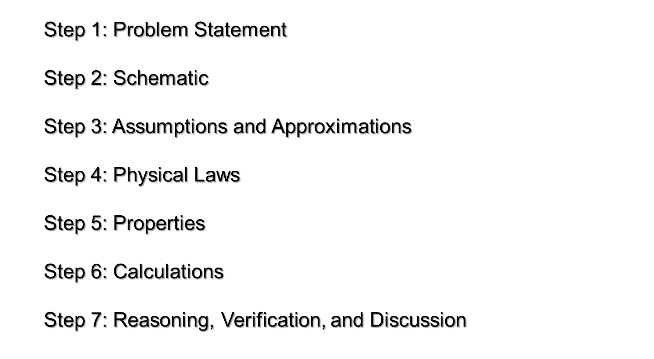
Thermodynamics problem-solving technique

Slide 4
System and Control volume

Slide 5
Classification of thermodynamics systems

Slide 6
Classification of thermodynamics systems
Mass NO
GAS
2 kg
3 m³
m = const.
E = const.
GAS
2 kg
1 m³
Energy NO
CLOSED System
with Moving Boundary
ISOLATED System
Mass YES
Energy YES
OPEN System

Slide 7
Classification of thermodynamics systems
BOUNDARY around of OPEN System is CONTROL SURFACE /CONTROL VOLUME.
Real Boundary
In
Out
Imaginary Boundary
Mass and Energy can pass through Control Volume Boundaries

Slide 8
Thermodynamics property
Property: any measurable/observable characteristics of the substance when the system is in equilibrium state.
Intensive property:
Those properties do not depend on the mass, such as temperature, pressure and density.
Extensive property:
Those properties depend on the mass, such as volume, total energy and etc.

Slide 9
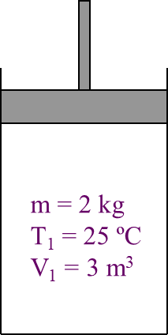
State & Equilibrium
Those properties of system describe the condition of the system is system STATE
m = 2 kg
T₁ = 25 ºC
V₁ = 1 m³
STATE 1
STATE 2

Slide 10
State & Equilibrium
EQUILIBRIUM (State of Balance)
Thermal Equilibrium :
NO Temperature Gradient throughout the system.
Mechanical Equilibrium :
NO Pressure Gradient throughout the system.
Phase Equilibrium :
System having more than 1 phase.
Mass of each phase is in equilibrium.
Chemical Equilibrium :
Chemical composition is constant
NO reaction occurs.

Slide 11
Path and Process
Quasi-Static
State 2
State 1
t=t₁
t=0
State 2
Property B
Non-Quasi-Static
State 1
Path
t=t_{2t}
t₂ < t₁
t=0
Property A

Slide 12
Path and Process

Slide 13
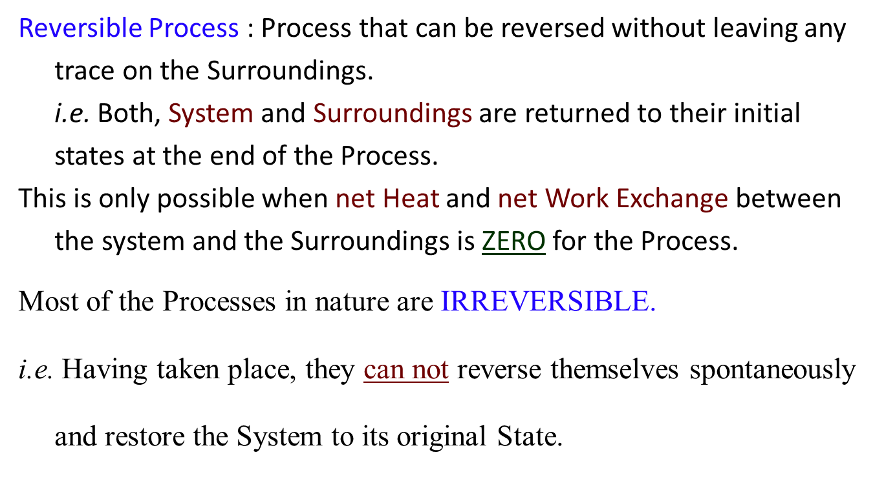
Reversible / Irreversible Process

Slide 14
Appropriate system boundaries to analyze a variety of thermodynamics components and system
TUTORIAL CHAPTER 1

Slide 15
Exercise#1
Express a pressure of 75.2 kPa as a gage pressure. The local atmospheric pressure is 103.4 kPa.
Notice that the result is negative. This can also be read “28.2 kPa below atmospheric pressure” or “28.2 kPa vacuum.”

Slide 16
Exercise#2
Express a gage pressure of –42.7 kPa as an absolute pressure.
Because no value was given for the atmospheric pressure, we will use p_{atm}=101 kPa:

Slide 17
Conclusion of The Chapter 2

Slide 18
Hae-Geon Lee (2012) Introduction. Materials Thermodynamics
Huang, Biao, Yutong Qi, and A. K. M. Murshed. "First Principle Modelling for Chemical Processes." Dynamic Modelling and Predictive Control in Solid Oxide Fuel Cells: First Principle and Data-Based Approaches: 11-29.
Kanoglu, Mehmet, Ibrahim Dincer, and Yunus A. Cengel. "Exergy for better environment and sustainability." Environment, Development and Sustainability 11.5 (2009): 971-988.

