Slide 1
GEOTECHNICAL ENGINEERING Slope Stability (Learning activities)
For updated version, please click on
http://ocw.ump.edu.my
by
Dr. Amizatulhani Abdullah Faculty of Civil Engineering ad Earth Resources amizatulhani@ump.edu.my

Slide 2
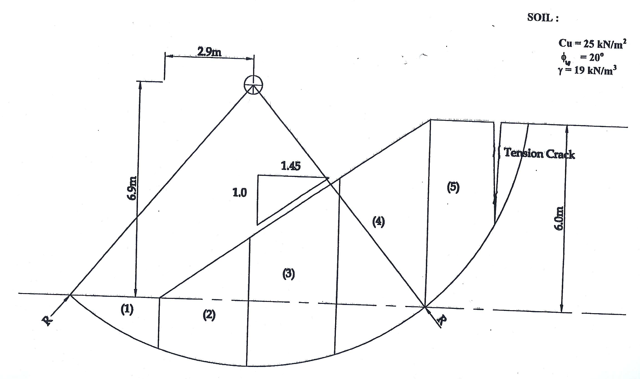
Using the method of slices, determine the factor of safety of the slope for a trial slip circle as shown in the figure. Calculate the depth of tension crack where the slip circle suppose to end.
Slope Stability by Dr. Amizatulhani Abdullah

Slide 3
Author Information Dr. Amizatulhani Abdullah Dr. Mohd Yuhyi Mohd Tadza Dr. Youventharan Duraisamy Dr. Muzamir Hasan Ir. Azhani Zukri

