Slide 1
BSB3503 - Biomanufacturing CHAPTER 9 Instrument Controls System (Feedback and Feed forward)
Author: Nurul Azyyati Sabri
Co-Author / Editor: Rama Yusvana Faculty Industrial Sciences & Technology yusvana@ump.edu.my

Slide 2
Learning outcomes
To understand the theory of instruments controls.
To understand process control system.

Slide 3
Process control
Maintaining room to a specific temperature and kept constant over time -> Process control.
The temperature = controlled variable.
It is also the input variable measured by a thermometer and used to decide whether to heat or not to heat.

Slide 4
Process control
The desired temperature = the setpoint.
The state of the heating element is the manipulated variable.
A common misconception in process control is that it is all about the controller – that you can force a particular process response just by getting the right tuning parameters.

Slide 5
Introduction to Process Control
In reality, the controller is just a partner. A process will respond to a controller’s commands only in the manner which it can. To understand process control you must understand the other partners as well: sensors, final control elements and the process itself.
All of these determine what type of response the controller is capable of extracting out of the process. It is not the other way around.

Slide 6
Basic Elements of Process Control
Controlling a process requires knowledge of four basic elements, the process itself, the sensor that” measures the process value, the final control element “that “changes the manipulated variable”, and the controller.

Slide 7
Important Terminology in Control System
Control Objective
Measured Process Variable (PV)
Set Point (SP)
Controller Output (CO)
Manipulated Variable
Disturbances (D)

Slide 8
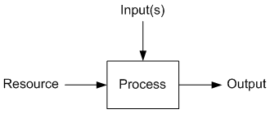
“What is a Process”
“An operation that uses resources to transform inputs into outputs”.
The resource provides the energy into the process for the transformation to occur.

Slide 9
What is a Process
Each process has dynamic behavior that governs the transformation.
Determined by the physical properties of the inputs, the resource, and the process itself.

Slide 10
What is “Process Control”
“The act of controlling a final control element to change the manipulated variable to maintain the process variable at a desired set point”.
Our definition of process control is a controllable process that behave in a predictable manner.
“For a given change in the manipulated variable, the process variable must respond in a predictable and consistent manner”.

Slide 11
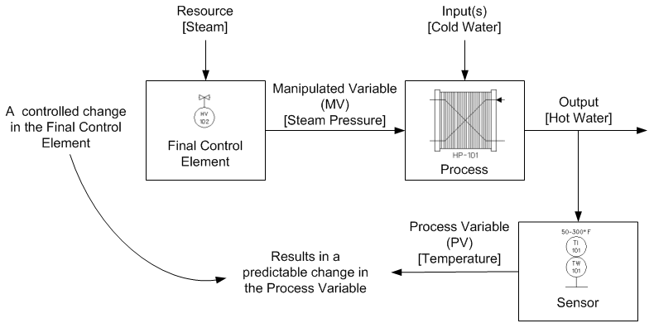
What is Process Control

Slide 12
Process Control
Terminology:
“The manipulated variable (MV) is a measure of resource being fed into the process, for instance how much thermal energy”.
“A final control element (FCE) is the device that changes the value of the manipulated variable”.
“The controller output (CO) is the signal from the controller to the final control element”.

Slide 13
Process Control
Terminology:
“The process variable (PV) is a measure of the process output that changes in response to changes in the manipulated variable”.
“The set point (SP) is the value at which we wish to maintain the process variable at”.

Slide 14
Process Flow Diagram (PFD)

Slide 15
Open-loop & Closed loop Control System

Slide 16
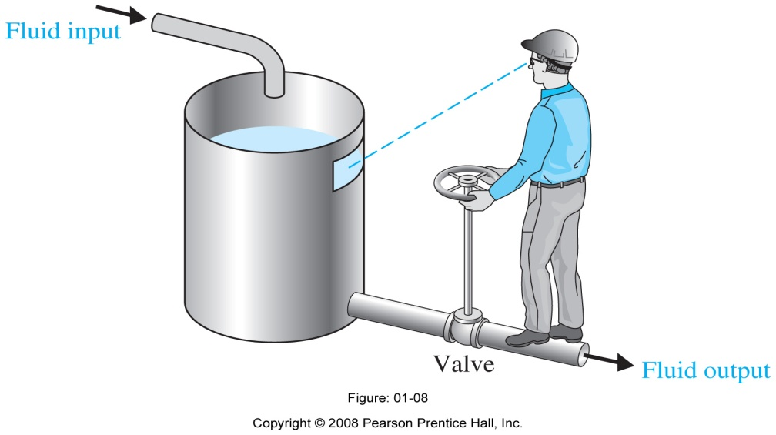
Goal: Regulate the level of fluid by adjusting the output valve.
Determine: The input, the operator, the sensor.
Notes:
Figure: 01-08. Manual control system for regulating the level of fluid in a tank by adjusting the output valve. The operator views the level of fluid through a port in the side of the tank. The input is a reference level of fluid that the operator is instructed to maintain (this reference is memorized by the operator). The power amplifier is the operator, and the sensor is visual. The operator compares the actual level with the desired level and opens or closes the valve ( actuator), adjusting the fluid flow out, to maintain the desired level.

Slide 17
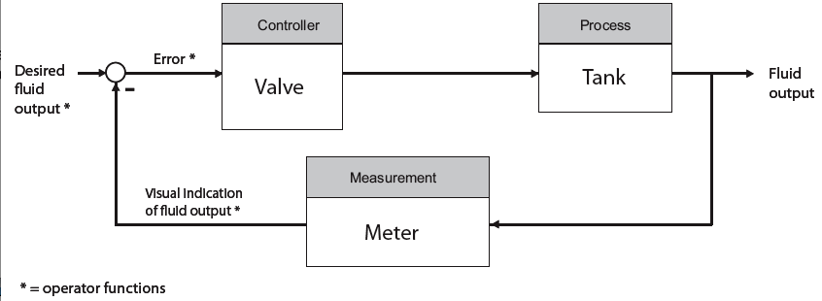

Slide 18
Advantages & Disadvantages
Type of system | Advantages | Disadvantages
Open-loop control system | 1. “Simple construction and ease of maintenance”. 2. “Less expensive than a corresponding closed-loop control system” 3. “There is no stability problem” 4. “Convenient when output is hard to measure or measuring the output precisely is economically not feasible” | 1. “The system response very sensitive to external disturbance and internal variations in system parameters”. 2. “Recalibration is necessary from time to time in order to maintain the required quality in the output”

Slide 19
Advantages & Disadvantages
Type of system | Advantages | Disadvantages
Closed-loop control system | “Makes the system response relatively insensitive to external disturbance and internal variations in system parameters”. “Possible to use relatively inaccurate and inexpensive components to obtain the accurate control of a given plant.” “Better control of transient & steady-state response” “Increased accuracy” -Increased ability to reproduce output with varied input. | 1. Risk instability 2. Complexity in analysis and implementation and expensive

Slide 20
Choosing the Right Instrument
Instruments are the eyes and ears of the plant
Many choices available
Instruments and valves need to be selected, sized and installed properly

Slide 21
Types of Valves (FYI) Linear Motion
Linear motion valves have a closure member that moves with a linear motion to modify the rate of flow through the valve.
Linear motion valves are generally named for the shape of their closure member.
Common linear motion valves include
Globe
Gate
Diaphragm
Pinch

