Slide 1
Electric and Electronic Technology Chapter 2C – Resistance in Series and Parallel
by
Akhtar Razali FKM akhtar@ump.edu.my

Slide 2
Chapter Description
Aims
To distinguish resistance in series and parallel
To analyze equivalent resistance in series and parallel and combination circuit
Expected Outcomes
Replace series or parallel combinations of resistances by equivalent resistances.
Determine currents and voltages of circuits by combining resistance in series and parallel
Other related Information
One of mid semester exam is from this topic
No other relevant information be disclosed
References
Rizzoni G., 2004, Principles and Applications of Electrical Engineering, Revised Fourth Edition, Fourth Edition, McGraw Hill
Hambley A.R., 2005, Electrical Engineering Principles and Applications, Third Edition, Pearson Prentice Hall

Slide 3
Contents
Series circuit
Parallel circuit
Delta and Y circuit
Equivalent resistance in series and parallel and combination circuit

Slide 4
Series Resistance

Slide 5
Series Resistance
We can define the equivalent resistance Req to be sum of the resistance in series,or
R_{eq}=R₁+R₂+R₃
To calculate V source, the equation is now as below:
V=R_{eq}i

Slide 6
Series Resistance
Thus, we can conclude that 3 resistances in series can be replaced by the equivalent resistance R_{eq}.
Source: https://commons.wikimedia.org/wiki/File:Resistors_in_Series.svg

Slide 7
Series Resistance
Therefore,
“a series combination of resistances has an equivalent resistance equal to the sum of the original resistance.”

Slide 8
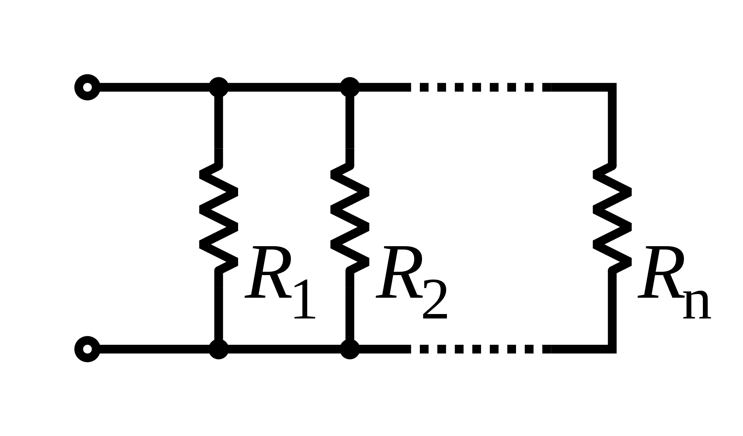
Parallel Resistance
In parallel circuit, the voltage across each element is the same.
Source: https://commons.wikimedia.org/wiki/File:Resistors_in_parallel.svg

Slide 9
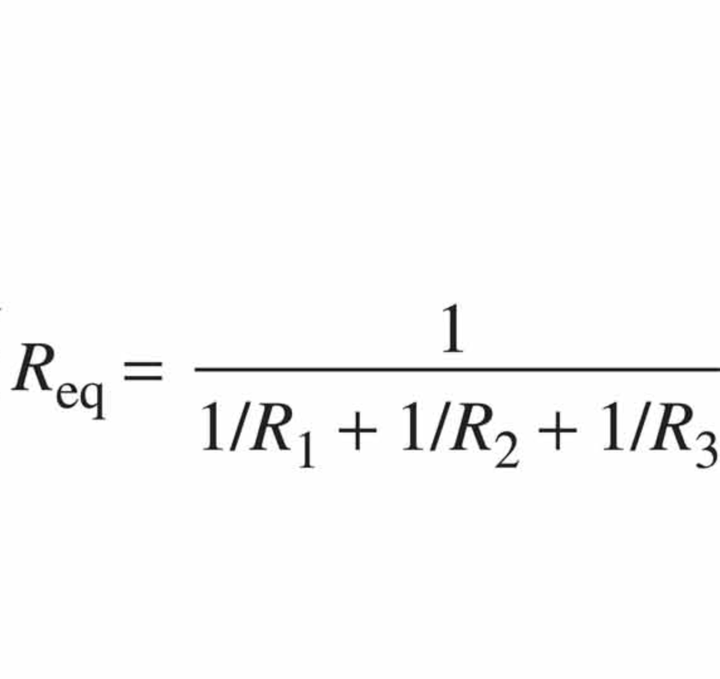
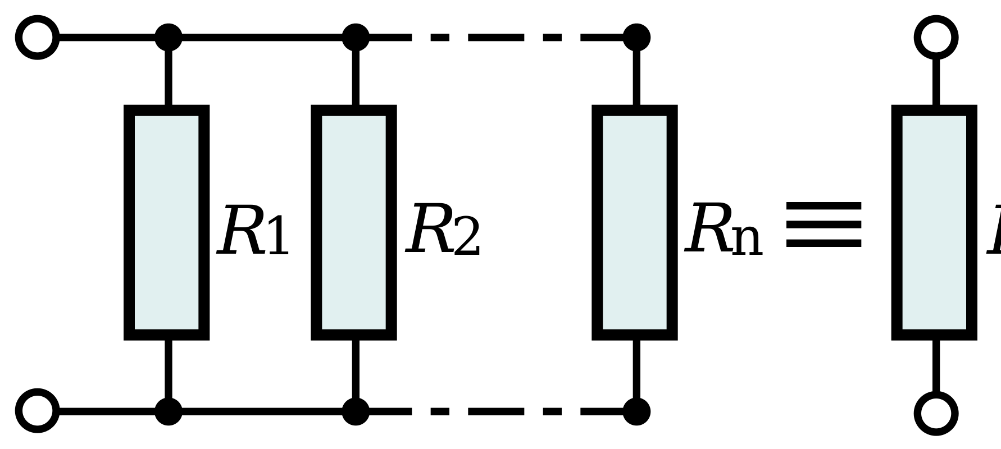
Parallel Resistance
Therefore, we can define the equivalent resistance as:

Slide 10
Network Analysis by using series and parallel equivalents
An electrical network consists of circuit elements such as resistances, voltage sources, and current sources, connected together to form closed paths.
Network analysis is the process of determining the current, voltage, and power for each element.

Slide 11
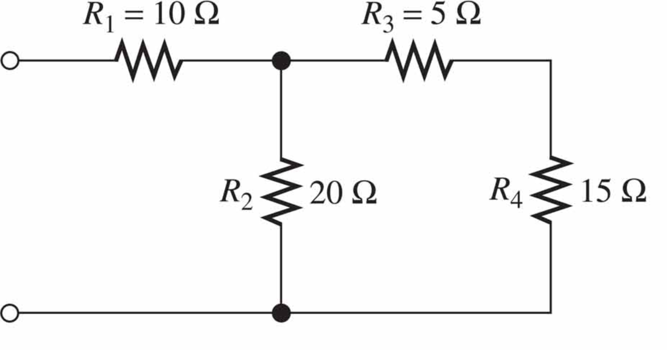
Combining Resistances in Series & Parallel
Exercise 1:
find a single equivalent resistance for below circuit.
Source: Rizzoni

Slide 12
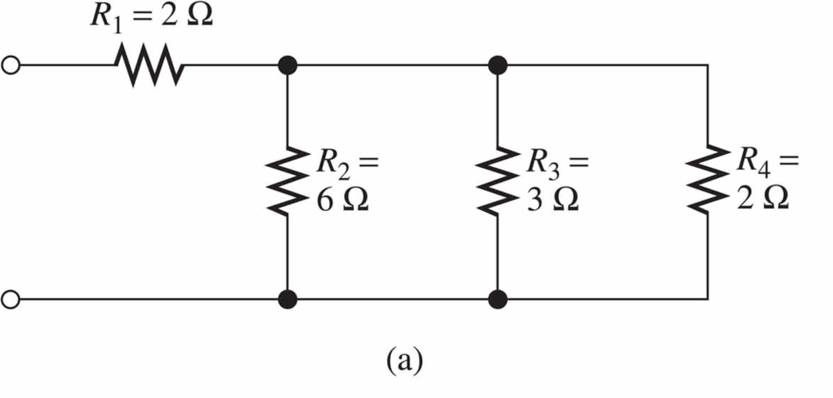
Exercise 1
find the equivalent resistance for each of networks.
Source: Rizzoni

Slide 13
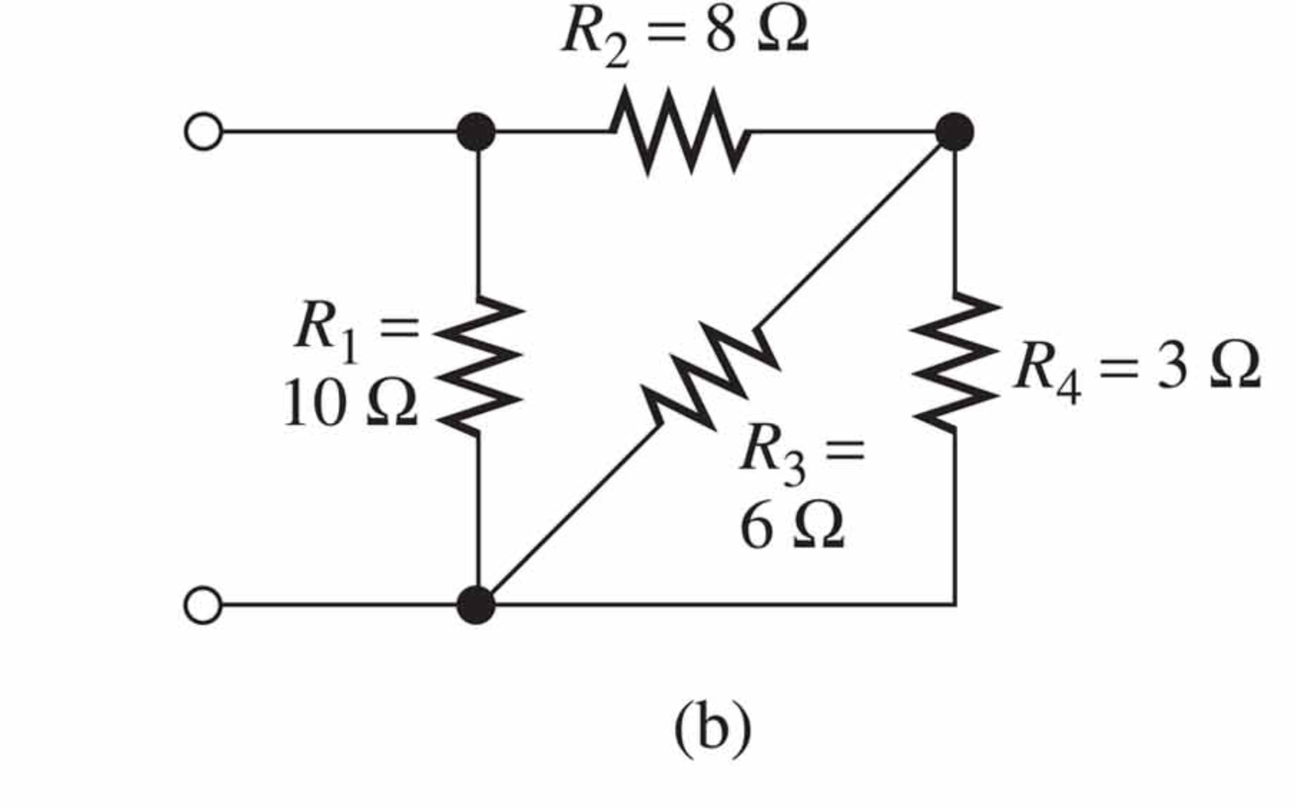
Exercise 2
Source: Rizzoni

Slide 14
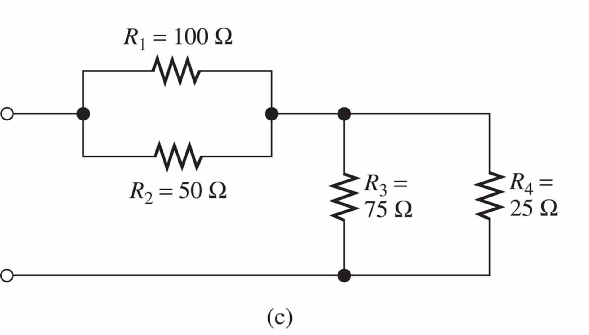
Exercise 3
Source: Rizzoni

Slide 15
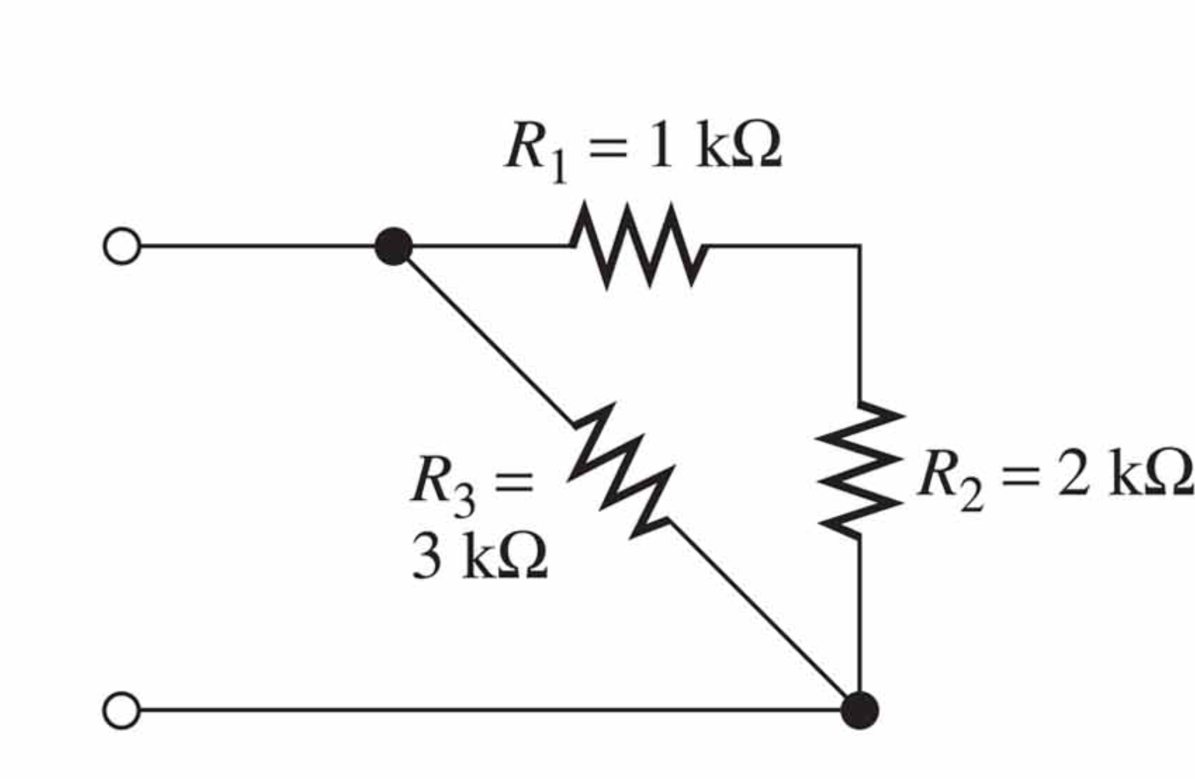
Exercise 4
Source: Rizzoni

Slide 16
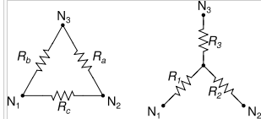
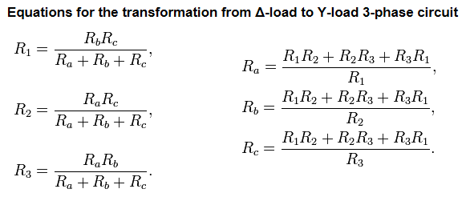
Delta to Y Conversion
Source: Rizzoni

Slide 17
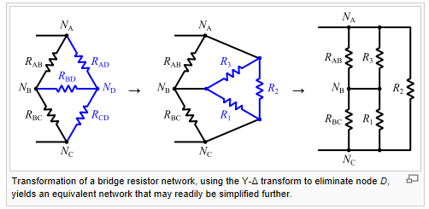
Example 1
Source: https://commons.wikimedia.org/wiki/File:Wye-delta_bridge_simplification.svg

Slide 18
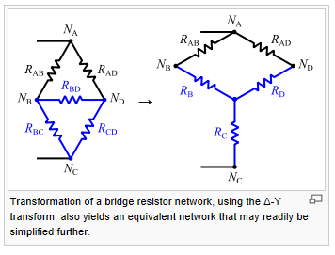
Example 2
Source: Wikimedia

Slide 19
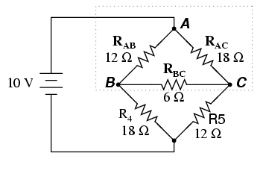
Exercise 1
Source: Rizzoni

Slide 20
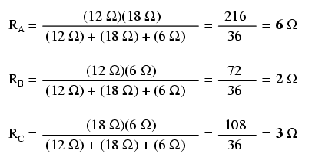
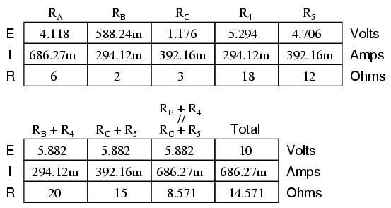
Solution Exercise 1
Source: Rizzoni

Slide 21
Analysis Steps
Steps in solving circuits using series/parallel equivalents:
Begin by locating a combination of resistances that are in series or parallel.
Redraw the circuits with the equivalent resistance for the combination found in Step 1.
Repeat Steps 1 and 2 until the circuits is reduced as far as possible.
Solve for the currents and voltages in the final equivalent circuit. Then, transfer results back one step and solve for additional unknown currents and voltages. Again transfer the results back one step and solve. Repeat until all of the currents and voltages are known in the original circuit.
Check your results to make sure that KCL is satisfied at each node, KCL is satisfied for each loop, and the powers add to zero.

Slide 22
Conclusion of The Chapter
Conclusion #1
Resistance in series, just add all the resistors involved.
Resistance in parallel, cannot add directly but to use fraction equation for N numbers of resistors.
Conclusion #2
To work out equivalent resistance, do the analysis to the farthest end of the voltage source.
Whenever you see voltage source, just short circuit it.
Whenever you see current source, just break the connection

Slide 23
Akhtar Razali FKM, UMP.

