Slide 1
Chapter 6 Construction Quantity Measurement
By
Mohd Arif Sulaiman
Faculty of Civil Engineering & Earth Resources
mdarif@ump.edu
Construction Quantity Measurement, by Mohd Arif

Slide 2
Chapter Description
Expected Outcomes
Able to calculate the area required.
Able to calculate the volume of material to be cut and fill.
References
Barry F. Kavanagh, "Surveying with Construction Application", 0-13-048215-3 Pearson, Prentice Halll, 2004.
Bannister, Raymond, Baker,"Surveying",0-582-30249-8, Prentice Hall 1998.
William Irvine, "Surveying for Construction", 4th Ed.,0-07-707998-1, McGraw-Hill,1998.

Slide 3
AREA COMPUTATION
AREA
Regular
Irregular

Slide 4
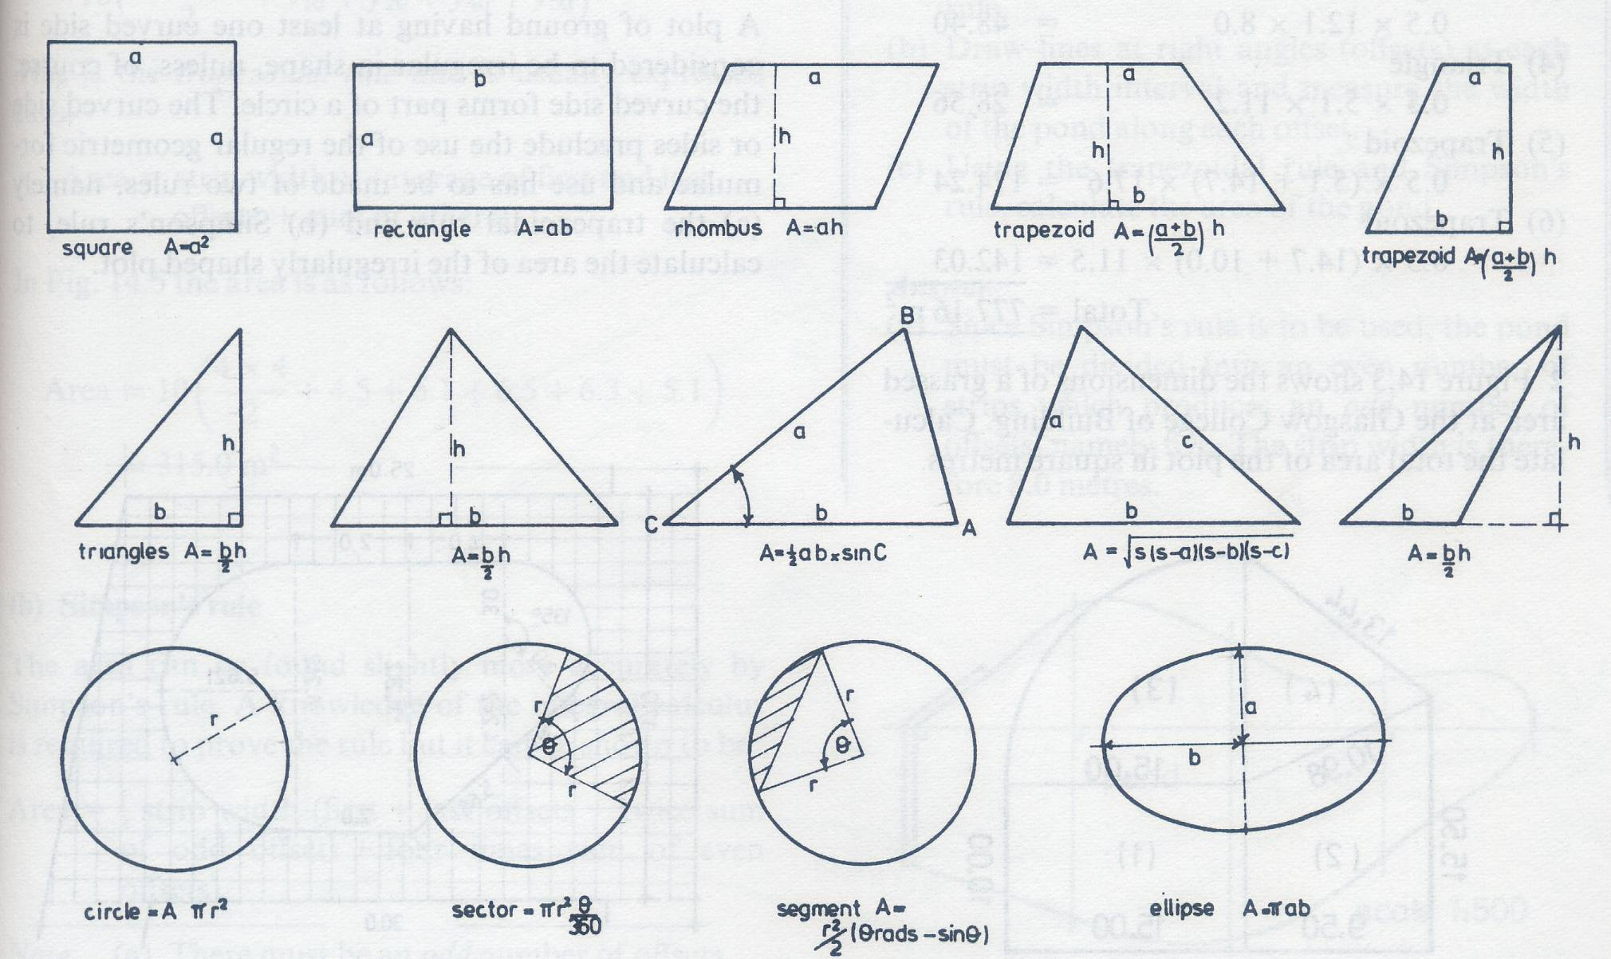
Regular area

Slide 5
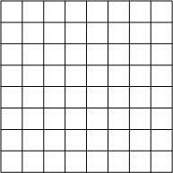
Irregular area

Slide 6
Longitudinal section and cross section
Chainage
interval
C
Of road
CH50
CH100
CH150
CH200
CH250
Longitudinal section shows the shape of profile of the existing ground surface along the proposed centre line of construction
Cross section indicate the shape of existing ground surface perpendicular to the proposed centre line

Slide 7
The trapezoidal Rule
Area = strip width x (average of first and last offset
+ sum of others offset)
Area = 10 x [ (4.0 + 4.0)/2 + 4.5 + 5.1 + 6.5 + 6.3 + 5.1]
= 315.0 m2

Slide 8
Simpson’s Rule
Area = 1/3strip width [first + last offsets + 2(sum
of odd offsets) + 4(sum of even offsets)]
Area = 10/3 x [4 + 4 + 2(5.1 + 6.3) + 4(4.5 + 6.5 + 5.1)]
= 317.3 m2

Slide 9
SIMPSON’S RULE VS TRAPIZOIDAL RULE
Simpson’s Rule : there must be an odd number of offsets and the offsets must be rigalar intervals.

Slide 10
Other method
Mid ordinate rule
Average ordinate rule
Poncelent’s
rule
Francke’s rule

Slide 11
Food of Mind
Q1. The following perpendicular offset were taken from a chain line to the irregular boundary.
Chainage (m) | 0 | 30 | 60 | 90 | 120 | 150 | 180 | 210
Offset (m) | 0 | 2.65 | 3.80 | 3.75 | 4.65 | 3.60 | 5.00 | 5.80
Calculate the area between the chain line and the irregular boundary by i)trapezoidal rule, and ii) Simpson’s rule.
i) 790.5 m2 ii)781 m2

Slide 12
Area From Coordinates
Method of Double-Meridian Distance Refer to Traversing Note
Method of Double Longitudes
Method of Total Coordinate Products

Slide 13
Method of Double Longitudes
In other to find the area of any polygon, the following is the sequence of operations:
Find the double longitude and difference in northings (ΔN) of each line.
Multiply double longitude by ΔNorth.
Add these products algebraically.
Halve the sum.

Slide 14
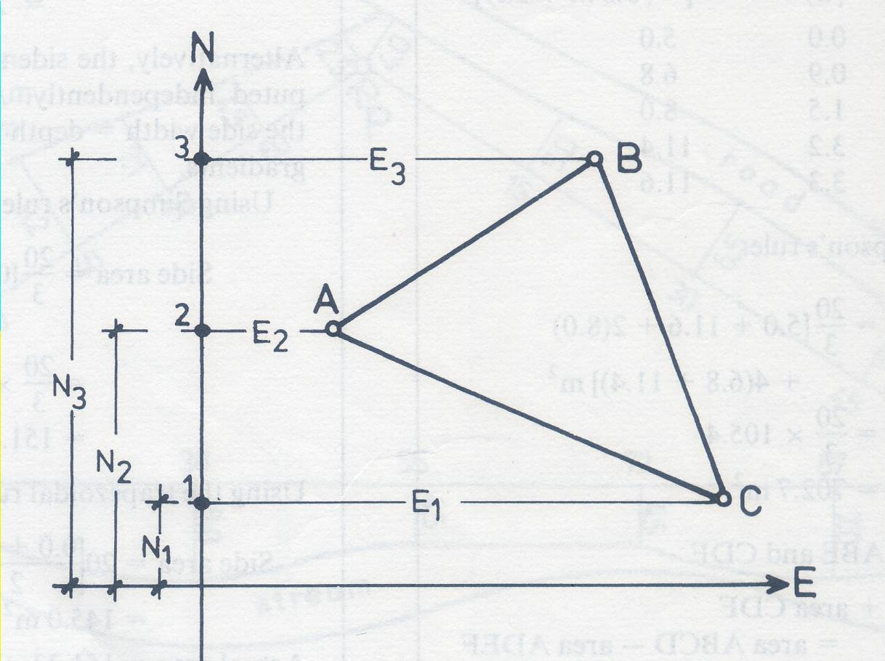
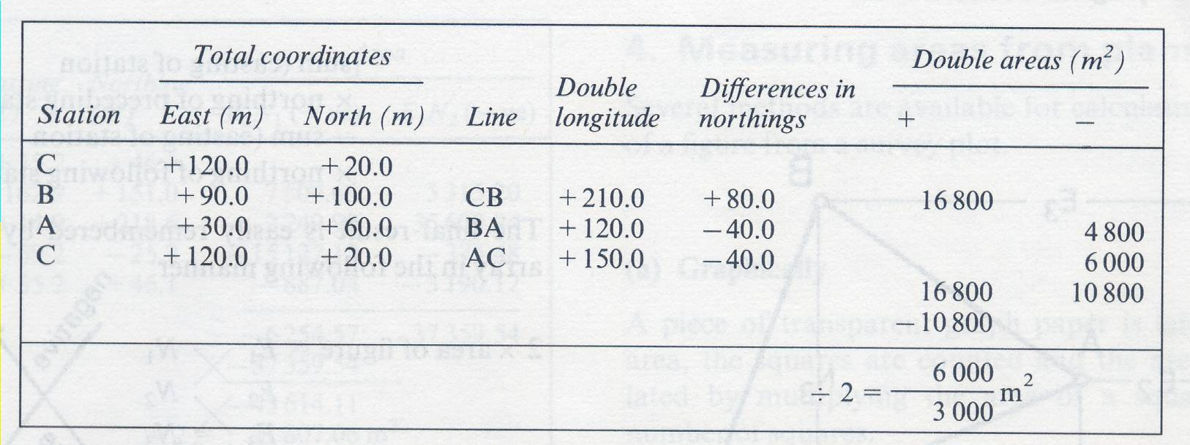

Slide 15
Method of total coordinates product
The following is the sequence of operations in the calculation of the area of any polygon:
Write the array of eastings and northings. Note that E1 and N1 are repeated at the bottom of the column.
Multiply the departure of each station by the latitude of the preceding station and find the sum.
Multiply the departure of each station by the latitude of the following station and find the sum.
Find the algebraic difference between operation 2 and 3 above.
Halve this figure to give the area of the polygon.

Slide 16
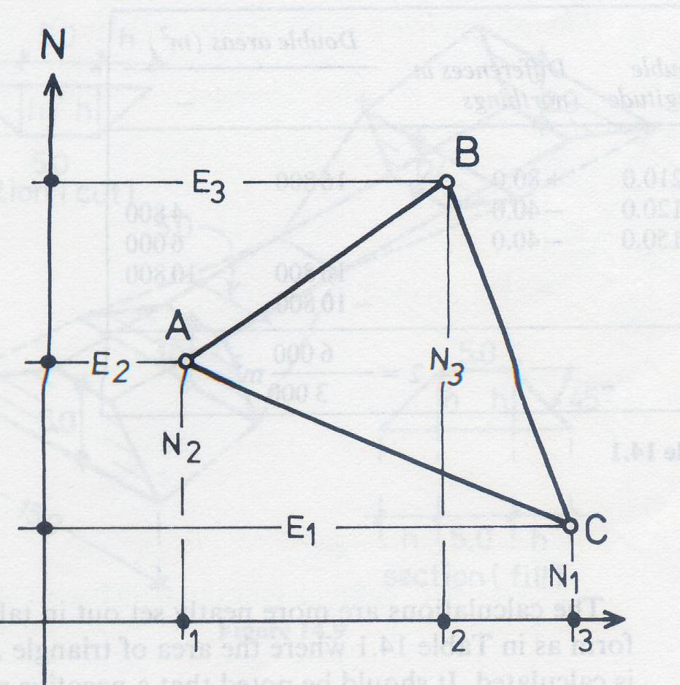
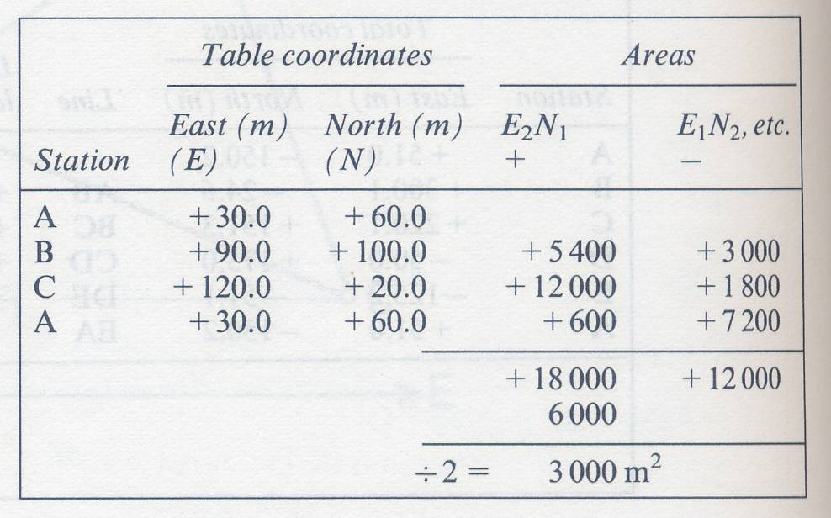

Slide 17
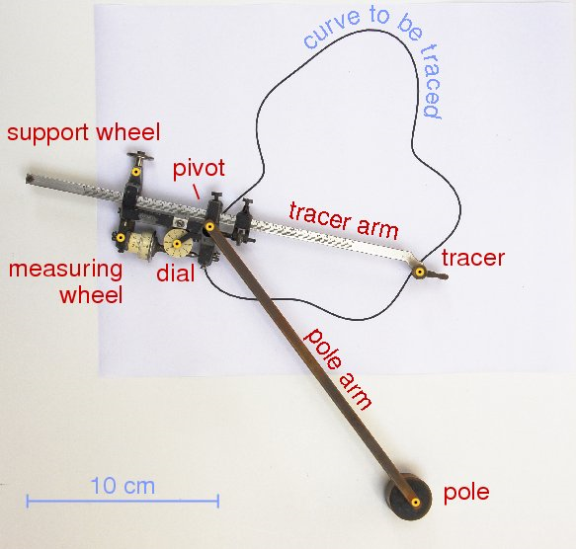
Planimeter

Slide 18
Food of mind
Food of Mind
The following table gives the corrected latitudes and departures (in meters) of the sides of the closed traverse PQRS
Side | Latutude |  | Departure
 | N | S | E | W
PQ | 128 |  | 9
QR | 15 |  | 258
RS |  | 143 | 9
SP | 0 |  |  | 276
Compute its area using Method of total coordinates product

Slide 19
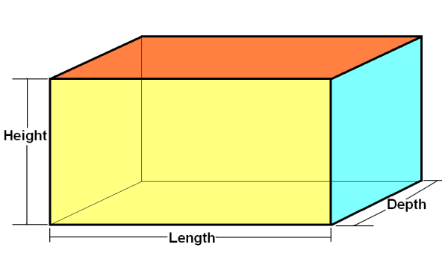
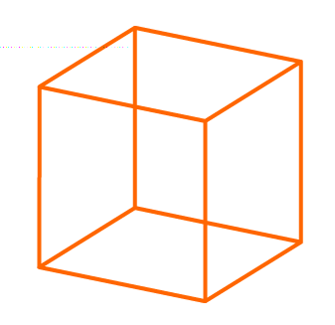
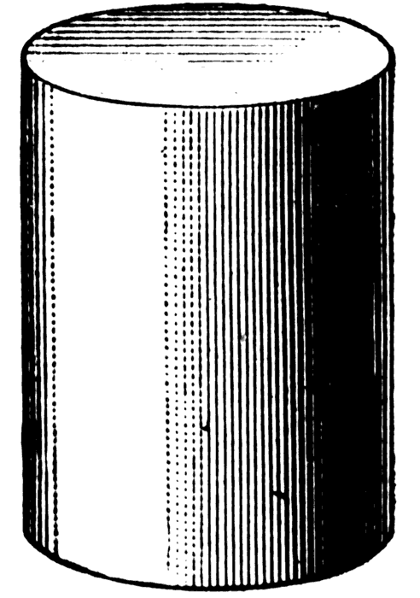
AREA COMPUTATION

Slide 20
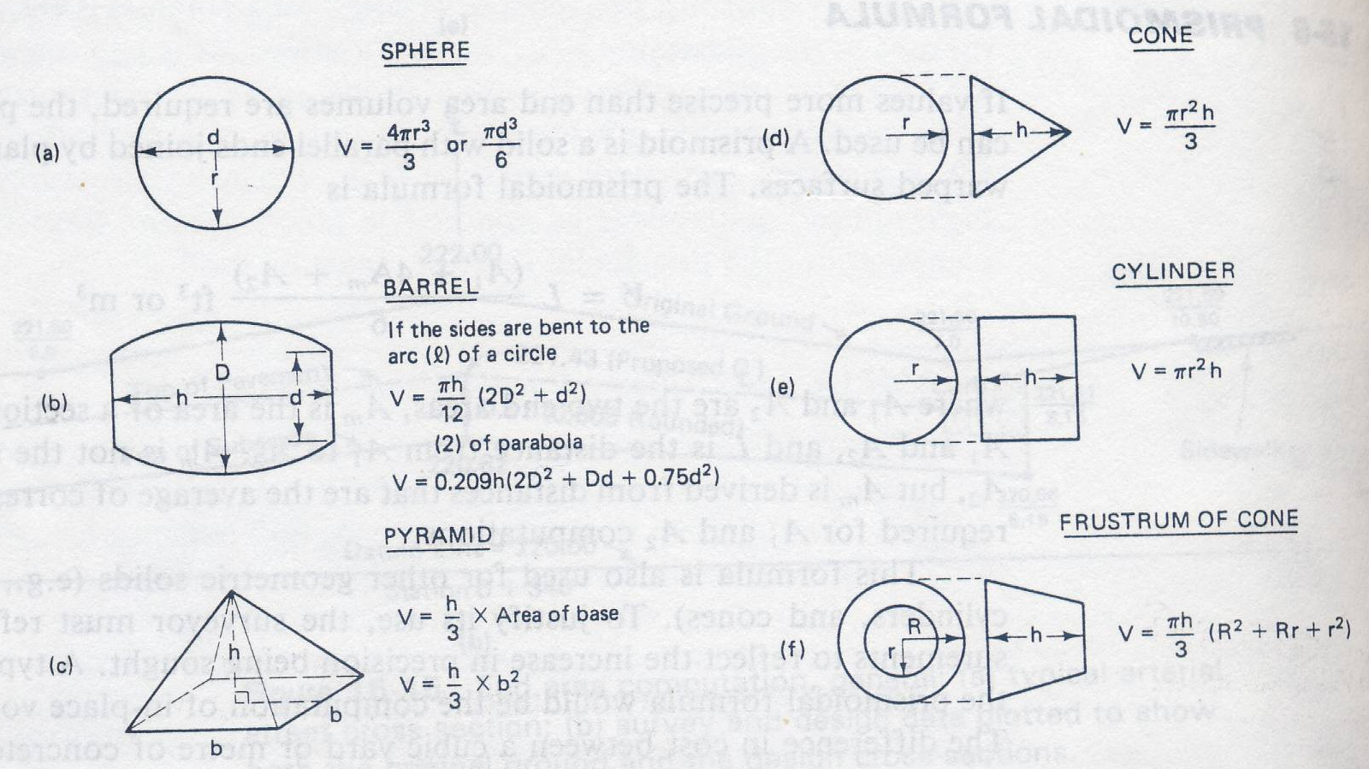
Regular area

Slide 21
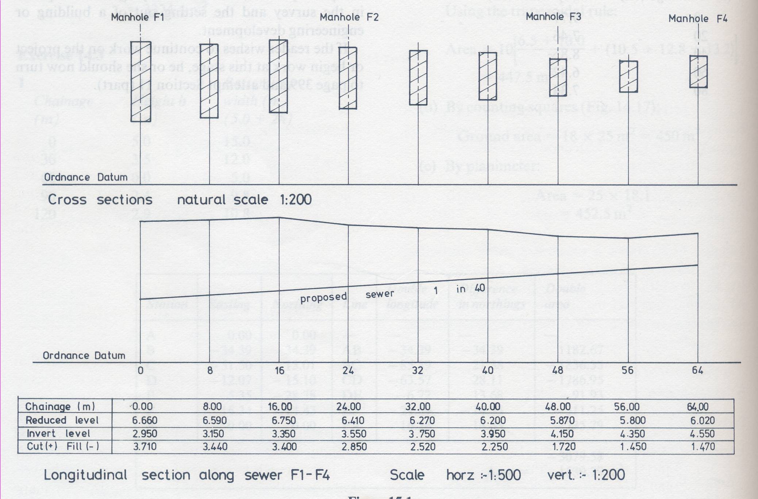
Cuttings (With vertical sides)
Given that the trench is to be 0.8 m wide and has vertical sides, calculate the volume of material to be removed to form the excavation.

Slide 22
Chainage (m) | Depth (m)
0 | 3.71
8 | 3.44
16 | 3.40
24 | 2.85
32 | 2.52
40 | 2.25
48 | 1.72
56 | 1.45
64 | 1.47
Method 1 : Side Area
a. Using Simpson’s rule and callling the chainage interval D, the area A of the side of the trench is found from the formulae:
A = (D/3)[first + last + 2(odds) + 4(evens)] m
= (8/3)[(3.71 + 1.47) + 2(3.40 + 2.52 +1.72)
+ 4(3.44 + 2.85 + 2.25 + 1.45)]
= 161.12 m
V = (161.12 x 0.8) m³
=128.9 m³

Slide 23
Chainage (m) | Depth (m)
0 | 3.71
8 | 3.44
16 | 3.40
24 | 2.85
32 | 2.52
40 | 2.25
48 | 1.72
56 | 1.45
64 | 1.47
Method 1 : Side Area
b. Using the trapezoidal rule
A = D[average of first and last depths + sum
of others]
= 8[(3.71 + 1.47)/2 + 3.44 + 3.40 + 2.85 +
2.52 + 2.25 + 1.72 + 1.45]
= 161.76 m2
V = (161.76 x 0.8) m³
= 129.4 m³

Slide 24
Chainage (m) | Depth (m) | Area (D x 0.8) m2
0 | 3.71 | 2.97
8 | 3.44 | 2.75
16 | 3.40 | 2.72
24 | 2.85 | 2.28
32 | 2.52 | 2.02
40 | 2.25 | 1.80
48 | 1.72 | 1.38
56 | 1.45 | 1.16
64 | 1.47 | 1.18
Method 2 : Cross Sections
The cross sectional area at each chainage point is calculated and the values entered directly into Simpson’s rule to produce the volume.
V = D/3)[A1+A9+2(A3+A5+A7)+4(A2+A4+A6+A8)] m³
= (8/3) [2.97+1.18+2(2.72+2.02+1.38)
+4(2.75+2.28+1.80+1.16)] m³
= (8/3)[48.35] m³
= 128.9 m³

Slide 25
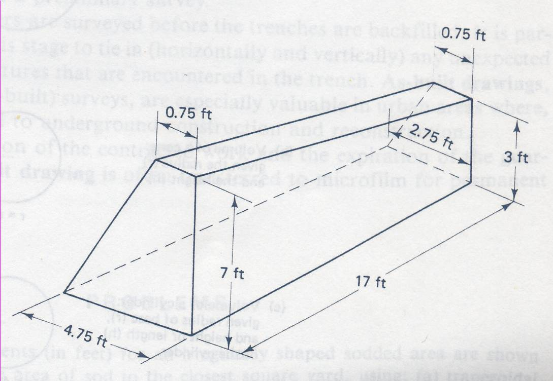
Prismoidal Formula
V = (L/6)[A1 + 4Am + A2) m3 or ft3
A1 = [(0.75+4.75)/2] x 7 = 19.25 ft2
Am = [(o.75+3.75)/2] x 5 = 11.25 ft2
A2 = [(0.75+2.75)/2] x 3 = 5.25ft2
V = (17/6)[19.25 + 4(11.25) + 5.25]
= 196.92 ft3

Slide 26
Cutting and embankments (with sloping sides)
One level section
Three level section
Cross fall section

Slide 27
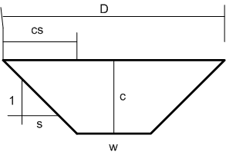
One level section
Trapezium formula
Or ??????

Slide 28
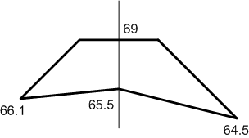
Three level section
Given that the roadway is 5.0 m wide and the side slope at gradient 1 to 1.
Ans : 32.45 m2

Slide 29
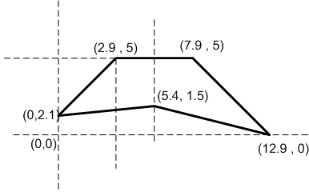
Or …by coordinate

Slide 30
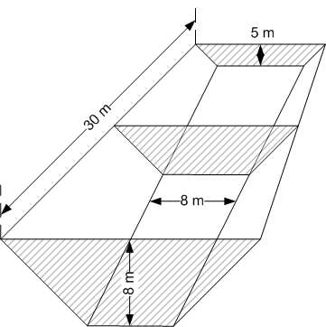
Food of Mind
Figure shows a proposed cutting where the following information is known
Length of cutting = 30 m
Formation width = 8 m
Depth at commencement = 8 m
Depth at end = 5 m
Side slope = 1 in 1
Using the prismoidal formula, calculate the volume of material to be removed.
2850 m3

Slide 31
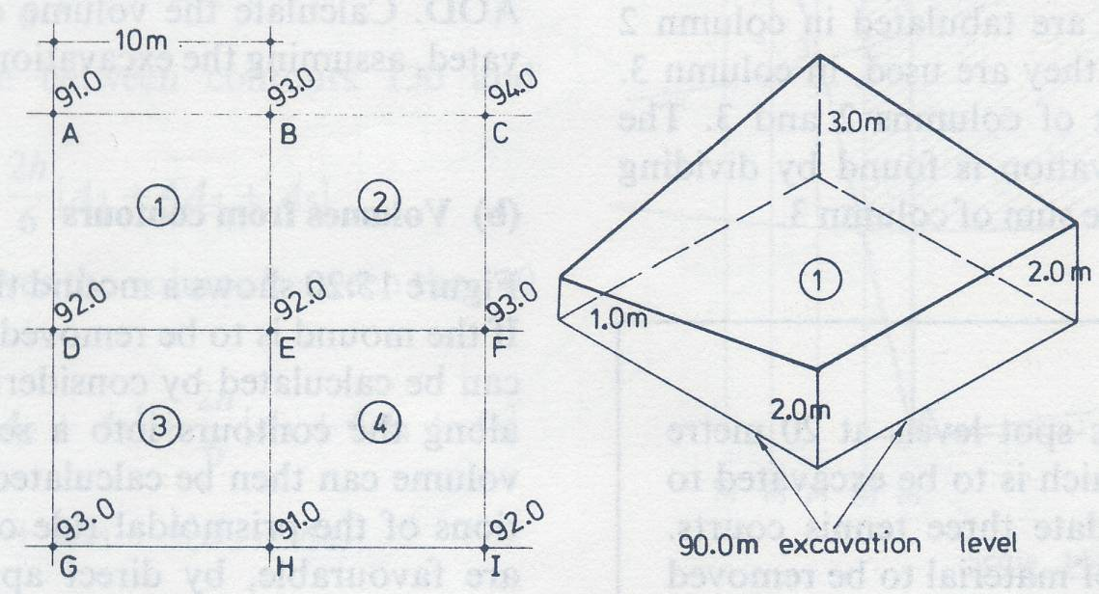
Volume of large scale earthworks
Volumes from spot levels
Mean height of each truncated prism above 90.00m level is
Prism 1 = (1.0+3.0+2.0+2.0) / 4 = 2.0 m
2 = (3.0+4.0+3.0+2.0) / 4 = 3.0 m
3 = (2.0+3.0+2.0+1.0) / 4 = 2.0 m
4 = (2.0+2.0+1.0+3.0) / 4 = 2.0 m
Mean height excavation = (2+3+2+2)/4
= 2.25m
Total Area of site = 20 x 20 = 400m2
Total Volume = 2.25 x 400 = 900 m2
Volume of each prism = mean height x area of base

Slide 32
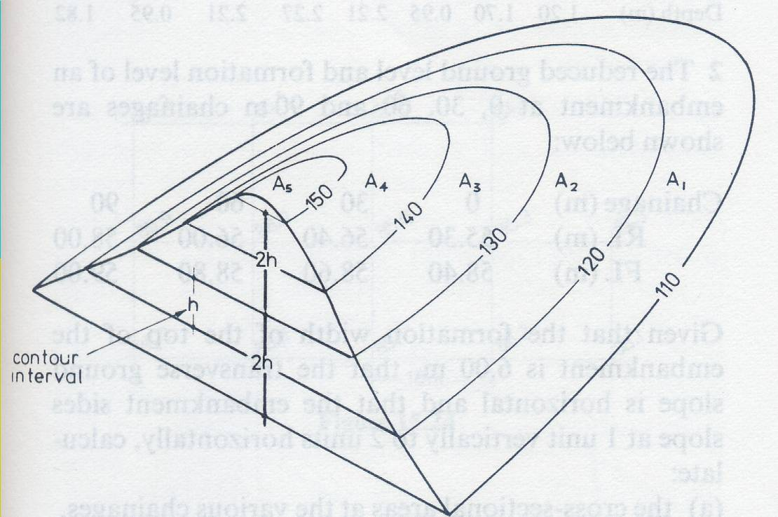
b. Volume From Contours
Using Simpson’s Rule
Volume = (h/3) [ First Area+Last Area+2(Sum of Odd Area)+4(Sum of Even Area)]
The part of the solid lying above last area contour is not included in a bove calculations. It must calculated separately. In general,
Volume = 1/3 [base area x height]

Slide 33
Author Information Dr Idris bin Ali
Dr Cheng Hock Tian

