Slide 1
Engineering Surveying Introduction to Survey Engineering
By
Mohd Arif Sulaiman
Faculty of Civil Engineering & Earth Resources
mdarif@ump.edu
Introduction To Survey Engineering, by Mohd Arif

Slide 2
Chapter Description
Expected Outcomes
Able to explain the definition & principle of surveying
Able to demonstrate and understand the units measurement
Able to read and understand the information shown on site plans.
References
Barry F. Kavanagh, "Surveying with Construction Application", 0-13-048215-3 Pearson, Prentice Halll, 2004.
Bannister, Raymond, Baker,"Surveying",0-582-30249-8, Prentice Hall 1998.
William Irvine, "Surveying for Construction", 4th Ed.,0-07-707998-1, McGraw-Hill,1998.

Slide 3
Definition & principle of surveying
What is surveying??
Is a science and art of measuring, recording and drawing to scale, the location, the size and shape of natural and man-made features on a surface of the earth.

Slide 4
Survey are usually performed for reasons:
To collect data, which can then be drawn to scale on a plan or map.
To lay out dimensions shown on a design plan in order to precisely define the field location for the proposed constructions facility.

Slide 5
Plane Survey vs Geodatic Survey
Collimation plane
Earth surface
Curvature of earth
Survey that ignore the curvature of earth are called as plane survey
Large areas of the earth’s involved and the curvature of the earth must be taken into account.

Slide 6
Classification of survey
Chain survey
Traverse survey
Tacheometry
Levelling
Plane tabling
triangulation
Based on instrument used

Slide 7
Branches of survey
Engineering survey
Defence survey
Geological survey
Geographical survey
Route survey
Mine survey
Archaelogical survey
Control survey
Based on purpose of survey

Slide 8
Classification of survey
Land survey
Hydrographic survey
Underground survey
Aerial survey
Based on placed of survey

Slide 9
Basic principles
Measure distance
Measure distance at right angles
Measure distance and angle
Measure angles
The fundamental rule in surveying project is WORK FROM THE WHOLE TO THE PART.

Slide 10
Sources of errors
Personal errors
Instrumental errors
Natural errors

Slide 11
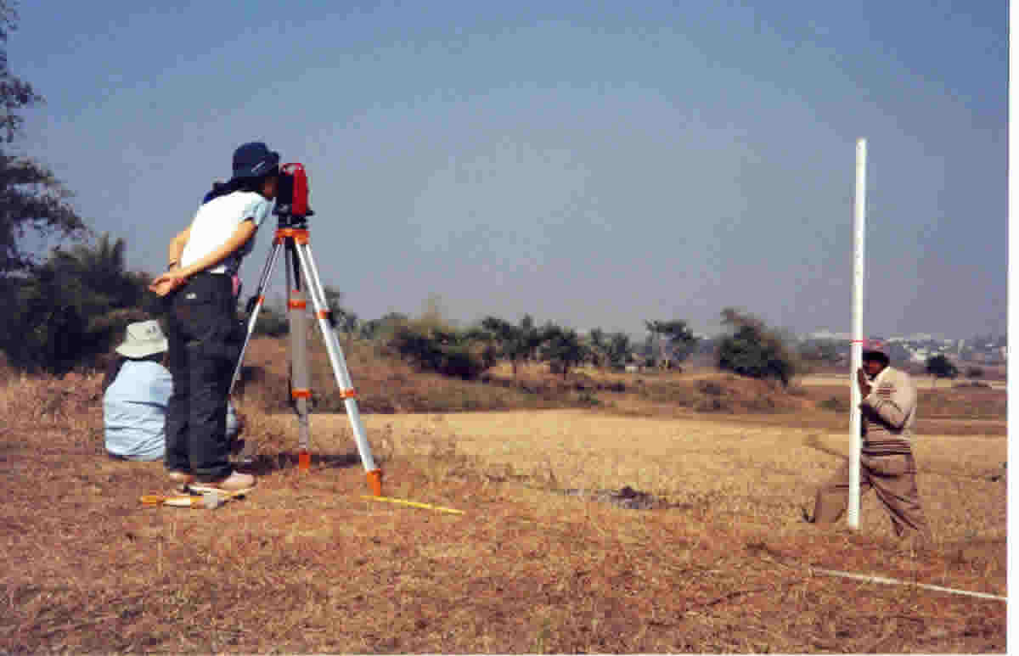

Slide 12
Identify sources of error in previous picture.
An observer takes a reading without doing temporary adjustment to the instrument used
Uncalibrated equipment used to collect data
Exposure of equipment to direct sun light in extreme climate for a long period.

Slide 13
Systematic error
Error which occur from well understood causes and can be reduced by adopting suitable method.
Random error
Error due to combination of causes and beyond the control of surveyor.

Slide 14
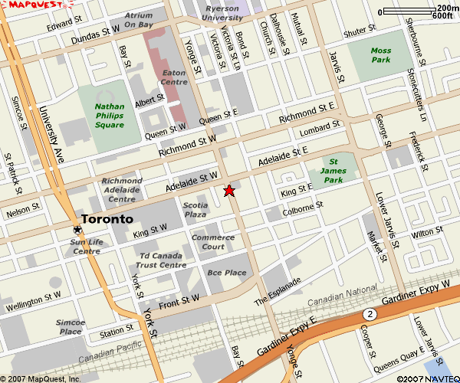
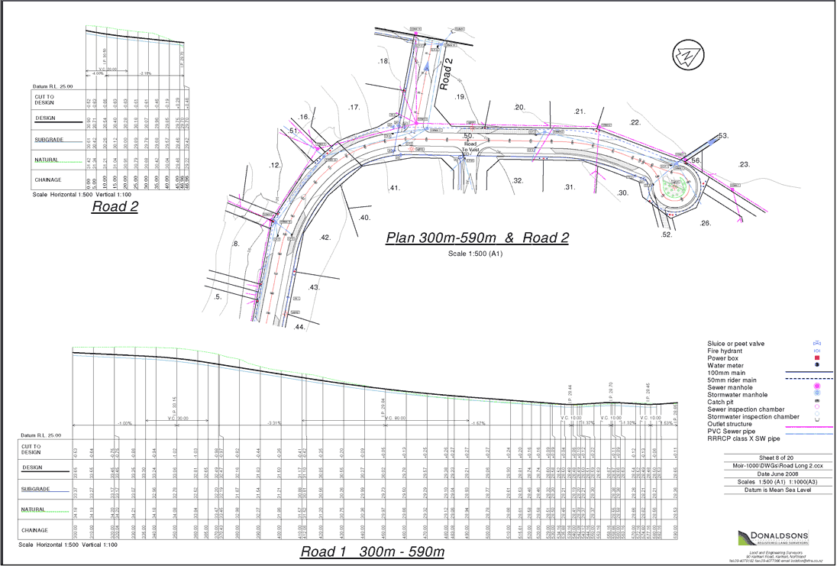
Understanding map and plan
MAP
PLAN
Are representation on paper of physical features on the ground

Slide 15
Plan
Will accurately define widths of roads, size of building, etc. every features are exactly true to scale
Map
Is a representation, no matter how accurately it may be shown

Slide 16
Common features
symbol
scale
Grid line
Surface relief
Plan views of the actual objects being portrayed.
Ratio between the drawing of the object and the actual object itself.
Expressed in word
By a drawn scale
By a representative fraction.
Undulation in the ground surface are shown on a plan by contour lines and sport heights.
North point indicating the direction of north chosen for that particular plan

Slide 17
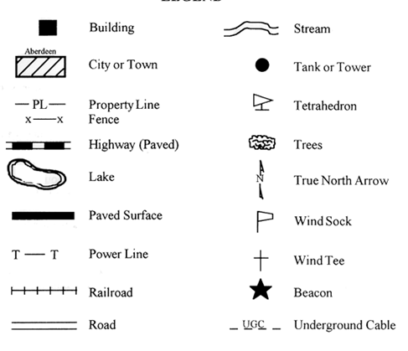
Symbol

Slide 18
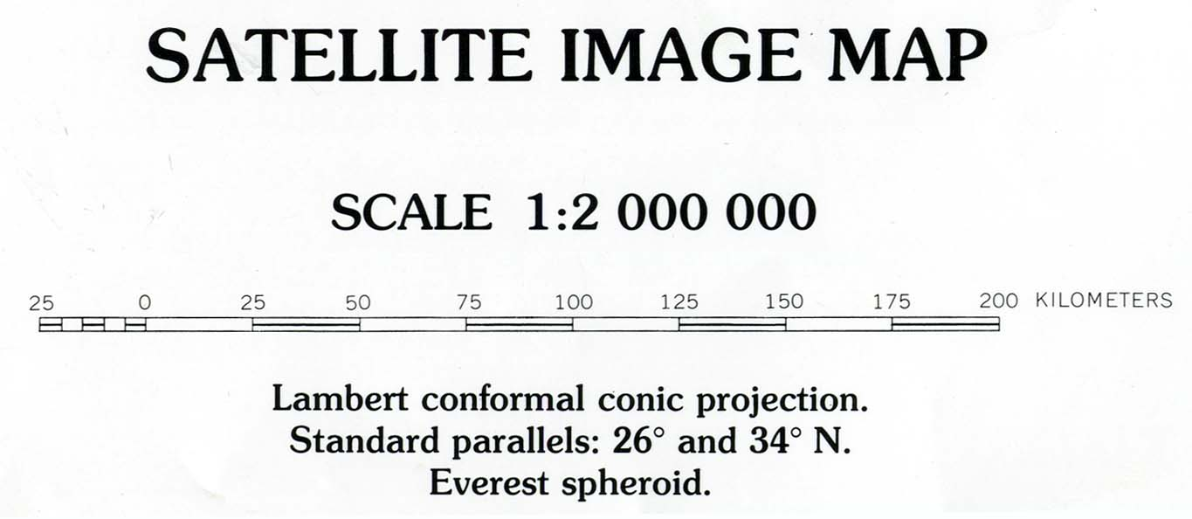
Scale

Slide 19
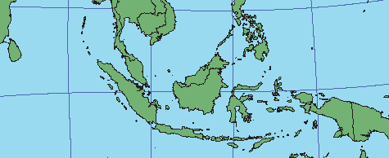
Grid Line
Grid Line

Slide 20
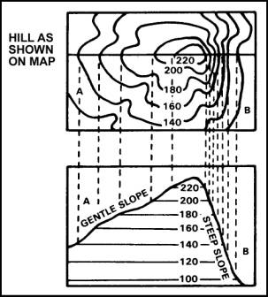
Surface Relief
Surface Relief

Slide 21
Unit and Measurement
QUANTITY | UNIT | SYMBOL
Length | Metre | m
Area | Square metre | m²
Volume | Cubic metre | m³
Mass | Kilogramme | kg
Capacity | Litre | l

Slide 22
Author Information Dr Idris bin Ali
Dr Cheng Hock Tian

