Slide 1
IMAGE PROCESSING COLOR IMAGE PROCESSING
Editor by
DR. FERDA ERNAWAN
Faculty of Computer Systems & Software Engineering ferda@ump.edu.my

Slide 2
Today’s Lesson
Color image processing
Color Fundamental
CIE Chromacity Diagram
Color Models
Pseudocolor Image Processing
Intensity Slicing
Learning Outcomes:
To understand fundamental of color.

Slide 3
Color Image
Color image is a descriptor that can be used for various tasks, e.g.: segmentation, object detection, tracking and identification
Human can distinguish thousands of color intensities.

Slide 4
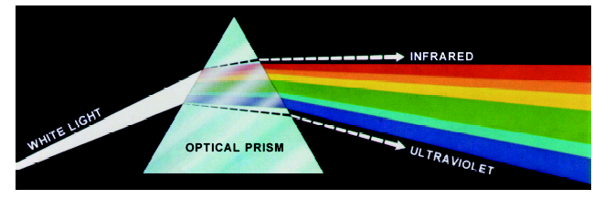
Color Fundamentals
Isaac Newton found that when sunlight passes through a optical prism, the emerging beam is divided into spectrum of colors.
Images taken from Gonzalez and Woods, 2016

Slide 5
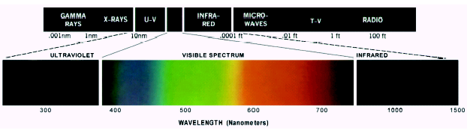
Color Fundamentals
Human Visual System can perceive the electromagnetic spectrum about 400 to 700 nm.
Human eye has 6 to 7 million cones to identify color spectrums.
Images taken from Gonzalez and Woods, 2016

Slide 6
Color Fundamentals
Human visual system perceives an object by light reflected from the object.
A red object reflects light with wave lengths about
600 – 700 nm while absorbing most of the energy at other wavelengths
White Light
Colours Absorbed
Green Light

Slide 7
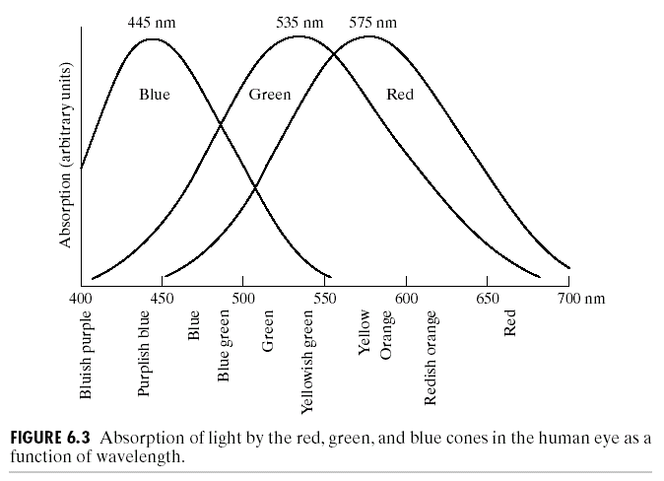
Color Fundamentals
Images taken from Gonzalez and Woods, 2016

Slide 8
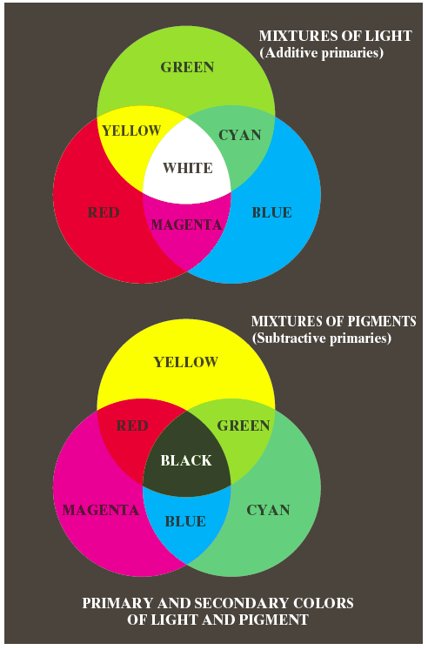
Color Fundamentals
The primary color can be merged with another colors to produce the secondary colors.
Combination of the three primary colors produces white.
Mixing a secondary with its opposite primary produces white (e.g. red+cyan).
Images taken from Gonzalez and Woods, 2016

Slide 9
Color Fundamentals
Important difference:
Primary colors of light (green, blue, red)
Primary colors of pigments
A color that absorbs or subtracts a primary color of light and reflects the other two.
These are cyan, yellow and magenta (CMY).
A proper combination of pigment primaries produces black.

Slide 10
CIE Chromaticity
CIE chromaticity diagram provides a specific color value.
There are three things that effect the way a color is perceived
Characteristic illumination
Object
Interpretation information in the human eye.

Slide 11
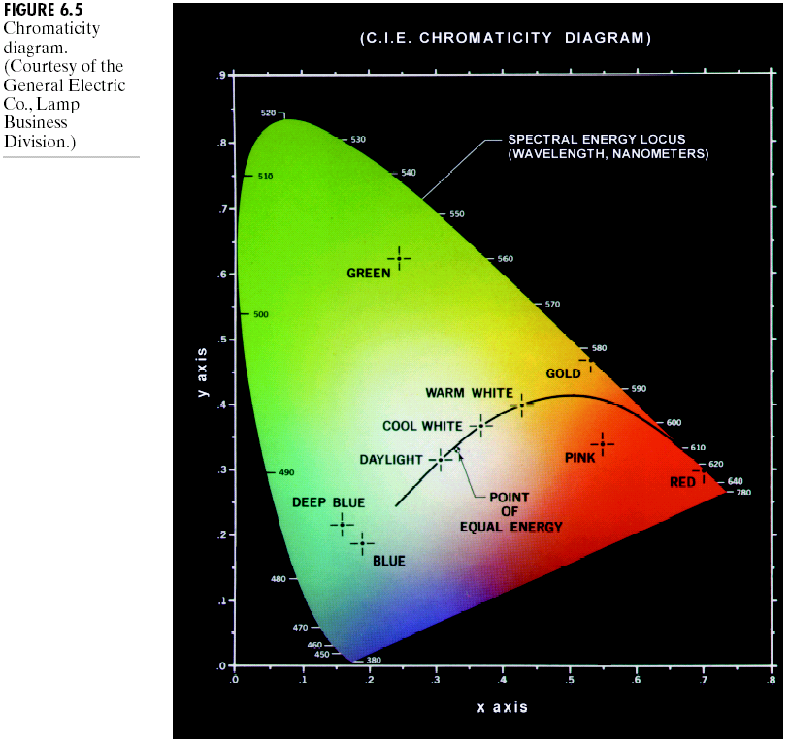
CIE Chromaticity
Green: 13% blue, 25% red, and
62% green.
Red: 1% blue, 67% red and 32% green.
The diagram is usefull for color mixing.
x-axis shows the red proportion and the y-axis shows the green proportion used to produce a specific color.
The blue proportion used in a color is defined as:
z = 1 – (x + y)
Images taken from Gonzalez and Woods, 2016

Slide 12
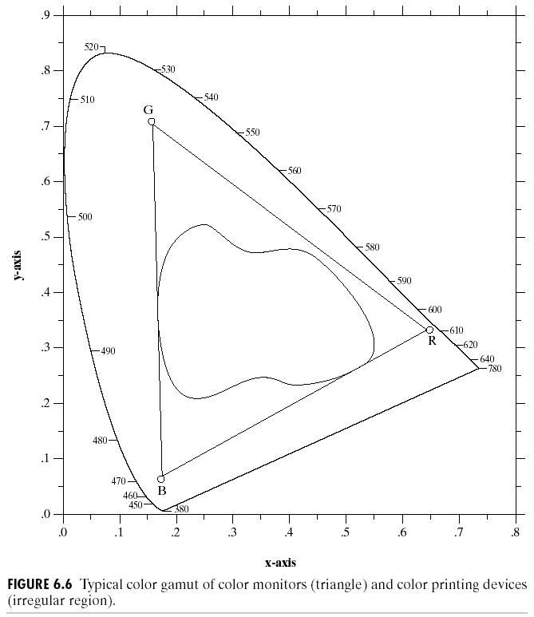
CIE Chromaticity
The entire color range can’t be displayed using three colors
The triangle shows the typical color gamut produced by RGB monitors

Slide 13
Color Models
There are different ways to model color:
RGB
CMY and CMYK
HIS
YUV/YCbCr
Notes:
RGB-color monitor, video camera
CMY prointing
HIS human describe color
YUV video compression

Slide 14
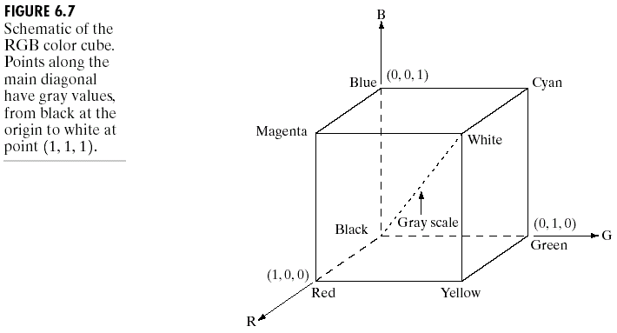
RGB
Images taken from Gonzalez and Woods, 2016

Slide 15
RGB
The color spectra from red, green and blue light beams are summed at the surface of the projection screen.
A color image is represented by a two dimensional array of three variate vectors which are comprised of the pixel’s red, green and blue values.
A true color image 24-bits consists 16,777,216 colors.
RGB colors are widely used in monitor model, LCD screen, television, etc.

Slide 16
RGB
Images taken from Gonzalez and Woods, 2016

Slide 17
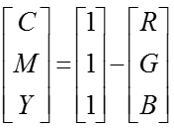
CMY Model
CMY model is utilized for color printer and color copier. To convert RGB color space to CMY is defined as:

Slide 18
The HSI Color Model
Practically, RGB colors are not useful for recognition and user specification of colors.
Intensity, saturation and hue are useful to describe the human color perception.
HSI is used to specify colors using the artistic notion of tints, shades and tones.

Slide 19
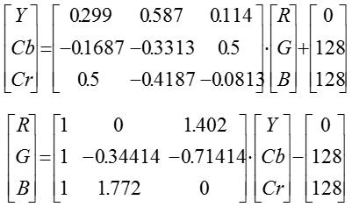
YUV / YCbCr model
Converstion RGB to YCbCr is defined as:

Slide 20
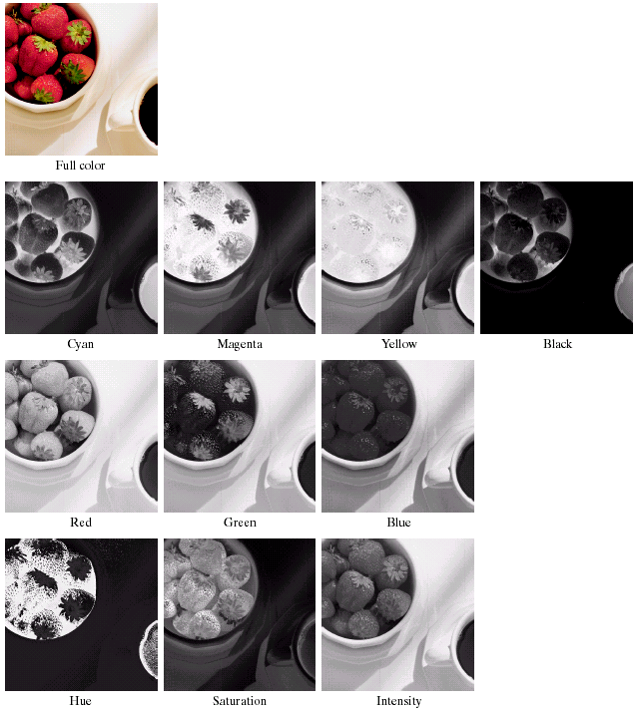
A true color image and its various color-space

Slide 21
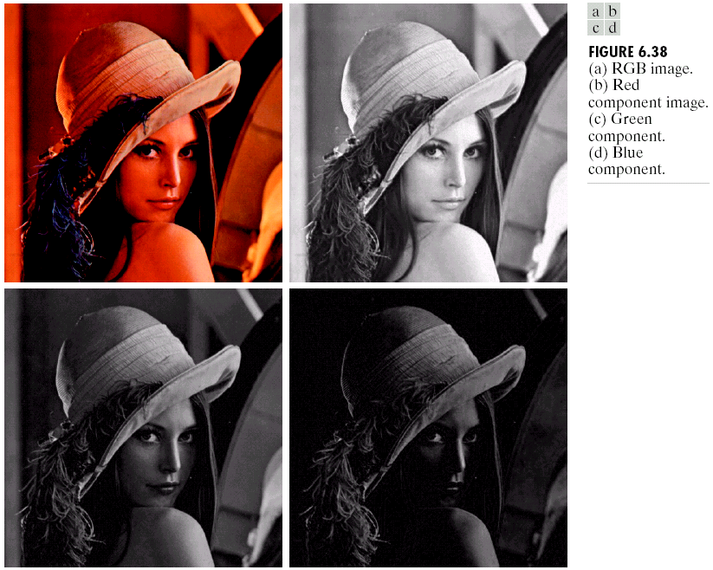
Example of RGB
RGB color image
Red channel
Green channel
Blue channel

Slide 22
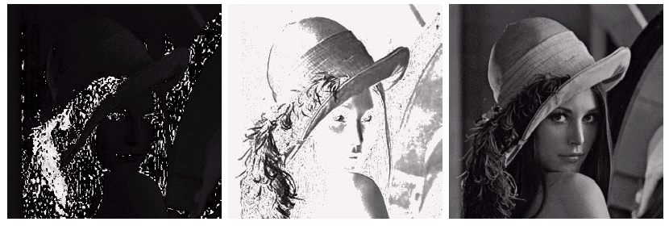
Example of HSI
HIS elements of the RGB color image (a) Hue (b) Saturation (c) Intensity

Slide 23
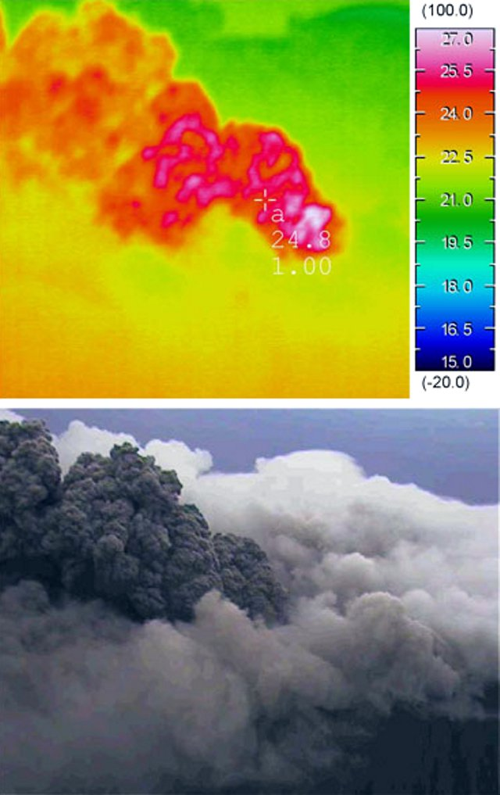
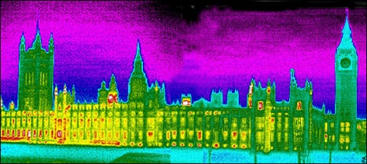
Pseudo-color Image
Pseudo-color (false color) is assigning colors from greyscale values according to a specific criterion.
Pseudo-color image is used for human visualization.

Slide 24
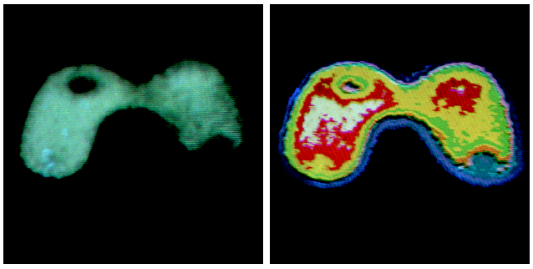
Intensity Slicing
Intensity slicing adopts pseudo-color image process.
Each intensity is assigned a color

Slide 25
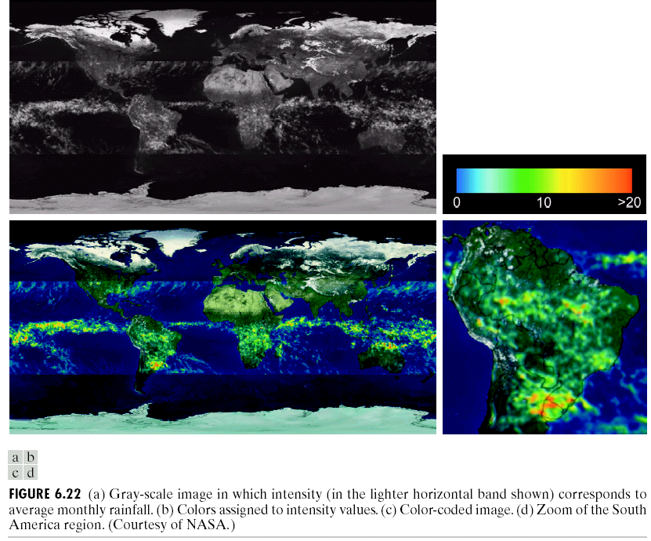
Intensity Slicing: Example

Slide 26
Color Image Processing
Choice of appropriate color space
Independent channel processing
Multi-channel processing

Slide 27
References
R.C. Gonzalez and R.E. Woods, 2016. Digital Image Processing, Pearson Education India; Third edition.
A.K. Jain, 2015. Fundamentals of Digital Image Processing, Pearson Education India; First edition.
R.C. Gonzalez, R.E. Woods and S.L. Eddins, 2017. Digital Image Processing Using MATLAB. McGraw Hill Education; 2 edition.
S. Jayaraman, T. Veerakumar, S. Esakkirajan, 2017.Digital Image Processing, McGraw Hill Education; 1 edition.

