Slide 1
Digital Electronics Memory Devices and Its Operation
by
Norazian Subari
Fakulti Kejuruteraan Elektrik & Elektronik aziansubari@ump.edu.my

Slide 3
Topics

Slide 9
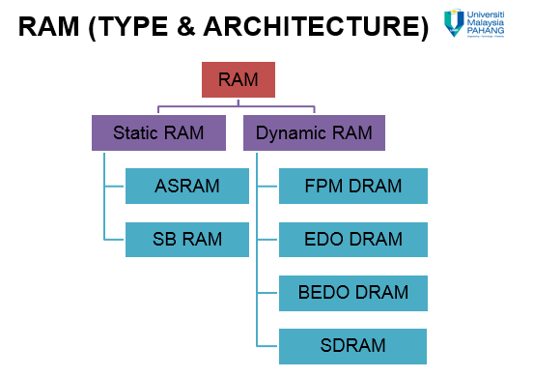

Slide 10
References
T. Floyd, “Digital Fundamental”, 10th Ed., USA : Prentice-Hall, 2008.
R.J. Tocci, “Digital Systems: Principles and Applications”, 10th Ed., USA : Prentice-Hall, 2006.

Slide 11
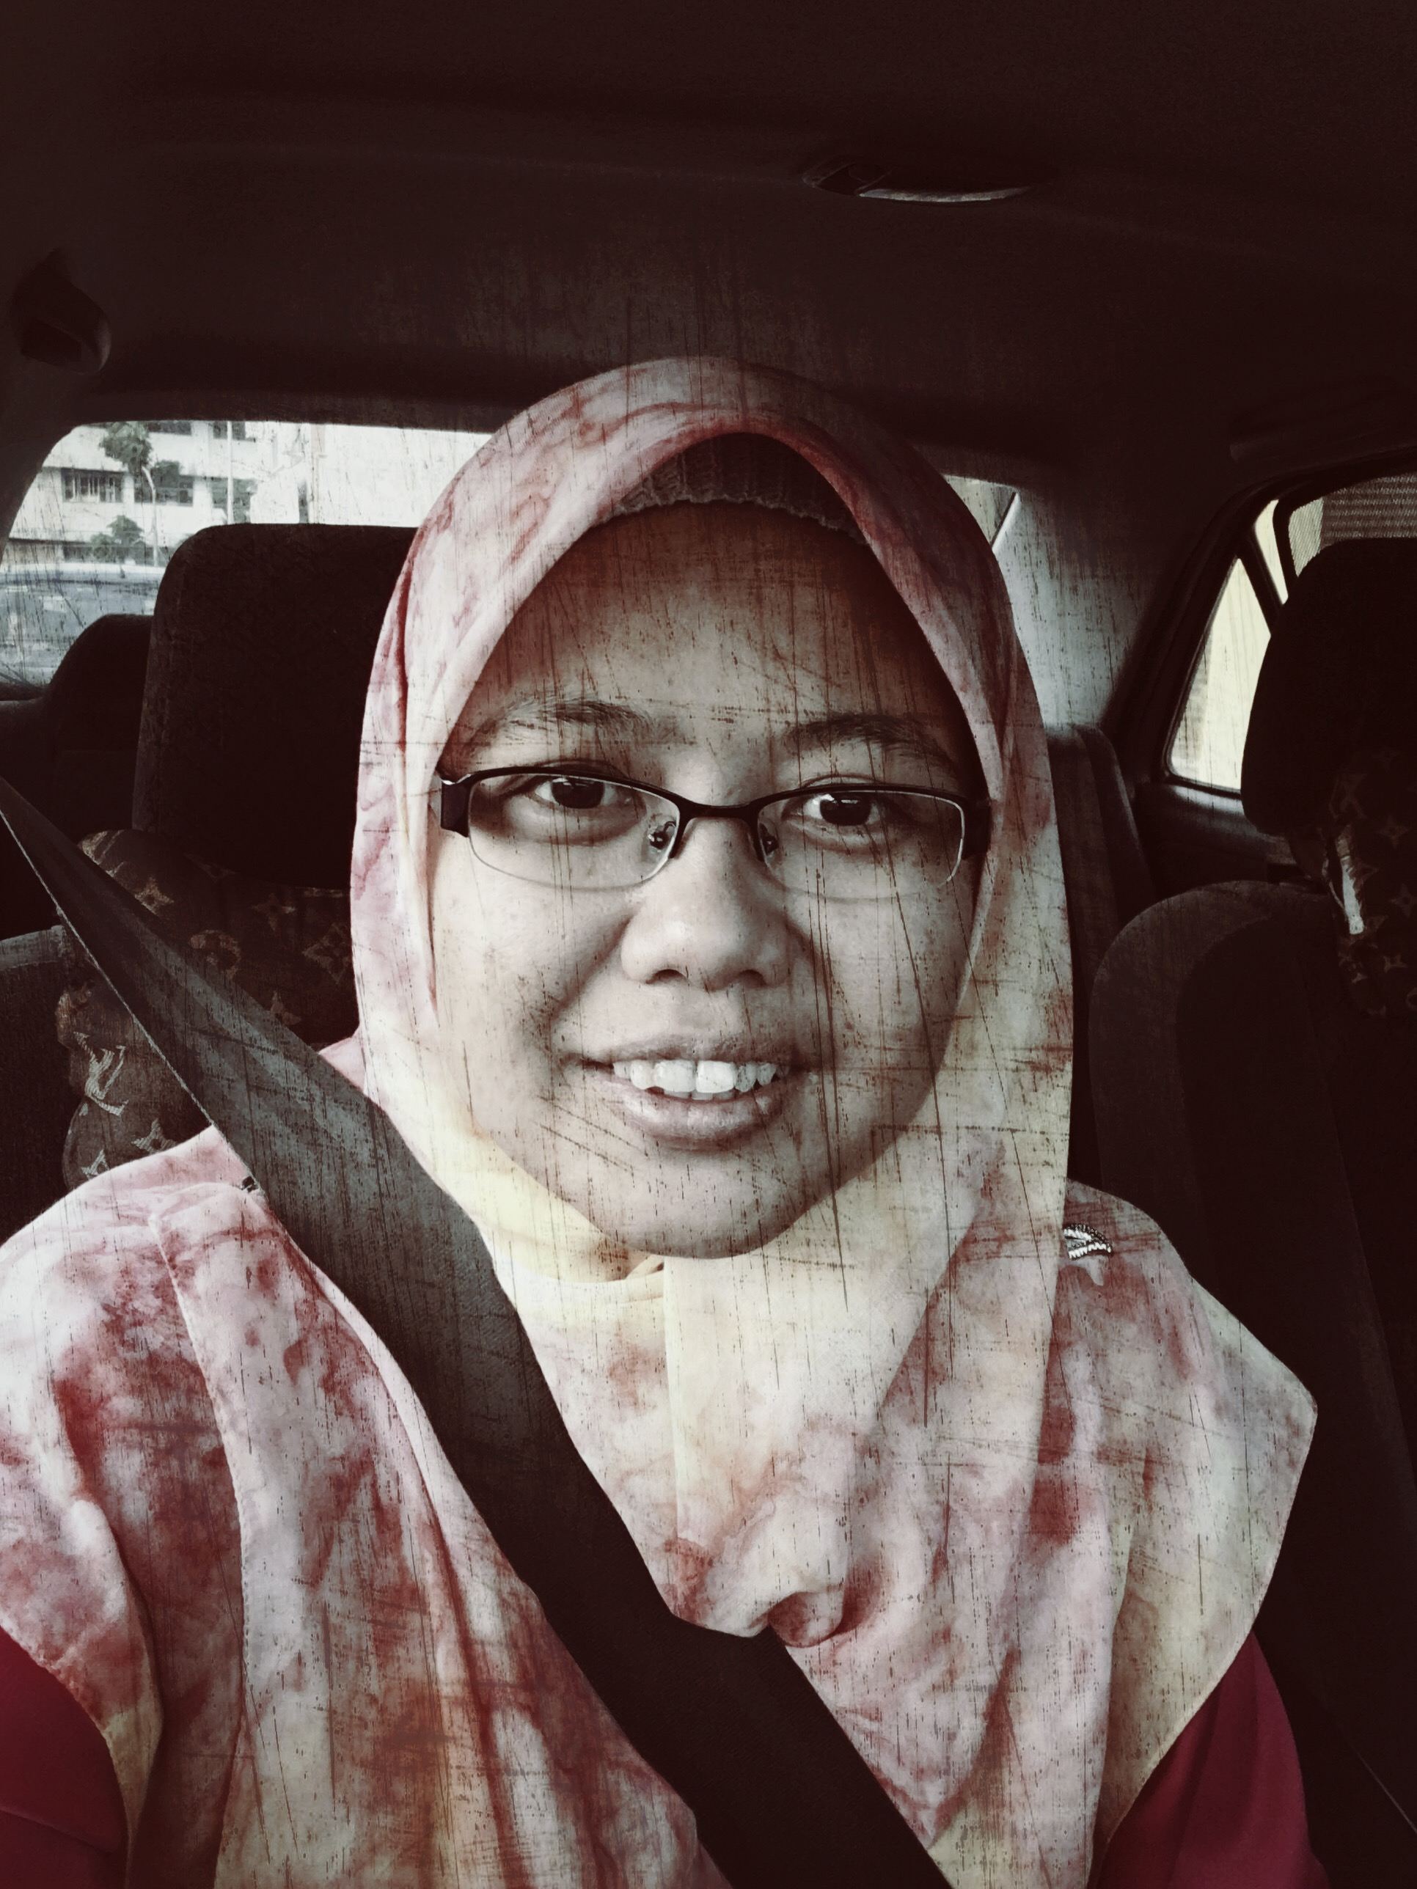
Norazian Subari Fakulti Kejuruteraan Elektrik & Elektronik Universiti Malaysia Pahang 26600 Pekan, Pahang, Malaysia http://fkee.ump.edu.my/index.php/en/staff-menu/articles-staff/1622-norazian-subari-main-profile

