Slide 1
IMAGE PROCESSING IMAGE WATERMARKING
Editor by
DR. FERDA ERNAWAN
Faculty of Computer Systems & Software Engineering ferda@ump.edu.my

Slide 2
Today’s Lesson
Introduction to digital watermarking
Watermarking applications
Watermark Classification
Watermarking System
Watermarking Methods
Spatial Domain (LSB technique)
Frequency domain (Spread spectrum technique)
Different types of attack
Image Watermarking Performance
Learning Outcomes:
Introduce image watermarking techniques
Notes:
Digital watermarking is the process of embedding information into a digital signal which may be used to verify its authenticity or the identity of its owners, in the same manner as paper bearing a watermark for visible identification. In digital watermarking, the signal may be audio, pictures, or video. If the signal is copied, then the information also is carried in the copy. A signal may carry several different watermarks at the same time.

Slide 3
Digital Watermarking
Digital image watermarking can be used to protect a copyright, production, illegal distribution, unauthorized manipulation, piracy, forgery, theft and ownership of digital image.
Image watermarking technique embeds an authorized mark information in the digital image to protect the ownership of digital image (Ernawan et al., 2016).
Embedding a watermark without degrading the perceptual image quality and at the same time making it difficult to remove.
Embedding and extracting the watermark image should be limited to authorized users only.
Notes:
Digital watermarking is the process of embedding information into a digital signal which may be used to verify its authenticity or the identity of its owners, in the same manner as paper bearing a watermark for visible identification. In digital watermarking, the signal may be audio, pictures, or video. If the signal is copied, then the information also is carried in the copy. A signal may carry several different watermarks at the same time.

Slide 4
Watermarking Applications
Copyright Protection and Authentication
To protect copyright and intellectual property.
Fingerprinting and Digital Signatures
To identify those who make illegal copies or redistribute.
Copy Protection and Device Control
To control a hardware device such as enable copy from device scans for an existing watermark, enables record for a specific movie.

Slide 5
Watermarking Applications
Broadcast Monitoring
To secure their intellectual property and not permit illegal rebroadcasting activities (news, movies, shows)
Data Authentication
To prove the authenticity in medical images. A watermark is used to validate that the watermarked image has not been modified.

Slide 6
Classification and Requirement
Robustness
Resistance ability of the watermark against modification made to the original file. The embedded information can survive after different types of attack.
Imperceptibility
The watermarked and original image cannot be distinguished from each other.
Non-detectable
Watermarked image is not detectable, it is consistent with the original data.

Slide 7
Classification and Requirement
Security
Attacker difficult to manipulate the watermark information.
Complexity
The expenditure to detect embedded a watermark information.
Capacity
Embedding capacity that can be embedded into the host image.
Unchanging image size
Image size is not changed after embedding watermark.

Slide 8
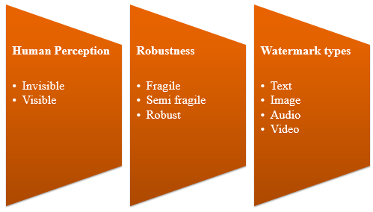
Watermark Classification
Notes:
Excluding the obvious case of visible watermarks, we can classify the watermarks as FRAGILE or ROBUST. The fragile watermark is used for detecting even the smallest alteration of an image, while the robust one is specially designed to withstand a wide range of “attacks”, which basically are trying to remove the watermark, but without destroying the image/video.

Slide 9
Visible Watermark
A watermark logo can be viewed as the property of the ownership.
Notes:
A visible watermark is a visible translucent image which is overlaid on the primary image. Perhaps consisting of the logo or seal of the organization which holds the rights to the primary image, it allows the primary image to be viewed, but still marks it clearly as the property of the owning organization.
It is important to overlay the watermark in a way which makes it difficult to remove, if the goal of indicating property rights is to be achieved.
An example shows both a watermark and an image with the watermark overlaid.

Slide 10
Invisible Watermark
Distortion of embedded watermark is too small to be noticed.
A watermark can be extracted by authorized extraction software
Watermark
Host image
Watermarked image
Notes:
An invisible watermark is an overlaid image which cannot be seen, but which can be detected algorithmically. Different applications of this technology call for two very different types of invisible watermarks:
A watermark which is destroyed when the image is manipulated digitally in any way may be useful in proving authenticity of an image. If the watermark is still intact, then the image has not been "doctored." If the watermark has been destroyed, then the image has been tampered with. Such a technology might be important, for example, in admitting digital images as evidence in court.
An invisible watermark which is very resistant to destruction under any image manipulation might be useful in verifying ownership of an image suspected of misappropriation. Digital detection of the watermark would indicate the source of the image.

Slide 11
Fragile/ Semi Fragile/ Robust
Watermark fails to be detected from watermarked image after slightly modification. (Fragile).
Watermark resists beginning transformation, while a watermark fails to be detected after malignant transformation (Semi-fragile).
Watermark resists against different types of attack (Robust).
Notes:
The aims of such photo watermarks are completely different: A (semi-)fragile watermark is a mark which is (highly) sensitive to a modification of the stego-medium. A fragile watermarking software scheme should be able to detect any change in the signal and identify where it has taken place and possibly what the signal was before modification. It serves at proving the authenticity of a document. On the opposite, a robust photo watermark should be stuck to the document it has been embedded in, in such a way that any signal transform of reasonable strength cannot remove the watermark.

Slide 12
Watermarking System
Watermark W
Watermark
embedding
system
Host Image I
Watermarked Image
Key K
Watermark embedding process
Watermarked Image
Watermark
Extraction
system
Test Data
Watermark extraction
Key K
Watermark recovery process
Watermarking scheme includes embedding process and watermark extraction. The ideal watermarking is to embed such amount of information into host image that provides tradeoff between robustness and imperceptibility by human visual system.

Slide 13
Watermarking Extraction Schemes
Watermark Extraction Schemes
Non-blind watermarking system means that the scheme requires original host image for extraction/detection. The original host image is used to extract the watermark.
Blind watermarking scheme means that the scheme does not need the original image to extract the watermark.

Slide 14
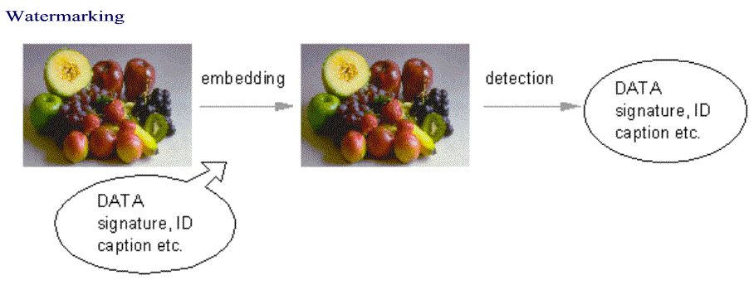
How It Works?

Slide 15
Watermarking Technique
Spatial Domain
Digital watermarking manipulates the pixel values for adding watermark information.
For example: Least significant bit (LSB)
Frequency Domain
Adding or changing component of digital images can be transferred to other value domains.
For example: Spread Spectrum Watermarking

Slide 16
Least Significant Bit
A true color image consists of three channels : red, green and blue component. For each pixel has 1 byte / 8 bits, given a bright purple as shown below:
Y0 = {R=254, G=1, B=254}
Least significant bit is a simple technique, this technique embeds a watermark into the least of bits. The result of watermark embedding based on LSB in Y0 is given as:
Y1 = {R=254, G=1, B=253}
Human visual system is almost impossible to detect a difference of 1 on a color scale.
While the watermark can easily be removed when the watermarked image is compressed by JPEG compression.

Slide 17
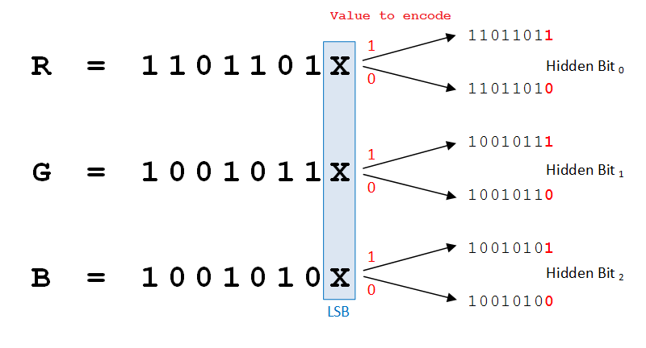
Least Significant Bit
Random numbers based on a secret key can distribute watermark embedding into the host image.
Increasing the number of bits can give significantly effect to the quality of watermarked image.

Slide 18
Frequency-Based Techniques

Slide 19
Frequency-Based Techniques
Embedding watermark schemes in frequency coefficients will produce higher robustness than embedding watermark schemes in spatial domain.
A watermarking scheme which uses frequency-based should embed a watermark in low frequency order or medium frequencies.
Embedding a watermark in a low frequency can produce a higher quality degradation of the watermarked image.
Embedding a watermark in a high frequency makes less robust and it is higher probability being lost when the watermarked images are compressed.

Slide 20
DCT
DCT B of an input image A is defined as:
for p = 0, 1, 2, …, M−1 and q = 0, 1, 2, …, N−1
where
Inverse DCT is calculated by:

Slide 21
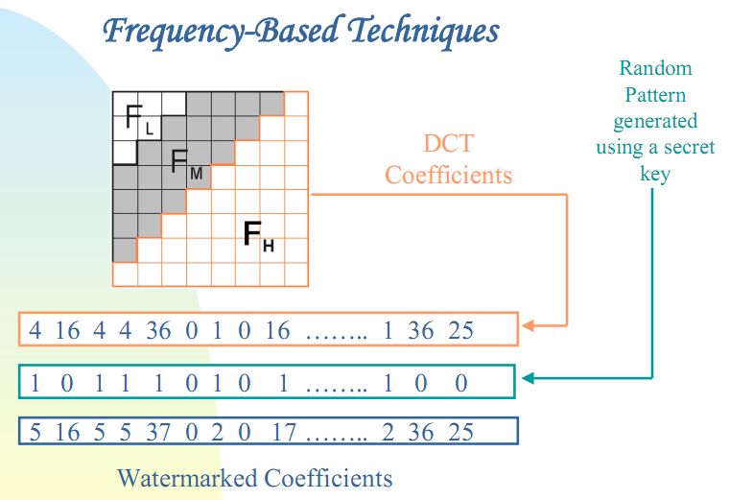
Frequency-Based Techniques

Slide 22
Wavelet Watermarking Techniques
Discrete wavelet transform (DWT)
The DWT has been widely implemented in the digital image watermarking because of its multiresolution capability.
DWT is a transform to decompose an image into the frequency bands LL, LH, HL, and HH.
The DWT technique performs multi-resolution and excellent localization characteristics.

Slide 23
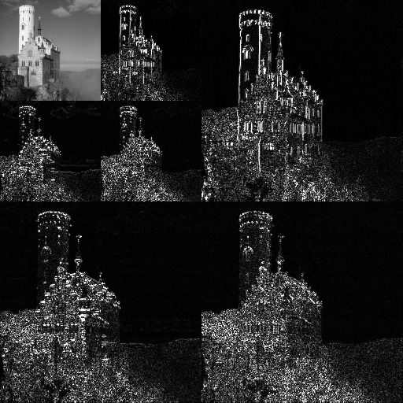
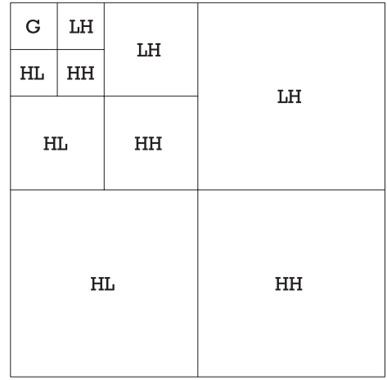
Wavelet Watermarking Techniques

Slide 24
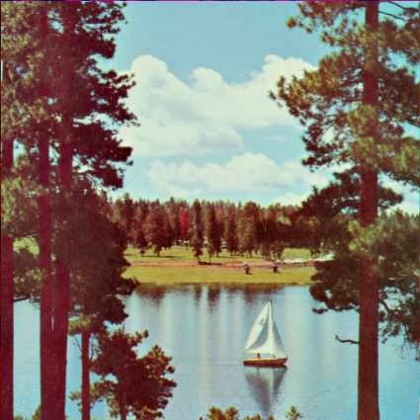
Wavelet Watermarking Techniques
DWT Coefficients Fusion and IDWT rules
Host images
Multilevel DWT
LL | HL
LH | HH
Watermarked images
Watermark
1st level DWT
Key

Slide 25
Spread-Spectrum Techniques

Slide 26
Foundations of Attacking
Three effects make detection of watermarking useless:
Watermark cannot be detected.
False watermarks are detected.
Unauthorized detection of watermark.

Slide 27
Signal Processing Attacks
Average Filter
Median Filter
Wiener Filter
Gaussian Noise
Speckle Noise
Gaussian Lowpass Filter
Pepper and Salt Noise
Sharpening
Poisson Noise
Adjust Image
Histogram Equalization
JPEG image Compression
JPEG2000, etc.

Slide 28
Geometrical Attacks
Rotation
Cropping Attack
Translate Attack
Scaling
Cut attack 100 rows
Cut Attack 100 columns
Shift
Shearing attack

Slide 29
Some Methods
Collusion Attack
Estimate the watermark from different works with same watermark
The attackers can obtain an approximation of the watermark by averaging the watermarked works

Slide 30
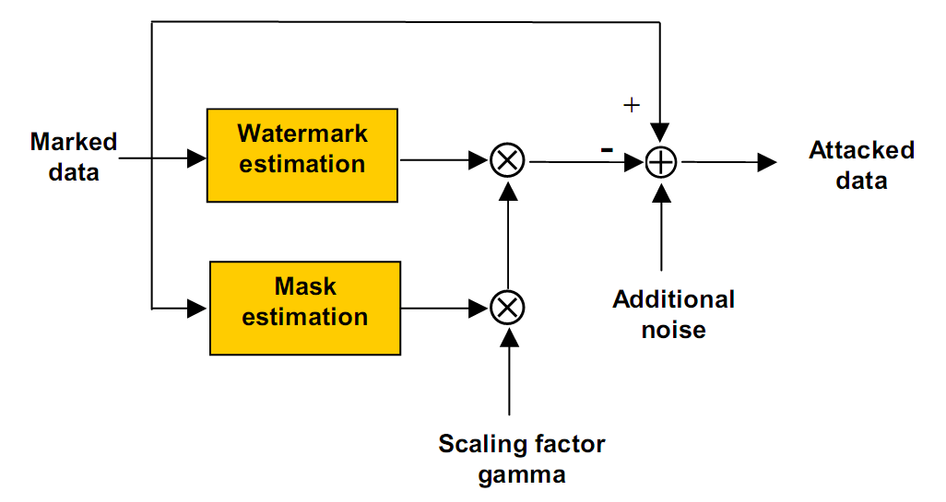
Remodulation Attack
Damage watermark base on watermark estimation

Slide 31
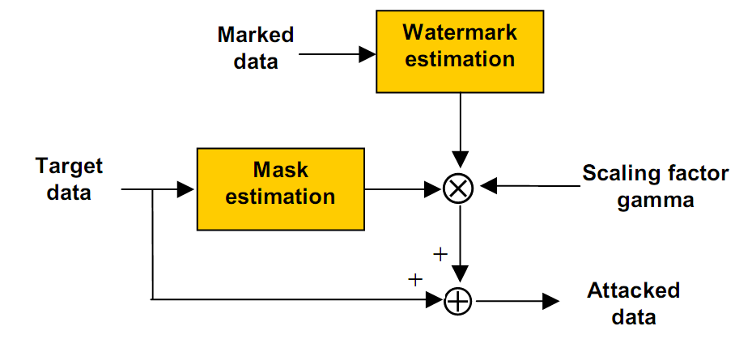
Copy Attack

Slide 32
Image Watermarking Performance
Imperceptibility Measurement
SSIM is utilized to find the perceptual similarity between the original image and the watermarked image. SSIM is defined by:
where α>0, β>0, γ>0, are parameters which can be adjusted to signify their relative importance.

Slide 33
Image Watermarking Performance
Imperceptibility Measurement
Absolute Reconstruction Error (ARE) can be defined as:
where
denotes the original host image and
implies the watermarked image.

Slide 34
Image Watermarking Performance
Imperceptibility Measurement
Peak Signal to Noise Ratio (PSNR) can be defined as:
where
denotes the original host image and
implies the watermarked image.

Slide 35
Image Watermarking Performance
Robustness Measurement
To measure the robustness property, the extracted watermarks (after applying different types of attack) are evaluated by Normalized Cross-Correlation (NC) and Bit Error Rate (BER). The range of NC values of 0 to 1. NC and BER are given as:
Where is the extracted watermark and the W(i, j) is the original watermark.

Slide 36
Image Watermarking Performance
Robustness Measurement
where denotes the exclusive OR operation. M and N denote the number of rows and number of columns of the watermark image

Slide 37
References
F. Ernawan, M. N. Kabir, M. Fadli, Z. Mustaffa. (2016). Block-based Tchebichef image watermarking scheme using psychovisual threshold. International Conference on Science and Technology-Computer (ICST), 27-28 Oct. 2016, pp. 6-10.
F. Ernawan. (2016). Robust Image Watermarking Based on Psychovisual Threshold. Journal of ICT Research and Applications, Vol. 10, No. 3, pp. 228-242.
N.A. Abu, F. Ernawan, N. Suryana and S. Sahib, (2013). Image Watermarking Using Psychovisual Threshold over the Edge. Information and Communication Technology, Yogyakarta, Indonesia, pp. 519-527.

