Slide 1
GEOTECHNICAL ENGINEERING Environmental Geotechnics
For updated version, please click on
http://ocw.ump.edu.my
by
Dr. Amizatulhani Abdullah Faculty of Civil Engineering ad Earth Resources amizatulhani@ump.edu.my

Slide 2
Chapter description
Aims
This chapter provides further discussion and explanation related to environmental geotechnics.
Expected Outcomes
Aware on the application of emerging technologies and sustainability to manage landfill.
References
Das, B.M., “Principles of Geotechnical Engineering, 5th edition”, Thomson Learning (2002).
Raj, P.P., “Soil Mechanics & Foundation Engineering”, Prentice Hall (2008).
Liu, C. & Evett, J.B., “Soils and Foundations, 7th edition”, Prentice Hall (2008).
Whitlow, R., “Basic Soil Mechanics”, Prentice Hall (2004).
Environmental Geotechnics by Dr. Amizatulhani Abdullah

Slide 3
Content
Introduction
Waste composition in Malaysia
Sanitary landfill
Environmental imbalance
Landfill design
Liner and leachate removal systems for landfill
Closure of landfill
Geosynthetics material
Conclusion
Environmental Geotechnics by Dr. Amizatulhani Abdullah

Slide 4
Introduction
Environmental geotechnics is an interdisciplinary subject that applies geotechnical principles, processes and techniques in a way to preserve the environment.
All the construction activities especially those that close related to geotechnical engineering should be carefully plan and the execution should not bring any harm to the environment.
In order to achieve that, the application of modern tools are encourage so that it will not only reduce the environmental impact but also benefit the environment.
Environmental Geotechnics by Dr. Amizatulhani Abdullah

Slide 5
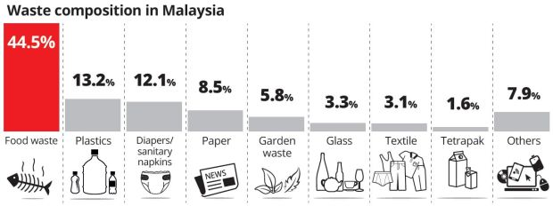
Waste composition in Malaysia
Source: http://www.thestar.com.my
Statistic in 2016 shows that Malaysians (Kuala Lumpur residents) generate 3500 tonnes of domestic and industrial waste a day.
Environmental Geotechnics by Dr. Amizatulhani Abdullah
Notes:
http://www.thestar.com.my/metro/community/2016/05/30/managing-kls-rubbish-residents-in-the-city-are-more-conscious-of-the-amount-of-waste-they-generate-a/~/media/4e61c86243ae4c128df62ed7825db0d2.ashx/?h=232&w=620 (retrieve date 22/08/2017)

Slide 6
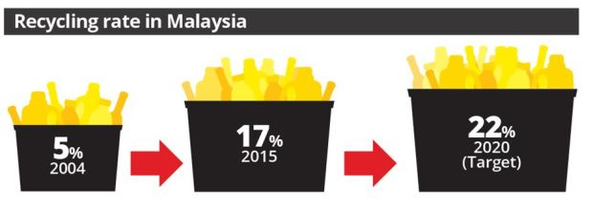
Recycling rate in Malaysia
Source: http://www.thestar.com.my
The amount of waste generation did not balance with the percentage of recycling among Malaysians.
Most of Malaysian’s waste were end up in landfills.
Environmental Geotechnics by Dr. Amizatulhani Abdullah

Slide 7
Landfill in Malaysia
No | States | Number of landfill | Average area (ha) | Waste received (ton/day) | Landfill level
 |  |  |  |  | Level 0 | Level 1 | Level 2 | Level 3 | Level 4
1 | Johor | 18 | 5.6 | 1082 | 10 | 6 | 2 | 1 | 0
2 | Melaka | 4 | 18.5 | 1065 | 2 | 0 | 1 | 1 | 0
3 | N. Sembilan | 11 | 10.9 | 727 | 7 | 3 | 1 | 0 | 0
4 | Selangor | 14 | 10.6 | 2285 | 0 | 7 | 1 | 1 | 5
5 | Pahang | 14 | 8.7 | 895 | 5 | 3 | 2 | 3 | 1
6 | Terengganu | 8 | 5.6 | 707 | 2 | 4 | 1 | 0 | 1
7 | Kelantan | 12 | 5.6 | 424 | 10 | 1 | 1 | 0 | 0
8 | Perak | 19 | 10.3 | 1450 | 9 | 6 | 3 | 1 | 0
9 | Kedah | 10 | 7.7 | 893 | 3 | 2 | 4 | 0 | 1
10 | P. Pinang | 2 | 22.3 | 1400 | 0 | 0 | 1 | 1 | 0
11 | Perlis | 1 | 4.0 | 100 | 0 | 0 | 0 | 0 | 1
12 | Sarawak | 36 | 2.9 | 1000 | 20 | 14 | 2 | 0 | 0
13 | Sabah | 20 | 21.7 | 851 | 15 | 4 | 1 | 0 | 0
14 | KL | 1 | 12.0 | 600 | 0 | 0 | 1 | 0 | 0
15 | Labuan | 1 | 12.1 | 12 | 0 | 1 | 0 | 0 | 0
Total |  | 171 | 158.5 | 13491 | 85 (48%) | 51 (30%) | 21 (12%) | 8 (5%) | 9 (5%)
Level 0 : Open dumping
Level 1 : Controlled tipping
Level 2 : Controlled landfill with daily cover soil
Level 3 : Sanitary landfill with leachate recirculation system
Level 4 : Sanitary landfill with leachate treatment system
Source: Ministry of Housing and Local Government, 2001
Environmental Geotechnics by Dr. Amizatulhani Abdullah
Notes:
https://image.slidesharecdn.com/kncttakamatsuspeciallectureoct2013veriipdf-140127184930-phpapp01/95/knct-takamatsu-special-lecture-oct-2013pdf-31-638.jpg?cb=1390848652

Slide 8
Sanitary landfill
Sanitary landfill or solid waste management is one of the common environmental problems facing any community.
Since the beginning of time, people have disposed of solid wastes by burning or depositing them in open dump.
When land was plentiful of waste materials, location of the dump posed little problem or danger.
Today sanitary landfill is a controlled dump and in intended to isolate the wastes from the environment.
Environmental Geotechnics by Dr. Amizatulhani Abdullah

Slide 9
The first concern in designing & locating a sanitary landfill site must be the nature of the waste materials.
Waste materials can be subdivided into general classes :
Type |  | Sources
Urban / Municipal | Garbage | Food
 | Combustible rubbish | Paper, wood, cloth, plastic
 | Noncombustible rubbish | Metals, glass, bricks, stone
 | Bulk wastes | Crates, appliances, tires
 | Animal | Dead animals
Industrial | Construction / demolition | Lumber, bricks, roofing, pipe
 | Nonhazardous | Nontoxic or nonflammable materials from manufacturing
 | Hazardous | Toxic or flammable or chemical wastes from manufacturing
Agricultural | Animal | Manure, slaughterhouse
 | Plant | Food processing operations
Radioactive | Low level | Hospitals, laboratories
 | High level | Nuclear power plants
Environmental Geotechnics by Dr. Amizatulhani Abdullah

Slide 10
Problem arising from the disposal of solid wastes is not the material itself, but rather the types of pollution that can be released into the environment when air, water come into contact with it.
All types of pollution which are water, gas, air and soil in sanitary landfill must be controlled.
Environmental Geotechnics by Dr. Amizatulhani Abdullah

Slide 11
Environmental imbalance
Solid & liquid wastes
Petroleum contamination
Acid rain & acid drainage
Scrap wastes
Arid lands and deserts
Wetlands
Coastal margins
Soil erosion
Land subsidence
Environmental Geotechnics by Dr. Amizatulhani Abdullah
Environmental Geotechnics by Dr. Amizatulhani Abdullah

Slide 12
Water pollution
Depletion of dissolved oxygen through aerobic decay.
Bacteriological and virus contaminations.
Pollution of surface streams with runoff from the site.
Chemical alteration of groundwater and surface waters.
Gas and air pollution
Noxious odors.
Releases of methane from anaerobic decomposition, ammonia, hydrogen, hydrogen sulfates and other gases.
Dust released during operations and smoke caused by fires.
Soil pollution
Release of ions that can react with the soils.
Release of chemical compounds or ions that are taken up and concentrated in plants.
Aesthetic pollution
Unsightly or odious aspects of an active landfill.
Increased traffic and truck spillage.
Environmental Geotechnics by Dr. Amizatulhani Abdullah

Slide 13
Landfill design
The proposed of a landfill is to dispose the solid waste materials safely at a minimum cost.
It is necessary to plan its operation once o geologically suitable site has been defined.
The control of leachate movement is a primary importance in the design of a landfill.
Leachate generation and movement are controlled by the hydrologic characteristic of the area and also by the geological of the site.
Specifically the underlying rock or soil unit and its permeability, structure, attitude and lithology as well as the cover material available are the factors that decide the suitability of a site as landfill.
Environmental Geotechnics by Dr. Amizatulhani Abdullah

Slide 14
Liner and leachate removal systems for landfill
To prevent leachate from penetrating the underneath soil, liner made from geosynthetics material were placed at the bottom of the landfill.
Leachates that accumulated will be pumped out and treated before it can be safely released to the environment.
Environmental Geotechnics by Dr. Amizatulhani Abdullah

Slide 15
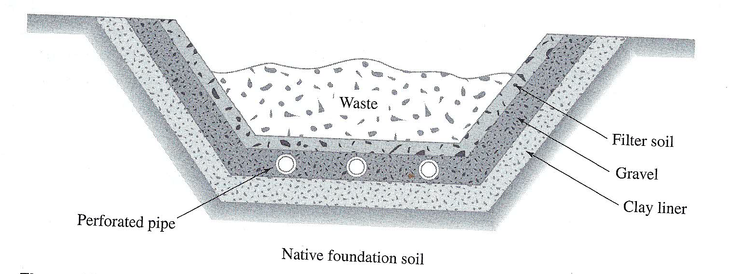
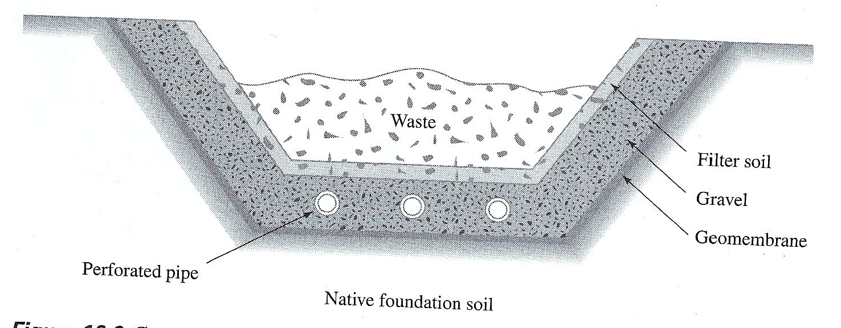
Cross section of single clay liner system for a landfill (Das, 2002)
Cross section of single geomembrane liner system for a landfill (Das, 2002)
Environmental Geotechnics by Dr. Amizatulhani Abdullah

Slide 16
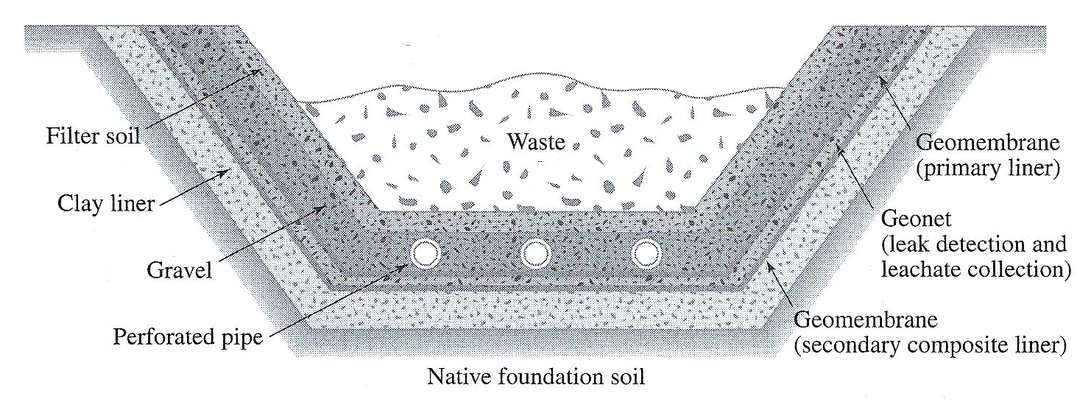
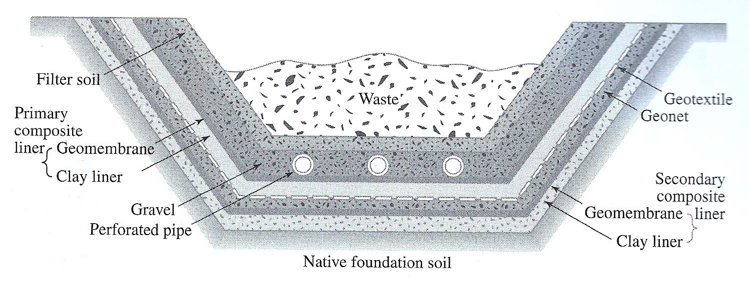
Cross section of double liner system for a landfill (Das, 2002)
Cross section of double liner system for a landfill (Das, 2002)
Environmental Geotechnics by Dr. Amizatulhani Abdullah

Slide 17
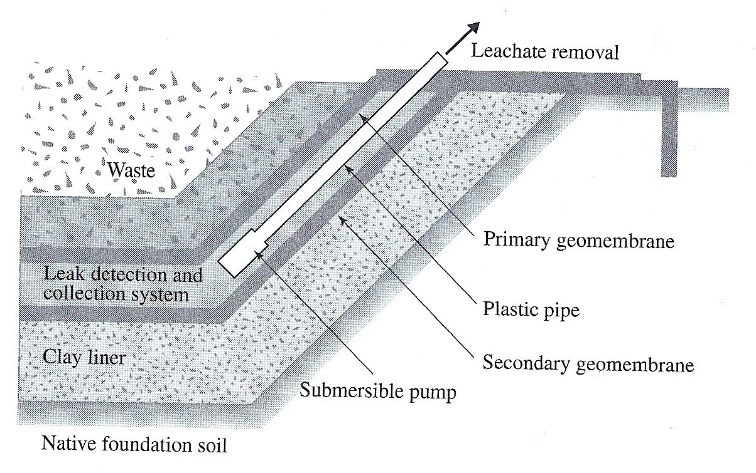
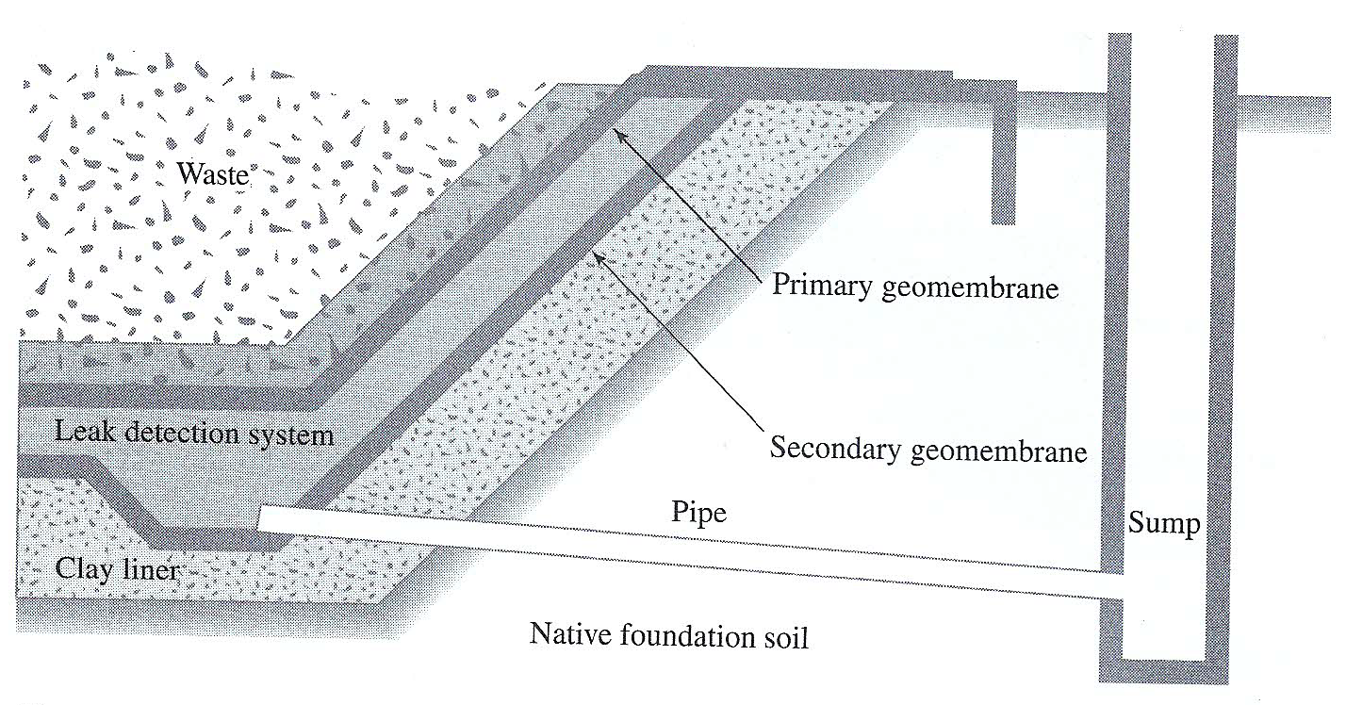
Leak detection, collection, collection and removal of leachates by means of pumping (Das, 2002)
Leak detection, collection, collection and removal of leachates by means of gravity monitoring (Das, 2002)
Environmental Geotechnics by Dr. Amizatulhani Abdullah

Slide 18
Closure of landfill
The landfill, after completion may become a problem unless adequate planning & maintenance practices are followed.
Compaction can cause surface collapse & long term chemical reaction within the waste may produce dangerous gases such as methane.
Gas generation will be enhance by entry of water into the body of the fill; to prevent a building up of gas pressure, venting system may be necessary.
Toxic & hazardous wastes must be further separated from the environment by increasing the distance between the waste & water.
COVER MATERIAL – An important factor in design of a landfill is the type of available cover material. Many state require that a layer of soil, at least 15cm thick, be placed over the exposed waste at the end of each operating day.
Environmental Geotechnics by Dr. Amizatulhani Abdullah

Slide 19
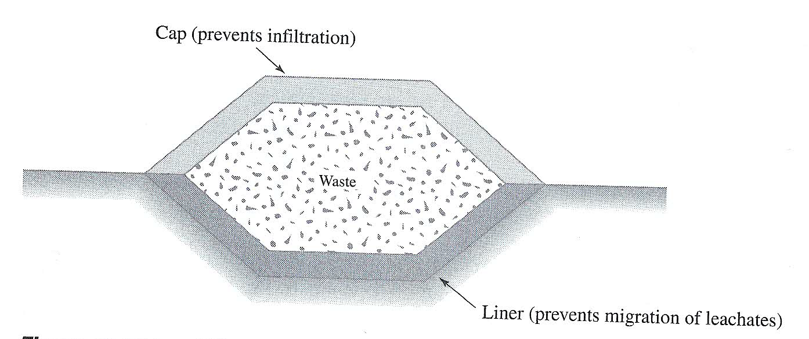
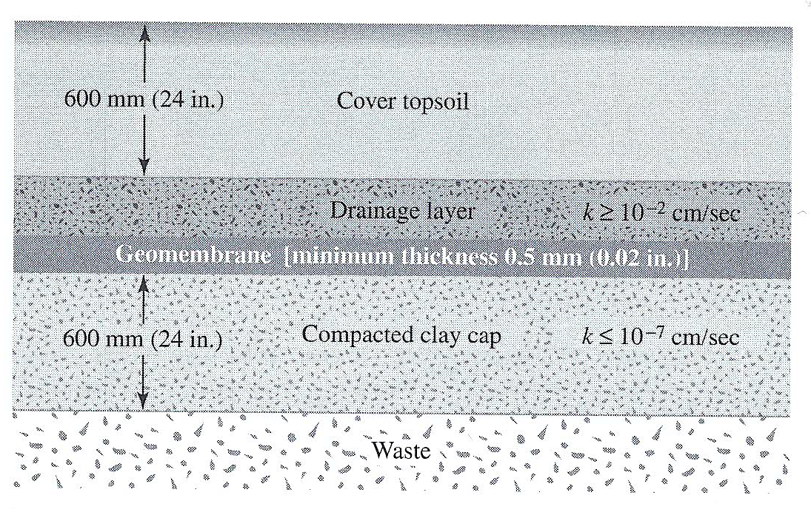
Landfill with liner and cap (Das, 2002)
Schematic diagram of the layering system for landfill cap (Das, 2002)
Environmental Geotechnics by Dr. Amizatulhani Abdullah

Slide 20
Geosynthetics material
In order to overcome the environmental imbalance issues, the use of modern tools such as geosynthetics material are encouraged.
Geosynthetics is a plastic sheet product, which have found rapid application in civil engineering construction.
Since the late 1960s & early 1970s.
Used as a planar product manufactured from polymeric material. It can be used with soil, rock, earth or other geotechnical structure.
Environmental Geotechnics by Dr. Amizatulhani Abdullah

Slide 21
Classification of geosynthetics
The broad categories are listed below:
GEOCOMPOSITE : a product composed with two or more material.
GEOFOAM : block or planar rigid cellular foam polymeric material.
GEOMEMBRANE : an essentially impermeable geosynthetic composed of one or more synthetic sheet.
GEOSYNTHETIC CLAY LINER : a manufactured hydraulic barrier consisting of clay bonded to a layer of geosynthetic material.
GEOTEXTILE : a permeable polymeric material comprised of synthetic fibers and textile (most widely use in slope structure)
Environmental Geotechnics by Dr. Amizatulhani Abdullah

Slide 22
Geosynthetic are generally identified by the following criteria:
Density of polymer (High density or low density)
Type of basic element constituting (eg. filament, yard, strand, rib & etc)
Manufacturing process (eg. woven, heat-bonded non woven, stitch-bonded, knitted & etc)
Physical properties describing the material ( eg. mass per unit area, thickness & opening size)
Environmental Geotechnics by Dr. Amizatulhani Abdullah

Slide 23
Geotextiles is the most versatile materials, serving several function in geotechnical engineering including SEPARATION, FILTRATION, DRAINAGE, REINFORMENT & PROTECTION.
The filtration and drainage function correspond to particle filtration during water flow and water transmission, respectively.
Usually it is made from synthetic polymers of polypropylene which are resistant to biological & chemical degradation.
Environmental Geotechnics by Dr. Amizatulhani Abdullah

Slide 24
When used as fluid barriers, geosynthetics impede the flow of liquids in application such as waste containment.
In the last function of protection, geosynthetics are used as stress relief layer (eg. blankets to reduce surface erosion due to rainfall impact)
The properties of geosynthetics required in the design will depend on the specific engineering functions that it expected to perform.
Environmental Geotechnics by Dr. Amizatulhani Abdullah

Slide 25
Conclusion
Conclusion #1
Improper dumping may lead to different kind of pollution : water pollution, gas and air pollution, soil pollution, aesthetic pollution.
Conclusion #2
There are four important elements in sanitary landfill design : daily cover, leachate collection system, gas ventilation system, permanent cover.
Conclusion #3
Geosynthetics material can be divided into several types and each of it has different function and application : geocomposite, geofoam, geomembrane, geosynthetic clay liner, geotextile.
Environmental Geotechnics by Dr. Amizatulhani Abdullah

Slide 26
Author Information Dr. Amizatulhani Abdullah Dr. Mohd Yuhyi Mohd Tadza Dr. Youventharan Duraisamy Dr. Muzamir Hasan Ir. Azhani Zukri

