Slide 1
Digital Electronics MSI Logic
by
Norazian Subari
Fakulti Kejuruteraan Elektrik & Elektronik aziansubari@ump.edu.my

Slide 2
Chapter Description
Expected Outcomes
At the end of this topic, students should be able to:
Analyze and use decoder and encoder in various types circuit application.
Understand the operation of multiplexers and de-multiplexers.
Compare two binary numbers by using the magnitude comparator circuit.

Slide 3
Topics
Decoder and Encoder
Multiplexer and De-multiplexer
Magnitude Comparator
Adder

Slide 4
Decoder and encoder
Decoder
* n inputs
*2^{n} outputs
*ONLY activated when a unique code is presented
*An Output that corresponds to a binary number (sets of inputs)

Slide 5
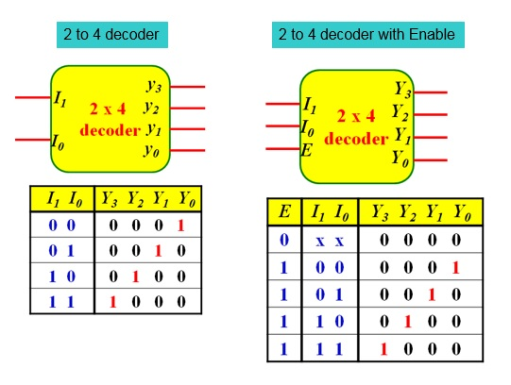
Decoder

Slide 6
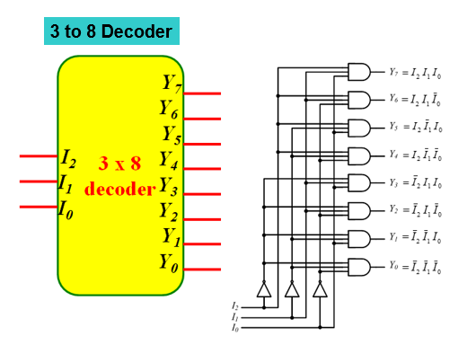
Decoder

Slide 7
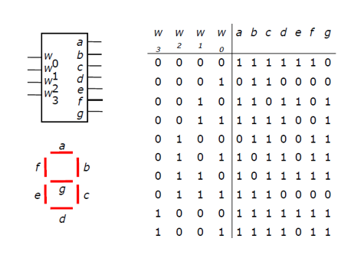
Application Decoder
BCD to 7 Segment

Slide 8
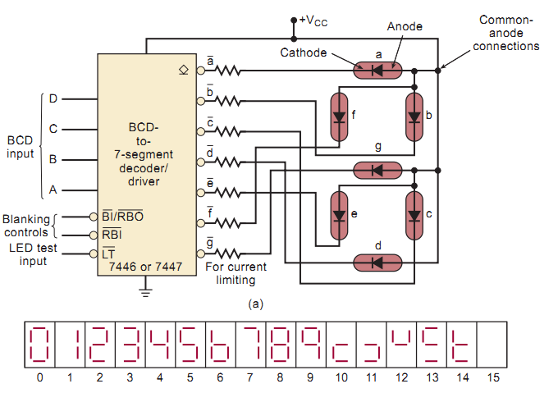
Application Decoder

Slide 9
Decoder and encoder
Encoder
* n outputs
*2^{n} inputs
*reverse of deconder
*Generated output in unique binary code according to individual input

Slide 10
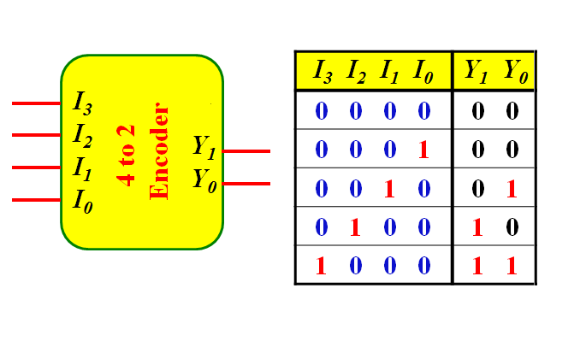
ENcoder
4 to 2 Encoder

Slide 11
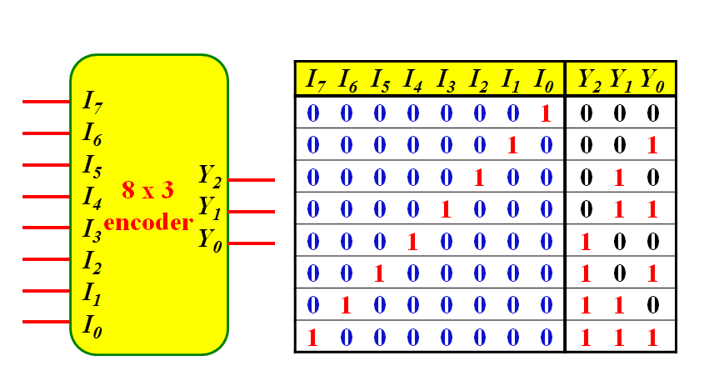
ENcoder
8 to 3 Encoder

Slide 12
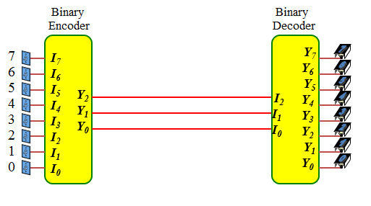
Combination decoder & encoder

Slide 13
Multiplexer & de-multiplexer
Multiplexer
n data select
2^{n} data inputs
1 data output
Demultiplexer
n data select
1data inputs
2^{n} data output
Select ONE input signal to passes to the output
Receive ONE input signal to passes to the output

Slide 14
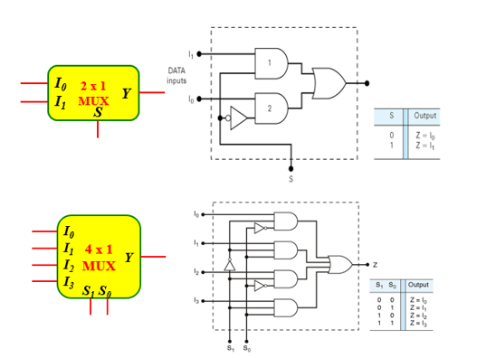
multiplexer
2 to 1 Multiplexer
4 to 1 Multiplexer

Slide 15
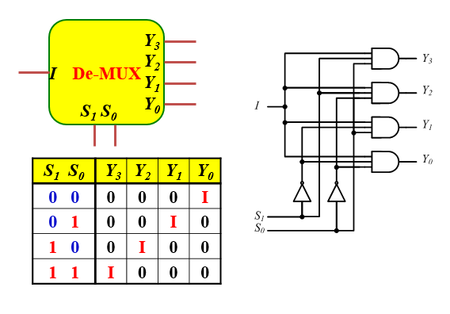
DE-multiplexer
2 to 4 De-multiplexer

Slide 16
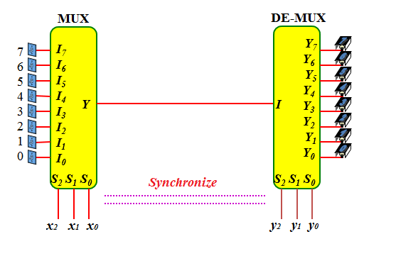
Combination MULTIPLEXER & DE-MULTIPLEXER

Slide 17
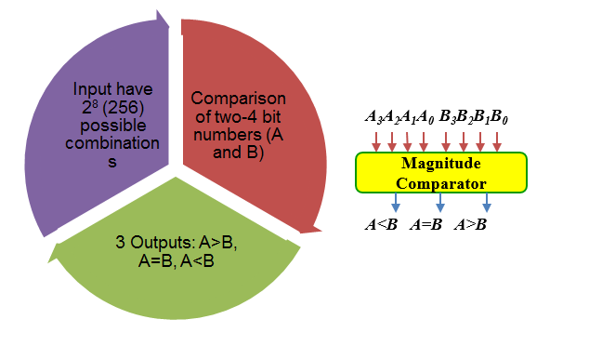
MAGNITUDE COMPARATOR

Slide 18
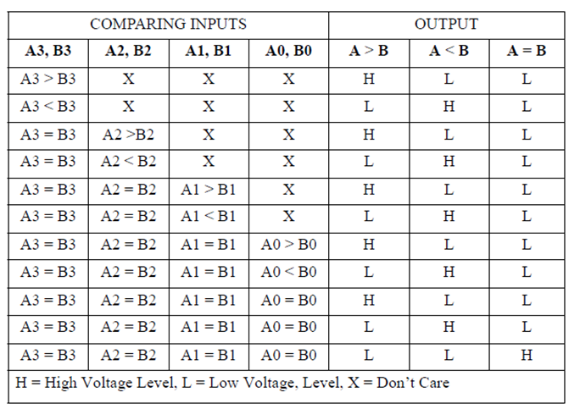
Truth table of 4-bits COMPARATOR

Slide 19
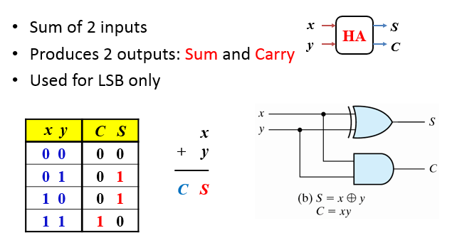
Adder : Half adder

Slide 20
Adder : full adder

Slide 21
References
T. Floyd, “Digital Fundamental”, 10th Ed., USA : Prentice-Hall, 2008.
R.J. Tocci, “Digital Systems: Principles and Applications”, 10th Ed., USA : Prentice-Hall, 2006.

Slide 22
Norazian Subari Fakulti Kejuruteraan Elektrik & Elektronik Universiti Malaysia Pahang 26600 Pekan, Pahang, Malaysia http://fkee.ump.edu.my/index.php/en/staff-menu/articles-staff/1622-norazian-subari-main-profile

