Slide 1
BSB3503 - Biomanufacturing CHAPTER 4 GMP – Documentation Part I (SOP)
Author: Nurul Azyyati Sabri
Co-Author / Editor: Rama Yusvana Faculty Industrial Sciences & Technology yusvana@ump.edu.my

Slide 2
Learning Outcomes
To explain the importance of SOP and validation
To understand and write SOP

Slide 3
Introduction to GMP
Principle of GMP is that quality is built into a product
Assure that the product meets the final specifications
manufactured by the same procedures.

Slide 4
Method
Check the quality of the facility
Investigate the starting materials
Production process at all stages
Testing system of the product
Investigate whether materials contain sufficient labelling
Storage system

Slide 5
Quality management
The basic elements of quality management are:
Covering the organizational structure,
Availability of systematic actions → Quality assurance.

Slide 6
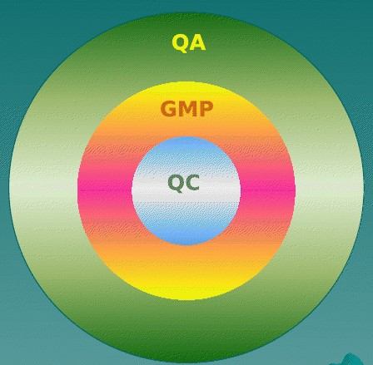
Quality management
Interrelated aspects of quality management

Slide 7
Quality management
QC activities includes
sampling
determining specifications
maintaining records
Record all deviations
Conduct investigation.
Stop or quarantine failed products from entering the market

Slide 8
Quality management
Different from one company to the other - depending on the
size
the quantity of products manufactured
the operations involved
the local regulatory authorities

Slide 9
Quality management
A company can range from:
i) a small single product facility
ii) a large multi-product company.

Slide 10
Documentation
Key to operating a pharmaceutical company.
Establish, monitor, and record "quality" for all aspects of the production and quality control.
Documents includes.
SOP, Specifications and Master Formulae
Forms for recording data
Identification numbers
Label

Slide 11
Data recording documents
Completed during the performance of tasks or tests.
Include forms, reports, records, and log books.
Provide the evidence to meet the established quality requirements.

Slide 12
Identification numbers
To number and track information.
Such as SOP numbers, etc.

Slide 13
Labels
Identify the status.
These include
raw material
quarantine labels
release etc.

Slide 14
Labels
These permit the identification and tracking of materials.

Slide 15
Standard Operating Procedures (SOPs)
Standard operating procedures (SOPs) are the “detailed written instructions that specify how a test or administrative procedure is to be performed, or how a piece of equipment is operated, maintained and calibrated”.
Indicate exactly how things are done and are kept current by review and approved revision.
The original maintained in a central file.

Slide 16
SOP assessment → the evaluation → final approval
SOPs are used as a reference by the persons responsible.
SOPs follow a formal & scientific format.

Slide 17
SOP assessment → the evaluation → final approval
There should be specific instructions for each step.
Initial draft of an SOP is written by the person performing the procedure.

Slide 18
Standard Operating Procedures (SOPs)
When appropriate, a formal data sheet or data record form is prepared for an SOP.
This form equipped with checklists, checkboxes, and blanks.
Has spaces for signatures of the operator.

Slide 19
Standard Operating Procedures (SOPs)
Signed by the department supervisor.
Ensure that the required data provide the evidence that the procedure was performed according to the SOP.

Slide 20
Standard Operating Procedures (SOPs)
The datasheets also provide instructions for
recording deviations
calculations & requirements
comparison of results
criteria for repeating procedures.

Slide 21
The following data which developed during R&D and Process Design will be well described in the SOP form
Chemicals and components required
Full description
A list of equipment required
Technician Training Requirement

Slide 22
Test methods or observations.
Processing control parameters
Step-by-step description
Data-handling requirements
Reporting and documentation requirements

Slide 23
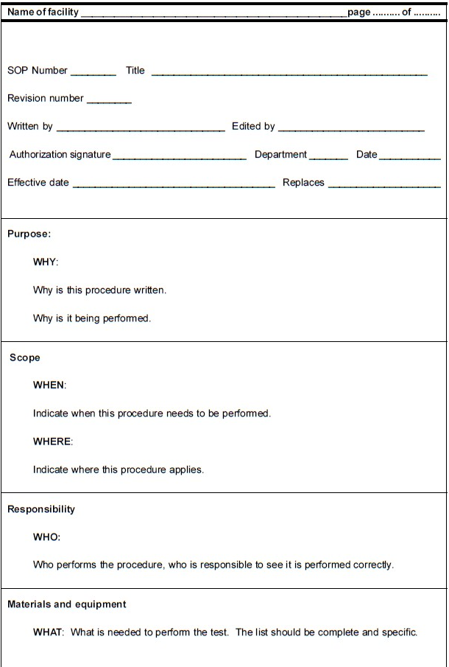
Example SOP

Slide 24
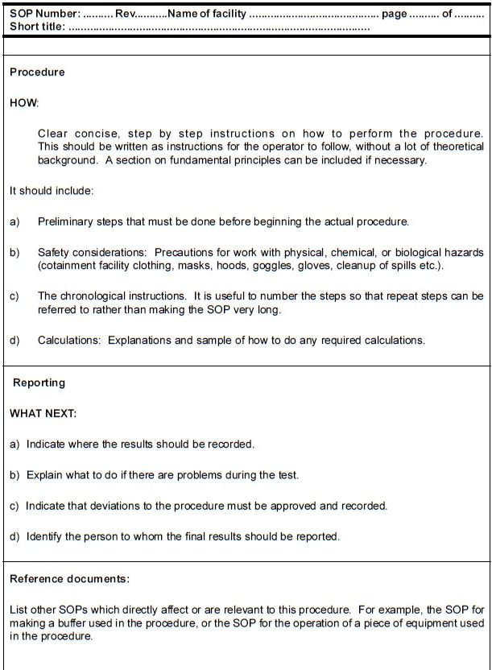
Example SOP

Slide 25
Company name and pagination:
the company name and pagination must appear on every page of the document.
Title:
The title should be descriptive

Slide 26
Identification and control:
Procedures must be uniquely identified. This identification supports accountability and traceability of the document throughout the facility and over time as it changes. The accountability and traceability of procedures are based on assigning them identification number or codes and control numbers or codes (revision and edition numbers)
Purpose:
The purpose or objective of a procedure should restate and expand a well-written title. Expand or quality the directive language used in the title (e.g. operation, monitoring and routine maintenance associated with CEPP and New Brunwsik Bioreactor)

Slide 27
Scope:
The scope should provide limits to the use of the procedure.
Responsibility:
Who is responsibility for the performing the work describes? Who is responsible for reporting the work? Are there special training for certification equipments?

Slide 28
Procedure:
Describe the procedure in a step-by-step, chronological manner. Use active verb and direct statement. E.g. Open the main switcher, Open valve number XYZ, Record the DO value after 30 minutes, etc.
Calculation/ data handling/ documentation requirements:
Describe how the raw data are managed and reported. Provide examples of calculations, when appropriate.
Frequency:
This should be written for maintenance and cleaning SOPs

Slide 29
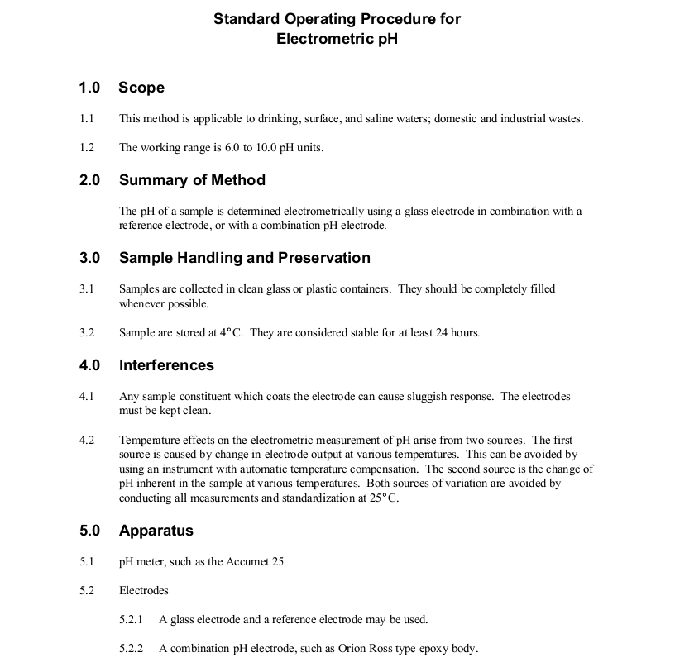
EXAMPLE

Slide 30
