Slide 1
GEOTECHNICAL ENGINEERING Slope Stability (Learning activities)
For updated version, please click on
http://ocw.ump.edu.my
by
Dr. Amizatulhani Abdullah Faculty of Civil Engineering ad Earth Resources amizatulhani@ump.edu.my

Slide 2
Reference
1) Das, B.M., “Principles of Geotechnical Engineering, 5th edition”, Thomson Learning (2002).
Slope Stability by Dr. Amizatulhani Abdullah

Slide 3
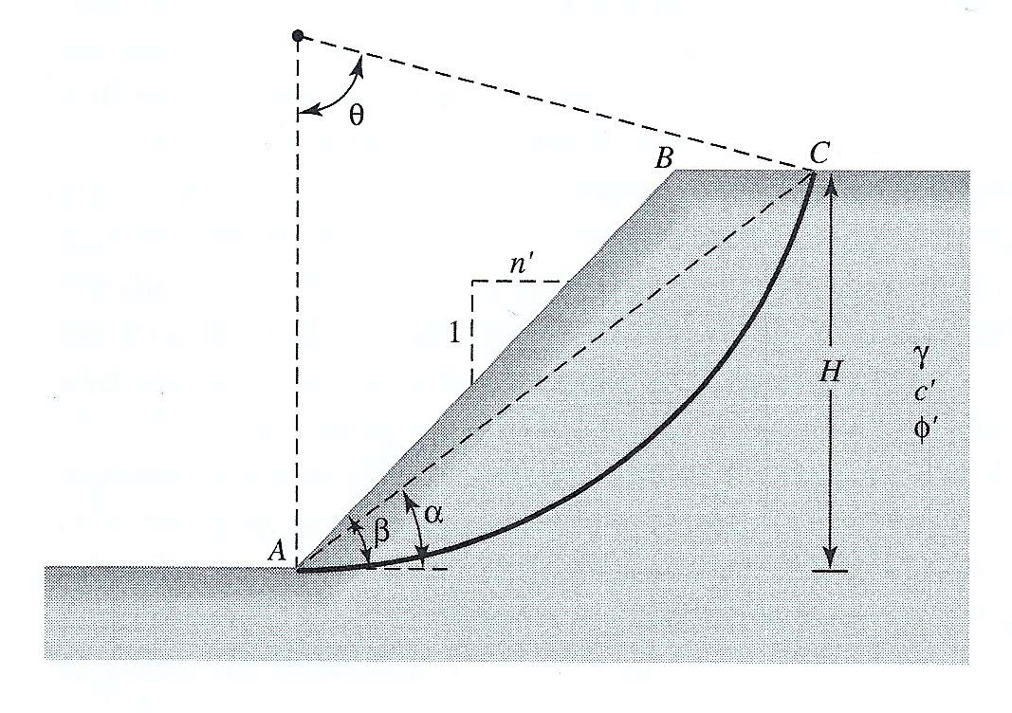
Parameters | Value
β ° | 45
φ ° | 15
c kN/m² | 18
γ kN/m³ | 17.1
H m | 5
α ° | 30
θ ° | 80
Das (2002)
Figure 1
Referring to Figure 1 and using the ordinary method of slices, find the factor of safety with respect to sliding.
Slope Stability by Dr. Amizatulhani Abdullah

Slide 4
Author Information Dr. Amizatulhani Abdullah Dr. Mohd Yuhyi Mohd Tadza Dr. Youventharan Duraisamy Dr. Muzamir Hasan Ir. Azhani Zukri

