Slide 1
Power Plant Technology Sustainable Issues in Power Plants (Lecture 2)
by
Mohamad Firdaus Basrawi, Dr. (Eng) Mechanical Engineering Faculty mfirdausb@ump.edu.my

Slide 2
Solutions:
Improvement of Conventional Power Generation System
Energy Efficient technology
3) Renewable energy
http://greenplanetethics.com/wordpress/wp-content/uploads/2012/05/sustainable-Energy-Mix.jpg

Slide 3
Solutions:
Improvement of Conventional Power Generation Systems
Energy Efficient technology
2) Renewable energy
Energy Efficient Technology
Supply (Cogeneration, trigeneration, combined cycle, etc)
Transmission (Smart Grid, etc)
Demand (Green Building, Energy star, etc)
Renewable Energy
Solar
Hydro
Biomass
Wind
Geothermal
etc

Slide 4
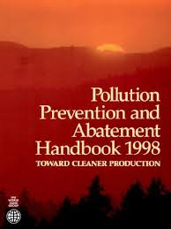
Solutions:
Improvement of Conventional Power Generation
Energy Efficient technology
3) Renewable energy
Regulation on Emissions
Pollution Prevention and Abatement Handbook, WORLD BANK GROUP, Effective July 1998
“This document sets forth procedures for establishing
maximum emissions levels for all fossil-fuelbased
thermal power plants with a capacity of 50
or more megawatts of electricity (MWe) that use
coal, fuel oil, or natural gas.”
Department of Environmental (DOE) of every country should come out with their own Regulations.
Many adopt World Bank Group guideline

Slide 5
Summary of Emissions Guideline
Emissions | Power Plant Type | Limit
PM | All type | 50 mg/Nm³
SO2 | All type | 0.2tons per day/MWe
NOx | Coal-fired Power Plant | 750 mg/Nm³
 | Oil-fired Powe Plant | 460mg/Nm³
 | Gas-fired Power Plant | 320mg/Nm³
 | Gas-fired Turbine | 125mg/Nm³
 | Diesel-fired turbine | 165mg/Nm³
 | Fuel oil-fired turbine | 300mg/Nm³
 | Engine-driven power plants | 2000mg/Nm³
 | All other cases | 400mg/Nm³ (dry at 15% O2)
Refer the handbook for detail guideline

Slide 6
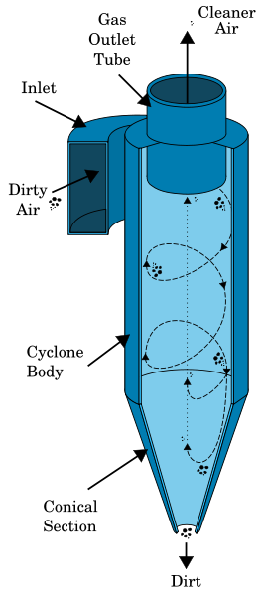
PM Abatement Method: Cyclonic seperation
Cyclonic separation is a method that uses vortex separationremoving particulates from a gas, air, or liquid stream.
It uses rotational effect and gravity to separate mixtures of fluids and solids.
It can also be used to separate liquid droplets in a gaseous flow.
http://en.wikipedia.org/wiki/Cyclonic_separation

Slide 7
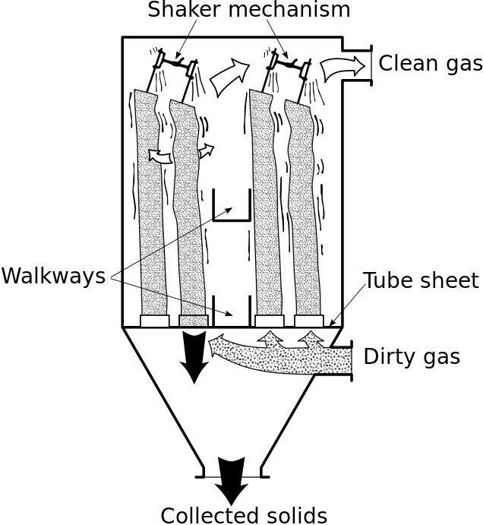
PM Abatement Method: Baghouses (fabric filters)
A baghouse or fabric filter removes particulates out of gas or air flow released from combustion or other processes.
It is not only used in Power plants, but also vacuum cleaner, pharmaceutical producers, steel mills, chemical producers, food manufacturers, and other industrial companies to control emission.
http://en.wikipedia.org/wiki/Baghouse

Slide 8
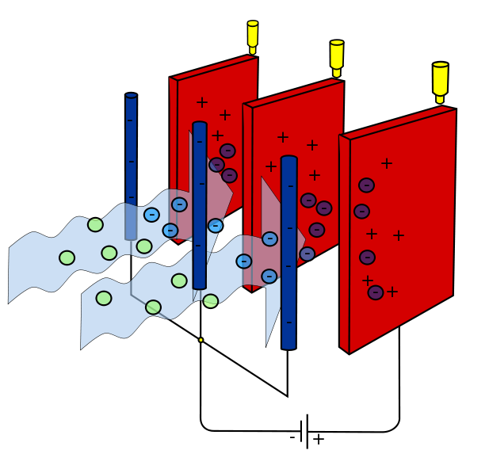
PM Abatement Method: Electrostatic Precipitator (ESP)
An electrostatic precipitator (ESP) is very efficient filtration device that removes fine particles including smoke and dust from a gas flow by the force of an induced electrostatic charge as shown in figure.
http://en.wikipedia.org/wiki/Electrostatic_precipitator

Slide 9
Summary of PM Abatement
Emissions | Abatement Method | Remarks
PM | Cyclones | -Adequate as precleaning devices. -Overall removal efficiency <90%. Lower for PM10
 | Baghouse (Fabric filters) | -Removal efficiency of 99.9% or better for all size of PM
 | ESP | -ESPs are available in a broad range of sizes. -Removal efficiency of 99.9% or better for all size of PM -

Slide 10
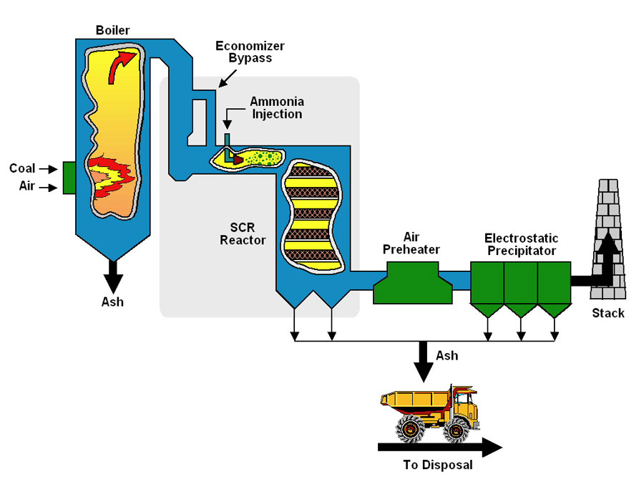
NOx Abatement Method:
Selective Catalytic Reduction (SCR)
SCR converting NOx into H2O and N2 by catalyst helps. A gaseous reductant including aqueous ammonia or urea, anhydrous ammonia is added to a exhaust gas stream.
SCR catalysts are made from various ceramic materials including titanium oxide and other oxides of base metals (molybdenum, vanadium, and tungsten).
SCR reductacts including Ammonia or urea.
4NO + 4 NH₃ +O₂ -> 4N₂+6H₂O
2NO₂ + 4 NH₃ +O₂ -> 4N₂+6H₂O
http://www.pennenergy.com/articles/pennenergy/2010/02/coalogix-and-flsmidth.html

Slide 11
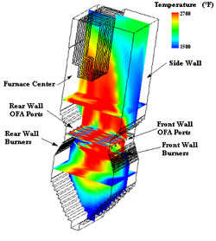
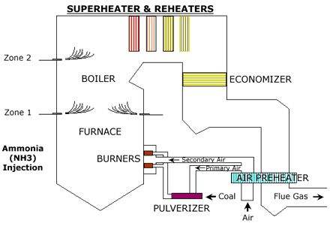
NOx Abatement Method: Selective Non-Catalytic
Reduction (SNCR)
SCNR uses urea or ammonia into the furnace of the boiler at the point where the flue gas temperature is in the range of 760-1,090ºC to react with NOx and the results is H₂O, N₂, CO₂.
NH₂CONH₂ (Urea) +H₂O -> CO₂ +2NH₃
4NO +O₂ + 4 NH₃ -> 4N₂+6H₂O
http://www.hamonusa.com/hamonresearchcottrell/products/nox

Slide 12
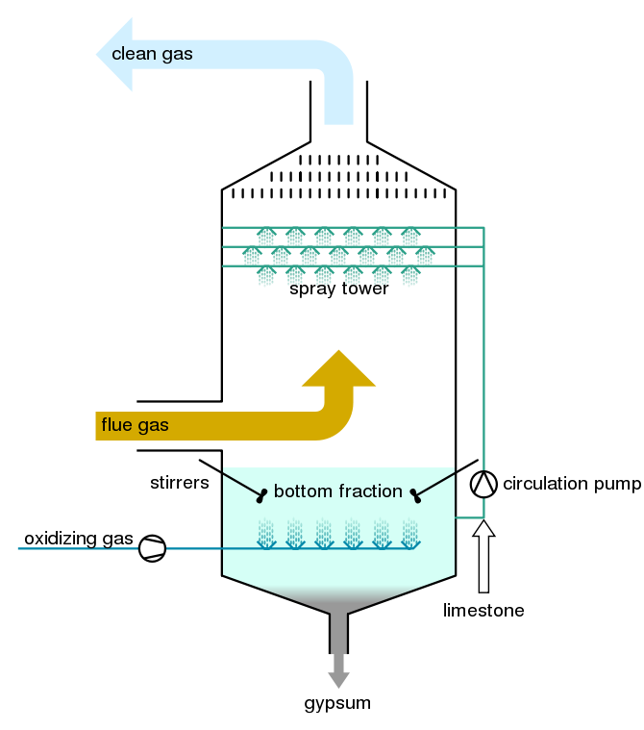
SO₂ Abatement Method: Flue-Gas Desulfurization (FGD)
with scrubber
Wet Scrubber is a device that remove SO2 from flue gas. The flue gas stream is forced to have contact with the scrubbing liquid by spraying it with the liquid, or by other contact methods.
SO₂ is acidic and therefore scrubbing liquid is usually alkaline such as CACO₃ (limestone), CASO₃(Calcium sulfite), etc.
SO₂ (gas) + CACO₃(Solid) -> CASO₃ (solid)+ CO₂
(gas)
SO₂ (gas) + CA(OH)₂(Solid) -> CASO₃ (solid)+ H₂O (gas)
http://en.wikipedia.org/wiki/Flue-gas_desulfurization#mediaviewer/File:Flue_gas_desulfurization_unit_EN.svg

Slide 13
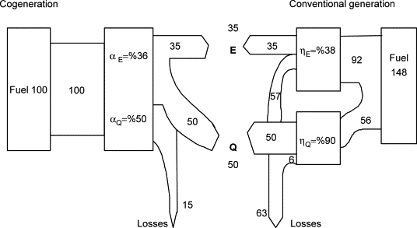
Solutions:
Improvement of Conventional Power Generation
Energy Efficient technology
3) Renewable energy
What is cogeneration system?
85%
57%
HI Onovwiona, VI Ugursai, Residential cogeneration systems: review of the current technology, Renewable and Sustainable Energy Reviews, 5, 389-431.

Slide 14
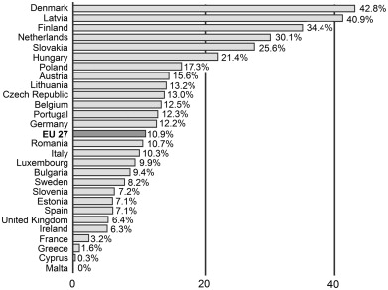
G. Westner, R. Madlener, The benefit of regional diversification of cogeneration investments in Europe: A mean-variance portfolio analysis, Energy Policy, 38, 7911-7920.

Slide 15
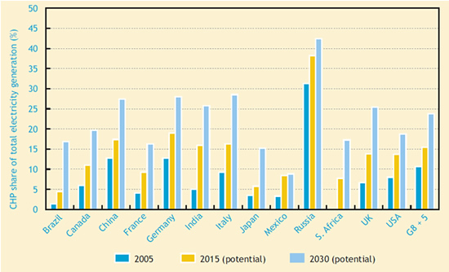
http://www.iea.org/chp/

Slide 16
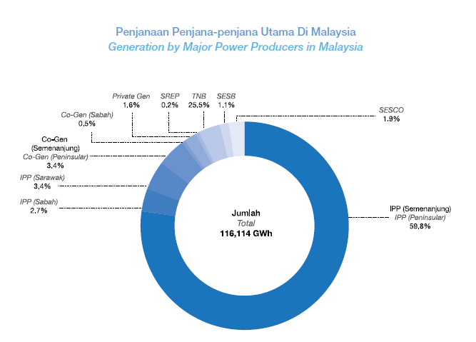
Do you think Malaysia has a cogeneration system?

Slide 17
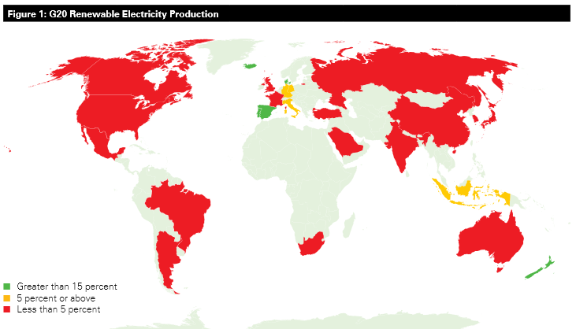
Solutions:
Improvement of Conventional Power Generation
Energy Efficient technology
3) Renewable energy
Which country is the leader in renewable energy?
Delivering On Renewable Energy Around The World: How Do Key Countries Stack Up? by Jake Schmidt and Aaron Haifly

Slide 18
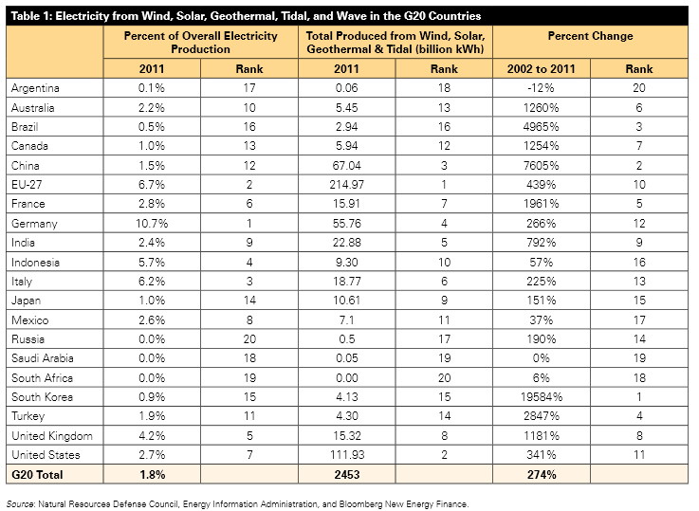

Slide 19
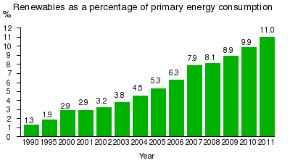
http://en.wikipedia.org/wiki/Renewable_energy_in_Germany
Renewable energy production in Germany

Slide 20
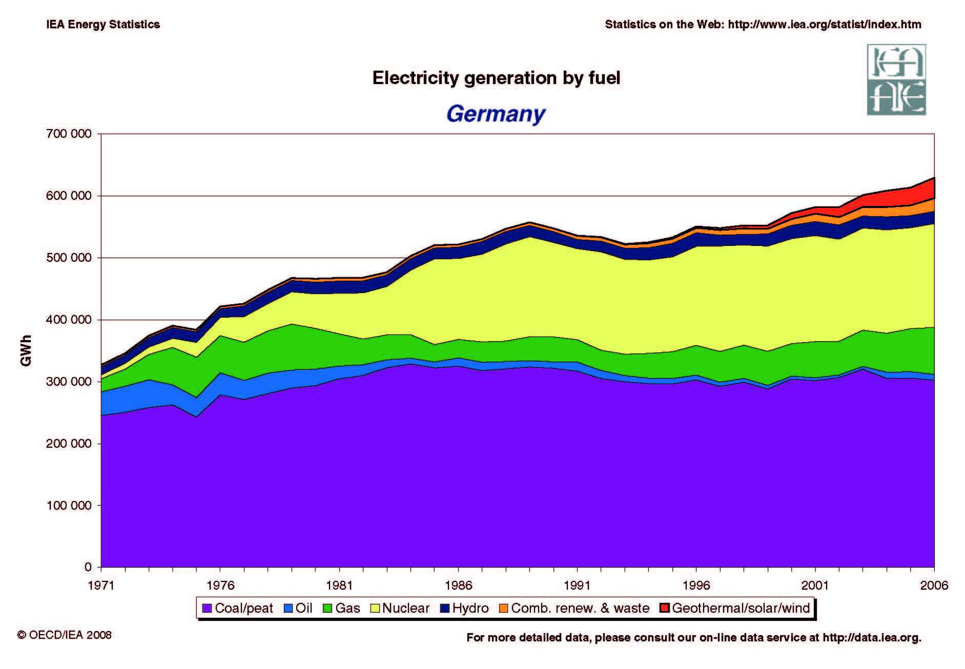
http://www.theoildrum.com/node/9419

Slide 21
How about renewable energy in Malaysia?
Small Renewable Energy Programme (SREP)
lunched on 11th May 2001.
Goals: to tap the waste energy potential especially from the palm oil industry,
to promote innovation and technology development in alternatives energy, to achieve remaining electrical power demand in the country, to reduce greenhouse gas emissions.
Initial target of the programme was to install 500MW electrical power by renewable energy within 2001-2005.
In the programme,
-any project developer can apply a 21 years license under Renewable Electricity Purchase Agreement.
-the capacity of a single SREP project can be larger that 10MW, but the maximum capacity for sale to grid is not more 10MW.

Slide 22
Problems in SREP
Technical:
Lack of experience and technology such as digesters and boilers for EFB.
Insufficient exposure, education and experience among all stakeholders (e.g.,developers, electric utilities, Planners, financial institutions, research institutes).
High cost for feasibility studies and grid interconnection.
Economic:
Low tariff for renewable energy.
Reluctant financiers and bankers.
Cheap fossil fuel and the failure to include the cost of externalities in electricity prices.
Institutional:
Problems in program design including capacity caps, long waiting times for project approval, and no specific authority as a regulator.
Disinterest and occasional hostility from national utilities and convoluted Renewable Energy Power Purchase Agreements (REPPAs).
Lack of proper implemented national frameworks

Slide 23
SREP effect

Slide 24
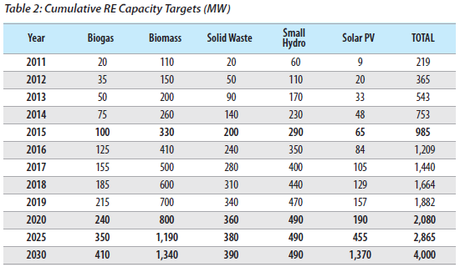
New policy in RE
Government had setup an institution called Sustainable Energy Development Authority Malaysia (SEDA)
It will implement Feed-in tariff (FiT) mechanism which was mandated under the Renewable Energy Acts that was introduced in April 2011.

Slide 25
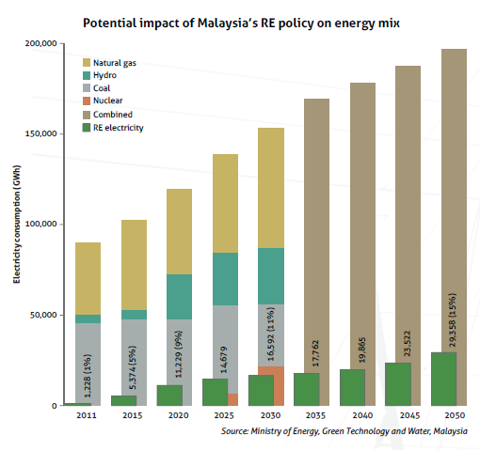

Slide 26
Bussiness chance?

Slide 27
Other programmes
Biomass Generation and Cogeneration in the Malaysian Palm Oil Industry (BIOGEN)
This project was started in January 2003.
Supported by Global Environment Facility (GEF), UNDP, Ministry of Energy, Water and Communication, Malaysia Energy Center and the private sector.
The objective is for developing and implementing activities that build capacity of stakeholders and facilitate the better adoption of RE system.
It focuses on palm oil industries and the use of waste material in generating electricity and selling the electricity to grid.

Slide 28
Other programmes
Malaysia Building Integrated Photovoltaics (MBIPV)
100 kWp Development PV Project was implemented by inisiatif Kementerian Tenaga, Air dan Komunikasi and Japanese government represented by NEDA in Marak, Sabah.
Completed on 1995. It is the pioneer in efficient technology transfer in PV technology.
TNB Research Sdn Bhd is performing research project on 'Photovoltaic Grid Connected Roof Solar 3kW‘ (RM500,000).
Demonstration of 'Hybrid Diesel Solar PV' by Persatuan Pencinta Alam Malaysia, also funded by TNB (RM472,000).

Slide 29
Conclusions
Electricity became more important in our modern life.
Substantial amount of energy is used for power generations.
Power generations cause fossil fuel depletion and environmental problems.
Efficient power generation, Efficient distribution and Efficient power consumption are importants.
Utilizations of renewable energy became more important.
Many countries switching their fuel from fossil and nuclear to renewable energy.

Slide 30
Cooperative learning
Compare FiT in Malaysia with 2 or more other countries in the world in various aspect. For instace, in terms of type of renewable energy, mechanism, penetration rate, obstacle, etc.
Requirement:
5 pages
A4 size
Font: 12point
Reference must be clearly cited
In generating electricity, which power plant have the highest effect to the environment in terms of global warming and acid rains. If the power plant has a capacity of 50 MW and operate throughout the year, compare among Coal fired Steam turbine, CCGT, and Microturbine.
Discuss 15 acts that you can do in your daily life that contribute to the mitigation of energy related problems. Explain also how it works .

