Slide 1
Engineering Surveying Introduction to Survey Engineering
By
Mohd Arif Sulaiman
Faculty of Civil Engineering & Earth Resources
mdarif@ump.edu
Introduction To Survey Engineering, by Mohd Arif

Slide 2
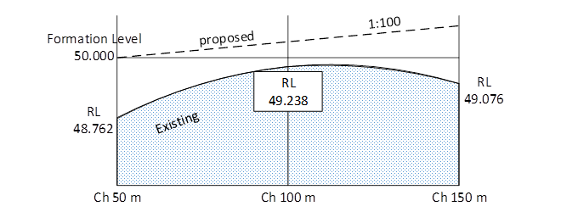
Exercise #6
Question 1
A centre line of a proposed road of formation width 6 m is rising at a slope of 1 in 100 from chainage 50 m to chainage 150 m as shown in Figure Q1(a). The existing ground levels on the centre line at chainage 50 m, 100 m, and 150 m are 48.762 m, 49.238 m and 49.076 m respectively. The formation level at CH 50 m is 50.000 m. Figure Q1(b) shows the cross section of every chainage. The side slope of section is 1 in 2 at all chainages, calculate the volume of soil to be embarked for the proposed road.
Figure Q1(a)

Slide 3
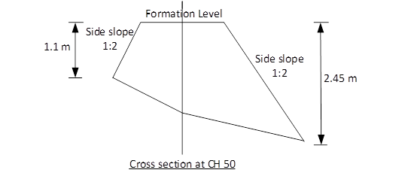
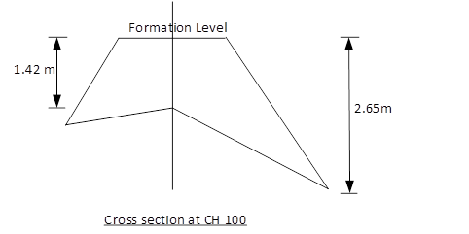
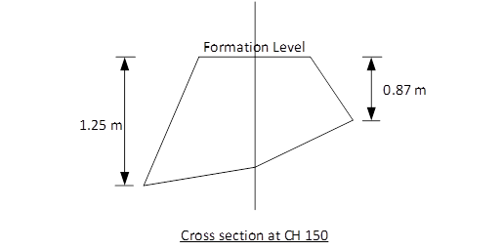
Figure Q1(b)

Slide 4
Question 2
Figure Q2 shows three cross sections with their respective ground levels and formation levels for new proposed housings. Calculate the volume of material excavated in constructing the proposed platform
Figure Q2

Slide 5
Author Information Dr Idris bin Ali
Dr Cheng Hock Tian

